Slide 1
Acts 27
Voyage to Rome – Shipwreck at Sea
Paul has appealed to Caesar – so being sent to Rome
“This account of Paul’s voyage to Rome is like no other story in all the Bible” (Reese)
  Attention given to ships & seas, winds & waves, islands, towns and harbors
  Description of first century ships & seamanship
  Story of a servant of God in midst of an extreme emergency

Slide 2
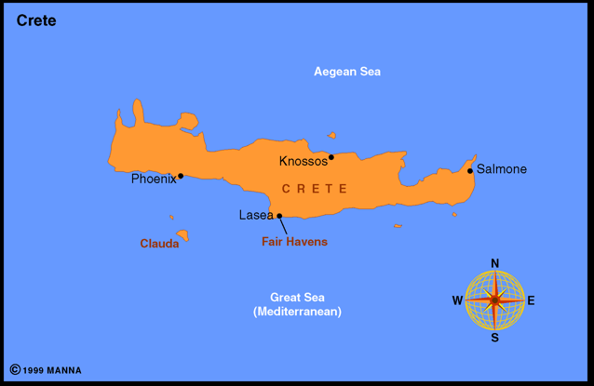
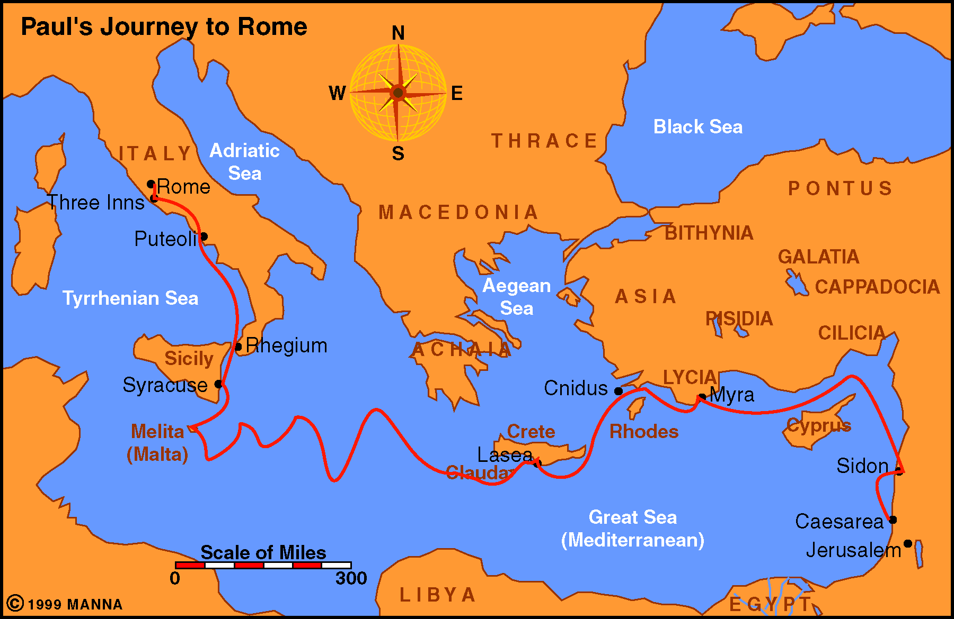
Paul Journey 4

Slide 3

Were in a storm that seemed to be overwhelming
Cast four anchors into the sea (v. 29)
Anchors proved to be ineffective – ship was lost
However, Paul was on board
Because of who he was (a man of God, a man of faith) – he was anchored – though the ship was not!
Paul had four strong anchors

Slide 4
Times when seas are calm – sailing is smooth (v. 13)
But – unexpectedly a contrary wind will arise (v. 14)
In midst of storm – time for decision & action (vv. 18-19)
Could easily be discouraged or just give up – Luke did (v. 20)

Slide 5

Your Storm
Turmoil in the family
Difficulties on job
Health challenges
Personal problems
Church issues
Strained relationships

Slide 6

The Presence of God (v. 23)

Slide 7
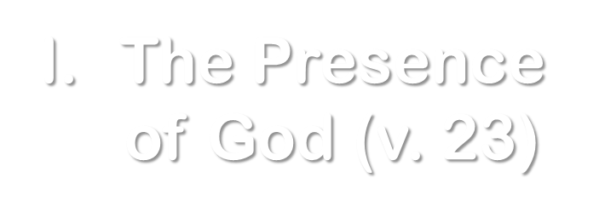
Paul knew he was not alone
  God did not disappear in the darkness of the storm
  God was there to comfort, strengthen, help & assure…

Slide 8
Paul knew he was not alone
God has assured us – he will not leave
  Heb. 13:5
  Psa. 23:4
  What an encouragement: every step, valley & mountain – He is still there!
  Phil. 4:13 – I can face it all….
Notes:
Story told about Tony Campolo. Talked his mother into letting him walk to school and home (2nd grade). Later in years bragged about his independence – mother then told him – you were not alone – I followed you both ways!

Slide 9
Paul knew he was not alone
God has assured us – he will not leave
Assurance come with total devotion & commitment (v. 23b)
  Why the angel appeared to him and not others on the ship
  I belong to God
    Not a god that belongs to me
    I am God’s (Rom. 12:1)
  Serve God (Gal. 2:20)
Do you have such devotion
That you can be assured of His presence?

Slide 10
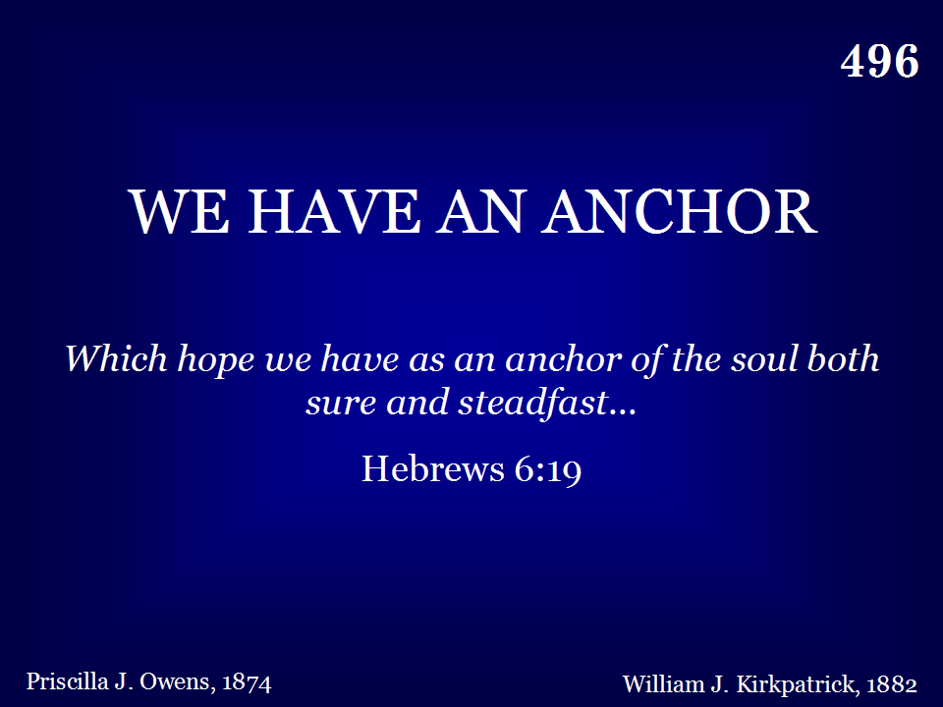
496 - We Have An Anchor - Title

Slide 11
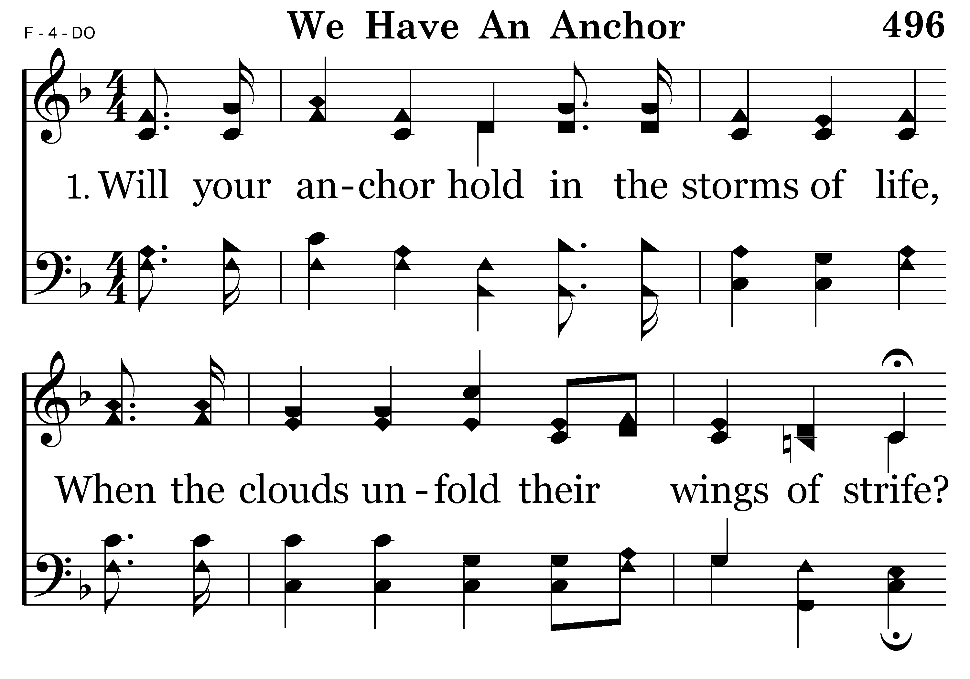
496 - We Have An Anchor - 1.1

Slide 12
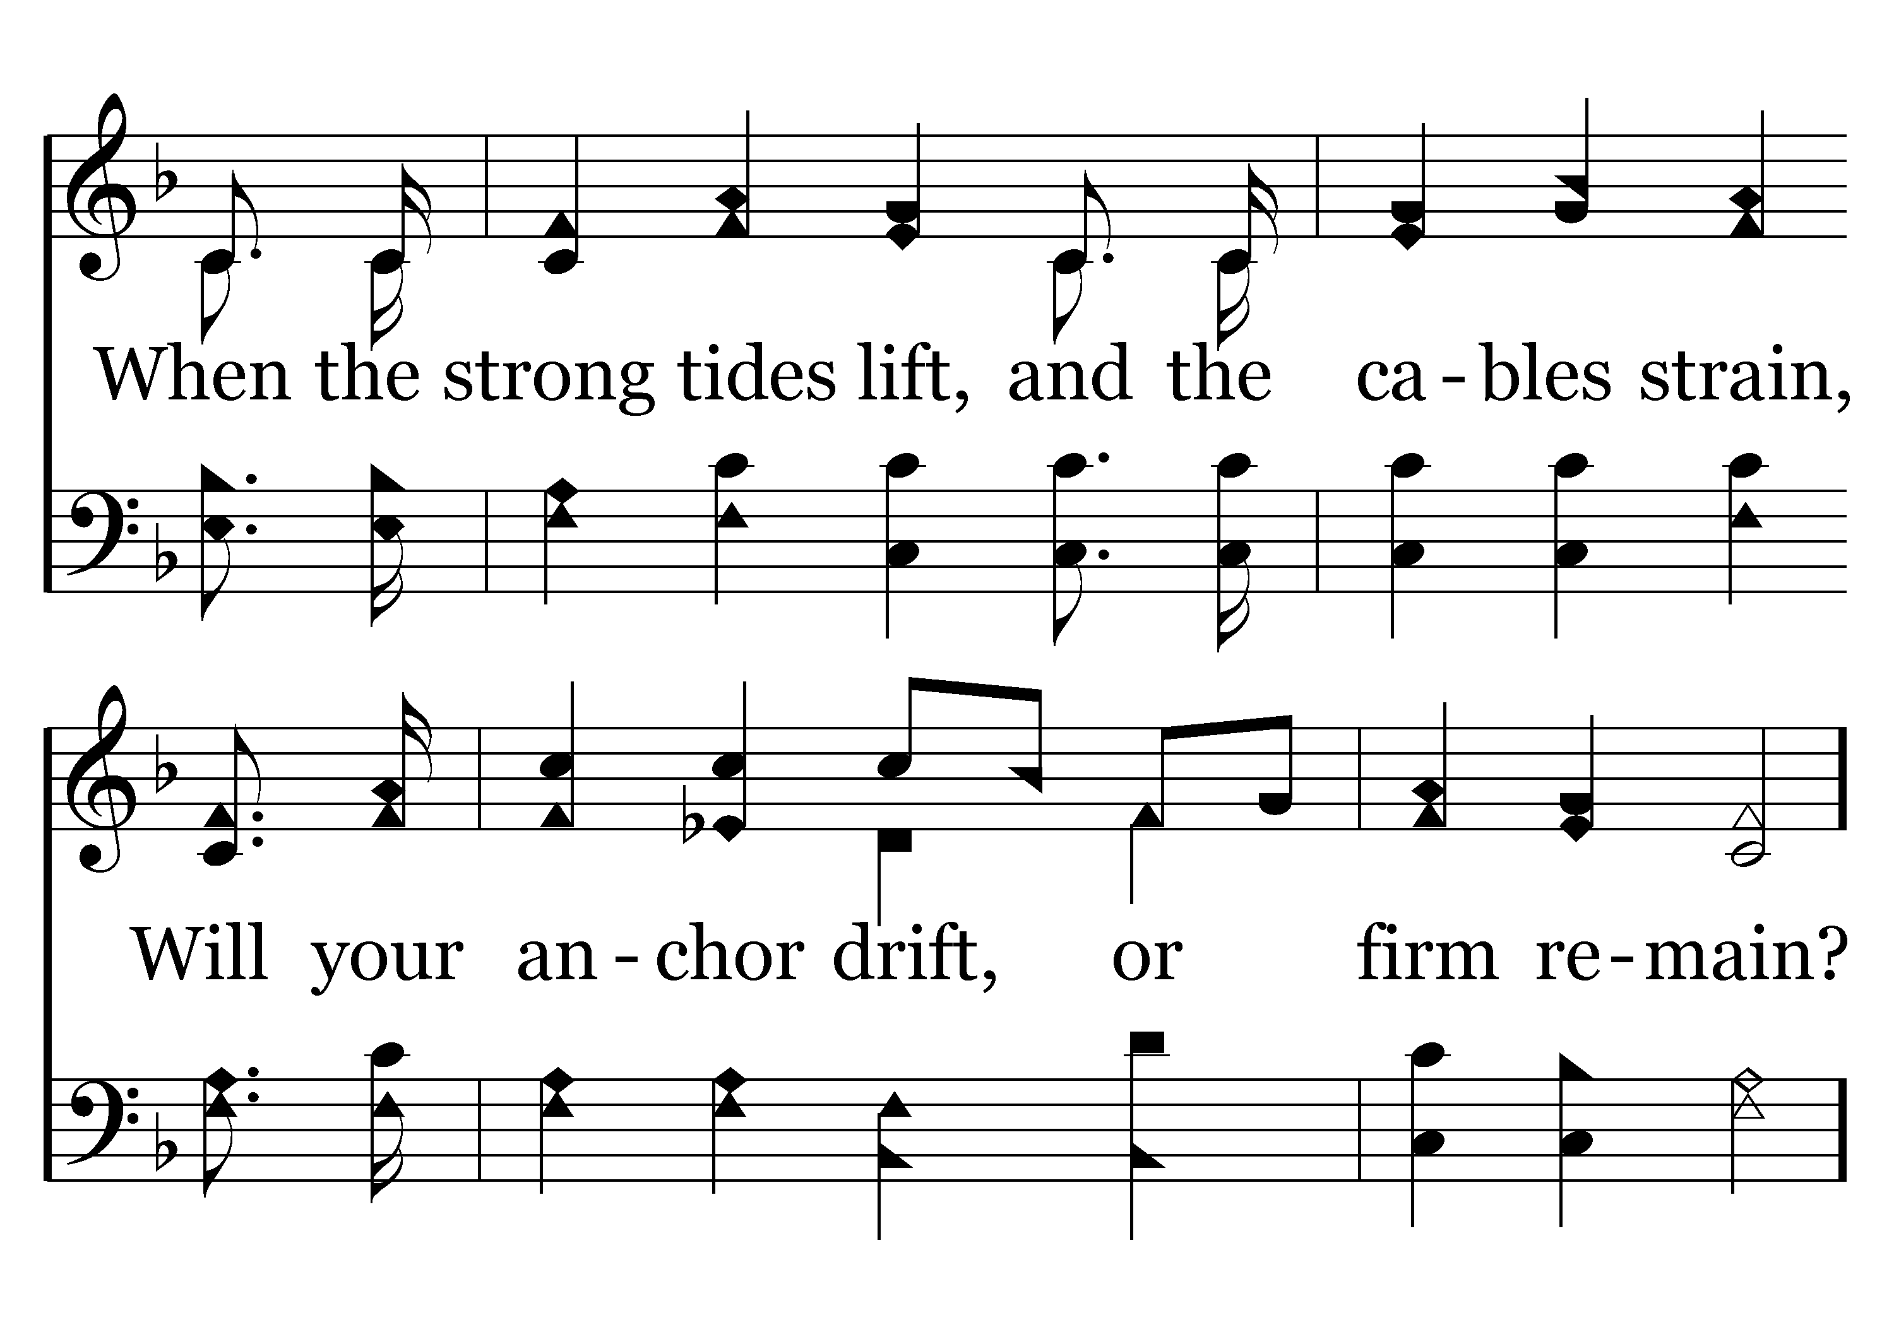
496 - We Have An Anchor - 1.2

Slide 13
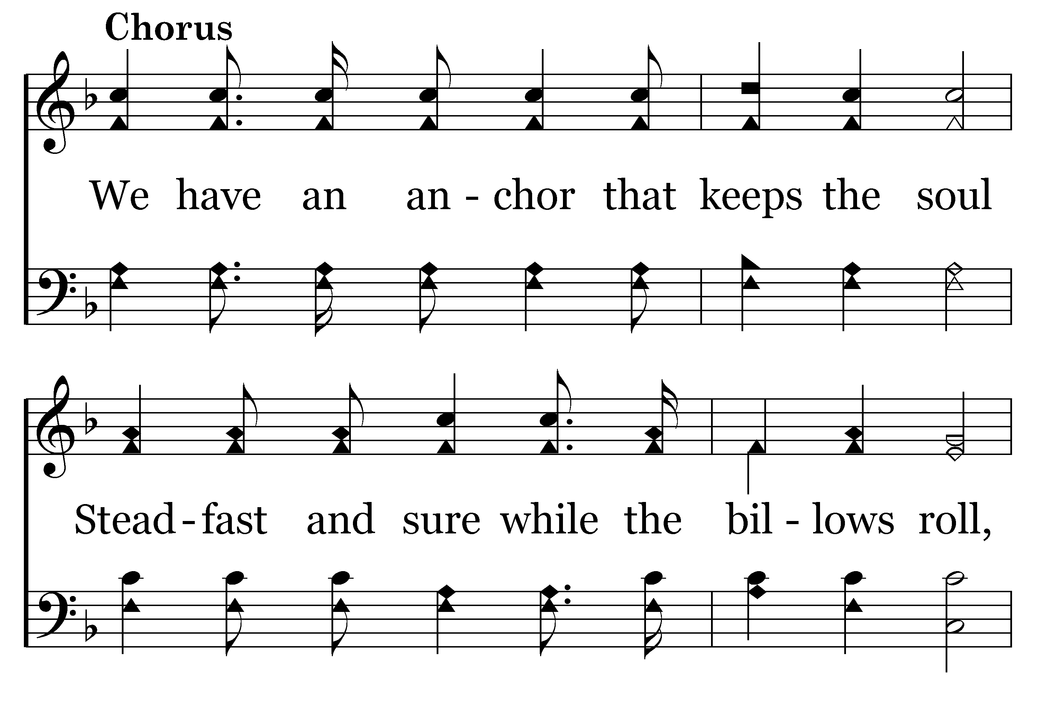
496 - We Have An Anchor - C.1

Slide 14
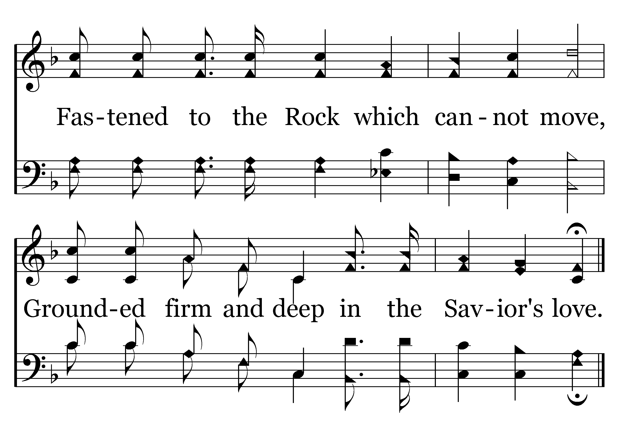
496 - We Have An Anchor - C.2
End of Verse 1

Slide 15
The Presence of God (v. 23)
The Promise of God (vv. 24-25)

Slide 16
God reminded Paul of promise would stand before Caesar
  Acts 23:11
  Times need be reminded of what we have already been told – further assured!
The Promise of God (vv. 24-25)
Notes:
Story of man called car salesman up – “Tell me about it all over again – I’m getting discouraged!”

Slide 17
God reminded Paul of promise would stand before Caesar
Promise is granted to Paul & fellow travelers
  Perhaps a response to prayer
  At least a response to Paul somehow
The Promise of God (vv. 24-25)
Notes:
Story of man called car salesman up – “Tell me about it all over again – I’m getting discouraged!”

Slide 18
God reminded Paul of promise would stand before Caesar
Promise is granted to Paul & fellow travelers
The promises God has made:
  Word will not return void (Isa. 55:11)
  No temptation greater than bear (1 Cor. 10:13)
  Remember sins no more (Heb. 8:12)
  Never stumble or fall (2 Pet. 1:5-10)
  Prayer of righteous avails much (Jas. 5:16)
  Will be a remnant (Dan. 2:44)
  Christ is coming again (2 Pet. 3)
  Eternal life (1 Jno. 2:25)
The Promise of God (vv. 24-25)
Notes:
Story of man called car salesman up – “Tell me about it all over again – I’m getting discouraged!”

Slide 19
God reminded Paul of promise would stand before Caesar
Promise is granted to Paul & fellow travelers
The promises God has made:
Response was “I believe God that it shall be just as told me”
  Assurance, Reliance, Trust & Confidence
  God’s promises are sure and steadfast (Heb. 6:18)
  In spite of promises – some still took matters into own hands (vv. 28-39) – even trying to get off ship (vv. 30-31)
  They feared, fretted and fought – but Paul had faith!
The Promise of God (vv. 24-25)
Notes:
Story of man called car salesman up – “Tell me about it all over again – I’m getting discouraged!”

Slide 20
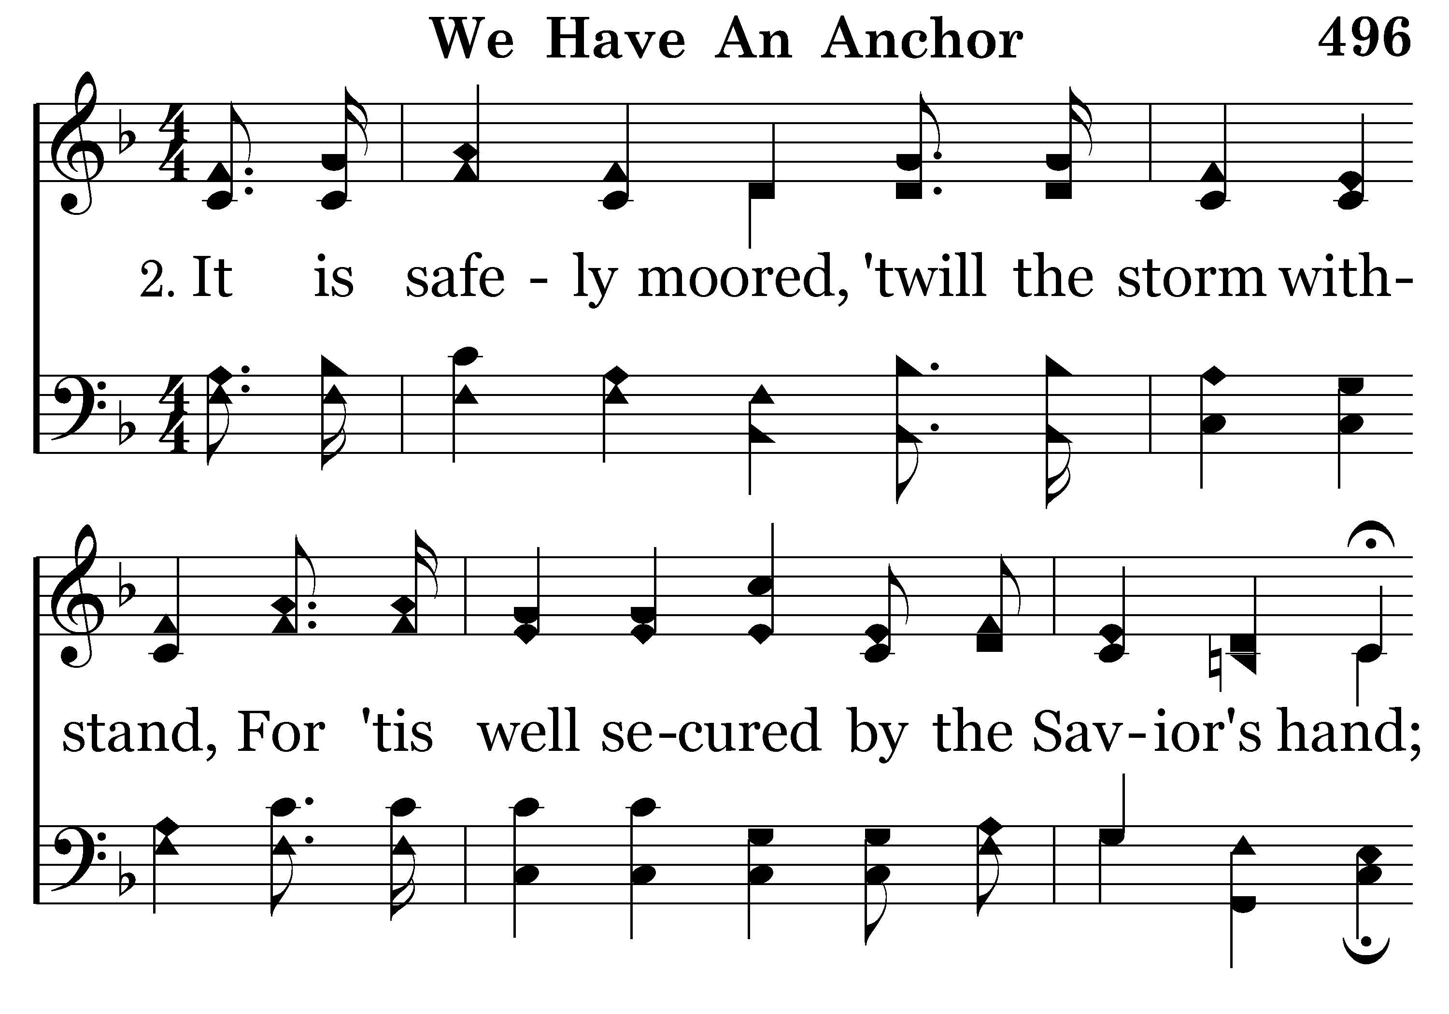
496 - We Have An Anchor - 2.1

Slide 21
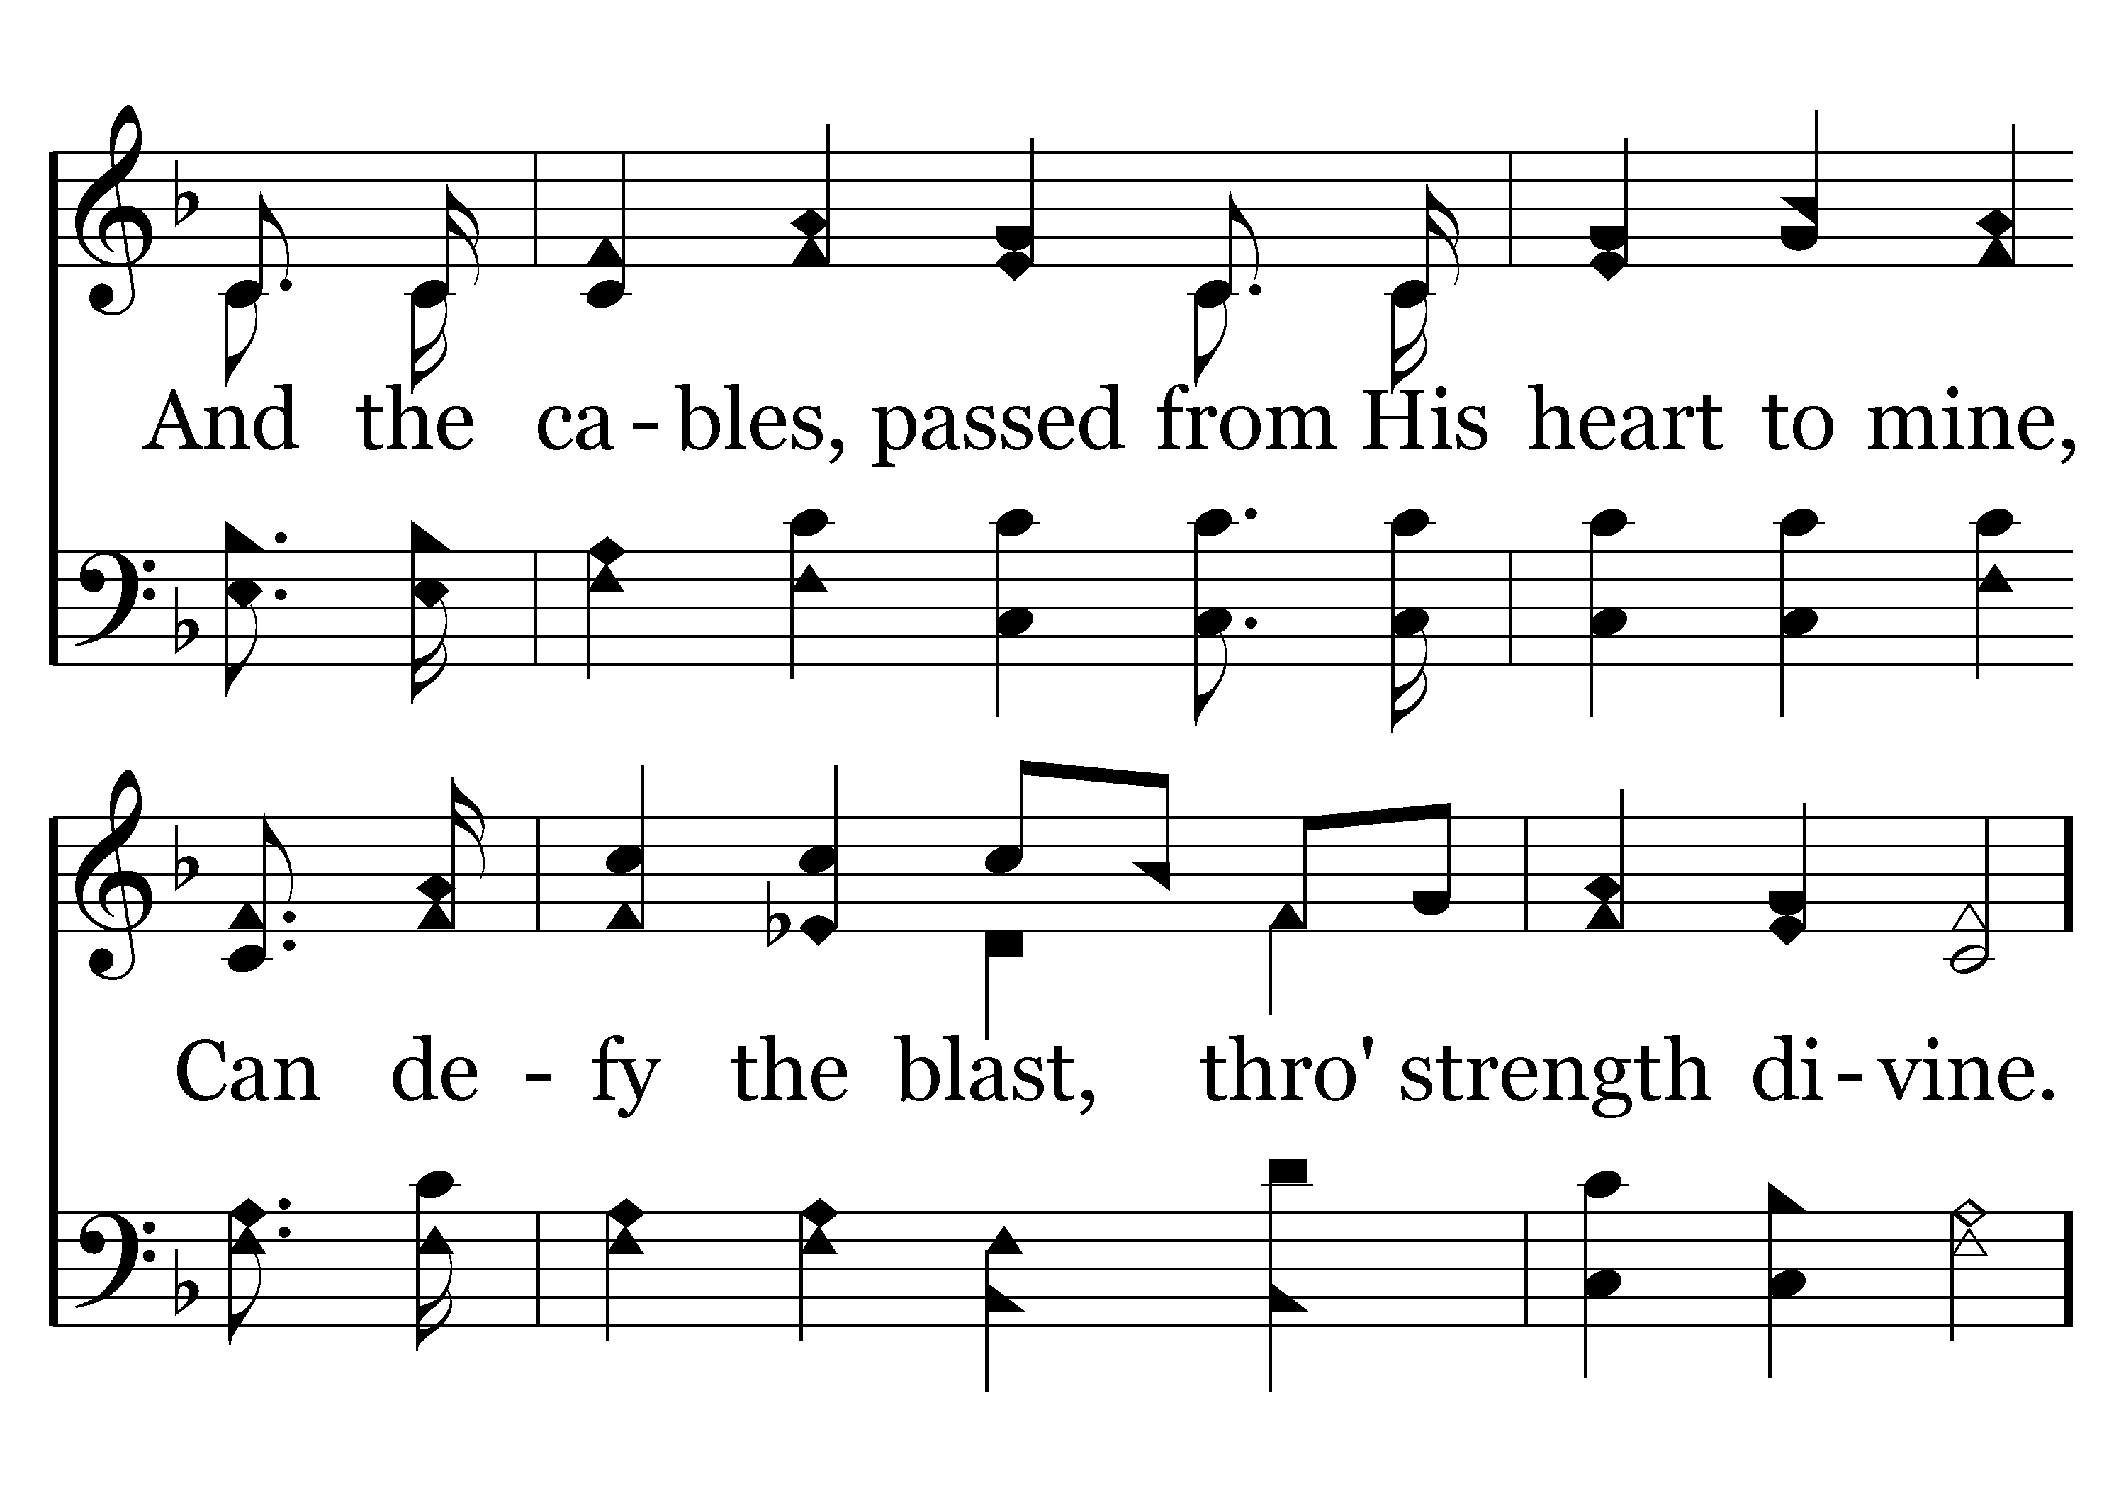
496 - We Have An Anchor - 2.2

Slide 22
496 - We Have An Anchor - C.1

Slide 23
496 - We Have An Anchor - C.2
End of Verse 2

Slide 24
The Presence of God (v. 23)
The Promise of God (vv. 24-25)
The Providence of God (v. 24)

Slide 25
Providence defined
  “The working of God through His provision in the natural and spiritual realms, and yet it is a control that violates neither the sovereignty of the human will nor the divine natural and spiritual laws.” (H. Hailey)
  “Providence” (Acts 24:2) comes from pronoia which means “forethought” (Vines). – God used forethought in creating a universe that he could control and use for his purpose.
  Providence is the non-miraculous use of natural law and circumstance to accomplish his purpose.
The Providence of God (v. 24)

Slide 26
Providence defined
Here in life of Paul – God is working out his purpose (v. 24)
  God’s purpose is to bring him before Caesar
  God is working that out through natural means
The Providence of God (v. 24)

Slide 27
Providence defined
Here in life of Paul – God is working out his purpose (v. 24)
We do not always know when or what God is doing
  Esther 4:14 – “who knows…”
  Philemon 15 – “perhaps”
  Can be assured God is accomplishing his will (Rev. 4:11)
The Providence of God (v. 24)

Slide 28
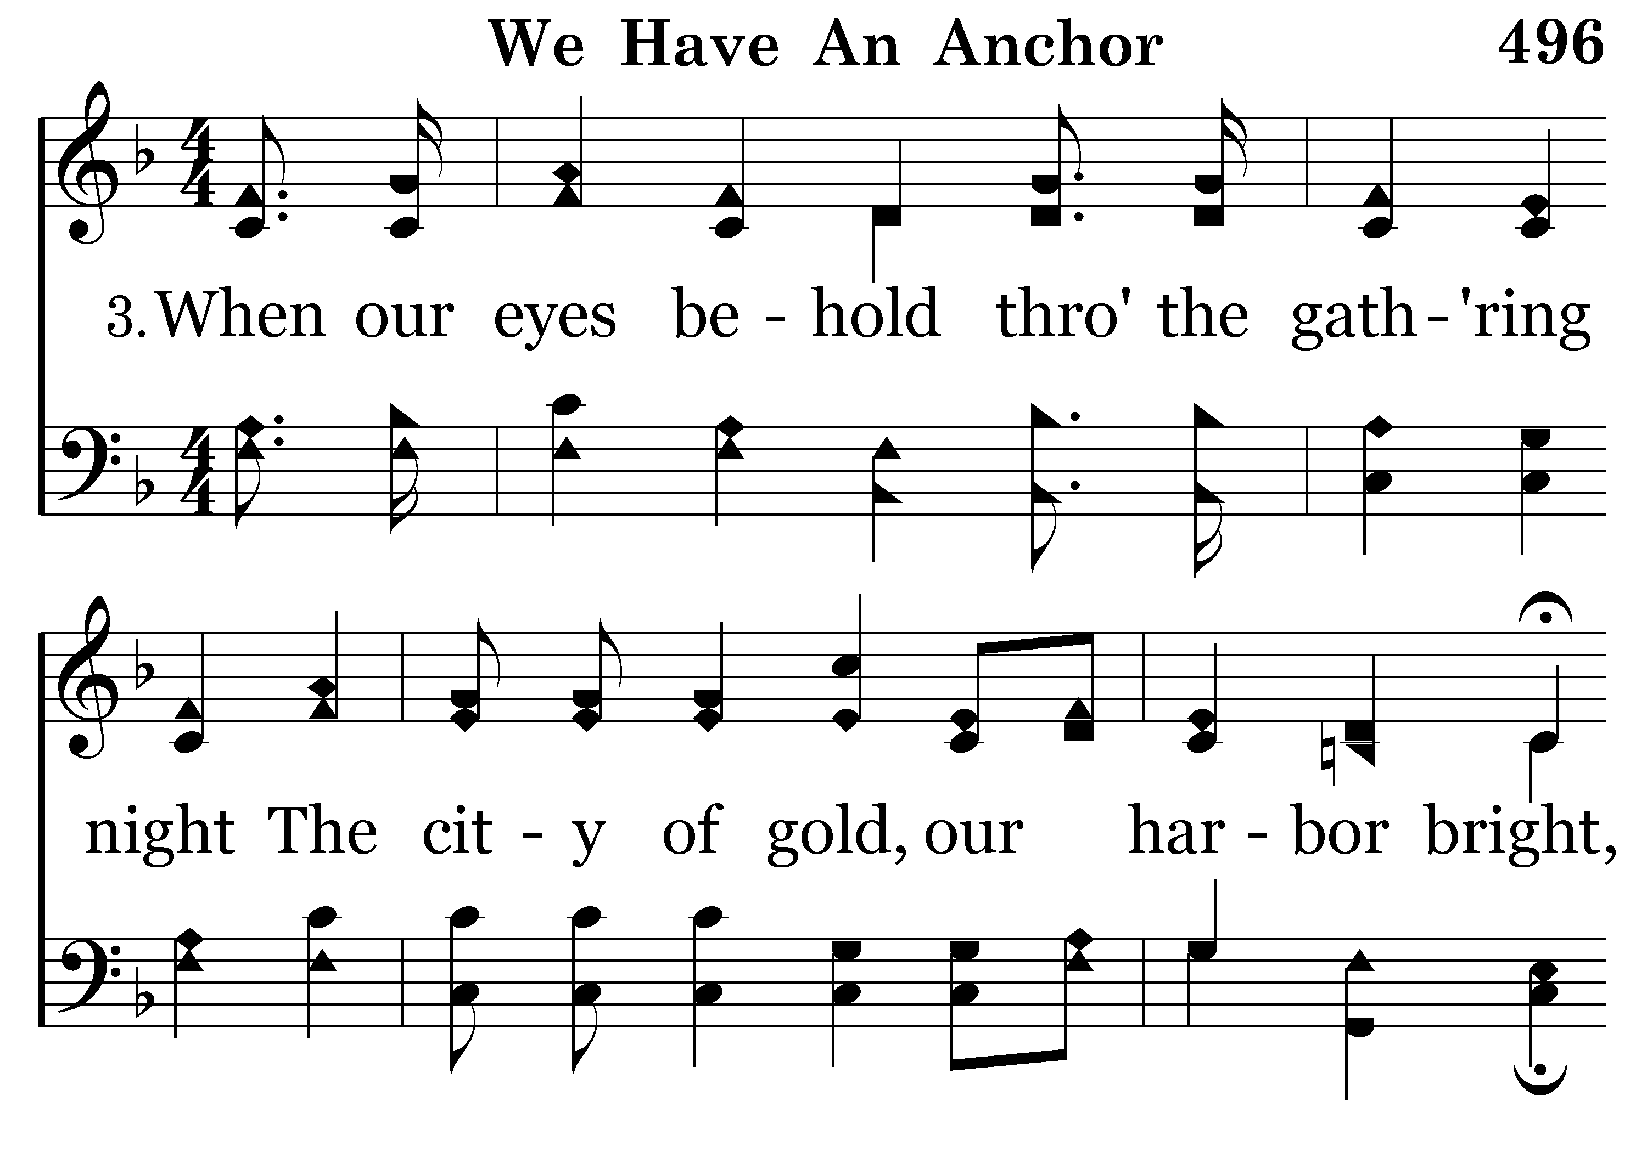
496 - We Have An Anchor - 3.1

Slide 29
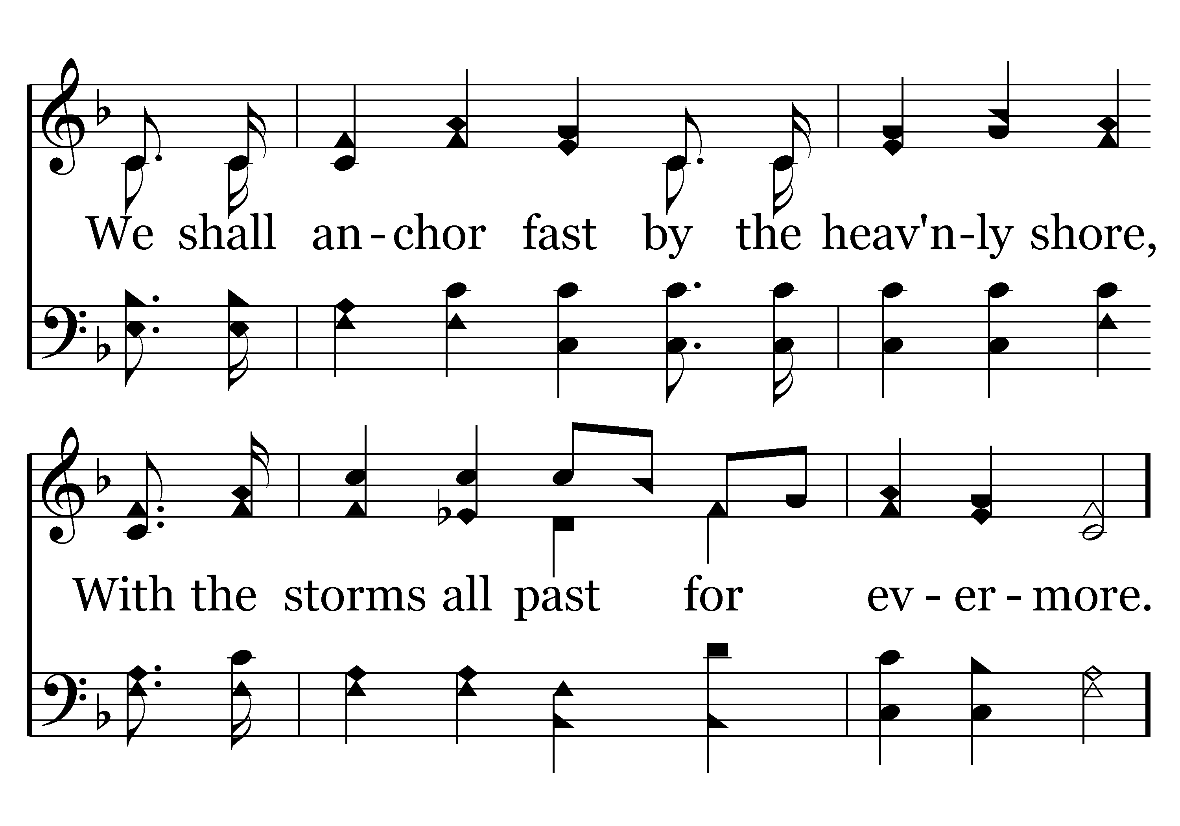
496 - We Have An Anchor - 3.2

Slide 30
496 - We Have An Anchor - C.1

Slide 31
496 - We Have An Anchor - C.2
End of Song

Slide 32
The Presence of God (v. 23)
The Promise of God (vv. 24-25)
The Providence of God (v. 24)
The Performance of God (v. 44)

Slide 33
Lord did what he had promised
  All made it safe to shore
  There was no loss of life
The Performance of God (v. 44)

Slide 34
Lord did what he had promised
God does what he says
  Powerful God (Luke 1:37)
  Can do everything (Job 42:2)
  Can do more than ask (Eph. 3:20)
The Performance of God (v. 44)

Slide 35
Lord did what he had promised
God does what he says
God will do what he has said – in midst of your storm
The Performance of God (v. 44)

Slide 36
The Presence of God (v. 23)
The Promise of God (vv. 24-25)
The Providence of God (v. 24)
The Performance of God (v. 44)

