Slide 1
Review
Dare to be a Daniel
I. Daniel Was a Man of Purpose
II. Daniel Was a Man of Principle
III. Daniel Was a Man of Purity
IV. Daniel Was a Man of Prayer

Slide 2
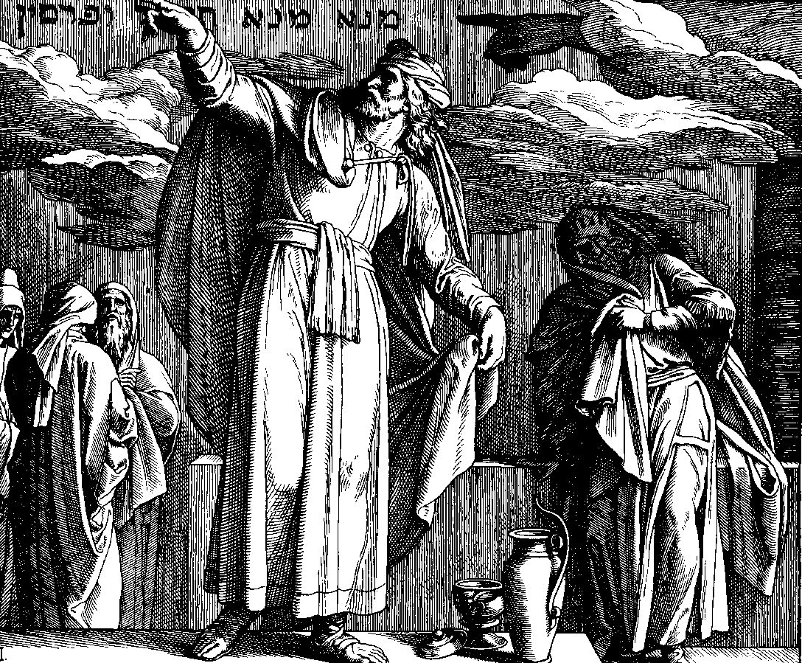
Aged Daniel Before The King
Daniel 5

Slide 3
Daniel Was An Exile Prophet
Pre-Exile
Post-Exile
Exile
Taken in the first group
606
597
586

Slide 4
Daniel Lived Through the Whole Babylonian Captivity
Daniel lived there 72 years ‑ outlived the 34 year reign of Nebuchadnezzar and those that followed.
Daniel lived to see Babylon fall to the Medes.
Daniel lived to see Remnant leave for Jerusalem ‑ led by Zerubbabel (Neh. 10:1-ff).
Links the pre‑exile with the post‑exile period. He spans the whole period of captivity.

Slide 5
Overview of Daniel
I. Historical Events (1‑6)
A. Under Babylonian rule (1‑5).
    1. Daniel’s test as a captive (1)
    2. Interpretation of Nebuchadnezzar’s dream about kingdoms to come (2).
    3. Daniel’s friends refuse to bow to the image and withstand the test of the fiery furnace (3).
    4. Interpretation of Nebuchadnezzar’s dream about God’s rule (4).
    5. Belshazzar’s feast and the fall of Babylon (5).
B. Under Medo‑Persian (6)
    1. Test of the lion’s den (6)

Slide 6
Chapter 1
I. Daniel’s test as a captive (1)
A. Daniel and three friends are selected for special training (vv. 1-7)
B. Daniel refuses to defile himself (vv. 8-16)
C. God rewards his faithful servants (vv. 17-21)

Slide 7
Chapter 2
    II. Interpretation of Nebuchadnezzar’s dream about kingdoms to come (2)
      A. The dream and decree of Nebuchadnezzar (vv. 1-16)
      B. Daniel gives glory to God for revealing the dream (vv. 17-30)
      C. Revelation and interpretation of Nebuchadnezzar’s dream (vv. 31-49)

Slide 8
Chapter 3
III. The Faith of Daniel’s Friends Is Challenged & Vindicated (3)
A. The temptation to bow to the image (vv. 1-7)
B. Their faith declared (vv. 8-18)
C. Their faith tested and vindicated (vv. 19-27)
D. Their faith is triumphant (vv. 28-30)

Slide 9
Chapter 4
IV. Nebuchadnezzar is Taught That God Rules in the Kingdom of Men (4)
A. Nebuchadnezzar’s dream (vv. 1-18)
B. The interpretation of the dream (vv. 19-27)
C. The fulfillment of the dream (vv. 28-33)
D. Nebuchadnezzar’s praise to God (vv. 34-37)

Slide 10
Kings of Babylon
Nabopolassar 625‑604 BC
Nebuchadnezzar 606‑561 BC
Evil‑Merodach 561‑560 BC
Neriglissar 559‑556 BC
Labash‑Marduk 556 BC
Nabonidus 555‑536 BC
Belshazzar (son of Nabonidus) was co‑regent the last few years of his reign.

Slide 11
Daniel 5
Old man:
80-90
years old
Belshazzar’s Feast (vv. 1-4)
Handwriting on the Wall (vv. 5-9)
Queen Suggests Getting Daniel (vv. 10-12)
Daniel’s Interpretation (vv. 13-29)
Belshazzar’s Fall (vv. 30-31)

Slide 12
Aged Daniel Before The King
Daniel 5
I. Maintaining Integrity (vv. 10-12)

Slide 13
Maintaining Integrity (vv. 10-12)
Faithful for many years
  Did not compromise (chapter 1)
  Did not bow to pressure (chapter 3)
  Maintained his faith (cf. 6:10)
  Can be faithful (Heb. 6:11)
In a difficult environment
  In Captivity – Prisoner of war!
  Tested, tried & threatened
  Wasn’t easy
  What testimony – old faithful servant is!

Slide 14
Aged Daniel Before The King
Daniel 5
Maintaining Integrity (vv. 10-12)
Reputation (v. 16)

Slide 15
Reputation (v. 16)
Have one
  People are watching
  Taking note of what you say & do
  Others are talking about you!
It spreads
  Word gets around (good and bad)
  Prov. 22:1
  Ecc. 7:1
What have they heard?

Slide 16
Aged Daniel Before The King
Daniel 5
Maintaining Integrity (vv. 10-12)
Reputation (v. 16)
Ready to Answer (v. 16)

Slide 17
Ready to Answer (v. 16)
Daniel – Known for Answering Difficult Matters
Are You Ready to Answer?
  1 Pet. 3:15 – be ready to give reason…
  Ready to give reason why believe – God is?
  Ready to tell why believe Bible is true?
  Ready to tell why believe Jesus is God?
  Ready to tell why believe one church?
  Ready to tell what is right on D&R?

Slide 18
Aged Daniel Before The King
Daniel 5
Maintaining Integrity (vv. 10-12)
Reputation (v. 16)
Ready to Answer (v. 16)
Learning From the Failure of Others (vv. 18-22)

Slide 19
Learning From the Failure of Others (vv. 18-22)
Belshazzar knew about Neb. – yet did same things
Ought to learn from other’s mistakes / failures
  Rom. 15:4
  1 Cor. 10:6-11
  Heb. 4:11
Often repeat the worst of mistakes
  Parents lack of discipline – carelessness
  Association with the world
  Marrying non-Christians
  Playing with fire (Prov. 5:8)

Slide 20
Aged Daniel Before The King
Daniel 5
Maintaining Integrity (vv. 10-12)
Reputation (v. 16)
Ready to Answer (v. 16)
Learning From the Failure of Others (vv. 18-22)
People Do Not Always Do What Know (v. 22)

Slide 21
People Do Not Always Do What Know (v. 22)
Explains the puzzle: “He surely knows better”
Most of our problems / sin – Doing things we know better than to do
  Need to doers – not just hearers (Jas. 1:22)
  David knew better (2 Sam. 11)
  Achan knew better (Joshua 7)
  Peter knew better (Gal. 2:11-14)
Often we ignore what we know (Rom. 10:3,17)

Slide 22
Aged Daniel Before The King
Daniel 5
Maintaining Integrity (vv. 10-12)
Reputation (v. 16)
Ready to Answer (v. 16)
Learning From the Failure of Others (vv. 18-22)
People Do Not Always Do What Know (v. 22)
Reminded of What We Already Know (v. 22)

Slide 23
Reminded of What We Already Know (v. 22)
Need reminding of what we know (2 Pet. 1:12)
  Need to hear truth over & over
  If been Christian very long – should sound familiar (“heard that before”)
  No harm – rather help when already studied that lesson, chapter, subject
Reasons need reminding
  Tendency to forget
  Often miss the obvious
  Some points finally hit us after ____ time!

Slide 24
Aged Daniel Before The King
Daniel 5
Maintaining Integrity (vv. 10-12)
Reputation (v. 16)
Ready to Answer (v. 16)
Learning From the Failure of Others (vv. 18-22)
People Do Not Always Do What Know (v. 22)
Reminded of What We Already Know (v. 22)
Weighed & Found Wanting (v.27)

Slide 25
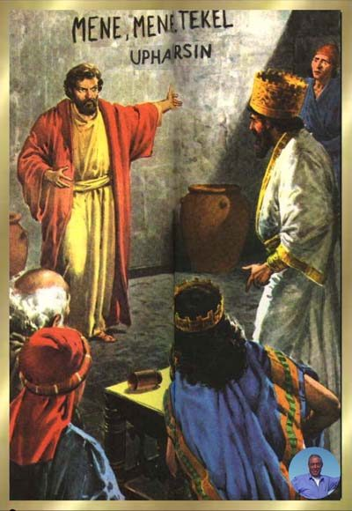
26 "This is the interpretation of each word. MENE: God has numbered your kingdom, and finished it;
27 TEKEL: You have been weighed in the balances, and found wanting;
28 PERES: Your kingdom has been divided, and given to the Medes and Persians."

Slide 26
Weighed & Found Wanting (v. 27)
We will be weighed (Judgment)
  2 Cor. 5:10
  Rom. 2:8-10
  Rev. 20:12
Will you be found wanting?
  What is missing in your life?
  What are you not doing now?
  Could you say “I know I should…”?

Slide 27
Aged Daniel Before The King
Daniel 5
Maintaining Integrity (vv. 10-12)
Reputation (v. 16)
Ready to Answer (v. 16)
Learning From the Failure of Others (vv. 18-22)
People Do Not Always Do What Know (v. 22)
Reminded of What We Already Know (v. 22)
Weighed & Found Wanting (v.27)

