Slide 2
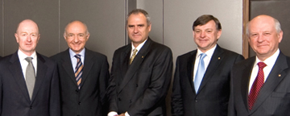
Deacons
The Office of a Deacon
The Work of a Deacon
The Qualifications of a Deacon
Acts 6:1-6

Slide 3
Plan & Process for
Deacon Appointment
Lessons:
  Aug. 14 – Office of a Deacon
  Aug. 21 – Work of a Deacon
  Aug. 28 - Qualifications of a Deacon
  Sept. 4 – Acts 6:1-6
Names to be submitted – Sept. 4 – 18
Looking for 2-3 new deacons
Names presented Sept 25 – asking for objections
Objections due: Oct. 9
Appoint new deacons – Oct. 16

Slide 4
Lesson 1
The Office of a Deacon
Term Means:
Servant
Minister
Special Sense
Qualifications
More than saints
Office of Work
Under elders
Job = work

Slide 5
Lesson 2
The Work of a Deacon
I. Their Work
II. Deacons Are Appointed Because There Is Work To Do
III. Deacons - Those Who Can Be Trusted With The Work/Task Given
IV. Our Responsibility Toward Deacons

Slide 6
Lesson 3
Qualifications of a Deacon
Reverent
Not Double Tongued
Not Given - Wine
Not Greedy
Hold Mystery
Tested
Blameless
Husband
Rule Children & Houses Well
Wife - Faithful

Slide 7
Deacons
Lessons From
Acts 6:1-7

Slide 8
1 Now in those days, when the number of the disciples was multiplying, there arose a murmuring against the Hebrews by the Hellenists, because their widows were neglected in the daily distribution.
2 Then the twelve summoned the multitude of the disciples and said, "It is not desirable that we should leave the word of God and serve tables.
3 Therefore, brethren, seek out from among you seven men of good reputation, full of the Holy Spirit and wisdom, whom we may appoint over this business;
4 but we will give ourselves continually to prayer and to the ministry of the word."
5 And the saying pleased the whole multitude. And they chose Stephen, a man full of faith and the Holy Spirit, and Philip, Prochorus, Nicanor, Timon, Parmenas, and Nicolas, a proselyte from Antioch,
6 whom they set before the apostles; and when they had prayed, they laid hands on them.
7 Then the word of God spread, and the number of the disciples multiplied greatly in Jerusalem, and a great many of the priests were obedient to the faith.
Acts 6:1-7

Slide 9
Appointment of the Seven To Care for the Widows
Hellenist widows were neglected (v. 1)
Apostles told brethren to choose seven men (vv. 2-4)
Seven were appointed (vv. 5-6)
Many obeyed the gospel (v. 7)

Slide 10
Circumstances
Social & Cultural Barrier
  Hellenist = Greek Jews - born in foreign country - did not speak Hebrew
  Hebrews - Native to Palestine
  Sometimes the Hebrews looked down on the Hellenist (Grecians) Though we are not told that here

Slide 11
Circumstances
Social & Cultural Barrier
Disciples multiplied
  Church is smaller - those in need not as likely to be overlooked
  Church grew & grew (4:4; 5:14)
  Means:
    More diversity
    Numbers make it more likely to overlook…

Slide 12
Circumstances
Social & Cultural Barrier
Disciples multiplied
Nature of the distribution
  “Daily distribution” – needs
  Coffman: “In the very nature of such distributions, it was inevitable that some should receive less, others more, and that almost any person desiring to find fault could easily have ‘discovered’ some basis for alleging it.” (Acts, p. 122)

Slide 13
Lessons From
Acts 6:1-7
Church Can Do Its Own Work

Slide 14
Church Can Do Its Own Work
Church sees to its own needy
  Daily distribution already being done
  Some widows needed more care
  Church selected men to see that it was done
  No organization formed to do the work

Slide 15

Church Can Do Its Own Work
Church sees to its own needy
Institutionalism – Church cannot do its own work
  Church’s work is to furnish the money
  “Home” (Institution) is to furnish the care
  Form another organization between church & work
Do its own work
(Arrange, Oversee & Provide)
Local
Church
“Home”
Separate
Organization
(Arrange, Oversee
& Provide)
$$
Widow
(Work of Care)
Care

Slide 16
Church Can Do Its Own Work
Church sees to its own needy
Institutionalism – Church cannot do its own work
The Church is All Sufficient to do Its Work
  Preach the gospel (1 Tim. 3:15) – No Missionary organization needed
  Relieve its own (1 Tim. 5:16) – No Benevolent organization needed
  Edify its own (Eph. 4:16) – No Sunday School organization needed

Slide 17
Lessons From
Acts 6:1-7
Church Can Do Its Own Work
When People Are Neglected

Slide 18
When People Are Neglected
Neglect Defined
  Means: “to look beyond - to overlook” (A.T. Robertson, Word Studies)
  Translated: “overlooked” (Darby, NIV, YLT); “not getting their share” (NCV)

Slide 19
Who Might Be Neglected
Widows
Any Needy Christian
Sick
Single
Older
Spiritually Weak
Ways We Might Neglect
Not Encouraging
Not Including Them
Not Demonstrate Love
Not Inform
Being Partial
Neglect - Overlooked
Notes:
Widows
Because don’t have husbands...
Needs - can’t take care of - (financially, physically)
Any needy Christian
Hate to ask for benevolence –
Notice - no indication that the widows of Acts 6 were doing the murmuring.
May be that we don’t take pains to notice what needs others have
Sick
Forget to check on them
Not realize how sick are..
Not even aware they were sick
May have needs - don’t think to see about
Those who are single
Not have a complete family.
May feel - don’t fit in with “groups”
Older
Easily feel - pushed aside - not needed.
Time passes slower for them.
Things can’t do - places can’t go...
Spiritually Weak
Leave them to sink or swim.
Miss for weeks before check on...
Don’t help them grow....
Not aware of what stumbling block they are facing...
In What Ways Do We Neglect One Another?
Not Encouraging One Another
Heb. 3:13; 10:24
Think things - fail to say it [nothing intention - in fact good intentions]
Not Including Them
Times - some left out of plans, gatherings, invitations, etc.
Left out of work of church –
Not mention them in a list of sick, etc.
Not Demonstrating Love & Care
May love brethren - Heb. 13:8; 1 Pet. 3:8
1 Cor. 13 - show that love...
May really care - concerned - appreciate... but they don’t know till we show...
Not Informing
Brethren were informed of problem (v. 2) and the planned solution.
Communication eliminates lot problems
Single, widows, those not in a position of knowing - need to be informed..
Congregations - need to know elders are doing...
Being Partial
1 Tim. 5:21
Partiality is not be fair - to show respect of persons.
Condemn sin in one - approve same in another
Actions based on prejudice (text)
Not to be confused with kindness & friendship toward some - not have toward others:
Ex: Jesus’ friendship - John ...
Did more with Peter, James & John
You may do for one - not for all (B-day gift - card - go to lunch)

Slide 20
When People Are Neglected
Neglect Defined
Not Always Intentional
  This case may have been intentional – but not necessarily
  Seems - not intentional
    If so - seem that a rebuke in order
    If so - why didn’t apostles/disciples defend their neglect?
    Not a rebuke to those who complained nor to the disciples
  Times we may neglect some among us - when that is done - not assume intentional

Slide 21
When People Are Neglected
Neglect Defined
Not Always Intentional
Neglect Causes Discouragement & Complaints
  Must have discouraged the Hellenist - They murmured! – (Complained, ESV, NASV)
  Must have discouraged their widows
  They complained - “our widows being left out!”
  Today – results will be the same

Slide 22
When People Are Neglected
Neglect Defined
Not Always Intentional
Neglect Causes Discouragement & Complaints
Criticism Is Justified
  The actions of the apostles - indicated that those who murmured had a valid point!
  Else - catering to grumblers!
  When complaints are made - need to consider the possibilities:
    Could be overstated – invalid
    Could be misunderstanding
    Could be valid point!

Slide 23
When People Are Neglected
Neglect Defined
Not Always Intentional
Neglect Causes Discouragement & Complaints
Criticism Is Justified
Neglect Needs to be Corrected
  Immediately the apostles sought a remedy
  Then & only then did the complaints help

Slide 24
When People Are Neglected
Neglect Defined
Not Always Intentional
Neglect Causes Discouragement & Complaints
Criticism Is Justified
Neglect Needs to be Corrected
When Not Being Included is Not “Neglect”

Slide 25
When Not Being Included
is Not “Neglect”
  Some were not included in our text:
    Seven appointed to serve “deacons”
      Of the 1,000's, were there not more?
      Means some who qualified not appointed
      Perhaps more qualified – but only 7 needed
    Widows that were not “widows indeed” (1 Tim. 5:16)
  Those who persist in sin - purposely excluded from some things
    1 Cor. 5:9-13
    2 Thess. 3:6-14
    By including them - encourage them in their sin

Slide 26
Lessons From
Acts 6:1-7
Church Can Do Its Own Work
When People Are Neglected
Selecting Men To Serve

Slide 27
Selecting Men To Serve
Servants Selected Because of a Need
  If men not appointed – apostles have to do it (v. 2)
  Not appointed – just so they could be “deacons”

Slide 28
Selecting Men To Serve
Servants Selected Because of a Need
Selection Done by the Congregation
  Apostles (leaders) asked the congregation to do the selecting (v. 3)
  They were given the qualification – asked to “seek out among you…”
  Not just selected by the leadership
Acts 6:3
Therefore, brethren, seek out from among you seven men of good reputation, full of the Holy Spirit and wisdom, whom we may appoint over this business;

Slide 29
Selecting Men To Serve
Servants Selected Because of a Need
Selection Done by the Congregation
Appointed by the Leadership
  Apostles said, “Whom we may appoint…”
  The brethren chose the men (v. 5)
  Apostles appointed them (v. 6)

Slide 30
Selecting Men To Serve
Servants Selected Because of a Need
Selection Done by the Congregation
Appointed by the Leadership
Number was Determined by Need & Leadership

Slide 31



1
2
5
6
3
4
7
Number was Determined by Need & Leadership
Acts 6:3
Therefore, brethren, seek out from among you seven men of good reputation, full of the Holy Spirit and wisdom, whom we may appoint over this business;
Need: enough work for seven
  Fewer men would not be enough
  More men would be too many
Leadership suggested the number needed

Slide 32
Lessons From
Acts 6:1-7
Church Can Do Its Own Work
When People Are Neglected
Selecting Men To Serve
Emphasis on the Spiritual

Slide 33
Emphasis on the Spiritual
Not Want to Neglect the Spiritual (v. 2)
  In the midst of a “crisis” of physical needs
  In the midst of trying to fix a complaint
Emphasis on Prayer (vv. 4, 6)
  Apostles would give themselves to prayer & word
  Prayed before appointed the seven
Wanted Men Full of Faith (v. 5)
  One thing to have faith
  Another thing to be FULL of it!

Slide 34
Lessons From
Acts 6:1-7
Church Can Do Its Own Work
When People Are Neglected
Selecting Men To Serve
Emphasis on the Spiritual

Slide 35
Deacon Selection
Process

Slide 36
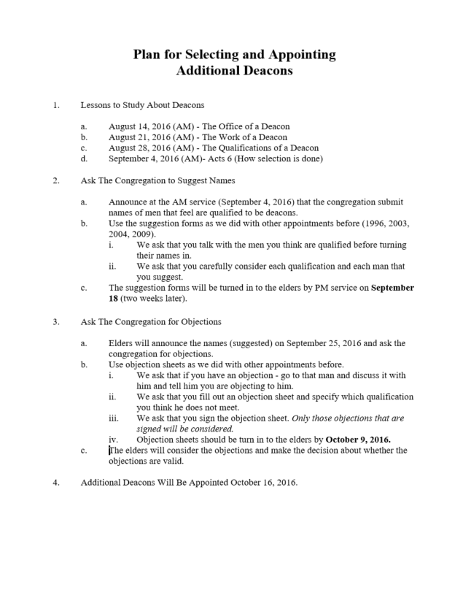

Slide 37
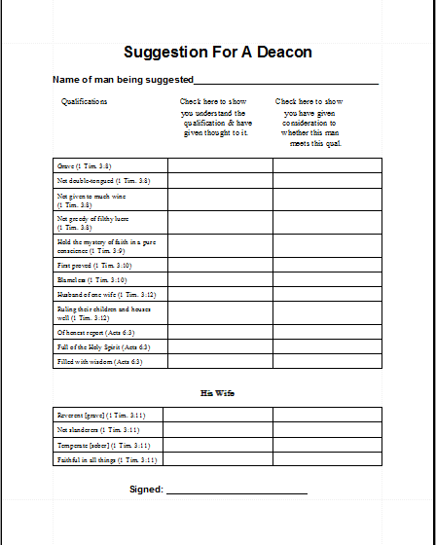

Slide 38
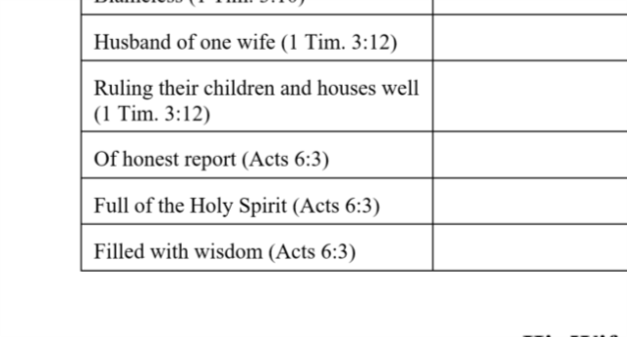

Slide 39
Sign the form
(no anonymous)
Same process
used in 1996, 2003, 2004, 2009
Turn in to elders
By
Sept. 18
Talk to man (men) before
suggesting him
Carefully consider: (1) Your understanding
Carefully consider: (2) If the man meets those

Slide 40
