Slide 1
Some have a hard time figuring out what the Bible teaches
Bible is not a list of “thou shalt” and “thou shalt not”
Two areas of struggle:
  Hard time concluding what is right and wrong
  Hard time drawing conclusions from text without specific wording
Recently asked – why God rejected Cain’s sacrifice – when God had not told him what to offer (Gen. 4:3-4)
How do I know the following – though not specifically stated:
  Gambling is a sin?
  Dancing is a sin?
  When clothing is immodest?
  Lord’s Supper is to be taken every week?

Slide 2
Two Ways
The Bible
Teaches
Explicitly (Directly)
  Disciples to go teach (Mark 16:15)
  Lord’s supper on first day (Acts 20:7)
  Repentance & baptism for remission (Acts 2:38)
Implicitly (Indirectly)
  Command to go teach applies to us
  Lord’s supper on first day applies to us
  Acts 8:35-38 – that Eunuch was taught about baptism
  Acts 16:31-ff – that Jailer was taught about baptism

Slide 3
How the Bible Teaches

Slide 4
How the Bible Teaches
By Principle

Slide 5
By Principle
The Bible lays down principles – that we are expected to apply
  Will be multiple times and opportunities to apply
  Violation of principles is a sin (1 John 3:4)

Slide 6
By Principle
The Bible lays down principles – that we are expected to apply
How a principle works
  Love (Matt. 22:38-40; Rom. 13:9-10)
    Jesus expected others to apply it (Luke 10:25-37)
    Paul expected others to apply it (1 Cor. 12:31 – 13:7)
  Golden Rule (Matt. 7:12)
    Do not have a list of all application
    Do not have a list of all violations
  Be an Example (Matt. 5:13-16)
    Not told all details of being an example
    How do I know when I have not salt or light?

Slide 7
By Principle
The Bible lays down principles – that we are expected to apply
How a principle works
Illustrated
  Suppose teacher tells class: “Stay in your seats while I am out of the room.”
  Student expected to apply the principle.
  Implicitly says:
    Do not go down hall
    Do not go to office
    Do not go across the room
    Do not go to restroom

Slide 8
How the Bible Teaches
By Principle
By Evidence

Slide 9
By Evidence
The Bible gives abundant evidence from which to draw the proper conclusion
  The conclusion may not be stated
  However, the conclusion is expected!
  The evidence gives assurance of the conclusion

Slide 10
By Evidence
The Bible gives abundant evidence from which to draw the proper conclusion
How evidence works
  Murder (body, weapon, possible motive, whereabouts…)
  Theft (opportunity, items, etc.)
  Direction of storm (came from the North)

Slide 11
By Evidence
The Bible gives abundant evidence from which to draw the proper conclusion
How evidence works
Examples of God giving evidence – expects a conclusion
  Is Jesus the coming one? (Luke 7:18-23)
  Can put away for any cause? (Matt. 19:1-6)
  Miracles (John 20:30-31)

Slide 12
How the Bible Teaches
By Principle
By Evidence
By Inference

Slide 13
By Inference
The Bible infers or implies things not specifically stated
  The conclusion is implied
  Ill: Jesus went down into the water (Matt. 3:16)
  An inference is not an assumption (i.e. Lydia’s household included infant children)

Slide 14
By Inference
The Bible infers or implies things not specifically stated
Examples of God teaching by inference
  Creation says - is a God (Psa. 19:1; Rom. 1:20; Acts 14:17)
  Love says we are disciples (John 13:34-35)
  Prophecies & miracles prove Christ (Mt. 16:1-2; Lk. 12:54)
  Gentiles accepted (Acts 10, 11, 15)
  Life beyond grave (Matt. 22:23-33)

Slide 15
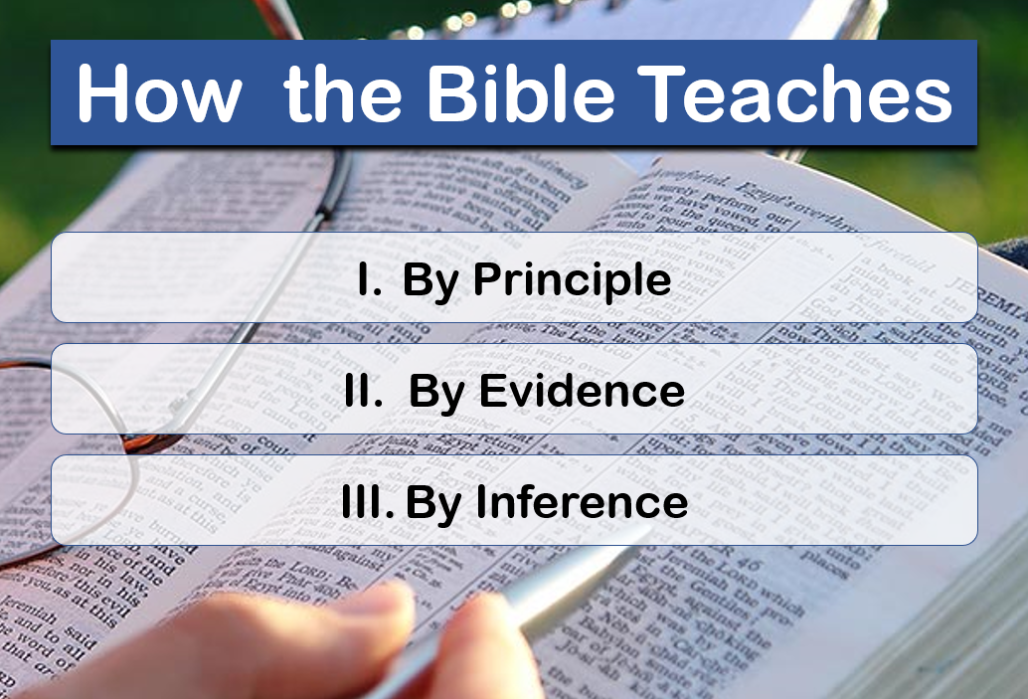
Each of the Three Overlap
Principle
Evidence
Inference

Slide 16
How the Bible Teaches
By Principle
By Evidence
By Inference

