Slide 1
Jesus Was a Miracles Worker
Foretold that Messiah would work miracles
(Isa. 35:5-6)
Book of John
“Miracles”
Climaxing – get bigger
Miracles were
Impressive /
Amazing
Equally Impressed with miracles didn’t do!

Slide 2
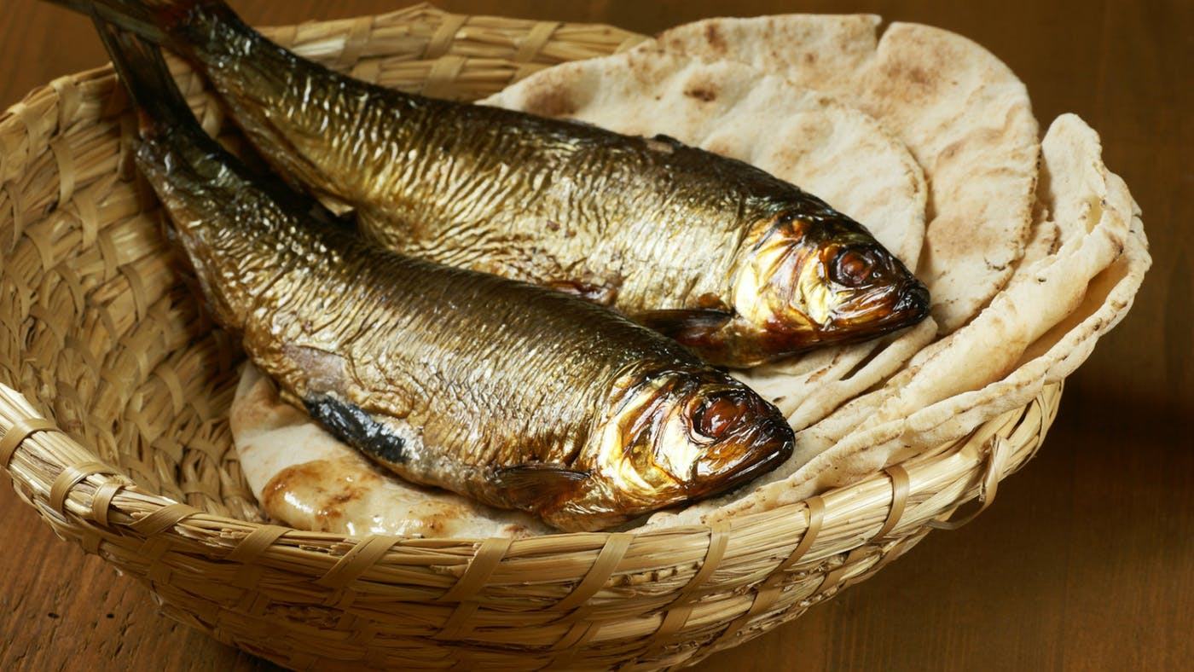
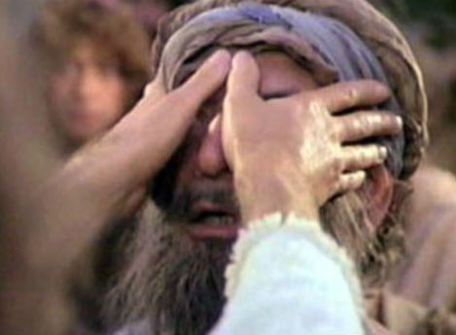
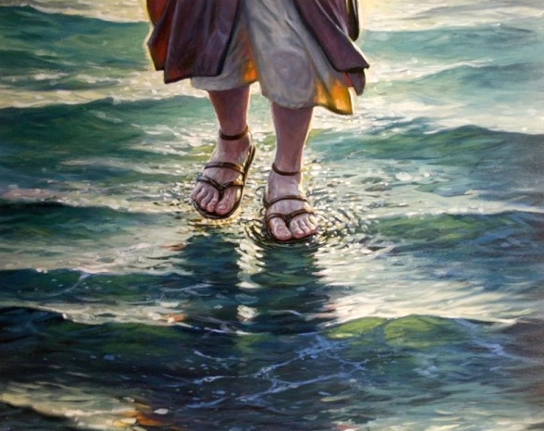
Miracles Jesus
Did Not Perform
Miracles Jesus Did Perform
Miracles Jesus Did Perform

Slide 3
Miracles Jesus Did Perform
The List

Slide 4
  Water to wine (John 2:1-11)
  Draught of fish (John 5:1-11)
  Calms the sea (Matt 8:23-27)
  Feeds 5,000 (Matt. 14:13-21)
  Walks on water (Mark 6:45-51)
  Feeds 4,000 (Mark 8:1-10)
  Money in fish (Matt. 17:24-27)
  Tree withered (Matt. 21:18-21)
  Healing of officials son (John 4:46-54)
  Healing of Peter’s mother-in-law (Matt. 8:14-15)
  Healing of leper (Mark 1:40-45)
  Healing of paralytic (Luke 5:18-26)
  Healing of withered hand (Matt. 12:9-13)
  Healing of centurion’s son (Luke 7:1-10)
  Raising of widow’s son (Luke 7:11-17)
  Raising of Jarius’ daughter (Mark 5:22-24)
  Heal of two blind men (Matt. 9:27-31)
  Raising of Lazarus (John 11:1-45)
  Healing of Malchus’ ear (John 18:10-11)
  Resurrection (Matt. 28:1-10)
The Miracles of Jesus

Slide 5
Miracles Jesus Did Perform
The List
The Purpose (John 20:30-31)
The Reaction
  Concluded that he was from God (John 3:2)
  Astonished (Matt. 14:33)
  Confounded enemies (John 11:47)
  Rejected & asked for more (Mark 8:11-12)

Slide 6
Miracles Jesus
Did Not Perform
Miracles Jesus Did Perform
Miracles Jesus Did Not Perform
Miracles Jesus Did Not Perform

Slide 7
Miracles Jesus Did Not Perform
Change stones to bread (Matt. 4:1-11)
Command fire down from heaven (Lk. 9:51-56)
Ask Father – 12 Legions of angels (Matt. 26:53)
Prophesy who struck him (Matt. 26:68)
Come down from cross (Matt. 27:40)
Force miracles on closed minded (Matt. 13:53-58; Mark 6:1-6)
  Mark: “could not” / Matthew: “did not”
  Means: chose not to
  Compare: Lk. 14:20; 1 John 3:9
More than is needed (Mark 8:11-13; Matt. 12:38-42; cf. Luke 16:31)

Slide 8
Miracles Jesus
Did Not Perform
Miracles Jesus Did Perform
Miracles Jesus Did Not Perform
Lessons Learned
Lessons Learned

Slide 9
Lessons Learned
Just because God has power – doesn’t mean he will
  Not working miracles today – not a question of power
  Much that God could miraculously do – doesn’t
God will not give evidence beyond what he has given / or is necessary
  If evidence given will not produce effect – nothing will
  Wishing for more or miracles – is useless
God will not work miracles / or take action contrary to his will
  Miracles – contrary to nature – not contrary to God’s will
  Cannot expect something from God – contrary to word
Salvation does not come miraculously
  Miracles surround conversion – did not save
  Every case of conversion saved the same way

Slide 10
Miracles Jesus
Did Not Perform
Miracles Jesus Did Perform
Miracles Jesus Did Not Perform
Lessons Learned

