Slide 1
Times we all need encouragement
Always someone in a situation where they could use it
Many of us come to services hoping to be encouraged
Sometimes our words / actions are crying out – “I need to be encouraged!”
Possible we are being encouraged – though we don’t realize it!

Slide 2
Encouragement
The
Help
We All
Need

Slide 3
Encouragement
The Meaning of Encouragement

Slide 4
The Meaning of Encouragement
Does not mean:
  Mere pat on the back – “Atta boy! Way to go!”
  Staying all positive (no rebuke, no correction, etc.)
  Assuring one that problems are not their fault

Slide 5
The Meaning of Encouragement
Does not mean:
Does mean:
  To enable another to meet their difficultly with confidence (Col. 2:2)

Slide 6

Barclay on Colossians 2:2
“Paul prays that their hearts may be encouraged. The word which he uses is parakalein. Sometimes that word means to comfort, sometimes to exhort; but always behind it there is the idea of enabling a person to meet some difﬁcult situation bravely and with conﬁdence. One of the Greek historians uses it in a most interesting and thought-provoking way. There was a Greek regiment which had lost heart and was utterly dejected. The general sent a leader to talk to it to such purpose that courage was reborn and a body of dispirited men became ﬁt again for heroic action. That is what parakalein means here. It is Paul’s prayer that the church may be ﬁlled with that courage which can cope with any situation.”
  Barclay, William (3rd ed. fully rev. and updated, p. 150)

Slide 7
The Meaning of Encouragement
Does not mean:
Does mean:
  To enable another to meet their difficultly with confidence (Col. 2:2)
  To strengthen (Deut. 1:38; 3:28; Ezra 1:6)
  To plead to action (Luke 15:28)
Vines: lit. denotes “to call to one’s side,” hence, “to call to one’s aid.” It is used for every kind of calling to a person which is meant to produce a particular effect, hence, with various meanings, such as “comfort, exhort, desire, call for,” in addition to its significance “to beseech,” which has a stronger force than aiteo (see ask)

Slide 8
The Meaning of Encouragement
Does not mean:
Does mean:
  To enable another to meet their difficultly with confidence (Col. 2:2)
  To strengthen (Deut. 1:38; 3:28; Ezra 1:6)
  To plead to action (Luke 15:28)
  Assure one doing what is right – be okay (1 Kings 22:13)

Slide 9
The Meaning of Encouragement
Does not mean:
Does mean:
Possible to encourage without basis (1 Kings 22:13; 1 Chron. 18:12)

Slide 10
Encouragement
The Meaning of Encouragement
The Need for Encouragement

Slide 11
The Need for Encouragement
We get discouraged
  “Discouraged” = opposite of encouraged; deprived of courage, confidence
  Examples:
    Israel (Num. 21:4) -

Slide 12
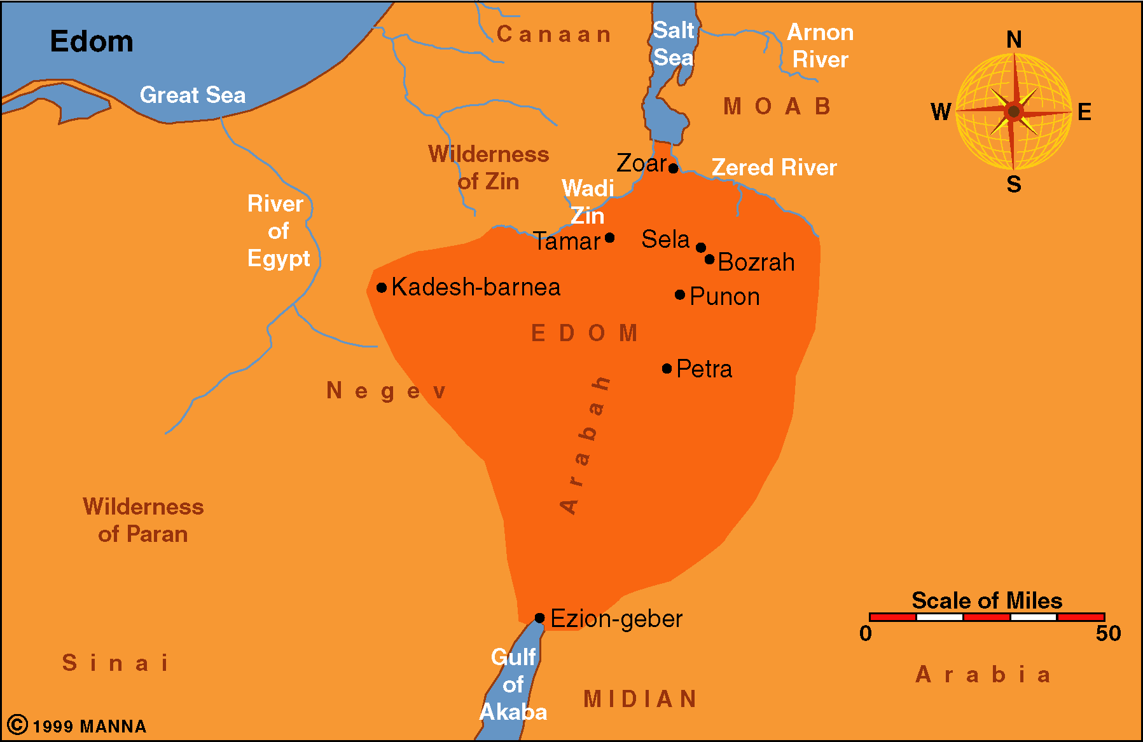
Edom
. Mt. Hor?

Slide 13
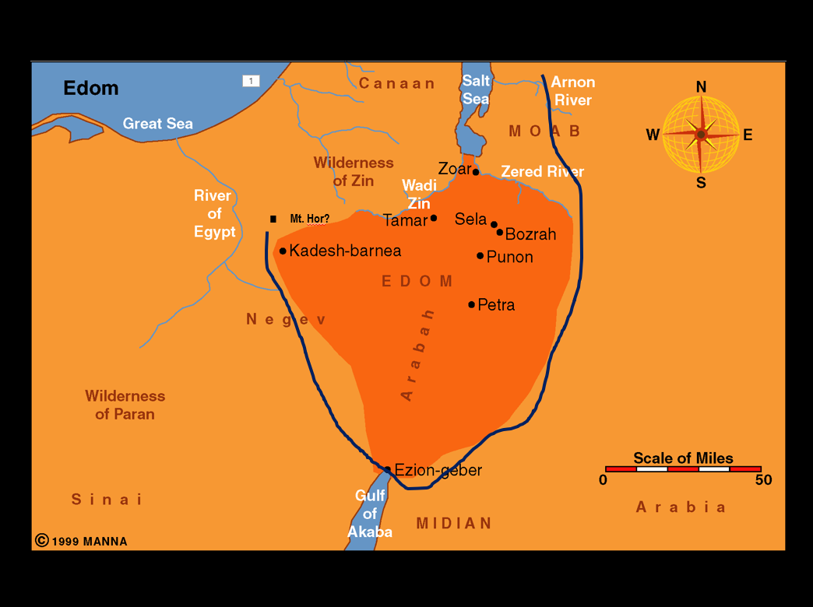
Israel was Discouraged
(Num. 21:4-5)
Situation: Israel had been forbidden to pass through Edom (Num. 20:20-21)
“Very discouraged” (v. 4)- “Impatient” (ESV, NASB) – things are not going as planned –
“Because of the way” (ASV, NASB, KJV fn)
  Not just on the way – but because of it!
  Took longer – not as planned – rough
Turned against God (v. 5)
Complained (v. 5)

Slide 14
The Need for Encouragement
We get discouraged
  “Discouraged” = opposite of encouraged; deprived of courage, confidence
  Examples:
    Israel (Num. 21:4) –
    Elijah (1 Kings 19:1-10) -

Slide 15
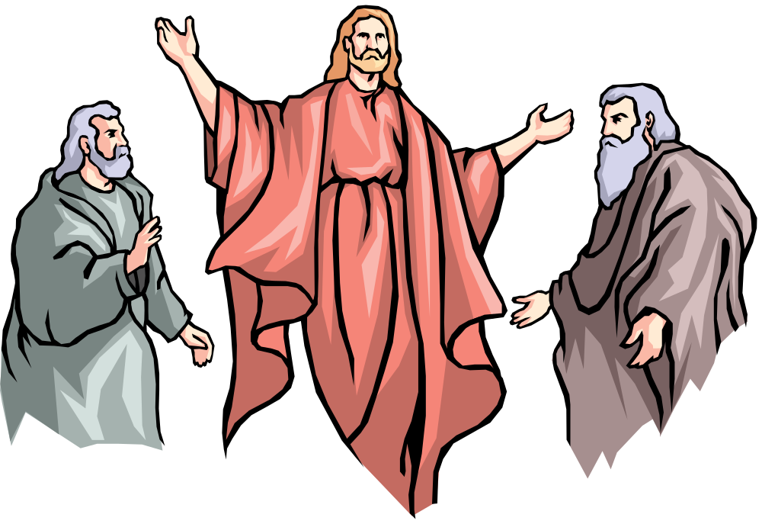
Elijah
Reached a Point Where He Was Pretty Low
Perhaps we think the great prophets are people of steel – unreal temperament
Jas. 5:17 – “nature like ours”
1 Kings 19:1-10 Reached a point:
  Thought no one cared
  Thought no one wanted to do right
  Lonely
  Just a soon die as live
Elijah Struggled – So Do We!

Slide 16
The Need for Encouragement
We get discouraged
  “Discouraged” = opposite of encouraged; deprived of courage, confidence
  Examples:
    Israel (Num. 21:4) –
    Elijah (1 Kings 19:1-10) –
    Hebrew Christians (Heb. 12:3, 5, 12)
  May be prompted by many things:
    Disappointed at sin of others
    Physical problems / sickness
    Material / financial difficulties
    Own sin
    Death of loved one

Slide 17
The Need for Encouragement
We get discouraged
God comforts the downcast (2 Cor. 7:6)
  “troubled” (NCV); “depressed” (NASB); “discouraged” (NLT)
  Conclude: the comfort and encouragement I need – God gives!
  Thus, I need to know HOW God does that!

Slide 18
The Need for Encouragement
We get discouraged
God comforts the downcast (2 Cor. 7:6)
We are to comfort the fainthearted (1 Thess. 5:14)
  “encourage” (ASV)
  Thus, encouragement is needed
  We need to know HOW to encourage!

Slide 19
Encouragement
The Meaning of Encouragement
The Need for Encouragement
The Means of Encouragement

Slide 20
The Means of Encouragement
By example (2 Chron. 28:19)
Assured Lord is with us/ no need for fear (2 Chron. 32:6-8)
Seeing blessing of the Lord (Ezra 7:28)
People who are encouraging (Acts 4:36)
Urged to continue on (Acts 11:23)
Being with brethren – mutual faith (Rom. 1:12)
Learn a doctrinal point (Acts 15:32; 1 Cor. 14:31)
Assured of promise of God – focus elsewhere (Acts 27:36)
Knowing /hearing brethren doing well (Phil. 2:19)

Slide 21
Encouragement
The Meaning of Encouragement
The Need for Encouragement
The Means of Encouragement

