Slide 1
Book of Esther
The King Deposes Vashti
Esther Chosen As Queen
Haman’s Plot to Kill the Jews
Esther Informed of the Plot & Agrees to Help

Slide 2
Esther 3
“Haman’s Plot to Kill the Jews”
  Haman promoted (vv. 1-2a)
  Mordecai would not bow to Haman (vv. 2b-4)
  Haman was angered and planned to kill all the Jews (vv. 5-6)
  Haman persuades the king to destroy the Jews (vv. 7-15)
    Cast lots to determine when (v. 7)
    Haman’s request granted by the King (vv. 8-11)
    Decree written and sent throughout the land (vv. 12-15)
      To destroy, kill & annihilate
      Plunder possessions
      On 13th day of 12th month (Adar)

Slide 3
Esther 4
“Esther Informed of the Plot & Agrees to Help”
  Mordecai mourned (vv. 1-3)
  Esther sought to comfort Mordecai (vv. 4-9)
    Sent garments (v. 4)
    Sent Hathach to know what and why (vv. 5-9)
      Mordecai gave Hathach a copy of the decree
      Requested the Queen to plea to the King
  Esther agrees to help (vv. 10-15)
    Refused because she could die for approaching the king (vv. 10-12)
    Mordecai said she would not be spared (vv. 13-14)
    Esther agreed to approach the King (vv. 15-17)

Slide 4
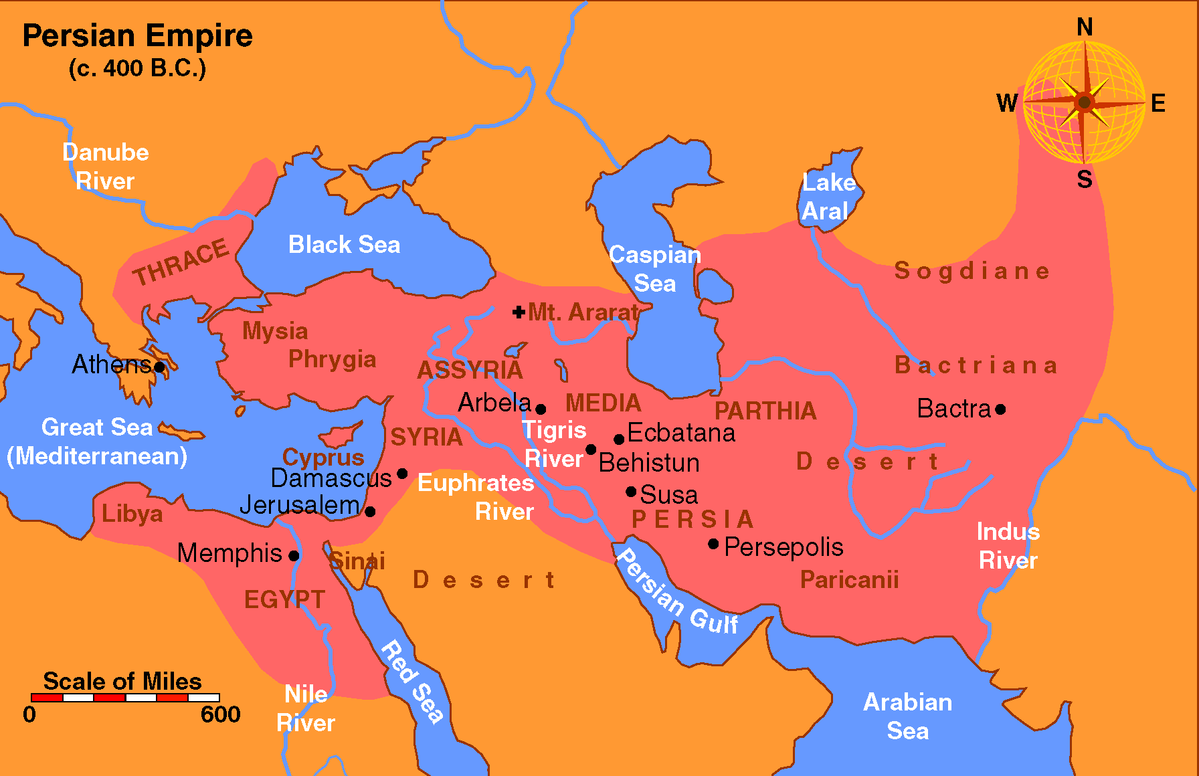

Slide 5
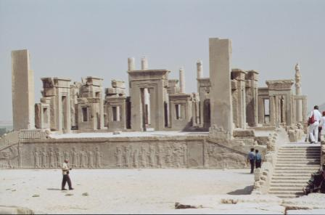
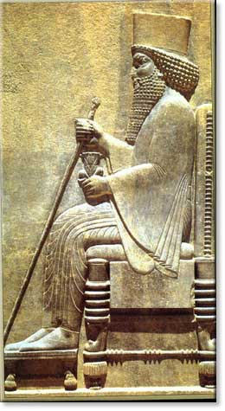

Slide 6
Lessons Learned
From a Heathen Palace
Many are affected by
the actions of one person
3:6 – All Jews suffer because of Mordecai’s refusal
4:5-9 – All Jews spared by Mordecai’s informing…
4:16 – All Jews spared by Esther’s request to king
Whole family suffers because of one member
Whole church has trouble because of one person
Whole family, workplace influence with gospel because of you!

Slide 7
Lessons Learned
From a Heathen Palace
Rash decisions (without knowledge or
wisdom) are often foolish
3:6 – Haman made a rash decision
3:10-15 – Ahasuerus made a rash decision
Ecc. 5:2 – don’t be rash or hasty
Prov. 15:28 – study to answer
Sudden, quick decisions about: career, move, school, marriage, etc. may prove to be trouble!
Contrast of Esther’s decision (4:10-17)

Slide 8
Lessons Learned
From a Heathen Palace
Faith that really trusts God
“I know God knows what he is doing – even
though I don’t know HOW he’s doing it.”
4:14 – Mordecai believes God will spare – but doesn’t really know HOW!
4:14 – He believes in providence! – “This just may be how God plans to….”
Job 19:25 – Job holds on for dear life….
Today: Trust that God knows what he is doing – He will do what is best – though I can’t see it now!

Slide 9
Lessons Learned
From a Heathen Palace
God’s people cannot remain silent
when the cry is needed!
4:14 – Remaining silent has serious consequences
4:14 – True that one person is not indispensible – but sure can make a difference
2 Kings 7:9 time we can’t remain silent
Can’t remain silent with the gospel – saves (Rom. 1:16)
Can’t be silent about sin (i.e. 1 Cor. 5:1-ff)

Slide 10
Lessons Learned
From a Heathen Palace
Danger in quick success & sudden advancement
3:1-ff – Haman sudden advanced in power
3:6 – seems to lose all reason and sense
Prov. 30:8-9 – sudden wealth poses temptation
Deut. 6:10-12 – sudden prosperity poses temptation

Slide 11
Lessons Learned
From a Heathen Palace
How far anger & revenge may go
3:5 – Haman was mad – real angry
3:6 – Anger brews to the point of revenge – kill one man and all his nation!
Anger can lead to hatred & harsh words (Col. 3:8)
Anger can get out of hand (Eph. 4:26)
Anger: destroy friendships, family, & a church

Slide 12
Lessons Learned
From a Heathen Palace
Lies will be told on you
Stretching the truth is a lie
3:8 – Haman lied about good people
3:8 – Took a true premise and stretched it!
Lies will be told on you, the Lord’s church, etc.
Bad things happen to good people
Stretching the truth – leave a different impression is dishonest (cf. 1 Cor. 13:7)

Slide 13
Lessons Learned
From a Heathen Palace
God uses people as
instruments of his purpose
4:14 – Mordecai thought it maybe that God would use Esther to accomplish great deliverance
She became the “instrument” of God’s purpose!
You may be the “instrument” God uses to:
  Save your neighbor, friend (Mark 16:15-16)
  Salvage the family
  Make necessary changes in a congregation (Ph. 4:2)

Slide 14
Lessons Learned
From a Heathen Palace
Use & Abuse of Power / Authority
(Power in bad hands – vs – power in good hands)
3:1,10 – Haman given power – abused it to serve self
4:14-17 – Esther has some power (influence) – uses it for the cause of right
Today many in authority (nation, home, church) self serving
Any power, authority, influence – used for the cause of right

Slide 15
Lessons Learned
From a Heathen Palace
Millions are destined to be destroyed.
What can & what will we do?
4:8-17 – Mordecai thought “we can help!”
4:10-17- Esther hesitated, but then agreed to help
Today – millions are doomed – what will we do?

Slide 16
“We cannot help but see a modern spiritual application of these chapters. Satan is the destroyer, and millions of people are going to hell unless somebody rescues them. Some Christians are like the king – eating and drinking and enjoying life, unconcerned about the danger. Others, like Mordecai, are deeply concerned to save the condemned people. There are the Esthers too who sacrifice themselves to intercede on behalf of the lost. Which are you?”
Warren Wiersebe, 404

Slide 17
Lessons Learned
From a Heathen Palace
Serious about prayer
4:16 – prayer is implied
Esther believed in the POWER of prayer.
Esther was SERIOUS about praying – Fervently!
Luke 18:1, 8 – Do we have faith in prayer?
Jas. 5:16 – are you fervent, serious about praying?

Slide 18
Lessons Learned
From a Heathen Palace
Courage to do right
4:16 – Esther was afraid - didn’t know if she would die or not – but had to courage to go to the king anyway
Courage = being scared to death – saddling up anyway
Takes courage to live godly in ungodly world
Takes courage to talk to another about the gospel
Take courage to rebuke a brother or sister
Takes courage to stand alone

Slide 19
Many are affected by
the actions of one person
Rash decisions (without knowledge or
wisdom) are often foolish
Serious about prayer
Faith that really trusts God
“I know God knows what he is doing – even
though I don’t know HOW he’s doing it.”
Courage to do right
God’s people cannot remain silent
when the cry is needed!
Danger in quick success & sudden advancement
How far anger & revenge may go
Lies will be told on you
Stretching the truth is a lie
God uses people as
instruments of his purpose
Use & Abuse of Power / Authority
(Power in bad hands – vs – power in good hands)
Millions are destined to be destroyed.
What can & what will we do?

