Slide 1
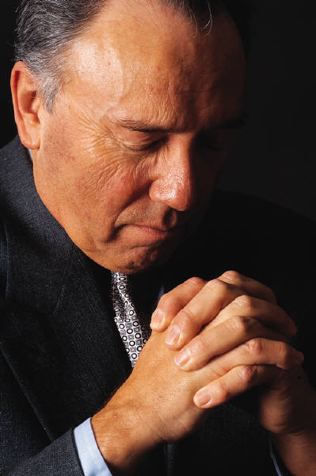
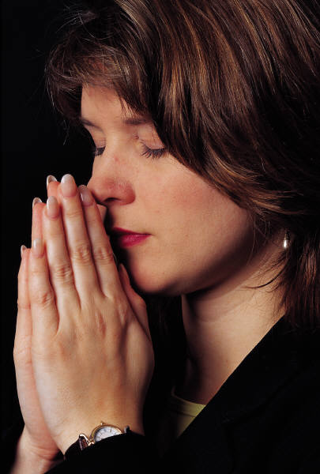
Pray Without
Ceasing
I. The Time For Prayer
II. The Place For Prayer
III. The Reasons For Prayer
IV. The Manner Of Prayer
V. The Content Of Prayer
VI. The Power Of Prayer

Slide 2
Prayers Can Be Hindered
1 Peter 3:7
Husbands, likewise, dwell with them with understanding, giving honor to the wife, as to the weaker vessel, and as being heirs together of the grace of life, that your prayers may not be hindered.
Hinder The
Actual Prayer
Hinder Prayer
From Being
Heard

Slide 3
Satan Hinders Prayers
of God’s People
Unforgiving Spirit

Slide 4
Unforgiving Spirit
Jesus said we must forgive to be forgiven
  Matt. 6:14-15 – if don’t forgive – neither will Father
  Thus, if we pray for forgiveness (Matt. 6:12) – our request is hindered
Parable of unforgiving servant (Matt. 18:21-35)
  One who does not forgive – punished
  Conclusion (v. 35)
How far should we go in forgiving? (Luke 17:1-4)
  If the sin occurred 7 times in a day
  If one comes saying, “I repent”

Slide 5
Satan Hinders Prayers
of God’s People
Unforgiving Spirit
Wandering Attention

Slide 6
Wandering Attention
Easy to let mind wander
  How often have we been praying – one thought leads to another – then another…
  Suddenly realize – not even thinking about praying
Prayer is active – not passive
  It is something you DO – not something done FOR US or TO US
  All worship must be in spirit (John 4:24)
  Must watch unto prayer (1 Pet. 4:7)
A fervent prayer – is one of concentration (Jas. 5:16)

Slide 7
Satan Hinders Prayers
of God’s People
Unforgiving Spirit
Wandering Attention
Continuing in Sin

Slide 8
Continuing in Sin
God does not hear those who continue in sin
  Isa. 59:1-2
  Prov. 28:9
  1 Pet. 3:12
  John 9:31

Slide 9
Continuing in Sin
God does not hear those who continue in sin
Some Christians continue in sin and continue to pray
  Ungodly attitudes
  Forsaking the assembling
  Drink
  Dress inappropriately
  Live in adultery
  Apathy & indifference
  Lust & Lewdness

Slide 10
Continuing in Sin
God does not hear those who continue in sin
Some Christians continue in sin and continue to pray
Prayer is no substitute for righteous living
  Sin hinders prayer (1 Pet. 3:7)
  Prayers are heard because we are righteous (1 John 3:22)
  “To pray while living in wrong-doing is to spread the sail while leaving the anchor unlifted”
This should serve as motive for living right

Slide 11
Satan Hinders Prayers
of God’s People
Unforgiving Spirit
Wandering Attention
Continuing in Sin
Lack of Spiritual Interest

Slide 12
Lack of Spiritual Interest
Lack of spiritual interest is common
  Other matters (sports, jobs, houses, fashion, entertainment, hobbies, etc.) occupies most of time
  Spend little time – praying, reading Bible – thinking about spiritual matters.
  Spiritual matters are just not on their mind that often.

Slide 13
Lack of Spiritual Interest
Lack of spiritual interest is common
The problem:
  Mind the things of the flesh (Rom. 8:1-8)
  Choked with cares & pleasures of world (Luke 8:14)
  Love the present world (2 Tim. 4:10)
Such a one – not as likely to pray “without ceasing” (1 Thess. 5:17)

Slide 14
Satan Hinders Prayers
of God’s People
Unforgiving Spirit
Wandering Attention
Continuing in Sin
Lack of Spiritual Interest
Ask Amiss

Slide 15
Ask Amiss
Possible to ask with wrong motive
  Jas. 4:3 – Ask amiss – “wrong motives” (NIV) – “ask wrongly” (ESV) / Context: that may spend on pleasures
  Ask for material – to satisfy our greed or lust
  Ask for ability – to inflate or satisfy pride
  Ask for opportunities – to receive praise
  Ask for blessings – to get my way

Slide 16
Ask Amiss
Possible to ask with wrong motive
Prayer should be offered - Selflessly
  Not as a promotion of self
  Not to satisfy own pleasures
  For others & the cause of Christ (i.e. Prayer of Jesus)
    Prayed for disciples (John 17)
    Prayed for Peter (Luke 22)

Slide 17
Ask Amiss
Possible to ask with wrong motive
Prayer should be offered – Selflessly
Must examine our motives as we pray (2 Cor. 13:5)
  What is my real reason for praying?
  Am I really asking for selfish reasons?
  Am I focused more on material than spiritual?
  Am I thinking of how I will benefit more than how affect others or the cause of the Lord?

Slide 18
Satan Hinders Prayers
of God’s People
Unforgiving Spirit
Wandering Attention
Continuing in Sin
Lack of Spiritual Interest
Ask Amiss
Self-Righteousness

Slide 19
Self-Righteousness
The Pharisee was self-righteous (Luke 18:9-14)
  Thought he was superior to others
  Thankful to God for self – and how good he was
Easily become spiritually proud
  Think we are stronger than we are (1 Cor. 10:12)
  Think we are something (Gal. 6:3)
  Feel we are better than others – have the corner on deep piety

Slide 20
Satan Hinders Prayers
of God’s People
Unforgiving Spirit
Wandering Attention
Continuing in Sin
Lack of Spiritual Interest
Ask Amiss
Self-Righteousness
Marital Discord

Slide 21
Marital Discord
Lack of respect for mate – hinders prayer (1 Pet. 3:7)
  Merely fail to give proper honor
  Doesn’t have to commit adultery, divorce or abuse her…
Context of 1 Peter 3:7
  Wife being submissive to his leadership (vv. 1-6)
  Dwelling with wife with understanding (v. 7)
  Honoring his wife (v. 7)
  Treating her as an equal (v. 7)

Slide 22
Marital Discord
Lack of respect for mate – hinders prayer (1 Pet. 3:7)
Context of 1 Peter 3:7
Could your marriage be hindering your prayers?
  By not loving mate as should (Eph. 5:25-33)
  By not fulfilling responsibilities (Tit. 2:5; 1 Tim. 5:8)
  By bickering, fighting (1 Cor. 13:1-7)
  By not living within roles (Eph. 5:25-33)

Slide 23
Satan Hinders Prayers
of God’s People
Unforgiving Spirit
Wandering Attention
Continuing in Sin
Lack of Spiritual Interest
Ask Amiss
Self-Righteousness
Marital Discord

