Slide 1
“Pray without ceasing”
(1 Thess. 5:17)
“What Paul means is: there must be no decline in the regularity of the habit of ‘taking hold of God’ in the midst of all circumstances of life.”
(William Hendriksen)

Slide 2
Barnes:
(1) That we are to be regular and constant in the observance of the stated seasons of prayer. We are to observe the duty of prayer in the closet, in the family, and in the assembly convened to call on the name of the Lord. We are not to allow this duty to be interrupted or intermitted by any trifling cause. We are so to act that it may be said we pray regularly in the closet, in the family, and at the usual seasons when the church prays to which we belong

Slide 3
(2) We are to maintain an uninterrupted and constant spirit of prayer. We are to be in such a frame of mind as to be ready to pray publicly if requested; and when alone, to improve any moment of leisure which we may have when we feel ourselves strongly inclined to pray. That Christian is in a bad state of mind who has suffered himself, by attention to worldly cares, or by light conversation, or by gaiety and vanity, or by reading an improper book, or by eating or drinking too much, or by late hours at night among the thoughtless and the vain, to be brought into such a condition that he cannot engage in prayer with proper feelings. There has been evil done to the soul if it is not prepared for communion with God at all times, and if it would not find pleasure in approaching his holy throne.

Slide 4
'Pray [adialeiptoos (NT:89)] without intermission:' not allowing prayerless gaps to intervene between the times of prayer.
(Jamieson, Fausset, and Brown)

Slide 5
Pray On Regular Basis
Col. 1:3 – “always praying for you”
Eph. 6:18 – “praying always with all prayer…”
Luke 18:1 – “men always ought to pray…”
1 Thess. 3:10 – “night and day praying…”
Should Be:
A Praying People

Slide 6

Prayer Defined (Rom. 10:1)
Heart’s
Desire &
Longings
God
Expressed
Taking my thoughts - talking to God about them
Taking my concerns - telling them to God
Taking my hopes, wishes - asking God for them
Taking my problems - asking for God’s help

Slide 7
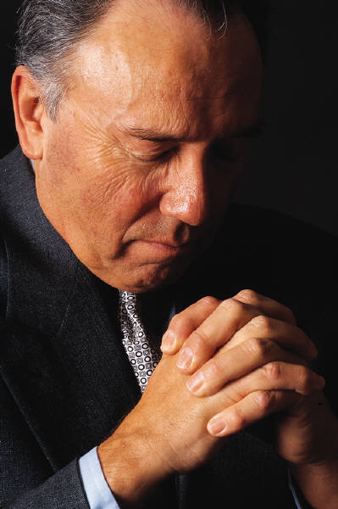
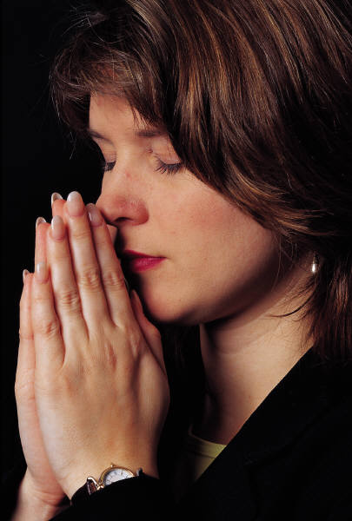
Pray
Without
Ceasing
1 Thess. 5:17

Slide 8
Pray Without
Ceasing
I. The Time For Prayer

Slide 9
Time for Prayer
Regular time to pray
  Psa. 55:17
  Dan. 6:10
  Daily
Make & schedule time
  Mark 1:35
  Luke 6:12
Anytime
  Day or night
  24 / 7 / 365

Slide 10
Pray Without
Ceasing
I. The Time For Prayer
II. The Place For Prayer

Slide 11
Place for Prayer
Place does not matter
  John 4:20-24
  No “holy” place to pray
Quiet – Solitary place
  Mark 1:35
  Luke 6:12
  Luke 22:39
Prayer important enough
  Lose some sleep
  Leave one place go to another

Slide 12
Pray Without
Ceasing
I. The Time For Prayer
II. The Place For Prayer
III. The Reasons For Prayer

Slide 13
Reasons for Prayer
Commanded
  1 Thess. 5:17
Praise God
  Matt. 6:9-13; Acts 2:42
To Grow
  Col. 1:9
To Gain Help
  Heb. 4:16
  1 Pet. 5:7
It works
  Jas. 5:16

Slide 14
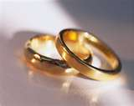
Prayer Affects the Marriage
How one treats their mate may hinder their prayers (1 Pet. 3:7)
Prayer is only valid reason to deprive / separate from mate (1 Cor. 7:5)

Slide 15
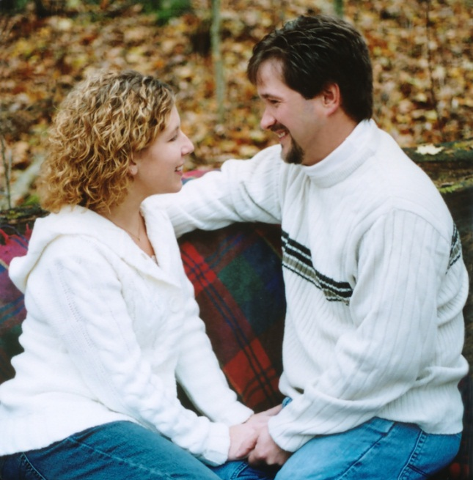
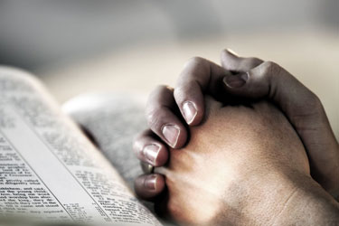
Affects
Prayer
Marriage
Affects

Slide 16
Pray Without
Ceasing
I. The Time For Prayer
II. The Place For Prayer
III. The Reasons For Prayer
IV. The Manner Of Prayer

Slide 17
Manner of Prayer
In spirit
  John 4:24 (cf. Rom. 2:28-29)
Fervent
  Jas. 5:16
  Earnest, striving, zealous
  Take it serious! (Lk. 22:44)
Not a ritual / recitation
  Matt. 6:5-13

Slide 18
Pray Without
Ceasing
I. The Time For Prayer
II. The Place For Prayer
III. The Reasons For Prayer
IV. The Manner Of Prayer
V. The Content Of Prayer

Slide 19
Content of Prayer
Specific things
  Luke 11:11-12
  Jas. 5:17-18
  Specific people (Lk. 22:32)
Elements – 1 Tim. 2:1
  Supplication (need / entreaty)
  Prayer (request for good)
  Intercession (plea for others)
  Thanks
Can vary
  Long (Lk. 6:12) Short (Mt 26)

Slide 20
Pray Without
Ceasing
I. The Time For Prayer
II. The Place For Prayer
III. The Reasons For Prayer
IV. The Manner Of Prayer
V. The Content Of Prayer
VI. The Power Of Prayer

Slide 21
Power of Prayer
What can do through prayer

Slide 22
What Can Do Through Prayer
Talk to the Almighty God (Matt. 6:9-13)
Change the weather (Jas. 5:16-18)
Heal the sick (Jas. 5:16-18)
Obtain forgiveness (Acts 8:22)
Spare a nation (Esther 4:16)
If prayer is powerful enough to do this --
it is powerful enough to accomplish what I need!

Slide 23
Power of Prayer
What can do through prayer
Prayer has power

Slide 24
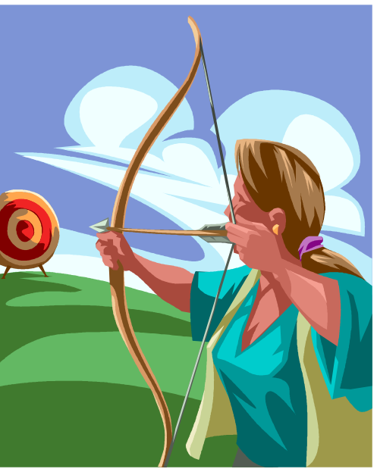
James 5:16-18
16 Confess your trespasses to one another, and pray for one another, that you may be healed. The effective, fervent prayer of a righteous man avails much.
17 Elijah was a man with a nature like ours, and he prayed earnestly that it would not rain; and it did not rain on the land for three years and six months.
18 And he prayed again, and the heaven gave rain, and the earth produced its fruit.

Slide 25
Every Prayer Receives An Answer
1 Peter 3:12
12 For the eyes of the LORD are on the righteous, And His ears are open to their prayers; But the face of the LORD is against those who do evil.
Yes
No
Wait

Slide 26
Power of Prayer
What can do through prayer
Prayer has power
Providence

Slide 27
Providence
“The working of God through His provision in the natural and spiritual realms, and yet it is a control that violates neither the sovereignty of the human will nor the divine natural and spiritual laws.” (H. Hailey)
“Providence” (Acts 24:2) comes from pronoia which means “forethought” (Vines). – God used forethought in creating a universe that he could control and use for his purpose.
See the word “provide” in “providence”
Providence is the non-miraculous use of natural law and circumstance to accomplish his purpose.

Slide 28
Providence
“It is the divine intervention in the affairs of men within the confines of natural law” (Winston Atkinson, Anchor Magazine)
Simply stated: God working through natural means

Slide 29
Providence –vs- MIracles
Providence
Birth of Child
Samuel
(1 Sam. 1:10-20)
Weather Change
Rain
(Jas. 5:16-17)
Miracle
Birth of Child
Jesus
(Matt. 1:23)
Weather Change
Calm Storm
(Matt. 8:26)
Natural Means
Supernatural Means

Slide 30
God is in Control
God is involved in the operation of the universe now
  Neh. 9:6-8 – Preserves the world he made
  Dan. 4:25 – Still rules in the kingdoms of men
  Rev. 4 – Still on his throne.

Slide 31
God is in Control
God is involved in the operation of the universe now
God is concerned for man
  Matt. 6:25-32 – cares for grass & us too.
  Matt. 10:29-31- notices every sparrow that falls

Slide 32
God is in Control
God is involved in the operation of the universe now
God is concerned for man
God’s will can be altered
  Doesn’t mean – change his law or revelation
  God has changed his mind
    Abraham’s plea for Sodom (Gen. 18:23-ff)
    Moses’ plea for Israel (Exo. 32:9-14)
    Jonah’s plea for Nineveh (Jonah 3)

Slide 33
How God Answers
God answers without violating human will
  Man is still a free moral agent (Rom. 6)
  Man still has freedom of choice
  Example: my prayer for someone to obey – will not violate their will.

Slide 34

How God Answers
God answers without violating human will
God answers without violating natural laws
  To do otherwise – miracle!
  God can operate within natural law and still be in the driver’s seat

Slide 35
WE Don’t know
Two specific cases:
  Esther 4:14 – “who knows…”
  Philemon 15 – “perhaps”
Need to be careful
  Know God’s providence is at work & answers
  Don’t know about specific cases

Slide 36
Pray Without
Ceasing
I. The Time For Prayer
II. The Place For Prayer
III. The Reasons For Prayer
IV. The Manner Of Prayer
V. The Content Of Prayer
VI. The Power Of Prayer

