Slide 1
Matthew 25 records two parables
that encourage us to watch and be ready
Parable of the Virgins (vv. 1-13)
Parable of the Talents (vv. 14-30)
Point: Watch & Be Ready
24:42-44
25:13

Slide 2
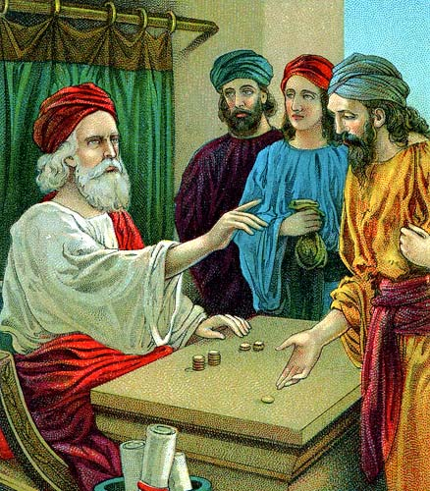
The
Parable
of the
Talents
Giving of the Talents
(vv. 14-15)
Management of the Talents
(vv. 16-18)
Reckoning of the Talents
(vv. 19-30)
(Matt. 25:14-30)

Slide 3
One Talent Man Failed - Saying, “I was afraid”
Matthew 25:24–25
²⁴ “Then he who had received the one talent came and said, ‘Lord, I knew you to be a hard man, reaping where you have not sown, and gathering where you have not scattered seed.
²⁵ And I was afraid, and went and hid your talent in the ground. Look, there you have what is yours.’

Slide 4
One Talent Man Failed - Saying, “I was afraid”
Knew what was expected (vv. 24, 26)
Opted for the “safe” course – didn’t risk anything (v. 18)
Claim of innocence – didn’t lose or steal the talent (v. 25)
Shifted the blame to his master – reasoned master asked too much (v. 24)
Opposite of five and two talent men
  Not afraid
  Did what was expected
  Active
  Did more than not steal or lose
Being afraid is opposite of courage (Josh 1:9)

Slide 5
One Talent Man Failed - Saying, “I was afraid”
Lesson:
God will judge not merely for doing wrong, but for NOT doing right!
Point:
When giving an account
said, “I was afraid”
to do what he knew he should do

Slide 6
“I Was Afraid”
Matthew 25:25

Slide 7
“I Was Afraid”
The Reasons Why
The Risks Taken
The Excuse Offered

Slide 8
“I Was Afraid”
The Reasons Why

Slide 9
The Reasons Why
Some Are Afraid
  Mistaken view of God (v. 24)
    Master demands too much – unfair
    Had little or no faith in master’s fairness / goodness
  No confidence in self (v. 25)
    Though his master did have confidence in him
    Thought he would fail
  Lacking in faith (Mark 5:36)
  Take focus off Lord – turn to dangers (Matt. 14:30)
  Function on misinformation (Neh. 6:13-14)
  Think something bad is going to happen (Job. 6:21)

Slide 10
The Reasons Why
Some Are Afraid
We Should Not Be Afraid
  Lord expects it of you (Matt. 25:24, 26-27)
  Lord is with you (Josh 1:9; 2 Chron. 20:15; Neh. 4:14; Jer. 1:8)
  Promises of God (Josh 8:1; Psa. 56:3,11)
  Can be prepared (Prov. 31:21)
  You have the ability (Matt. 25:18, 27; Phil. 4:13)

Slide 11
“I Was Afraid”
The Reasons Why
The Risks Taken

Slide 12
The Risks Taken
Some Risks in Doing What is Expected
  It was with all three given talents
  Any command involves risks (i.e. Moses - Exo. 4:1)
    Be baptized – may not remain
    Lord’s supper – may not observe in right manner
    Teach neighbor – may not accept it
    Lead – others may not follow
    Stand – may lose friends
    Say “No” – may be rejected

Slide 13
The Risks Taken
Some Risks in Doing What is Expected
Greater Risk in Failing to Act (cf. Jas. 4:17)

Slide 14
“I Was Afraid”
The Reasons Why
The Risks Taken
The Excuse Offered

Slide 15
The Excuse Offered
“I was afraid”
Was the excuse offered by the one talent man
It may be the excuse we offer at the judgment

Slide 16
Lord Asks:
“Why did you not obey the gospel? Why didn’t you become a Christian?”
Obeying gospel is not that hard (Rom. 10:4-10)
Salvation is offered to one & all (Rom. 10:11-17)
“I was Afraid”
“…couldn’t hold out and be faithful”
“…family turn against me”
“…would miss the life I have been living”
“…friends would ridicule me”

Slide 17
Lord Asks:
“Why did you not talk to you friends about the gospel? Why did you not teach them?”
Told to take the gospel to the world (Mk 16:15)
The taught should teach others (2 Tim. 2:2)
“I was Afraid”
“…they would not listen”
“…if I talked about religion, destroy our relationship”
“…they would ask questions I could not answer”
“…I couldn’t do a good job”

Slide 18
Lord Asks:
“Why did you not discipline your child? Why didn’t you correct their misbehavior?”
The rod will drive away misbehavior (Prov. 22:15)
Chastening will created respect (Heb. 12:9)
“I was Afraid”
“…it might destroy his spirit / will”
“…child might turn against me”
“…I would not be the fun parent”
“…make the child mad”

Slide 19
Lord Asks:
“Why did you not set your foot down – tell you teenager ‘No’? Why did you let your teen rule the house?”
Children not restrained become a grief (1 Sam. 3:13; 2:12-ff)
Parental authority must be respected (Eph. 6:1-4)
“I was Afraid”
“…he/she might rebel”
“…I would be viewed as being harsh”
“…not to let them do what others are doing”
“…would be thought of a odd or silly”
“…create friction with my mate”

Slide 20
Lord Asks:
“Why could you not be the leader to your wife?
Why didn’t you tell her ‘No’ ?”
Husband is to be a leader (Eph. 5:23-ff)
Husband bears responsibility (1 Pet. 3:7)
“I was Afraid”
“…she might leave me”
“…might start an argument”
“…make her mad – resent me”
“…she would think I didn’t love or trust her”

Slide 21
Lord Asks:
“Why did you not forgive the one that repented and begged for forgiveness?”
Lord forgives us as we forgive others (Mt. 18:35)
Command to forgive – even when hard (Lk 17:3ff)
“I was Afraid”
“…might think I didn’t take the sin serious”
“…might do the same thing again”
“…I could not turn loose and let it go”

Slide 22
Lord Asks:
“Why did you not withdraw yourself from those who walk disorderly?”
There is action taken by the church (1 Cor. 5:6)
There is action taken by individual (1 Cor. 5:9-11)
“I was Afraid”
“…might lose my relationship with them”
“…might cause a split in family”
“…never have same relationship with children and grandchildren”
“…lose a friend / family member”

Slide 23
“I Was Afraid”
The Reasons Why
The Risks Taken
The Excuse Offered

