Slide 1
Christians Struggle with
Bad Attitudes
Evidence: Everyone of us have had a bad attitude toward someone – sometime!
Every Christian has an “attitude” toward others
  May be good & right
  May be bad & wrong
Attitudes form the basis on how we treat them
  Matt. 15:19 – actions - from the heart

Slide 2
The Christian’s Struggle With Bad Attitudes
Who
Why
What
How

Slide 3
The Christian’s Struggle With Bad Attitudes
I. Who – Bears Responsibility

Slide 4
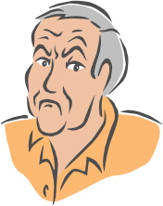
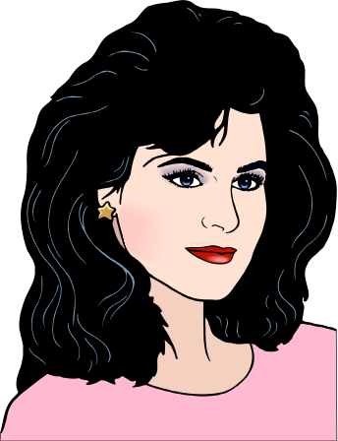
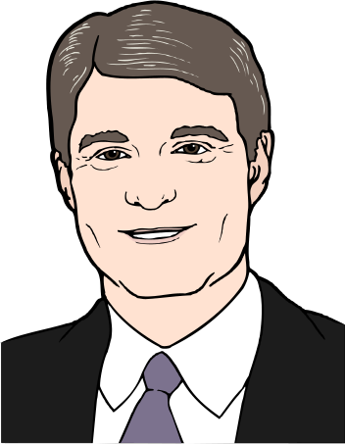
I. Who – Bears Responsibility
Common Problem:
Often think that others should have the right attitude toward us,
but do little thinking about whether we have the right attitude toward others

Slide 5
I. Who – Bears Responsibility
Rom 12:18
“If it is possible, as much as depends on you, live peaceably with all men.”
A. Do your part
1. Work hard toward a good relationship
2. Try – requires effort on your part
3. Make sure that no one can blame you
4. Required by any passage on relationships
5. May require a change in attitude

Slide 6
I. Who – Bears Responsibility
Rom 12:18
“If it is possible, as much as depends on you, live peaceably with all men.”
A. Do your part
B. Even if others don’t
1. Not say “as much as depends on them”
2. You are to see “if it is possible” to get along
3. We must take the “high road”

Slide 7
The Christian’s Struggle With Bad Attitudes
I. Who – Bears Responsibility
II. Why – Dangers Involved

Slide 8
II. Why – Dangers Involved
To be right
Treat others right – so we will be right
Not because they are “right”

Slide 9
II. Why – Dangers Involved
To be right
One sin breeds another
Sin has tendency to compound (2 Tim. 3:13)
Col. 3:5-9 – sins listed have breeding effect

Slide 10
Col. 3:5-9
Desire Uncleanness Fornication
Anger Wrath Malice Blasphemy

Slide 11
II. Why – Dangers Involved
To be right
One sin breeds another
Sin has tendency to compound (2 Tim. 3:13)
Col. 3:5-9 – sins listed have breeding effect
Attitude leads to action:

Slide 12

Attitude Leads To Action
Action
Attitude
Produces
Evil comes from heart (Matt. 15:19)
Lust leads to adultery (Matt. 5:28)
Hate leads to murder (1 Jn. 3:15)

Slide 13
II. Why – Dangers Involved
To be right
One sin breeds another
Attitudes can be sinful

Slide 14
Rom. 1:26-32
“Terribly Sinful”
Attitude
Homosexuality (vv. 26-27)
Sexual immorality (v. 29)
Murder (v. 29)
Haters of God (v. 30)
Covetousness (v. 29)
Maliciousness (v. 29)
Envy (v. 29)
Proud (v. 30)
Boasters (v. 30)
Undiscerning (v. 31)
Untrustworthy (v. 31)
Unloving (v. 31)
Unforgiving (v. 31)
Unmerciful (v. 31)

Slide 15
2 Cor. 12:20-21
“Terribly Sinful”
Attitude
Uncleanness (v. 21)
Fornication (v. 21)
Lewdness (v. 21)
Jealousies (v. 20)
Selfish ambitions (v. 20)
Conceit (v. 20)

Slide 16
Gal. 5:19-21
“Terribly Sinful”
Attitude
Adultery (v. 19)
Fornication (v. 19)
Lewdness (v. 19)
Idolatry (v. 20)
Murders (v. 21)
Drunkenness (v. 21)
Hatred (v. 20)
Jealousies (v. 20)
Selfish ambitions (v. 20)
Envy (v. 21)

Slide 17
2 Tim. 3:1-5
“Terribly Sinful”
Attitude
Blasphemers (v. 2)
Slanderers (v. 3)
Brutal (v. 3)
Love pleasure – not God (v.4)
Boasters (v. 2)
Proud (v. 2)
Unthankful (v. 2)
Unloving (v. 3)
Unforgiving (v. 3)
Headstrong (v. 4)
Haughty (v. 4)

Slide 18
II. Why – Dangers Involved
To be right
One sin breeds another
Attitudes can be sinful
Could deceive self – thinking I’m taking a strong stand
2 Cor. 2:11 – Seems like really taking a stand – while others are being “soft, tolerant” about it
May be that “my stand” is a tool of Satan
Example: Disagree with judgment – treat as sin!

Slide 19
II. Why – Dangers Involved
To be right
One sin breeds another
Attitudes can be sinful
Could deceive self – thinking I’m taking a strong stand
Could “hate” others – not realize it
Hate = lack of love (not despise)
a. 1 Jno. 3:15
b. Compare: Matt. 10:37 with Luke 14:26-27
2. If have a bad attitude – could “hate” others!

Slide 20
II. Why – Dangers Involved
To be right
One sin breeds another
Attitudes can be sinful
Could deceive self – thinking I’m taking a strong stand
Could “hate” others – not realize it
Could lose my soul!
Gal. 5:19-21 – Attitude can cause one to be lost
2 Cor. 12:20 – Some will lose their soul over attitude

Slide 21
The Christian’s Struggle With Bad Attitudes
I. Who – Bears Responsibility
II. Why – Dangers Involved
III. What – Attitudes to Overcome

Slide 22
III. What – Attitudes to Overcome
Pride / Arrogance
Expressed in several ways:
  “Holier than thou”
  Look down at other – inferior (Money, Social standing, Education, Nationality, etc. )
Matt.18:1-5
Rom. 12:3, 16
Phil. 2:1-4
Eph. 4: 2

Slide 23
III. What – Attitudes to Overcome
Pride / Arrogance
Hate / Disdain
Means
  Despise – have disgust for the person(s)
  Lacking in love (cf. 1 Jno. 3:15)
Matt. 5:21-26 – no place for it in kingdom

Slide 24
III. What – Attitudes to Overcome
Pride / Arrogance
Hate / Disdain
Bitterness
Means
  Closely kin to “hatred”
  Opposed to love (Col. 3:19)
Luke 15:25-ff – elder son was bitter

Slide 25
III. What – Attitudes to Overcome
Pride / Arrogance
Hate / Disdain
Bitterness
Unconcerned / Uncaring
Not really concerned / care about others: their feelings, their needs, their situation….
Rom. 12:15
Matt. 7:12

Slide 26
The Golden Rule
Matt. 7:12
Golden Rule Says: Treat others way you want to be treated
Means: “…we are as much obliged to them as they are to us” - Matthew Henry
Forces Us To Think About:
  Way I want to be treated
  Way I treat Others
  Compare the two
  More than how others treat me!

Slide 27
III. What – Attitudes to Overcome
Pride / Arrogance
Hate / Disdain
Bitterness
Unconcerned / Uncaring
Jump to Conclusions
Too often – draw conclusions without evidence
1 Cor. 13:7 – love believes all things

Slide 28
Give The Benefit Of Doubt
1 Cor. 13:7
Put best construction on matters
  “Is ever ready to believe the best of every person, and will credit no evil of any but on the most positive evidence...” A. Clarke
  Prov. 14:15
Don’t jump to conclusions
  All too often we fill in gaps that are not there
  Prov. 18:13
  Prov. 29:20

Slide 29
III. What – Attitudes to Overcome
Pride / Arrogance
Hate / Disdain
Bitterness
Unconcerned / Uncaring
Jump to Conclusions
Impatient
Not willing to “bear with” things we don’t like in others
Eph. 4:2 - longsuffering

Slide 30
Longsuffering
Eph. 4:2
Literally: Suffer Long
Patient - exercise restraint.
Suggest - Collision of opinions, differing

Slide 31
“No virtue, perhaps, is more frequently demanded in our intercourse with others. We do not go far with any fellow traveler on the journey of life before we find there is great occasion for its exercise. He has a temperament different from our own.”
- Barnes

Slide 32
“He has his own plans and purposes of life, and his own way and time of doing things. He may be naturally irritable, or he may have been so trained that his modes of speech and conduct differ much from ours.”
- Barnes

Slide 33
“We must indulge the friend that we love in the little peculiarities of saying and doing things which may be important to him, but which may be of little moment to us.”
- Barnes

Slide 34
Longsuffering
Eph. 4:2
Literally: Suffer Long
Patient - exercise restraint.
Suggest - Collision of opinions, differing
Time for tolerance
“taking whatever comes, putting up with one another in love” - BBE

Slide 35
III. What – Attitudes to Overcome
Pride / Arrogance
Hate / Disdain
Bitterness
Unconcerned / Uncaring
Jump to Conclusions
Impatient
Stubbornness
Refusal to look at self, change, or look for solutions
1 Sa. 15:23 – stubbornness is sin
Luke 18:9-14
Judges 2:19 – do what want

Slide 36
The Christian’s Struggle With Bad Attitudes
I. Who – Bears Responsibility
II. Why – Dangers Involved
III. What – Attitudes to Overcome
IV. How – To Overcome

Slide 37
IV. How – To Overcome
“I Must”
If I don’t – Lose my soul
If I don’t – May get worse
Can’t continue to say, “I just can’t help it…”

Slide 38
IV. How – To Overcome
“I Must”
“I Can”
Not impossible – Not that hard!
The Word is the answer (cf. 2 Tim. 3:1-5, 8, 16-17)

Slide 39



Vv. 1-5 – [The Problem]
V. 8 – [The Reason]
Vv. 16-17 – [The Answer]
Rejected
Return

Slide 40
IV. How – To Overcome
“I Must”
“I Can”
Not impossible – Not that hard!
The Word is the answer (cf. 2 Tim. 3:1-5, 8, 16-17)
Phil. 4:13 – I can do what God expects

Slide 41
IV. How – To Overcome
“I Must”
“I Can”
“I Will”
Not: “I’ll try, but not sure I can.”
Determination says, “I can” (Heb. 6:3)

Slide 42
The Christian’s Struggle With Bad Attitudes
I. Who – Bears Responsibility
II. Why – Dangers Involved
III. What – Attitudes to Overcome
IV. How – To Overcome

