Slide 1
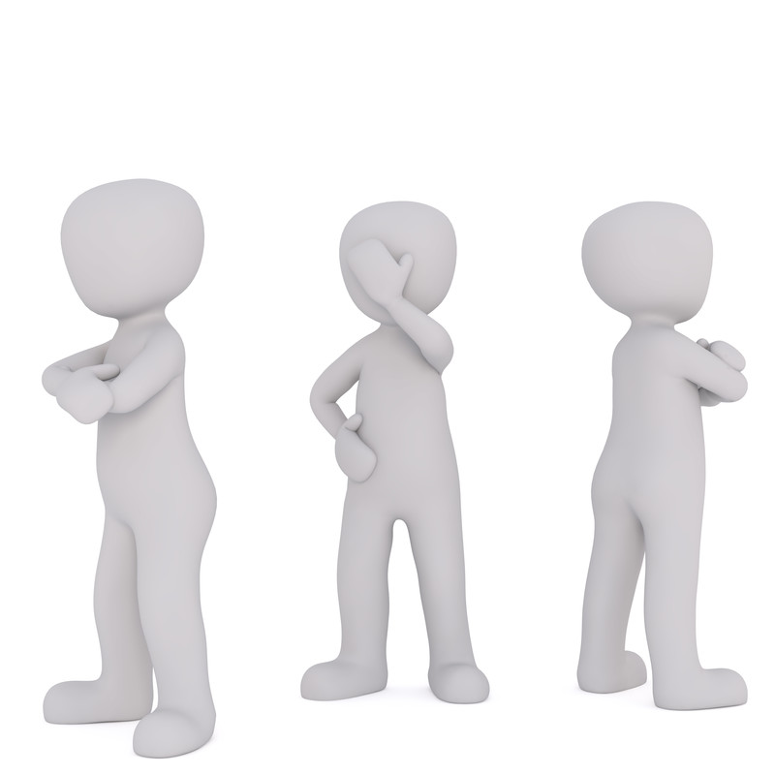
A Common Sin that is Seldom Acknowledged
Bitterness
May Otherwise Be:
Doctrinally Sound
Faithful in attendance
Knowledgeable in the Word
Active in the church

Slide 2
Bible Addresses the Problem of
Bitterness
Ephesians 4:31
“Let all bitterness, wrath, anger, clamor, and evil speaking be put away from you, with all malice.”

Slide 3
Bible Addresses the Problem of
Bitterness
Colossians 3:19
“Husbands, love your wives and do not be bitter toward them.”

Slide 4
Bible Addresses the Problem of
Bitterness
Hebrews 12:15
“looking carefully lest anyone fall short of the grace of God; lest any root of bitterness springing up cause trouble, and by this many become defiled”

Slide 5
Bible Addresses the Problem of
Bitterness
James 3:14
“But if you have bitter envy and self-seeking in your hearts, do not boast and lie against the truth.”

Slide 6
Since the Bible talks about it
I need to learn what it is
and what God says about it
What causes it?
What is the problem with it?
How do I get over it?
Ephesians 4:31
“Let all bitterness, wrath, anger, clamor, and evil speaking be put away from you, with all malice.”
Colossians 3:19
“Husbands, love your wives and do not be bitter toward them.”
Hebrews 12:15
“looking carefully lest anyone fall short of the grace of God; lest any root of bitterness springing up cause trouble, and by this many become defiled”
James 3:14
“But if you have bitter envy and self-seeking in your hearts, do not boast and lie against the truth.”

Slide 7
Bitterness

Slide 8
Bitterness
Its Meaning

Slide 9
Its Meaning
Comes from pikria
  BDAG: “State of being bitter in an affective sense, bitterness, animosity, anger, harshness.” (813)
  Swanson: “bitter resentment”
  Thayer: “Bitter hatred” (Eph.4:31); “bitterness of speech” (Rom. 3:14)
  Barclay: “The Greeks defined this word as long-standing resentment, the spirit which refuses to be reconciled (183)
  TDNT (Kittel): Originally pointed or sharp, i.e. arrows; later to “shrill” of noise, then to bitter or sharp taste.

Slide 10
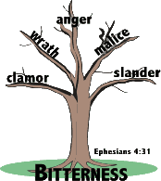
Its Meaning
Comes from pikria
It is hatred
  Animosity & resentment is hatred
  Lack of love = hatred (1 John 3:15)
  Closely related to wrath, malice, anger, etc. (Eph. 4:31)

Slide 11
Bitterness
Its Meaning
Its Causes

Slide 12
Its Causes
Immaturity
  The Corinthians had harsh feelings toward one another – were immature (1 Cor. 3:1-4)
  To love even your enemies is to be “perfect” (complete, mature) (Matt. 5:44-48)
  A person who hasn’t grown and developed spiritually – likely to become bitter

Slide 13
Its Causes
Immaturity
Lacking in Wisdom
  Prov. 10:18
  It is part of wisdom from below (Jas. 3:13-18)
  A person who doesn’t seek or use wisdom – is likely to become bitter

Slide 14
Its Causes
Immaturity
Lacking in Wisdom
Pride
  Simon was poisoned by bitterness (Acts 8:23)
  Translated: “full of bitter jealousy” (NCV)
  Thinking only of self (Envious - very envious)
  By asking for the miraculous gift – shows a desire of recognition!
  When one is filled with pride (thinking only about self) likely to become bitter!

Slide 15
Its Causes
Immaturity
Lacking in Wisdom
Pride
Lacking in Love
  Contrasted of love and being embittered (Col. 3:19)
  Love is the opposite of hate
  One who bitter and resentful – don’t know or practice love!

Slide 16
Its Causes
Immaturity
Lacking in Wisdom
Pride
Lacking in Love
Never Put off the Old Man
  Bitterness is part of the old man (Eph. 4:22-32)
  One who is bitter has kept the old man of sin alive – never put him off! – Living like the world!

Slide 17
Its Causes
Immaturity
Lacking in Wisdom
Pride
Lacking in Love
Never Put off the Old Man
Listen to the Wrong Source of Guidance
  Wisdom from above would not point you toward bitterness (Jas 3:13-18)
  Wisdom from the wrong source – feeds and strokes your anger, resentment, and hatred!
  When you get advice from the world – listen to the wrong people – don’t be surprise if your bitterness doesn’t grow!

Slide 18
Its Causes
Immaturity
Lacking in Wisdom
Pride
Lacking in Love
Never Put off the Old Man
Listen to the Wrong Source of Guidance

Slide 19
Bitterness
Its Meaning
Its Causes
Its Danger

Slide 20
Its Danger
Not Easily Detected
  Pictured as a root (Heb. 12:15; cf. Deut. 29:18)
    Not seen on surface – but see what it feeds
    Bitter plant that grows among the good
  The wrong done to makes one feel justified in harboring resentment – thus don’t see the bitterness
  Possible that the bitter one doesn’t see himself as bitter!

Slide 21
Its Danger
Not Easily Detected
Stirs Turmoil
  Prov. 10:12
  Lead to other sins that are turbulent (Jas. 3:14-16)
  Bitterness can cause us to make trouble out of something that we would tolerate in someone we liked!

Slide 22
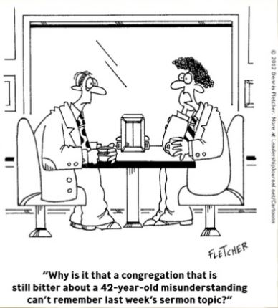

Slide 23
Its Danger
Not Easily Detected
Stirs Turmoil
Causes Us to Say Cutting Words
  Mouth reflects our bitterness (Rom. 3:14; cf. Psa. 10:7)
  Hatred is cruel (Psa. 25:19)
  Words of hatred (Psa. 109:3)
  Our bitterness is what drives the cutting and stinging words we let fly!

Slide 24
Its Danger
Not Easily Detected
Stirs Turmoil
Causes Us to Say Cutting Words
Robs You of Your Happiness
  Bitterness makes you miserable
  Never see a bitter person who is happy
  Prov. 15:17

Slide 25
Its Danger
Not Easily Detected
Stirs Turmoil
Causes Us to Say Cutting Words
Robs You of Your Happiness
Destroys You
  Heb. 12:15
  Becomes your master – it enslaves & controls you
  Not always what you eat that destroys you – it was eats at you!
  R. Nixon: “Others may hate you, but those that hate you don’t win – unless you hate them. And then, you destroy yourself.”

Slide 26
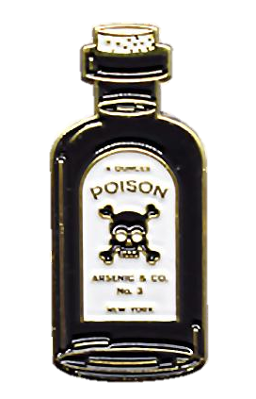
Bitterness is like drinking poison and hoping it will hurt someone else.

Slide 27
Its Danger
Not Easily Detected
Stirs Turmoil
Causes Us to Say Cutting Words
Robs You of Your Happiness
Destroys You

Slide 28
Bitterness
Its Meaning
Its Causes
Its Danger
Its Sinfulness

Slide 29
Its Sinfulness
It is Sinful
  It is of the old man (Eph. 4:31)
  It is of the devil (Jas. 3:14)
  It is hatred (Col. 3:19)

Slide 30
Its Sinfulness
It is Sinful
Commanded to Put it Away
  Old man to be put away (Eph. 4:31)
  Put away hatred by the grace of God (Titus 3:1-7)

Slide 31
Its Sinfulness
It is Sinful
Commanded to Put it Away
Conclusion:
  Can’t please the Lord with bitterness
  Can’t go to heaven with bitterness
  As deep as it runs, and as long as it may last – it can be put away!

Slide 32
Its Sinfulness
It is Sinful
Commanded to Put it Away
Conclusion:

Slide 33
Bitterness
Its Meaning
Its Causes
Its Danger
Its Sinfulness
Its Answer & Cure

Slide 34
Its Answer & Cure
Realize it is Sinful – Thus Must Change
Ephesians 4:31
“Let all bitterness, wrath, anger, clamor, and evil speaking be put away from you, with all malice.”
Colossians 3:19
“Husbands, love your wives and do not be bitter toward them.”
Hebrews 12:15
“looking carefully lest anyone fall short of the grace of God; lest any root of bitterness springing up cause trouble, and by this many become defiled”
James 3:14
“But if you have bitter envy and self-seeking in your hearts, do not boast and lie against the truth.”

Slide 35
Its Answer & Cure
Realize it is Sinful – Thus Must Change
Pray
  For strength to overcome (Phil. 4:13)
  For wisdom (Jas. 1:5)
  For the person for whom you harbor bitterness (Matt. 5:44)

Slide 36
Its Answer & Cure
Realize it is Sinful – Thus Must Change
Pray
Try to Understand the Person You Resent
  Phil. 2:4 – think about the other person
  Matt. 7:12 – treat him the way want to be
  1 Cor. 13:7 – give the benefit of the doubt

Slide 37
Its Answer & Cure
Realize it is Sinful – Thus Must Change
Pray
Try to Understand the Person You Resent
Learn to Love
  Love in commanded & expected (Heb. 13:1)
  Love even our enemies (Matt. 5:44)
  Love will do (1 Cor. 13:1-ff)
  Love can be learned!

Slide 38
Its Answer & Cure
Realize it is Sinful – Thus Must Change
Pray
Try to Understand the Person You Resent
Learn to Love

Slide 39
Bitterness
Its Meaning
Its Causes
Its Danger
Its Sinfulness
Its Answer & Cure

