Slide 1
On any subject, the Bible gives us a balanced view
Balanced view: Harmonize all that is said about the subject
God’s Goodness / Mercy
(Rom. 11:22)
God’s Severity / Wrath
(Rom. 11:22)
Word easy to understand
(Eph. 3:3-5)
Word hard to understand
(2 Pet. 3:16)
Love is kind & gentle
(1 Cor. 13:1-4)
Love is rebukes & chastens
(Rev. 3:19)

Slide 2
Easy to get an imbalanced view
God’s Goodness / Mercy
(Rom. 11:22)
Word easy to understand
(Eph. 3:3-5)
Love is kind & gentle
(1 Cor. 13:1-4)
God’s Severity / Wrath
(Rom. 11:22)
Word hard to understand
(2 Pet. 3:16)
Love is rebukes & chastens
(Rev. 3:19)

Slide 3
Easy to get an imbalanced view
God’s Severity / Wrath
(Rom. 11:22)
Word hard to understand
(2 Pet. 3:16)
Love is rebukes & chastens
(Rev. 3:19)
God’s Goodness / Mercy
(Rom. 11:22)
Word easy to understand
(Eph. 3:3-5)
Love is kind & gentle
(1 Cor. 13:1-4)

Slide 4
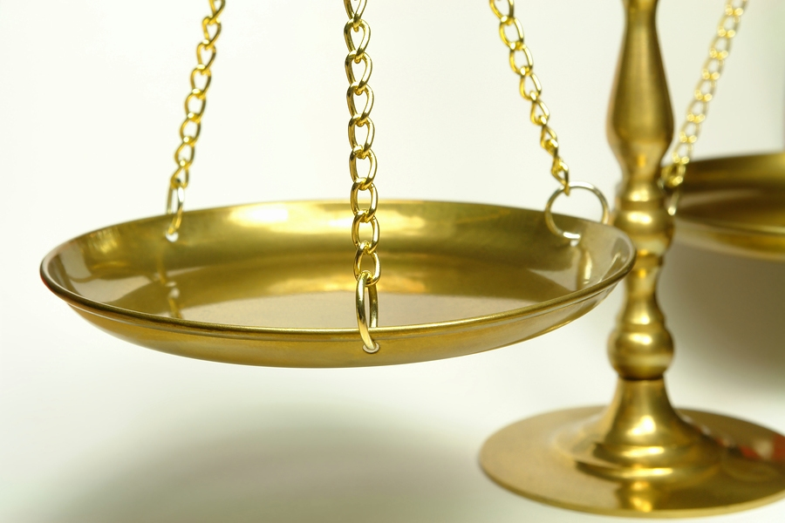
Balanced View
of Sin

Slide 5
Importance of a balanced view of sin
All of us can identify with sin
(Rom. 3:23; 1 John 1:8)
Some have a one-sided view
Focus only on its seriousness
Focus only on its hopefulness

Slide 6
Balanced View of Sin
Negative View: Seriousness

Slide 7
Negative View: Seriousness
Destroys Relation to God
  Stirs the wrath of God (Eph. 5:6; Col. 3:6)
  Separates from God (Isa. 59:1-2; Eph. 2:1; Jas. 1:15)
  Hinders our prayers (1 Pet. 3:7; Heb. 12:1)

Slide 8
Negative View: Seriousness
Destroys Relationship to God

Slide 9
Negative View: Seriousness
Destroys Relation to God
Destroys Hope
  If die in sin can’t go to heaven (John 8:21)
  Eternal separation from God (Rom. 6:23)

Slide 10
Negative View: Seriousness
Destroys Relationship to God
Destroys Hope

Slide 11
Negative View: Seriousness
Destroys Relation to God
Destroys Hope
Destroys Character
  Destroys name & reputation (Prov. 22:1; Ecc. 7:1)
  Brings shame and dishonor (Prov. 6:33)
  Hardens / callouses the heart (Heb. 3:7, 12)

Slide 12
Negative View: Seriousness
Destroys Relationship to God
Destroys Hope
Destroys Character

Slide 13
Negative View: Seriousness
Destroys Relation to God
Destroys Hope
Destroys Character
Destroys Family
  Families often torn apart because of sin (Lk. 12:49-53)
  Families split because of bad decisions (Ezra 10)
  Marriages fail because of sin (Eph. 5; 1 Pet 3)

Slide 14
Negative View: Seriousness
Destroys Relationship to God
Destroys Hope
Destroys Character
Destroys Family

Slide 15
Negative View: Seriousness
Destroys Relation to God
Destroys Hope
Destroys Character
Destroys Family
Destroys Esteem of Self
  Carry the guilt (Psa. 32:1-4; 38:1-8)
  Carry a cloud over head (Psa. 51:4)

Slide 16
Negative View: Seriousness
Destroys Relationship to God
Destroys Hope
Destroys Character
Destroys Family
Destroys Esteem

Slide 17
Negative View: Seriousness
Destroys Relation to God
Destroys Hope
Destroys Character
Destroys Family
Destroys Esteem of Self
Destroys Resistance
  Enslaves (2 Pet. 2:19; Prov. 5:22; Rom. 6)
  Grows (2 Tim. 3:13)
    David (2 Sam. 11-12)
    Achan (Josh 7)
    Peter (Matt. 26:33-75)
    Judas (John 12:6; 18:1-9)

Slide 18
Negative View: Seriousness
Destroys Relationship to God
Destroys Hope
Destroys Character
Destroys Family
Destroys Esteem
Destroys Your Resistance

Slide 19
Balanced View of Sin
Negative View: Seriousness
Positive View: Hopefulness

Slide 20
Positive View: Hopefulness
Can be Forgiven
  God is gracious and merciful (Micah 7:18; Neh. 9:17)
  Abundant in grace (Isa. 55:7; Rom. 5:20)
  Forgives ALL our sin (1 John 1:9)
  Remembers the sin no more (Heb. 8:12)

Slide 21
Positive View: Hopefulness
Can be Forgiven

Slide 22
Positive View: Hopefulness
Can be Forgiven
Can Change
  Christ can transform the sinner (Col. 1:21-22)
  David changed (Psa. 51)
  Paul changed (1 Tim. 1:15; 1 Cor. 15:9-10)
  Corinthians did (1 Cor. 6:9-11)

Slide 23
Positive View: Hopefulness
Can be Forgiven
Can Change

Slide 24
Positive View: Hopefulness
Can be Forgiven
Can Change
Can Overcome
  Can stop the sin (Rom. 6:1-2; 1 Pet. 4:1-3)
  Can forget the past (Phil. 3:13)
  Can be prevented (1 John 2:1)

Slide 25
Positive View: Hopefulness
Can be Forgiven
Can Change
Can Overcome

Slide 26
Positive View: Hopefulness
Can be Forgiven
Can Change
Can Overcome
Can be Useful
  Peter’s faith failed – denied Lord (Luke 22:32-34)
  Later strengthened his brethren (Luke 22:32)
  Later wrote 1 & 2 Peter (about living holy)
  Later became an elder (1 Pet. 5:1-3)

Slide 27
Positive View: Hopefulness
Can be Forgiven
Can Change
Can Overcome
Can be Useful

Slide 28
Negative View: Seriousness
Positive View: Hopefulness
Destroys Relationship to God
Destroys Hope
Destroys Character
Destroys Family
Destroys Esteem
Destroys Your Resistance
Can be Forgiven
Can Change
Can Overcome
Can be Useful

Slide 29
Balanced View of Sin
Negative View: Seriousness
Positive View: Hopefulness
Danger of an Imbalanced View

Slide 30
Danger of an Imbalanced View
Focus Only on the Negative View

Slide 31
Continue to view as guilty
Forgiveness is not easy (1 Cor 2:10-11)
Not consider own temptation (Gal. 6:1)
Negative View: Seriousness
Destroys Relationship to God
Destroys Hope
Destroys Character
Destroys Family
Destroys Esteem
Destroys Your Resistance

Slide 32
Danger of an Imbalanced View
Focus Only on the Negative View
Focus Only on the Positive View

Slide 33
Not afraid to sin – Minimize (1 Cor. 5; Rom. 2)
No consequence – not big deal
If toy with sin – come out well like…
Fail to distinguish (Guilt & Consequence)
Positive View: Hopefulness
Can be Forgiven
Can Change
Can Overcome
Can be Useful

Slide 34
Negative View: Seriousness
Positive View: Hopefulness
Destroys Relationship to God
Destroys Hope
Destroys Character
Destroys Family
Destroys Esteem
Destroys Your Resistance
Can be Forgiven
Can Change
Can Overcome
Can be Useful

Slide 35
Balanced View of Sin
Negative View: Seriousness
Positive View: Hopefulness
Danger of an Imbalanced View

