Slide 1

The Bible as a Whole
Objective: to get a view of the Bible as a whole
Bird’s eye view
Move back from the trees & see the forest
(God’s Eternal Plan)
Perhaps we fail to see the overall snapshot
Bible = bunch of stories, books, verses, etc.
In contrast to a common theme

Slide 2
The Bible as a Whole
God Has an Eternal Plan
The Eternal Plan is the Theme
Viewing the Bible
(God’s Eternal Plan)

Slide 3
The Bible as a Whole
God Has an Eternal Plan
The Eternal Plan is the Theme
Viewing the Bible
(God’s Eternal Plan)

Slide 4
God has a plan that is eternal
Need to understand the whole of God’s plan
God’s eternal plan = scheme of redemption
God Has an Eternal Plan

Slide 5
The Bible as a Whole
God Has an Eternal Plan
The Eternal Plan is the Theme
Viewing the Bible
(God’s Eternal Plan)

Slide 6
Fall of man
Promise of a redeemer (Gen. 3:15)
God built a nation
God preserved a nation
Nation departed from God
The Eternal Plan is the Theme
400 Years of Silence – Between the Testaments

Slide 7
Fall of man
Promise of a redeemer (Gen. 3:15)
God built a nation
God preserved a nation
Nation departed from God
Messiah has come
  John prepared way for Christ (Matt. 3; John 1)
  Message of the gospels (Matthew, Mark, Luke, John)
  Fulfilled Old Testament prophecies
The Eternal Plan is the Theme
400 Years of Silence – Between the Testaments

Slide 8
Born of a virgin: Isaiah 7:14
A descendant of Abraham: Genesis 12:1-3; 22:18
Of the tribe of Judah: Genesis 49:10
Of the house of David: 2 Samuel 7:12-16
Born in Bethlehem: Micah 5:2
Taken to Egypt: Hosea 11:1
Forerunner (John the Baptist): Isaiah 40:3-5
Would perform miracles: Isaiah 35:5-6
Would preach good news: Isaiah 61:1
Would minister in Galilee: Isaiah 9:1
Would cleanse the Temple: Malachi 3:1
Would enter Jerusalem as a king on a donkey: Zechariah 9:9
Would be rejected by Jews: Psalm 118:22
Sold for 30 pieces of silver: Zechariah 11:12
300+ Prophecies

Slide 9
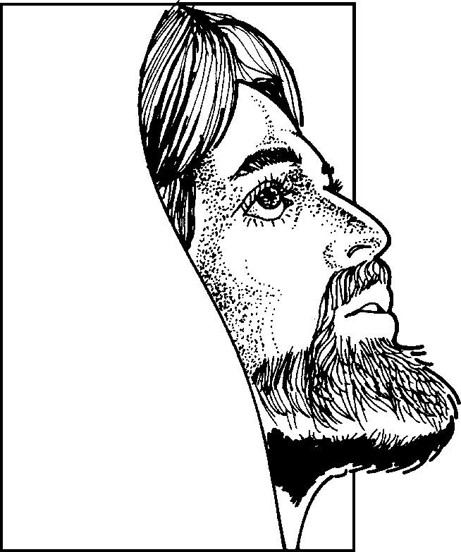
Who
is
Jesus
Christ?
Born of a virgin (Matt. 1:23)
Messiah (John 4:25-26)
Son of God –Deity (John 9:35; 5:17-18)
Died on the cross (1 Cor. 2:2)
Raised from the dead (Rom. 1:4)
Evidence of His Claim
The Miracles
“And truly Jesus did many other signs in the presence of His disciples, which are not written in this book; but these are written that you may believe that Jesus is the Christ, the Son of God, and that believing you may have life in His name.”
(John 20:30-31)

Slide 10
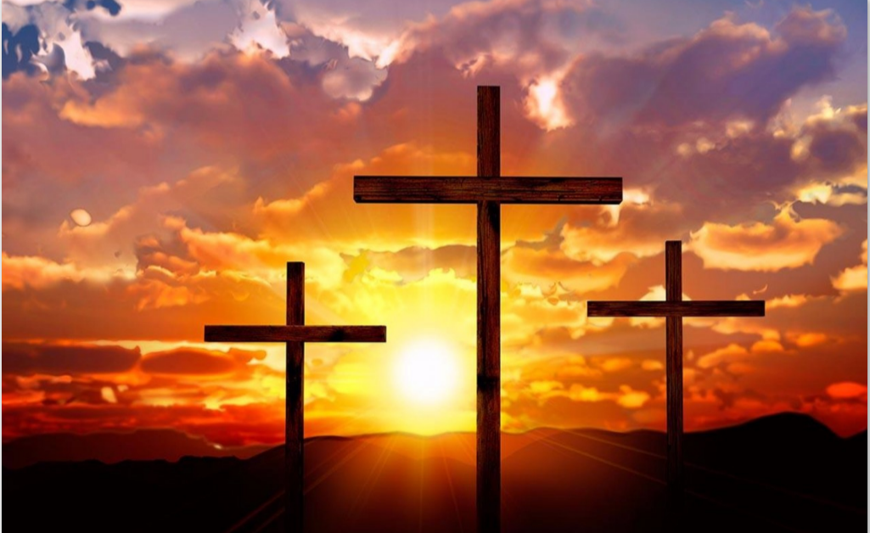
Christ Died as a Sacrifice
Sin (violation of law) Demands that a Penalty be Paid
Man Can’t Pay – Has Nothing to Pay
  Cannot be cleared
  Can only face the consequence (Rom. 6:23)
God Demands Blood Sacrifice
  Life is in the blood (Gen.9:4; Lev. 17:1-14; Deut. 12:23)
  Animal sacrifice could not pay the price (Heb. 10:4)
  Perfect sacrifice: Blood of Christ (1 Pet. 1:19)
He died so that we could be saved!
Matt. 26:28; Heb. 2:9; 9:22

Slide 11
Fall of man
Promise of a redeemer (Gen. 3:15)
God built a nation
God preserved a nation
Nation departed from God
Messiah has come
Messiah is preached to the world
  Message of Acts
    Conversions (Acts 2, 8, 9, 10, 16, 18, 19)
    Churches established
  Live for the Messiah (Romans – Revelation)
The Eternal Plan is the Theme
400 Years of Silence – Between the Testaments

Slide 12

The Golden Thread Running Through the Bible:
Christ the Redeemer
Genesis
Preserving a Nation
Leviticus -
Deut.
Kings & Chronicles
Isaiah
Joshua - Judges
Building a Nation
Exodus
Ruth
A Nation Departs
Jesus is the Messiah
Jeremiah
Matthew –
Luke
A Remnant Returns
The Messiah is Coming
John
Daniel
Ezra
Nehemiah
Acts
Live for Christ, Our Redeemer
Ezekiel
Epistles
Revelation

Slide 13
The Bible as a Whole
God Has an Eternal Plan
The Eternal Plan is the Theme
Viewing the Bible
(God’s Eternal Plan)

Slide 14
Arrangement of books
Viewing the Bible

Slide 15
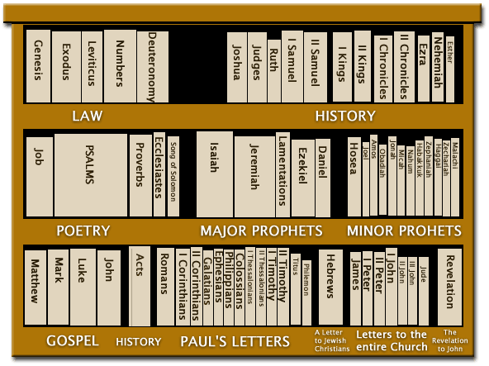
5
12
Old Testament
Bible Library
5
5
12
New Testament
4
1
14
7
1

Slide 16
Arrangement of books
Three periods
Viewing the Bible

Slide 17



End
of
World
Patriarchal Age
Gospel Age
For All Men
Mosaic Age
For Jews Only
Patriarchal Age
Began at Creation
God spoke to family head
Mosaic Age
For Abraham’s decendants (Deut. 5:1-3)
Law was temporary (Jer. 31:31-34)
To bring men to Christ (Gal. 3:19-29)
Gospel Age
Began at the cross
New Testament effective by the death of Christ (Heb. 9:16-17)

Slide 18
Arrangement of books
Three periods
Coming of Christ
Viewing the Bible

Slide 19
The Coming of Christ
Christ is Coming
Christ has Come
Christ is Coming Again
Genesis – Malachi
Preaching of John the Baptist
Matthew - John
Acts
Acts
Romans – Revelation

Slide 20
The Bible as a Whole
God Has an Eternal Plan
The Eternal Plan is the Theme
Viewing the Bible
(God’s Eternal Plan)

