Slide 1

The Bible as a Whole
Objective: to get a view of the Bible as a whole
Bird’s eye view
Move back from the trees & see the forest
(God’s Eternal Plan)
Perhaps we fail to see the overall snapshot
Bible = bunch of stories, books, verses, etc.
In contrast to a common theme

Slide 2
The Bible as a Whole
God Has an Eternal Plan
The Eternal Plan is the Theme
Viewing the Bible
(God’s Eternal Plan)

Slide 3
The Bible as a Whole
God Has an Eternal Plan
The Eternal Plan is the Theme
Viewing the Bible
(God’s Eternal Plan)

Slide 4
God has a plan that is eternal
  Eph. 1:4, 9
  Eph. 3:10-11
  Means – in God’s mind before creation (Gen. 1:1)
Creation
End of Time
God Has an Eternal Plan
(Gen. 1:1)
(2 Pet. 3:10)
God has not been going in different directions
But has always had a goal or plan

Slide 5
God has a plan that is eternal
Need to understand the whole of God’s plan
  The parts or elements of the whole must be understood in relation to the whole
God Has an Eternal Plan

Slide 6
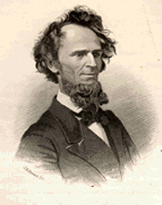

“In order to understand fully and perfectly any one part or element of a system, it is necessary to have, in the first place, a general and comprehensive knowledge of the whole. The several elements must be viewed and considered in their relations to each other and to the whole scheme or system of which they are the component and constituent parts. Nothing exist in a perfectly independent and isolated state.”
Robert Milligan, The Scheme of Redemption, xi

Slide 7
God has a plan that is eternal
Need to understand the whole of God’s plan
  The parts or elements of the whole must be understood in relation to the whole
  Must see the Bible as a unit
God Has an Eternal Plan

Slide 8
“And just so it is with respect to the Bible. It, too, is a unit. Its primary, general, and ultimate object is to develop one great and glorious System of Divine wisdom, justice, goodness, mercy, and love, through Jesus Christ, for the redemption of fallen man.”
Robert Milligan, The Scheme of Redemption, xii

Slide 9
God has a plan that is eternal
Need to understand the whole of God’s plan
God’s eternal plan = scheme of redemption
  Ephesians 2 – Objective of God’s eternal plan
  This is the theme of the Bible
  This explains why some things are included in the Bible and others are not
    What is included – because it in some way pertains to the theme or purpose
    What is not included – because it doesn’t pertain to the theme or purpose
God Has an Eternal Plan

Slide 10
The Bible as a Whole
God Has an Eternal Plan
The Eternal Plan is the Theme
Viewing the Bible
(God’s Eternal Plan)

Slide 11
Fall of man
  Given a law (Gen. 2:17)
  Law was violated (Gen. 3:1-6)
  Thus, man sinned (1 Jno 3:4)
  Man dies spiritually (Rom. 5:12)
  Remedy is needed (Rom. 7:24-25)
The Eternal Plan is the Theme

Slide 12
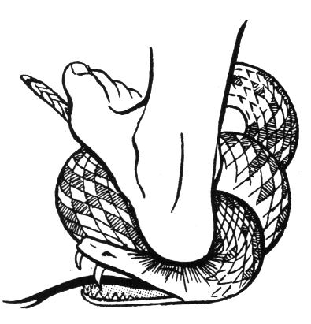
Fall of man
Promise of a redeemer (Gen. 3:15)
“And I will put enmity Between you and the woman, And between your seed and her Seed; He shall bruise your head, And you shall bruise His heel.”
The Eternal Plan is the Theme
Christ
“bruise His heel”
(Death)
Satan
“bruise your head”
(Resurrection)

Slide 13
Fall of man
Promise of a redeemer (Gen. 3:15)
God built a nation
  Man’s corruption led to man being scattered – developed into many nations (Gen. 6-11)
The Eternal Plan is the Theme

Slide 14
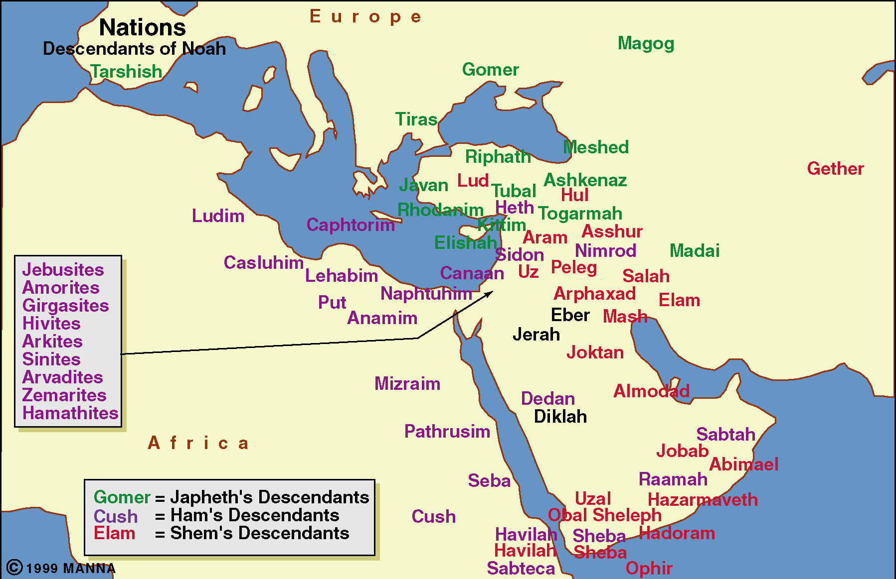
Nations – Descendants of Noah

Slide 15
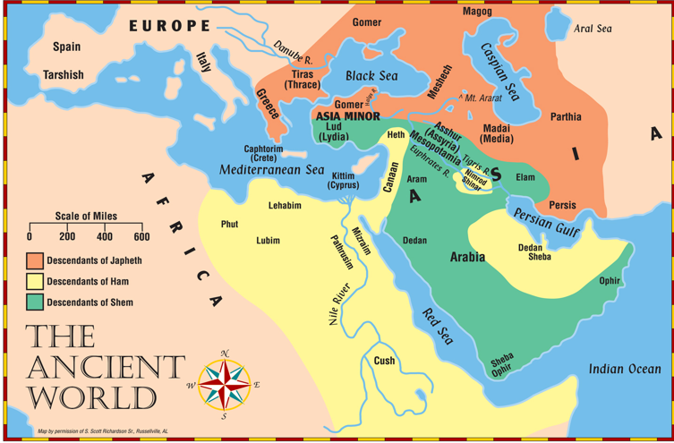

Slide 16
Fall of man
Promise of a redeemer (Gen. 3:15)
God built a nation
  Man’s corruption led to man being scattered – developed into many nations (Gen. 6-11)
  God focused on one nation – Jews
    Promised Abraham to make a great nation of his family (Gen. 12:1-3)
    From this nation the redeemer would come
The Eternal Plan is the Theme

Slide 17
Nations – Descendants of Noah
Abraham’s
Family
Jews / Hebrews

Slide 18
Gen 12:1-3
1 Now the LORD had said to Abram: "Get out of your country, From your family And from your father's house, To a land that I will show you.
2 I will make you a great nation; I will bless you and make your name great; And you shall be a blessing.
3 I will bless those who bless you, And I will curse him who curses you; And in you all the families of the earth shall be blessed."
Land
Nation
Seed
Promise of Salvation
Through a Redeemer
(Acts 3:25-26)

Slide 19
Fall of man
Promise of a redeemer (Gen. 3:15)
God built a nation
  Man’s corruption led to man being scattered – developed into many nations (Gen. 6-11)
  God focused on one nation – Jews
  Became a great nation
    Only 70 in number (Gen. 46:27; Exo. 1:5)
    Left Egypt 600,000 + (Exo. 12:37)
The Eternal Plan is the Theme

Slide 20
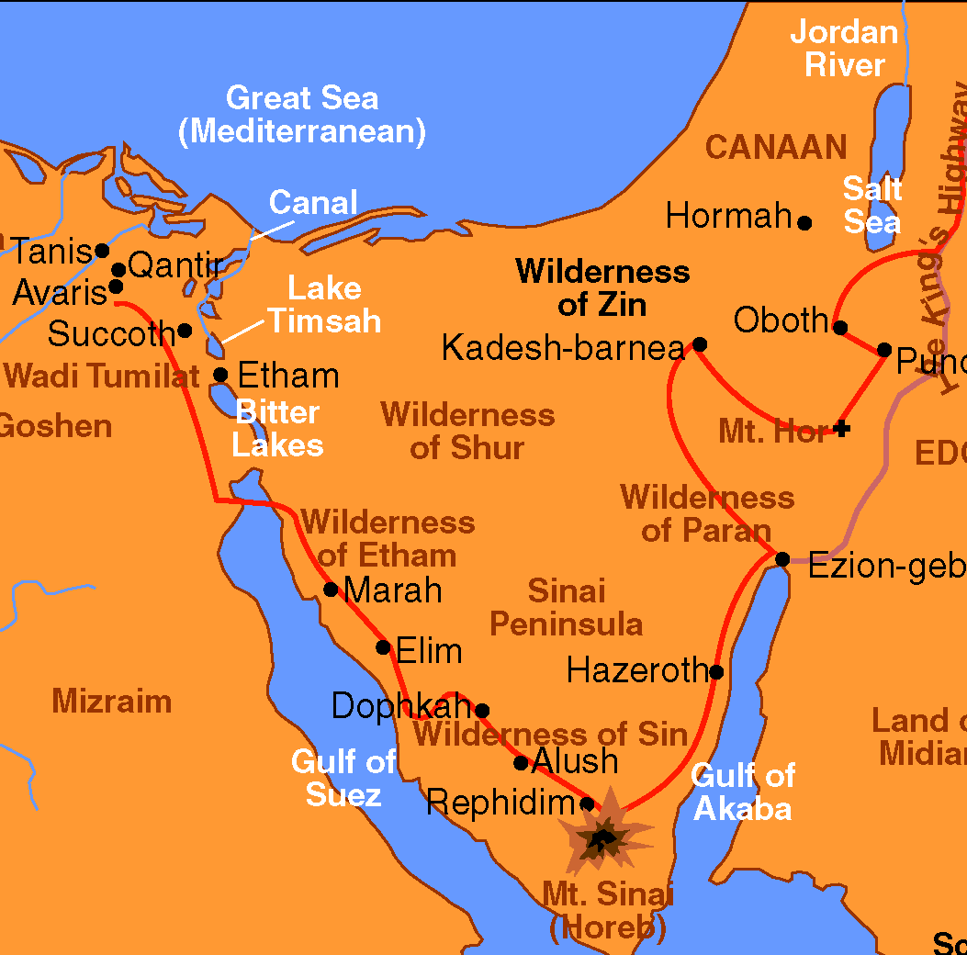
Fall of man
Promise of a redeemer (Gen. 3:15)
God built a nation
God preserved a nation
  Took nation to Egypt due to famine (Gen. 42-46)
  Delivered them from Egypt (Exo. 3-14)
  Provided for them in wilderness (Exo. 16-17)
The Eternal Plan is the Theme

Slide 21
Fall of man
Promise of a redeemer (Gen. 3:15)
God built a nation
God preserved a nation
  Took nation to Egypt due to famine (Gen. 42-46)
  Delivered them from Egypt (Exo. 3-14)
  Provided for them in wilderness (Exo. 16-17)
  Gave them a law (Exo. 20; Lev.; Deut.)
  Led them to the conquest of Canaan (Joshua)
The Eternal Plan is the Theme

Slide 22
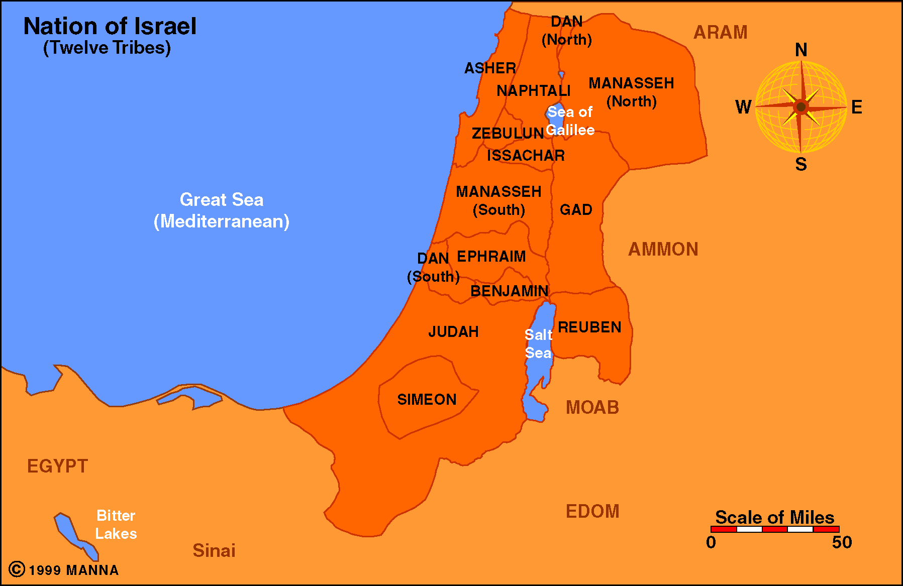
Fulfilled the Land Promise
(Gen. 12:1-3)

Slide 23
Fall of man
Promise of a redeemer (Gen. 3:15)
God built a nation
God preserved a nation
Nation departed from God
  Judges – continual cycle (Jud. 2:10; 21:25)
  Wanted a king like other nations (1 Sam. 8)
  United for a while (Saul, David & Solomon)
  Kingdom divided & kings lead them into idolatry (1 & 2 Kings; 1 & 2 Chronicles)
The Eternal Plan is the Theme

Slide 24
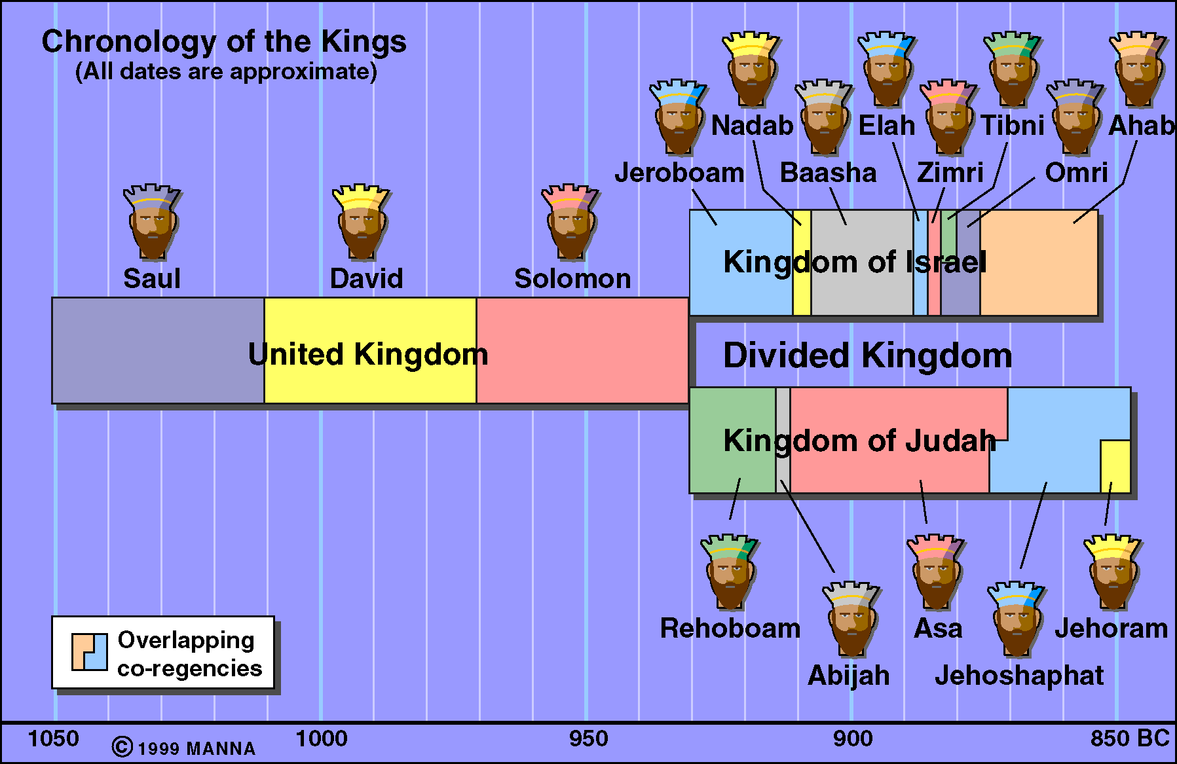

Slide 25
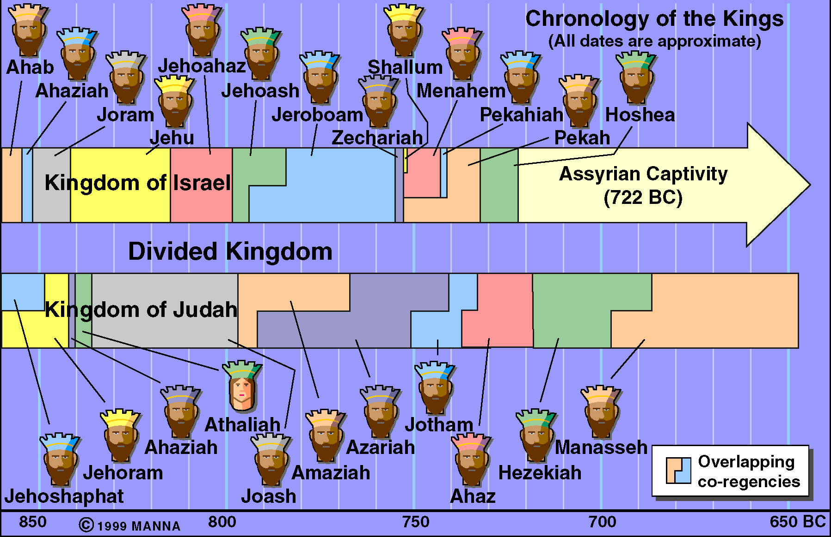

Slide 26
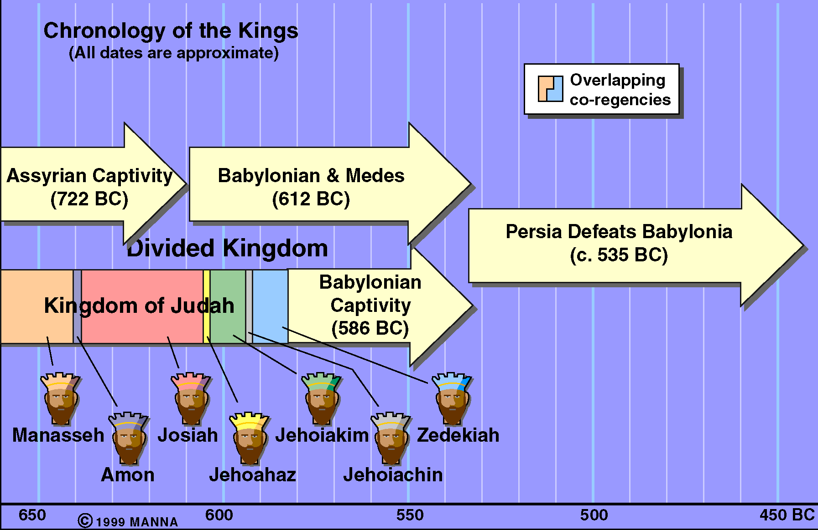

Slide 27


Work of Prophets
Sin of a Nation
Preached and warned a sinful nation (Jer. 35:15)
Foretold a coming of the Messiah (Isa. 53)
Dark Canvas
Brighter Future
Redeemer

Slide 28
Fall of man
Promise of a redeemer (Gen. 3:15)
God built a nation
God preserved a nation
Nation departed from God
  Judges – continual cycle (Jud. 2:10; 21:25)
  Wanted a king like other nations (1 Sam. 8)
  United for a while (Saul, David & Solomon)
  Kingdom divided & kings lead them into idolatry (1 & 2 Kings; 1 & 2 Chronicles)
  Brought a remnant back (Ezra, Neh., Haggai)
The Eternal Plan is the Theme

Slide 29
Captivity
70 Years
Daniel
Ezekiel
Return
Post-Exile
Ezra, Nehemiah
Esther, Haggai,
Zech., Malachai

Slide 30
Fall of man
Promise of a redeemer (Gen. 3:15)
God built a nation
God preserved a nation
Nation departed from God
The Eternal Plan is the Theme
400 Years of Silence – Between the Testaments

Slide 31
The Bible as a Whole
God Has an Eternal Plan
The Eternal Plan is the Theme
Viewing the Bible
(God’s Eternal Plan)

