Slide 1
We all have lost something – that we just had!
Keys – Phone – Book – A Note – Glasses – Wallet
The Disciples Lost Something At Sea They Thought They Had
Matthew 8:23-27
Mark 4:35-41
Luke 8:22-28

Slide 2
Luke 8:25
But He said to them, “Where is your faith?” And they were afraid, and marveled, saying to one another, “Who can this be? For He commands even the winds and water, and they obey Him!”

Slide 3
Where Is
Your Faith?
Implies Three Things
Luke 8:25

Slide 4
Where is Your Faith?
Faith Should Have Been Stronger
Luke 8:25

Slide 5
Faith Should Have Been Stronger
Seen his miracles – knew what he could do
  Turned water to wine (John 2:1-12)
  Healed a leper (Matt. 8:1-4)
  Healed centurion’s son (Matt. 8:5-13)
  Healed Peter’s Mother-in-law (Matt. 8:14-15)
  Healed demon poss. & sick (Matt. 8:16-17)
  If these were not sufficient – why the rebuke?

Slide 6
Faith Should Have Been Stronger
Seen his miracles – knew what he could do
Were following the Lord’s direction
  Disciples followed the Lord (Matt. 8:23)
  Lord told them go to other side (Mark 4:35; Luke 8:22)
  Why should faith give out – when:
    Doing what the Lord did?
    Doing what the Lord said?

Slide 7
Faith Should Have Been Stronger
Seen his miracles – knew what he could do
Were following the Lord’s direction
Were given a word of promise
  Were going to the other side (Mark 4:35; Luke 8:22)
  If perish in storm – Lord’s promise failed.
  Faith in the Lord – “We are going to make it…”

Slide 8
Faith Should Have Been Stronger
Seen his miracles – knew what he could do
Were following the Lord’s direction
Were given a word of promise
The Lord was with them
  They were not on their own
  Lord was in the boat with them (Mark 4:36)
  Did they think the Lord would perish?
  Did his presence mean nothing?

Slide 9
Where is Your Faith?
Faith Should Have Been Stronger
Faith Was Challenged
Luke 8:25

Slide 10
Faith Was Challenged
May have thought their faith was stronger
  Heard his sermon on mount (Matt. 5-7; Luke 6)
  Heard his parables (Luke 8; Mark 4)
  Personally been with the Lord – heard & seen!
  “…the disciples must have felt like postgraduate students in the School of Faith!” (WBW)
  Faith must be tested before it can be trusted!

Slide 11
Faith Was Challenged
May have thought their faith was stronger
Storm suddenly came upon them
  Sudden – with little or no warning (Matt. 8:24)
  Came down – over mountain tops (Luke 8:23)

Slide 12
“The lake lies between high hills and is thus subject to sudden tempests which develop excessive fury as they roar through the great trough in which the lake lies.”
  Lenski, R. C. H. (1961). (pp. 345-346). Minneapolis, MN: Augsburg Publishing House.
“This lake was subject to sudden squalls. Dr. Thomson (The Land and the Book, vol. ii. p. 59) says: ‘Small as the lake is, and placid, in general, as a molten mirror, I have repeatedly seen it quiver, and leap, and boil like a caldron, when driven by fierce winds from the eastern mountains.’”
  Barnes, A. (1884-1885). . (R. Frew, Ed.) (p. 90). London: Blackie & Son.

Slide 13
Faith Was Challenged
May have thought their faith was stronger
Storm suddenly came upon them
Looked like not going to make it
  Boat was covered (Matt. 8:24)
  Boat was filling (Mark 4:37)
  In jeopardy (Luke 8:23)

Slide 14
Where is Your Faith?
Faith Should Have Been Stronger
Faith Was Challenged
Faith Was Missing
Luke 8:25

Slide 15
Faith Was Missing
They were fearful (Mark 4:40)
Questioned if they Lord cared (Mark 4:38)
Failed to focus on what really mattered
  They were thinking of now – physically perishing!
  Even if they died in the storm – would be okay!

Slide 16
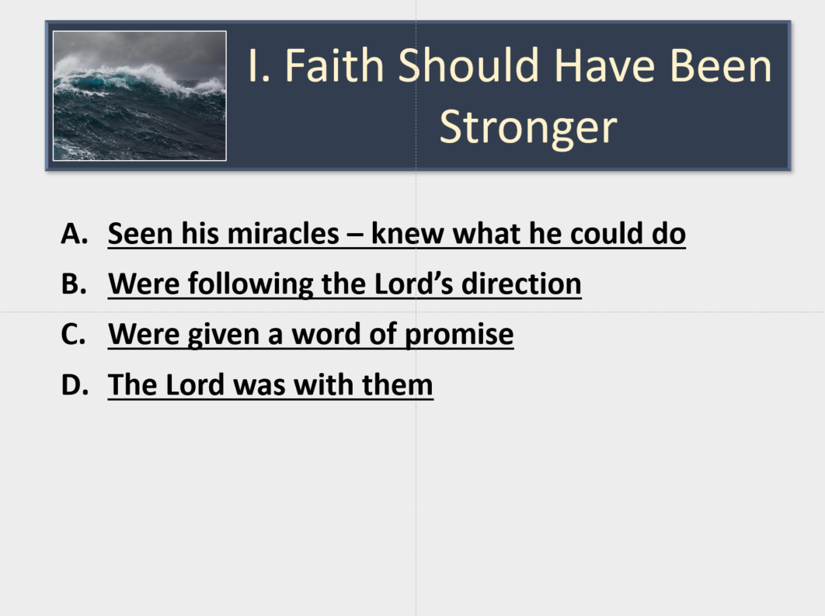
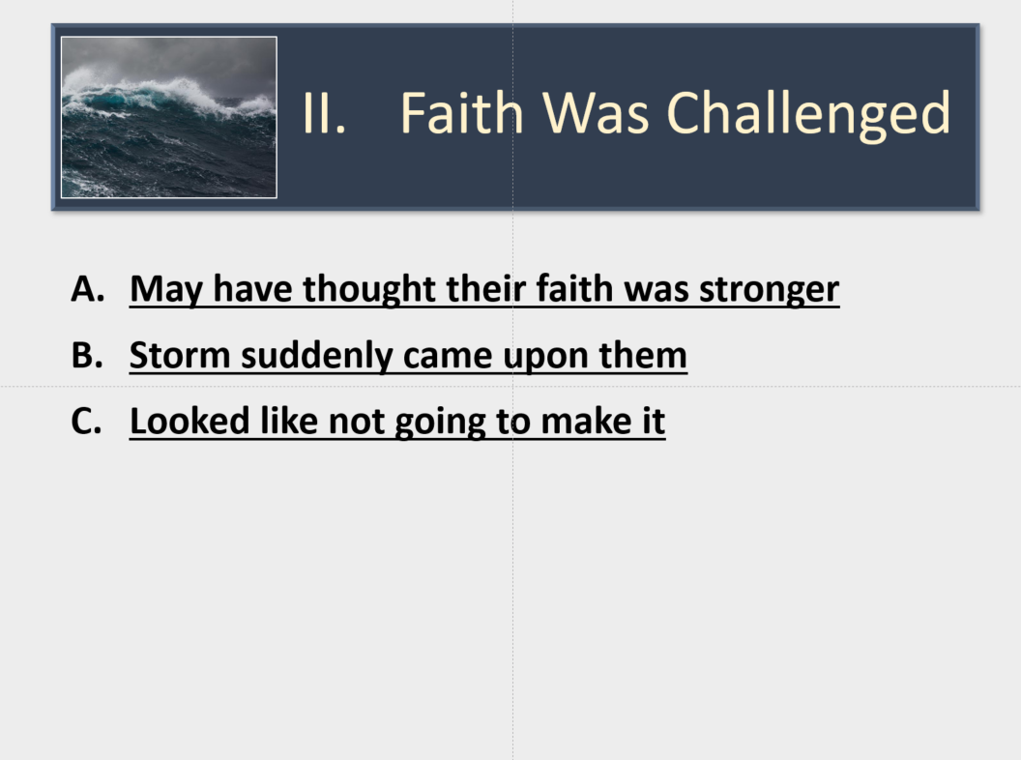
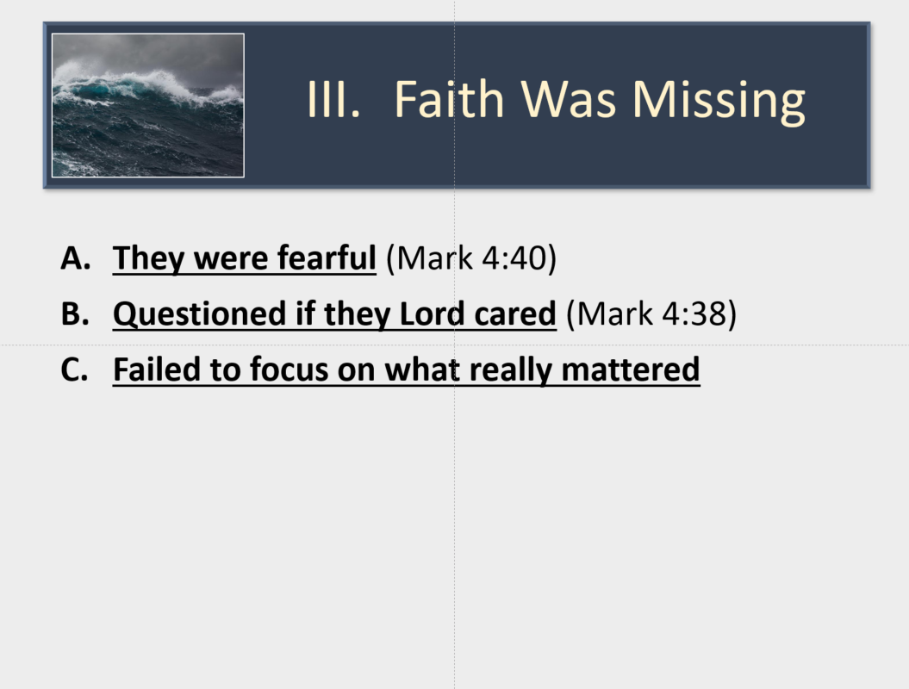
Where is Your Faith?

Slide 17
Where is Your Faith?
When storms of life suddenly appear?
When comes time to say “No!”?
When need to discipline your child?
When wonder if the hard hearted can change?
When our nation crumbles?
When tempted to stay at home?
When time to withdraw from your friend?
When conflict with what I know is right?

Slide 18
Where is Your Faith?
Faith Should Have Been Stronger
Faith Was Challenged
Faith Was Missing
Luke 8:25

