Slide 1
Mark 14:3-9
Mary pours expensive oil on head and feet of Jesus
She was criticized for such a waste
⁶ But Jesus said, “Let her alone. Why do you trouble her? She has done a good work for Me.
⁷ For you have the poor with you always, and whenever you wish you may do them good; but Me you do not have always.
⁸ She has done what she could. She has come beforehand to anoint My body for burial.

Slide 2
Have you done what you could?
Are you doing what you can?
Will you do what you can?

Slide 3
The Context
The Meaning
The Application

Slide 4
The Context

Slide 5
The Context
Parallel Accounts
Matthew 26:6-13
Mark 14:3-9
Luke 7:36-40
John 12:1-8

Slide 6
Parallel Accounts
X
Matt. 26:6-13 | Mark 14:3-9 | Luke 7:36-40 | John 12:1-8
Bethany (v. 6) | Bethany (v. 3) | Nain (v. 11) | Bethany (v. 1)
Simon (v. 6) (Leper) | Simon (v. 3) (Leper) | Simon (vv. 36, 40) (Pharisee) | Mary, Martha, Lazarus (v. 2)
Woman (v. 7) | Woman (v. 3) | Woman (v. 37) (Sinner) | Mary (v. 3)
Head (v. 7) | Head (v. 3) | Feet (v. 38) | Feet (v. 3)
Much (v. 9) | 300 Denarii (v. 5) |  | 300 Denarii (v. 5)

Slide 7
Parallel Accounts
Matt. 26:6-13 | Mark 14:3-9 | John 12:1-8
Bethany (v. 6) | Bethany (v. 3) | Bethany (v. 1)
Simon (v. 6) (Leper) | Simon (v. 3) (Leper) | Mary, Martha, Lazarus (v. 2)
Woman (v. 7) | Woman (v. 3) | Mary (v. 3)
Head (v. 7) | Head (v. 3) | Feet (v. 3)
Much (v. 9) | 300 Denarii (v. 5) | 300 Denarii (v. 5)

Slide 8
The Context
Parallel Accounts
Place

Slide 9
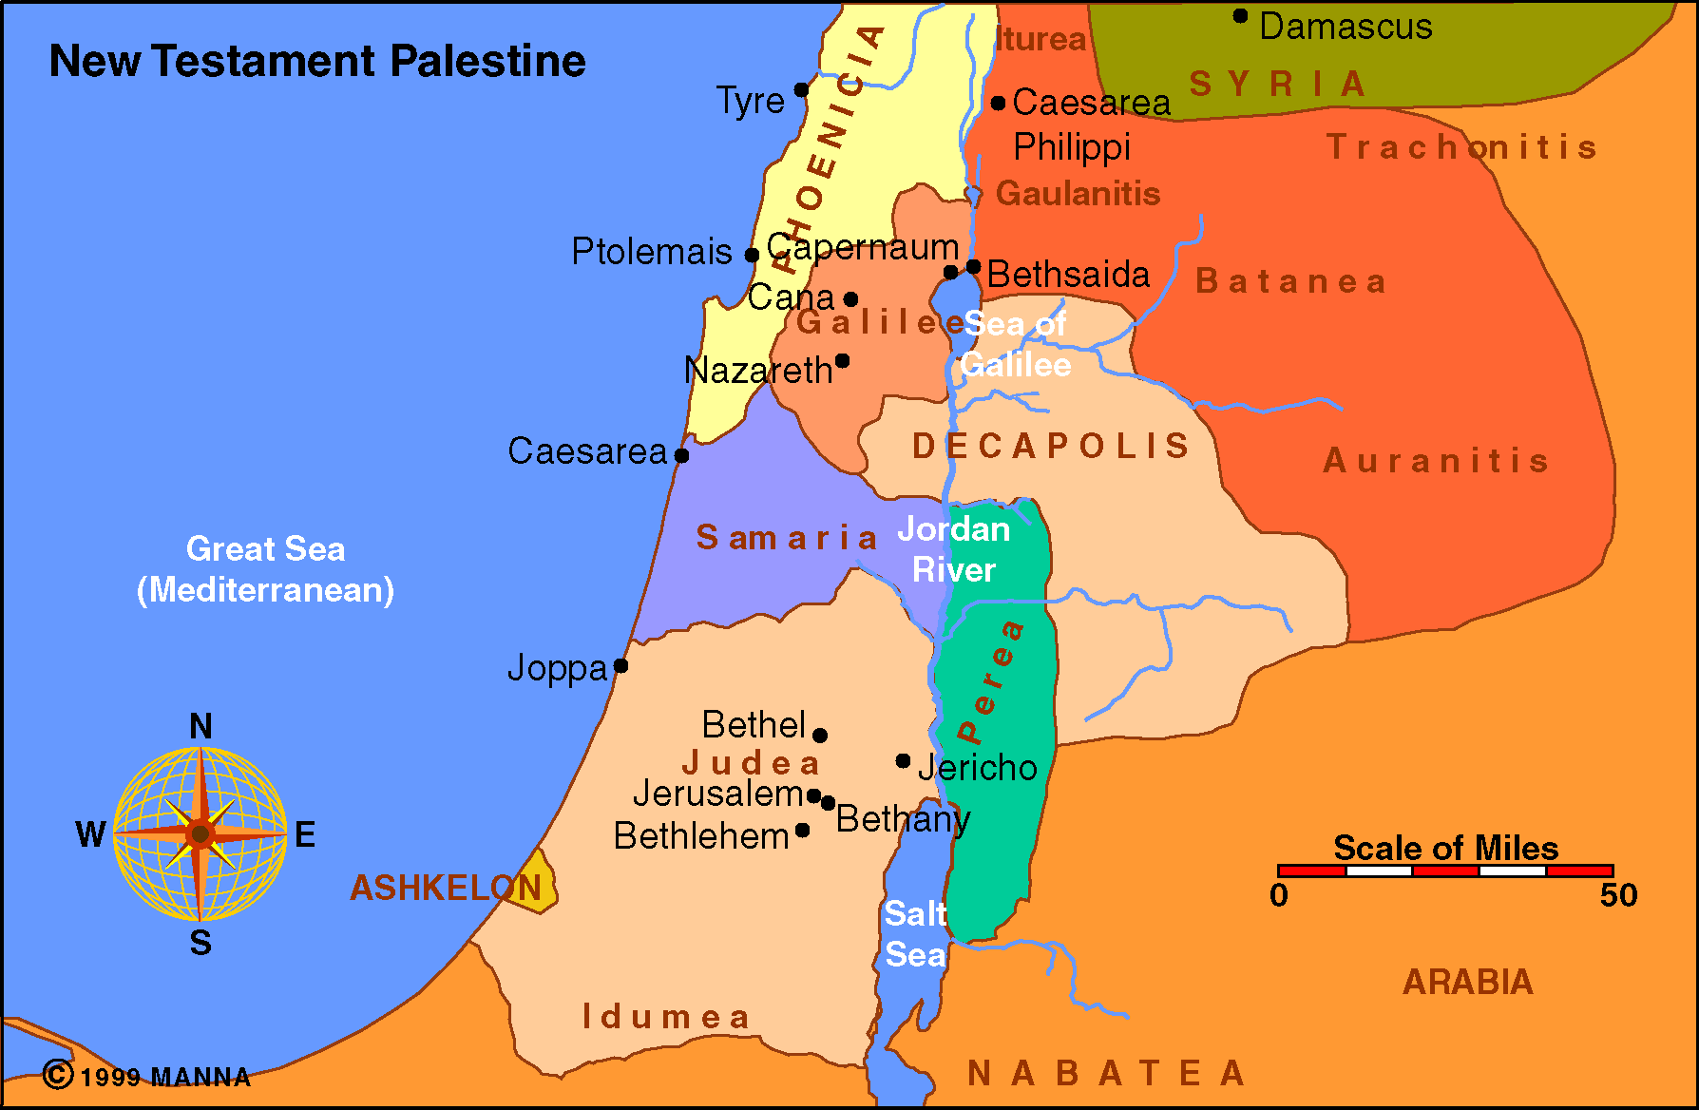
New Testament Palestine

Slide 10
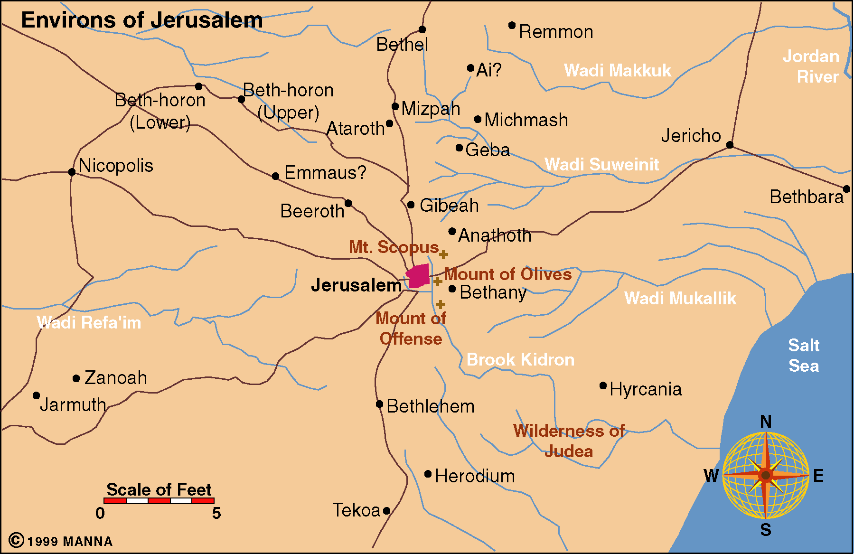
Environs of Jerusalem

Slide 11
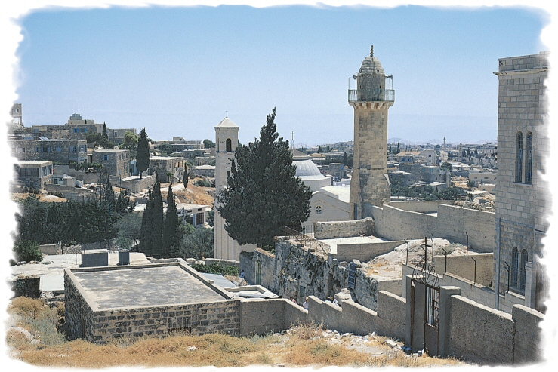

Slide 12
The Context
Parallel Accounts
Place
Time
  Matthew – During passion week at Passover
  Mark – During passion week at Passover
  John – Six days before the Passover

Slide 13
“Six days before the Passover” is not in conflict with the two days before the Passover mentioned in Matt. 26:2; Mark 14:1. Neither of these two evangelists gives the date of the supper at Bethany. They report a saying of Jesus that he would be betrayed and crucified at the feast of the Passover two days hence, while at the very same time the Jewish authorities resolved not to destroy him at the time of the Passover. Then, without following the chronological sequence of events, these two evangelists report the supper. Matthew merely says, “now when Jesus was in Bethany,” and Mark, “and being in Bethany,” neither fixing the date. John supplements the others and records the date.
  Lenski, R. C. H. (1961). The interpretation of St. John’s gospel (pp. 834–835). Minneapolis, MN: Augsburg Publishing House.

Slide 14
The Context
Parallel Accounts
Place
Time
Why Mention the Story in Mark’s Narrative
  Contrast her love – to Juda’s betrayal
  Preparation for his death
  Shows Juda’s attitude toward money

Slide 15
The Context
Parallel Accounts
Place
Time
Why Mention the Story in Mark’s Narrative
The Story

Slide 16
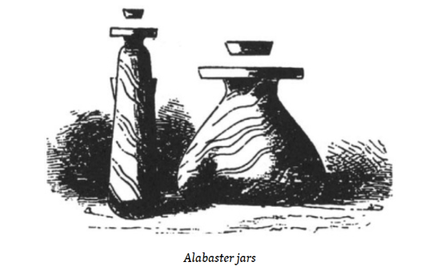
The Anointing at Bethany
The beginning of the story is condensed by Matthew & Mark
  Meal with Mary, Martha, and Lazarus (John 12:2)
    Perhaps in the home of Judas’ father Simon (v. 4)
    Perhaps Simon could be father of Mary, Martha, and Lazarus
  Woman is Mary (John 12:3; cf. 11:2)
Took an alabaster flask of Spikenard (Mark 14:3)
  Broke it (v. 3)
  Anointed head & feet (v. 3; Jno 12:3)
  Worth 300 denarii (year’s wage – NIV)
Freeman, J. M., & Chadwick, H. J. (1998). Manners & customs of the Bible (p. 472

Slide 17
The Anointing at Bethany
The beginning of the story is condensed by Matthew & Mark
Took an alabaster flask of Spikenard (Mark 14:3)
Woman was criticized (Mark 14:4-5)
  By disciples (Matt. 26:8)
  Some (Mark 14:4)
  By Judas (John 12:4-6)

Slide 18
The Anointing at Bethany
The beginning of the story is condensed by Matthew & Mark
Took an alabaster flask of Spikenard (Mark 14:3)
Woman was criticized (Mark 14:4-5)
Jesus responds to her critics (Mark 14:6-9)
  Leave her alone (v. 6)
  Done good (v. 6)
  Poor you have always (v. 7; cf. Deut. 15:11)
  Done what she could (v. 8)
  Prepared for my burial (v. 8)
  Spoken as a memorial to her (v. 9)

Slide 19
The Context
The Meaning

Slide 20
The Meaning
“…She has done what she could…”
Acted on the basis of the opportunity she had
Acted on the basis of what she possessed
Literally, “what she had, she did” (A. T. Robertson)

Slide 21
‘what she had she did’: it is generally agreed that the meaning of the verb echō ‘have’ being equivalent to dunamai ‘be able’ (cf. Field Notes, 14). Arndt & Gingrich echō I.6.a call attention to the fact that the full phrase would include the infinitive, ho eschen poiēsai epoiēsen ‘what she was able to do she did.’
  Bratcher, R. G., & Nida, E. A. (1993). A handbook on the Gospel of Mark (p. 430). New York: United Bible Societies.

Slide 22
The Meaning
“…She has done what she could…”
Acted on the basis of the opportunity she had
Acted on the basis of what she possessed
Literally, “what she had, she did” (A. T. Robertson)
Went to the limit of her ability – pushed!

Slide 23
Jesus is not applying to Mary the general proposition of doing what one can do. So we should also not apply this word of Jesus by urging everyone to do what he can in the work of the church. The aorists go far beyond that: when the one opportunity came to Mary, she not only was ready, saw and embraced it, but went to the limit of her ability in meeting that opportunity, in fact, would have done more if it had been possible.
  Lenski, R. C. H. (1961). The Interpretation of St. Mark’s Gospel (p. 604). Minneapolis, MN: Augsburg Publishing House.

Slide 24
The Meaning
“…She has done what she could…”
Acted on the basis of the opportunity she had
Acted on the basis of what she possessed
Literally, “what she had, she did” (A. T. Robertson)
Went to the limit of her ability – pushed!
She gave her best!

Slide 25
The Context
The Meaning
The Application

Slide 26
The Application
To Mary
  Opportunities
    “Love can see that there are things, the chance to do which comes only once.” (Barclay)
    Seized an opportunity that would soon pass (v. 7)
    Acted quickly – not planning, thinking and calculating & never get it done

Slide 27
The Application
To Mary
  Opportunities
  Worship
    This was an act of homage and devotion
    Did what she could to show her honor for the Lord!
    “To the few who today spend themselves mainly on worship and meditation (whom Mary again exemplifies in Luke 10:39) active ‘workers’ are warned not to say ‘To what purpose is this waste’” (Alan McNeile, 375)

Slide 28
The Application
To Mary
  Opportunities
  Worship
  Sacrifice & Love
    Not a little, but a lot
    She gave the BEST she had
    Extreme sacrifice to worship, honor & praise the Lord
    Note the extravagance of her love

Slide 29
“If love is true, there must always be a certain extravagance in it. It does not nicely calculate the less or more. It is not concerned to see how little it can decently give. If it gave all it had, the gift would still be too little. There is a recklessness in love which refuses to count the cost.”
  Barclay, W. (2001). The New Daily Study Bible: The Gospel of Mark (p. 381). Edinburgh: Saint Andrew Press.

Slide 30
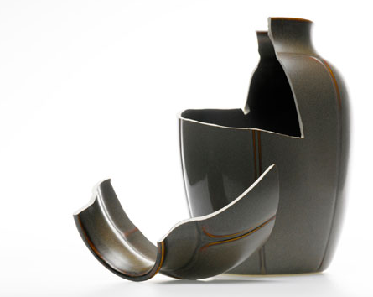
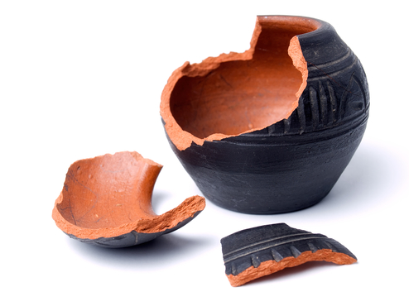
She Broke the Flask
She used it all
Doesn’t intend to spare any
This container / contents never to be used on another

Slide 31
The Application
To Mary
  Opportunities
  Worship
  Sacrifice & Love
  Priorities
    Giving to the poor is important – but this more (v. 7)
    Mary understood that!
    There are many things important – that must play second fiddle to worship and honor given to God!

Slide 32
The Application
To Mary
To Us
  Opportunities – Do you look at opportunities as “may not get this one again…?”
  Worship – Are you doing the best you can?
    Sick – are you really too sick?
    Working – do you really have to? Volunteer?
  Sacrifice & Love – Are you giving the best you have?
  Priorities – Is worship & service on top?
If we were to criticize you, would the Lord defend you saying,
“He / She has done what he / she could!”

Slide 33
The Context
The Meaning
The Application

