Slide 1
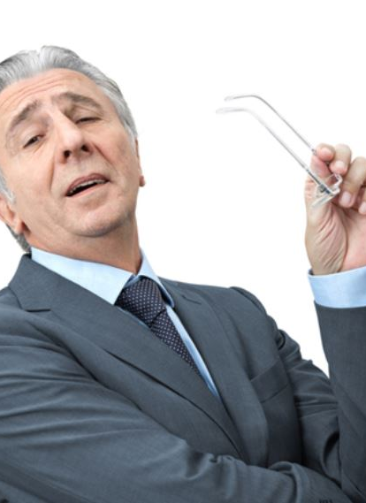
Perhaps you have had a dinner guest that made you uncomfortable
Some – obnoxious, rude, out of place
Others – due to something we have done – lack of wisdom!

Slide 2
Jesus was a dinner guest that made everyone present uncomfortable
Luke 14

Slide 3
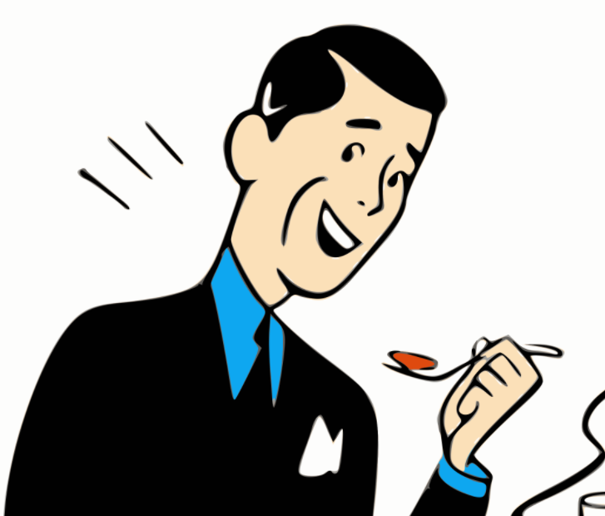
The Dinner Guest Who
Made Others Uncomfortable
The Pharisees
The Guest
The Host
The Jews
The Multitude
Luke 14

Slide 4
The Dinner Guest Who
Made Others Uncomfortable
The Pharisees: False Piety (vv. 1-6)

Slide 5
The Pharisees: False Piety (vv. 1-6)
Pharisees
  Watching for fault with Jesus (v. 1)
  They heartlessly “use” a sick man to accomplish their wicked plan (v. 2)
  Concerned with violating the Sabbath (cf. v. 3)
    As if really want to do God’s will
    Thought Jesus violated Sabbath at least seven times:
      Cast out demon (Lk. 4:31-37)
      Healed a fever (Lk. 4:38-39)
      Allowed disciples to pluck grain (Lk. 6:1-5)
      Healed a lame man (Jn. 5:1-9)
      Healed a man with a paralyzed hand (Lk. 6:6-10)
      Healed a crippled woman with demon (Lk. 13:10-17)
      Healed a man born blind (Jn. 9)

Slide 6
The Pharisees: False Piety (vv. 1-6)
Pharisees
Jesus exposes their hypocrisy (concern & devotion is false)
  Shift from concern to no real concern
    Could not answer about healing on Sabbath (vv. 3-4)
    Could not answer about actions on Sabbath (vv. 5-6)

Slide 7
The Pharisees: False Piety (vv. 1-6)
Pharisees
Jesus exposes their hypocrisy (concern & devotion is false)
  Shift from concern to no real concern
  Shift from putting Jesus in dilemma to being in one
  Shift from evidence /argument against Jesus to evidence for him
  Shift from great concern for man – to greater for animals
When Hypocrisy is Exposed:
May show that our seemingly concern for God’s law
is really no concern at all!
When Hypocrisy is Exposed:
See a difference in defending God’s law and defending our own thinking

Slide 8
The Dinner Guest Who
Made Others Uncomfortable
The Pharisees: False Piety (vv. 1-6)
The Guest: False Popularity (vv. 7-11)

Slide 9
The Guest: False Popularity (vv. 7-11)
The Guest
  Chose the best places (v. 7)
  Reason: arrogance – pride (v. 11)
  Status symbol – gave emphasis to reputation more than character
  They had been watching him – now he is watching them!

Slide 10
The Guest: False Popularity (vv. 7-11)
The Guest
The Parable (vv. 8-10)
  Addresses common courtesy and humility
  Extremely presumptuous to take the honor seat without being asked
  Be humble & let others lift or promote you
  This is not a false humility which is just as bad!
The Conclusion (v. 11)
  Those that exalt self – will be humbled
  Those who are humble will be exalted
A Disciple / Servant:
Must have true humility
& esteem others

Slide 11
The Dinner Guest Who
Made Others Uncomfortable
The Pharisees: False Piety (vv. 1-6)
The Guest: False Popularity (vv. 7-11)
The Host: False Hospitality (vv. 12-14)

Slide 12
The Host: False Hospitality (vv. 12-14)
The Host (v. 12)
  Implied reason for his invitation:
    Pay back for hospitality shown to him
    Putting other under obligation to invite him in future
  Kindness & generosity from a selfish motive
Jesus: Hospitality must be with right motive
  Not so I can benefit in return (v. 12; cf Mt. 19:27)
  But for the good of others (v. 13)
  Look to reward in heaven – not recognition now (v. 14)
Why do I Show Kindness to Others?
For what they can do for me?
To do good for them?

Slide 13
The Dinner Guest Who
Made Others Uncomfortable
The Pharisees: False Piety (vv. 1-6)
The Guest: False Popularity (vv. 7-11)
The Host: False Hospitality (vv. 12-14)
The Jews: False Security (vv. 15-24)

Slide 14
The Jews: False Security (vv. 15-24)
Assumption of Jews (v.15)
  Kingdom is material
  Jews will be in the kingdom (false security)

Slide 15
The Jews: False Security (vv. 15-24)
Assumption of Jews (v.15)
Parable of Great Supper (vv. 16-24)
  Point: correct misunderstanding: Jews by birth are in the kingdom
  Jews had been invited – didn’t come make excuses (vv. 16-20)
    Following Moses
    Children of Abraham (cf. John 8:32-33)
    Following the Law
  So, God turned to the Gentiles & rejected the Jews (vv. 21-24)
    These did not have the same excuses to make
    Jews perhaps expected another invitation - none

Slide 16
The Jews: False Security (vv. 15-24)
Assumption of Jews (v.15)
Parable of Great Supper (vv. 16-24)
Easy to Get A False Sense of Security
Been Baptized
In the “church of Christ”
Family is faithful
I am a elder, deacon, teacher

Slide 17
The Dinner Guest Who
Made Others Uncomfortable
The Pharisees: False Piety (vv. 1-6)
The Guest: False Popularity (vv. 7-11)
The Host: False Hospitality (vv. 12-14)
The Jews: False Security (vv. 15-24)
The Multitude: False Expectancy (vv. 25-35)

Slide 18
The Multitude: False Expectancy (vv. 25-35)
Multitude Followed (v. 25)
  When left house of Pharisee great crowd follows
  Jesus is not impressed
  Apparently they do not understand what is expected of them to be followers

Slide 19
The Multitude: False Expectancy (vv. 25-35)
Multitude Followed (v. 25)
Cost of Discipleship (vv. 26-38)
  Christ above all family relationships (v. 26)
  Willing to bear any burden of following (v. 27)
  Forsake ALL (vv. 28-33)
  A follower not willing to do what is expected is a useless disciple (vv. 34-35)
Many today want to follow Christ
But not before family
But not willing to forsake ALL
But are practically useless!

Slide 20
The Dinner Guest Who
Made Others Uncomfortable
The Pharisees: False Piety (vv. 1-6)
The Guest: False Popularity (vv. 7-11)
The Host: False Hospitality (vv. 12-14)
The Jews: False Security (vv. 15-24)
The Multitude: False Expectancy (vv. 25-35)

