Slide 1
Sermon on the Mount
Matthew 5-7
Greatest sermon ever preached – by the greatest preacher there ever was!
Perhaps the best known of his teaching, but the least understood or practiced
Parallel account Luke 6:17-49
  Matthew’s account – 3 times as extensive
  Luke (30 verses) Matthew (107 verses)

Slide 2
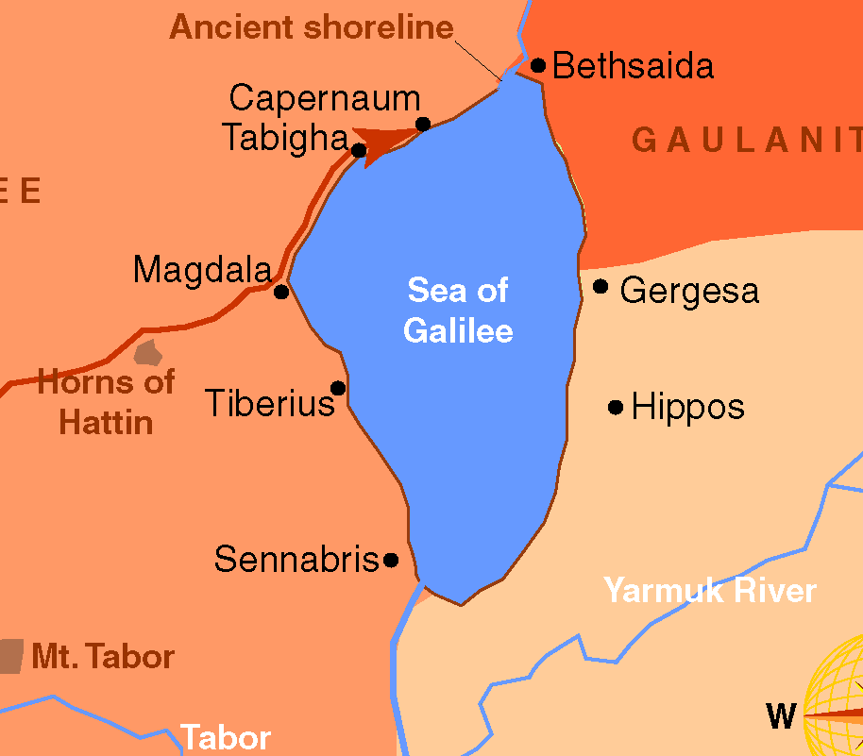
Sermon on the Mount
Matthew 5-7
Scene: the mountain
Luke 6:12 – went to mt. to pray then chose apostles – then came down with them
Tradition: mountain between Mt. Tabor & Tiberias
Mt. 8:5; Lk. 7:1 apparently near Capernaum
Luke: Level place (6:17)
Matthew: sat down (5:1)

Slide 3
Sermon on the Mount
Matthew 5-7
The Message
The Kingdom of God
Matt. 4:23 – preaching gospel of kingdom
“Kingdom” repeated throughout: (5:3, 10, 19, 20; 6:10; 33; 7:21)

Slide 4
Sermon on the Mount
Matthew 5-7
The Audience
Disciples (Matt. 5:1)
Multitude (Luke 6:17)

Slide 5
Outline
Sermon on the Mount
Citizens of the Kingdom (5:2-16)
  Characteristics [Beatitudes] (5:2-12)
  Their influence on the world (5:13-16)
Righteousness of the Kingdom (5:17 - 7:12)
  Harmonizes with the Old Testament (5:17-19)
  Exceeds the righteousness of the Scribes & Pharisee (5:20-48)
  Relationship to God (6)
  Relationship to man (7:1-12)
Exhortation to Enter the Kingdom (7:13-27)
  Enter the narrow gate that leads to life (7:13-14)
  Don’t let false prophets turn you aside (7:15-20)
  Only the obedient enter the kingdom (7:21-27)

Slide 6
Sermon on the Mount
The Citizens of the Kingdom (5:1-16)
The Righteousness of the Kingdom (5:17-48)
Sincere Devotion in the Kingdom (6:1-18)
Trusting God in the Kingdom (6:19-34)
Relating to Man in the Kingdom (7:1-12)
Entering the Kingdom (7:13-27)

Slide 7
The Citizens of the Kingdom
(Matt. 5:1-16)
Characteristics of the Citizens (5:2-12)
The Influence of the Citizens on the World (5:13-16)
Sermon on the Mount

Slide 8
The Citizens of the Kingdom
(Matt. 5:1-16)
Characteristics of the Citizens (5:2-12)
Sermon on the Mount

Slide 9
“The Beatitudes”
Beatitude comes from a Latin word meaning “blessing”
“Blessed” comes from root that means “to speak well of” – thus happy (Robertson)
“Its root is supposed to be a word meaning great, and its earlier meaning appears to be limited to outward prosperity; so that it is used at times as synonymous with rich.” (Vincent)
One who is happy because he is spiritually blessed!
These are not 8 different people – but 8 characteristics of the same people
Attacks the core of human reasoning – shocks his hearers at the kind of people who are really blessed!
Not mere statements – but exclamations! – “Oh the blessedness and joy of following Christ!”

Slide 10
Sermon
on
the Mount
Characteristics of the Citizens (5:2-12)
Poor in spirit (v. 3)
  Meaning:
    Poor – completely destitute – abject poverty – beggar
    In spirit – what a man is (not what he has)
      Recognizes utterly helpless – spiritually
      Puts his whole trust in God – dependent upon God
      Spiritually bankrupt!
      Thus, need guidance and instruction & will completely submit
  Theirs in the kingdom
    Enter the kingdom (John 3:3,5; Matt. 18:1-4)
    Heir to the eternal home (Rom. 8:17)

Slide 11
Sermon
on
the Mount
Characteristics of the Citizens (5:2-12)
Poor in spirit (v. 3)
Mourn (v. 4)
  Meaning:
    Mourn as weeping for the dead
    Mourn over wrong doing
      World (Rom. 9:2-3; 10:1)
      Brethren (1 Cor. 5:2)
      Own sin (Jas. 4:9; 2 Cor. 2:7)
  Comforted:
    Forgiven and know it (1 John 3:1-2)
    Sin is remembered no more (Heb. 8:12)
    Burden is lifted (Matt. 11:28)
    Example: 3,000 mourned (v. 37), comforted (vv. 38-41)

Slide 12
Sermon
on
the Mount
Characteristics of the Citizens (5:2-12)
Poor in spirit (v. 3)
Mourn (v. 4)
Meek (v. 5)
  Meaning:
    Complete mastery of one’s inner self
    Vines: begins with humility – submission to God – then gentle toward others
    Disciplined – controls self – humbly submits to God
  Inherit the earth
    Enjoy life on earth to the fullest

Slide 13
“But as the Israelites after taking possession of the land were harassed almost perpetually by their hostile neighbors, and even driven out of the country for a considerable period, it came to pass that the phrase was transferred to denote the tranquil and stable possession of the holy land crowned with all divine blessings, an experience which pious Israelites were to expect under the Messiah: Ps. 24 (25):13; 36 (37):9, 11, 22, 29, 34 Alex.; Is. 40:21; Tob. 4:12; ἐκ δευτέρας κληρονομήσουσι τὴν γῆν, Is. 61:7; hence it became a formula denoting to partake of eternal salvation in the Messiah’s kingdom:
  Thayer, J. H. (1889). A Greek-English lexicon of the New Testament: being Grimms Wilke's Clavis Novi Testamenti (p. 349).

Slide 14
Sermon
on
the Mount
Characteristics of the Citizens (5:2-12)
Poor in spirit (v. 3)
Mourn (v. 4)
Meek (v. 5)
  Meaning:
    Complete mastery of one’s inner self
    Vines: begins with humility – submission to God – then gentle toward others
    Disciplined – controls self – humbly submits to God
  Inherit the earth
    Enjoy life on earth to the fullest
    Used in Psa. 37:9, 11, 22
      Includes blessed in this life (cf. v. 34-36)
      Could include eternal life (cf. v. 18)

Slide 15
Sermon
on
the Mount
Characteristics of the Citizens (5:2-12)
Poor in spirit (v. 3)
Mourn (v. 4)
Meek (v. 5)
Hunger & thirst (v. 6)
  Meaning:
    Barclay: usually means hungry for some, but not all / here it is for the whole
    Craving hunger and thirst – go to any lengths to satisfy
    For righteousness – to be right with God (Rom. 1:17)
    Craving desire to be right with God
  Shall be filled
    Desire shall be satisfied – (cf. Rom. 3:31-26)
    Jesus is the water (John 4:13-14) & bread (John 6:35)

Slide 16
Sermon
on
the Mount
Characteristics of the Citizens (5:2-12)
Poor in spirit (v. 3)
Mourn (v. 4)
Meek (v. 5)
Hunger & thirst (v. 6)
Merciful (v. 7)
  Meaning:
    Show mercy, compassion and sympathy
    Born out of an awareness of our own need for mercy & gratitude for what God has done
    Puts himself in another’s place (Phil. 2:4) – feels how they feel
  Obtain mercy
    Will need forgiveness and get it (1 John 1:7-9)
    Receive help from our High Priest (Heb. 4:14-16)
    Others will respond with care

Slide 17
Sermon
on
the Mount
Characteristics of the Citizens (5:2-12)
Poor in spirit (v. 3)
Mourn (v. 4)
Meek (v. 5)
Hunger & thirst (v. 6)
Merciful (v. 7)
Pure in heart (v. 8)
  Meaning:
    Phillips: “utterly sincere”
    Purity of single-minded devotion (2 Cor. 11:2; Mt. 6:22,24)
    “Kingdom belongs to those who absolutely honest and sincere – not to those who never put both feet into the kingdom”
  See God
    See = understand, possess and enjoy (i.e. John 3:3, 36; Psa. 16:10)
    Enter into a relationship with God & enjoy the blessings

Slide 18
Sermon
on
the Mount
Characteristics of the Citizens (5:2-12)
Poor in spirit (v. 3)
Mourn (v. 4)
Meek (v. 5)
Hunger & thirst (v. 6)
Merciful (v. 7)
Pure in heart (v. 8)
Peacemakers (v. 9)
  Meaning:
    Seek peace with God (2 Cor. 5:20)
    Seek peace with brethren (Rom. 14:19) & others (Rom. 12:18)
    Opposite of a troublemaker
    Barclay – not merely passive acceptance of things, being afraid of trouble, but one who makes peace through struggle
  Children of God: Are God’s children and take on his characteristic (i.e. John 8:44)

Slide 19
Sermon
on
the Mount
Characteristics of the Citizens (5:2-12)
Poor in spirit (v. 3)
Mourn (v. 4)
Meek (v. 5)
Hunger & thirst (v. 6)
Merciful (v. 7)
Pure in heart (v. 8)
Peacemakers (v. 9)
Persecute you (vv. 10-12)
  Meaning:
    Suffering for righteousness sake (v. 10)
    Persecute: harass or troubled
    Revile: insult, called degrading names
    Say all manner of evil: false charges, slandered
  Theirs is the kingdom
    Enter the kingdom (John 3:3,5; Matt. 18:1-4)
    Heir to the eternal home (Rom. 8:17)

Slide 20
Sermon
on
the Mount
Characteristics of the Citizens (5:2-12)
Poor in spirit (v. 3)
Mourn (v. 4)
Meek (v. 5)
Hunger & thirst (v. 6)
Merciful (v. 7)
Pure in heart (v. 8)
Peacemakers (v. 9)
Persecute you (vv. 10-12
Essential to
Gain
Citizenship
Essential to
Maintain Citizenship

Slide 21
Sermon
on
the Mount
Characteristics of the Citizens (5:2-12)
Poor in spirit (v. 3)
Mourn (v. 4)
Meek (v. 5)
Hunger & thirst (v. 6)
Merciful (v. 7)
Pure in heart (v. 8)
Peacemakers (v. 9)
Persecute you (vv. 10-12
New Attitude
Toward Self
New Attitude
Toward God
New Attitude
Toward Others

Slide 22
The Citizens of the Kingdom
(Matt. 5:1-16)
Characteristics of the Citizens (5:2-12)
The Influence of the Citizens on the World (5:13-16)
Sermon on the Mount

Slide 23
Sermon
on
the Mount
The Influence of the Citizens on the World (5:13-16)
Salt (v. 13)
  Does two things: (Preservative [stay the rot] / adds flavor)
  Citizens of the kingdom stay sin’s rot
    By our example (1 Tim. 4:12)
    By teaching
    By our presence [profanity used less when present]
    World would be much worse – of no Christians!
  Christianity puts flavor into life – rather than taking it out!
  Lost its flavor (cf. Mk 9:50; Lk. 14:34-35)
    Idea is polluted & contaminated
    Barclay: outdoor ovens used salt beds under tiles - in time became polluted – had to be thrown out
    Point: never loose your effectiveness – never become worldly!

Slide 24
Sermon
on
the Mount
The Influence of the Citizens on the World (5:13-16)
Salt (v. 13)
Light (vv. 14-16)
  Light dispels darkness – enables us to see
  Parallel with “good works” (v. 16)
  Christians are to be light (Eph. 5:8; Phil. 2:15)
  Barclay: didn’t say light of the church, but light of the WORLD!
  See good works – glorify God
    Oppose of Rom. 2:23
    Lost men are moved to glorify God (not because we have LS every Sunday) but because they see Christ in you!

Slide 25
The Citizens of the Kingdom
(Matt. 5:1-16)
Characteristics of the Citizens (5:2-12)
The Influence of the Citizens on the World (5:13-16)
Sermon on the Mount

