Slide 1

Jesus Came
To Save The
Lost
(Luke 19:10)
(1 Tim. 1:15)
Do We Have a Passion for the Lost
Or
Do We Have a Loss of Passion?

Slide 2
Having a Passion
for
Lost Souls

Slide 3
God Expects Us To Seek The Lost
Great
Commission
Mk 16:15
The Taught
Should Teach
2 Tim. 2:2
Disciples
Preached
Acts 8:4
Should Grow
To Teach
Heb. 5:12
Ready to tell
why - believe
1 Pet. 3:15
Fishers of
men
Mark 1:17
This is the
work of Lord
1 Cor. 15:58

Slide 4
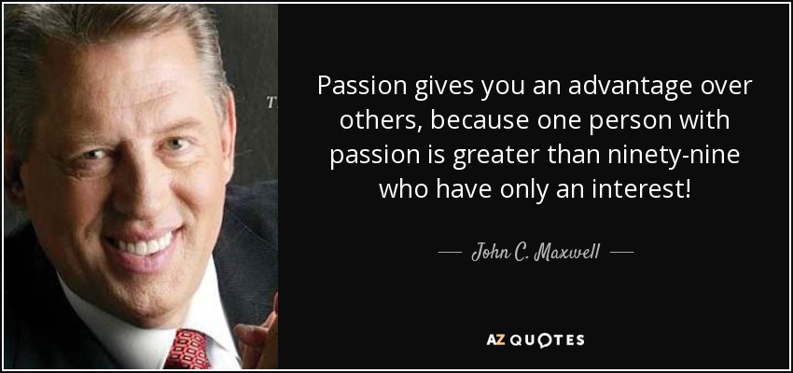
Passion is a Driving Force!
We all have an INTEREST in the lost, but do we have a PASSION for the lost?

Slide 5
Having a Passion
for
Lost Souls
WHO – How Passion Worked in Others

Slide 6
HOW
Christ (Matt. 9:36-38)
  What he felt – Compassion, pity (v. 36)
  What he saw – Burdened & scattered (v. 36)
  Where he focused – spiritual needs (vv. 37-38)
  How he responded (vv. 37-38)
    See the need (v. 37)
    Care deeply for them (v. 38)
How Passion Worked in Others

Slide 7
HOW
Christ (Matt. 9:36-38)
Paul (Rom. 9-10; 2 Tim. 2)
  Had heavy heart for lost (Rom. 9:2-3)
  Desire & prayer to save (Rom. 10:1-2)
  Willing to suffer to save (2 Tim. 2:8-10, 25)
How Passion Worked in Others

Slide 8
HOW
Christ (Matt. 9:36-38)
Paul (Rom. 9-10; 2 Tim. 2)
Peter & John (Acts 4:18-20)
  Forbidden to preach anymore (v. 18)
  We are going to listen to God (v. 19)
  “We cannot but speak…” (v. 20)!
How Passion Worked in Others

Slide 9
HOW
Christ (Matt. 9:36-38)
Paul (Rom. 9-10; 2 Tim. 2)
Peter & John (Acts 4:18-20)
Jeremiah (Jer. 20:1-13)
  Jeremiah arrested (vv.1-3a)
  Jeremiah tells Pashhur he will be taken captive (vv. 3b-6)
  Jeremiah tells God he thought of quitting, but couldn’t (vv. 7-13)
    Thought about quitting (v. 9a)
    Word was like a fire (v. 9b)
    Lord was with me (vv. 10-13)
How Passion Worked in Others

Slide 10
HOW
Christ (Matt. 9:36-38)
Paul (Rom. 9-10; 2 Tim. 2)
Peter & John (Acts 4:18-20)
Jeremiah (Jer. 20:1-13)
David (Psa. 39:3; 126:5-6)
  Fire burned in heart – had to speak (Psa. 39:3)
  Sow in tears and reap in joy (Psa. 126:5-6)
How Passion Worked in Others
Deeply Cared
Couldn’t Stay Quiet

Slide 11
Having a Passion
for
Lost Souls
WHO – How Passion Worked in Others
WHY – Why We Are Lacking in Passion

Slide 12
WHY
Spiritual Matters are Not Top Priority
  Not first (Matt. 6:33)
  Cares of the world – choked (Lk. 8:14)
  We seek our own (Phil. 2:21)
  Thus: not focused on spiritual matters
Why We Are Lacking in Passion

Slide 13
WHY
Spiritual Matters are Not Top Priority
Don’t View World as Lost
  World is lost in sin
    All men are sinners (Rom. 3:23; 1 John 5:14)
    If die in sin – hell (2 Thess. 1:7-9)
    Anyone who has not obeyed gospel – is lost and needs the gospel
  How we view people of the world
    Good people – just believe different
    Focus on friendship, likeable, good morals, etc.
    Little attention to fact that they are LOST!
    Reason: focus is on the here & now!
Why We Are Lacking in Passion

Slide 14
WHY
Spiritual Matters are Not Top Priority
Don’t View World as Lost
Message is not Viewed as Redemptive
  Gospel is message of salvation (Rom. 1:16-17)
  Gospel demands a change (Acts 17:30-31)
  Message can become social
    Focus on relationships
    How to be a better person
Why We Are Lacking in Passion

Slide 15
WHY
Spiritual Matters are Not Top Priority
Don’t View World as Lost
Message is not Viewed as Redemptive
Content to “Keep House”
  What mean by “keeping house”?
    Assemble & worship – do little more
    Maintain “status quo”
    Little or no effort to reach the lost
  Why are we content?
    Think our mission is merely to show up at worship
    View church as a “religious club”
    Don’t want to grow – don’t like “big” churches
  Antioch was not keeping house (Acts 13)
Why We Are Lacking in Passion

Slide 16
WHY
Spiritual Matters are Not Top Priority
Don’t View World as Lost
Message is not Viewed as Redemptive
Content to “Keep House”
Fear
  Fear of offending (John 16:8; Acts 13:45-48)
  Fear of alienating a friend (Luke 12:53)
Why We Are Lacking in Passion
Not focused on the spiritual!

Slide 17
Having a Passion
for
Lost Souls
WHO – How Passion Worked in Others
WHY – Why We Are Lacking in Passion
WHAT – What Passion Does for Us

Slide 18
WHAT
Soul-Winning Becomes Our Work
  Apostles – changed type of fishing (Luke 5:10)
  Disciples scattered had a job (Acts 8:4)
What Passion Does for Us

Slide 19
WHAT
Soul-Winning Becomes Our Work
Willing to Made Great Sacrifice
  Now live for Christ (Gal. 2:20)
  Paul suffered to teach the lost (2 Tim. 2:8-10)
What Passion Does for Us

Slide 20
WHAT
Soul-Winning Becomes Our Work
Willing to Made Great Sacrifice
Care Deeply about Those Who are Lost
  Jesus wept over lost city (Luke 19:41)
  Paul wept over his people (Rom. 9:1-3)
What Passion Does for Us

Slide 21
WHAT
Soul-Winning Becomes Our Work
Willing to Made Great Sacrifice
Care Deeply about Those Who are Lost
Focus on Saving Lost from the Fire
  Lost are in danger of fires of hell (2 Thess. 1:7-9)
  We are to pull them from the fire (Jude 23)
What Passion Does for Us

Slide 22
WHAT
Soul-Winning Becomes Our Work
Willing to Made Great Sacrifice
Care Deeply about Those Who are Lost
Focus on Saving Lost from the Fire
Rejoice over the Soul that is Saved
  Conversion is a big deal!
  There is value in one soul (Luke 15:6, 9, 22-24)
What Passion Does for Us
Makes us work at trying to reach the lost!

Slide 23
Having a Passion
for
Lost Souls
WHO – How Passion Worked in Others
WHY – Why We Are Lacking in Passion
WHAT – What Passion Does for Us
HOW – How to Cultivate Passion for the Lost

Slide 24
HOW
Recognize the Value of Soul
  Worth more than whole world (Mt. 16:26)
  Only thing of value!
How to
Cultivate
Passion for the Lost

Slide 25
HOW
Recognize the Value of Soul
Remember the Love of Christ
  Love of God gave Son (John 3:16)
  Love of Christ – died for all (2 Cor. 5:14)
How to
Cultivate
Passion for the Lost

Slide 26
HOW
Recognize the Value of Soul
Remember the Love of Christ
Think about How You Want to be Treated
  Golden rule (Matt. 7:12)
  Reverse the role (Ezek. 3:15)
How to
Cultivate
Passion for the Lost

Slide 27
HOW
Recognize the Value of Soul
Remember the Love of Christ
Think about How You Want to be Treated
Focus on Judgment to Come
  The lost will be judged (2 Cor. 5:10)
  Think of the lost you know standing before the judge!
How to
Cultivate
Passion for the Lost
Put yourself in their place!

Slide 28
Having a Passion
for
Lost Souls
WHO – How Passion Worked in Others
WHY – Why We Are Lacking in Passion
WHAT – What Passion Does for Us
HOW – How to Cultivate Passion for the Lost

