Slide 1
A Workman That Needs Not Be Ashamed
I. Be Not Ashamed (1)
II. A Workman (2)
III. Perilous Times (3)
IV. Continue To Preach The Word (4)

Slide 2
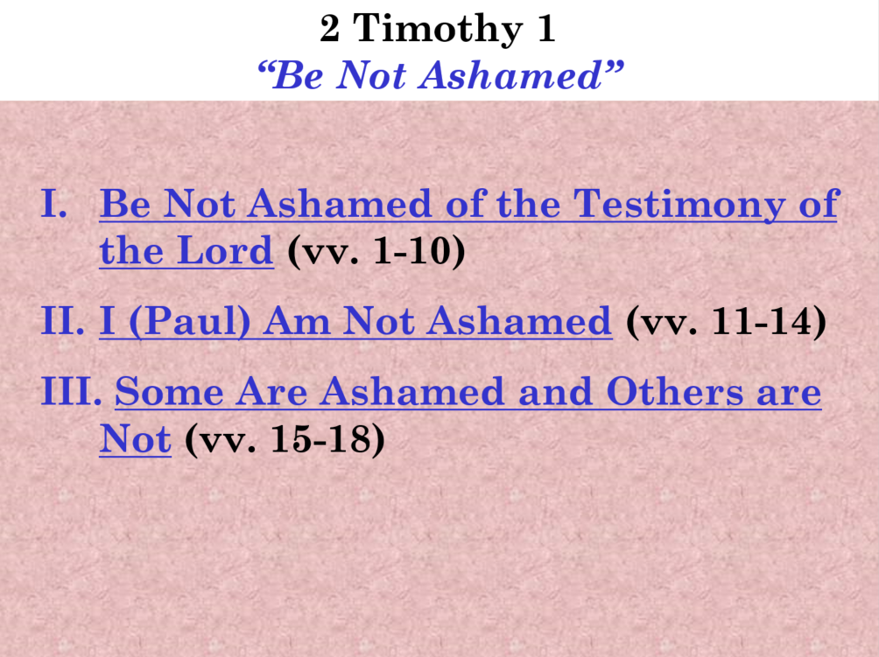

Slide 3
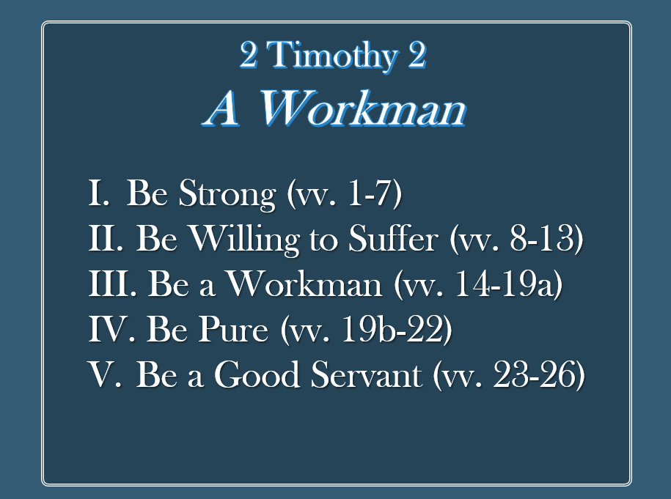

Slide 4
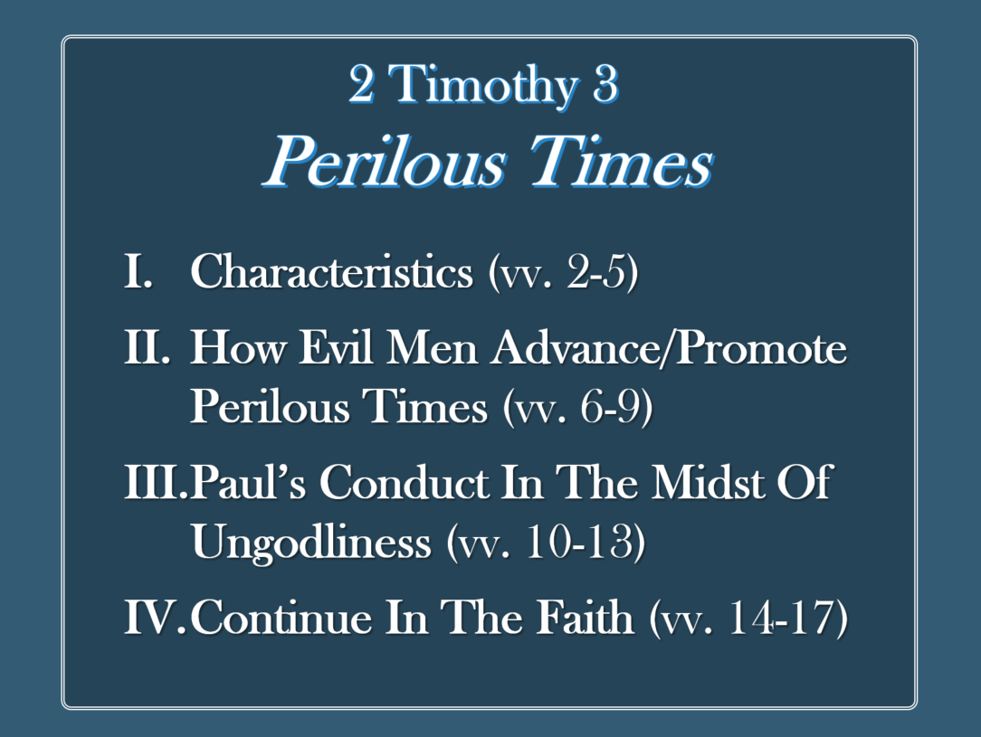

Slide 5
2 Timothy 4
Keep Preaching the Word
Paul’s Last Words
Key: Verse 2

Slide 6
Paul’s Last Words
2 Timothy 4
Keep Preaching the Word
The Charge to Preach (vv. 1-5)
The Mantle is Passed (vv. 6-8)
The Plea to Come (vv. 9-22)

Slide 7
Paul’s Last Words
2 Timothy 4
Keep Preaching the Word
The Charge to Preach (vv. 1-5)

Slide 8
The Charge to Preach (vv. 1-5)
Charge is before God and Christ (v. 1)
Ready in season and out (v. 2a)
Elements (v. 2b)
  Convince
  Rebuke
  Exhort
Time will come when men don’t want sound doctrine (vv. 3-5)
  Thus, seek teachers to scratch their ears (v. 3)
  They turn unto fables (v. 4)
  Watch, endure and preach (v. 5)

Slide 9
Paul’s Last Words
2 Timothy 4
Keep Preaching the Word
The Charge to Preach (vv. 1-5)
The Mantle is Passed (vv. 6-8)

Slide 10
The Mantle is Passed (vv. 6-8)
Looks Around at the Present (v. 6)
Looks Back at the Past (v. 7)
Looks Forward to the Future (v. 8)

Slide 11
Paul’s Last Words
2 Timothy 4
Keep Preaching the Word
The Charge to Preach (vv. 1-5)
The Mantle is Passed (vv. 6-8)
The Plea to Come (vv. 9-22)

Slide 12
The Plea to Come (vv. 9-22)
Come quickly (v. 9, 21)
Only Luke is with me (vv. 9-11a)
  Demas has forsaken me (v. 10)
  Crescens and Titus are gone (v. 10)
  Only Luke is here (v. 11a)

Slide 13
The Plea to Come (vv. 9-22)
Come quickly (v. 9, 21)
Only Luke is with me (vv. 9-11a)
Bring (vv. 11b-13)
  Mark (v. 11b)
  Cloak (v. 13)
  Books (v. 13)

Slide 14
The Plea to Come (vv. 9-22)
Come quickly (v. 9, 21)
Only Luke is with me (vv. 9-11a)
Bring (vv. 11b-13)
Alexander did me much evil (vv. 14-15)
The Lord is with me (vv. 16-18)
Conclusion (vv. 19-22)

Slide 15
Paul’s Last Words
2 Timothy 4
Keep Preaching the Word
The Charge to Preach (vv. 1-5)
The Mantle is Passed (vv. 6-8)
The Plea to Come (vv. 9-22)

