Slide 1
A Workman That Needs Not Be Ashamed
I. Be Not Ashamed (1)
II. A Workman (2)
III. Perilous Times (3)
IV. Continue To Preach The Word (4)

Slide 2
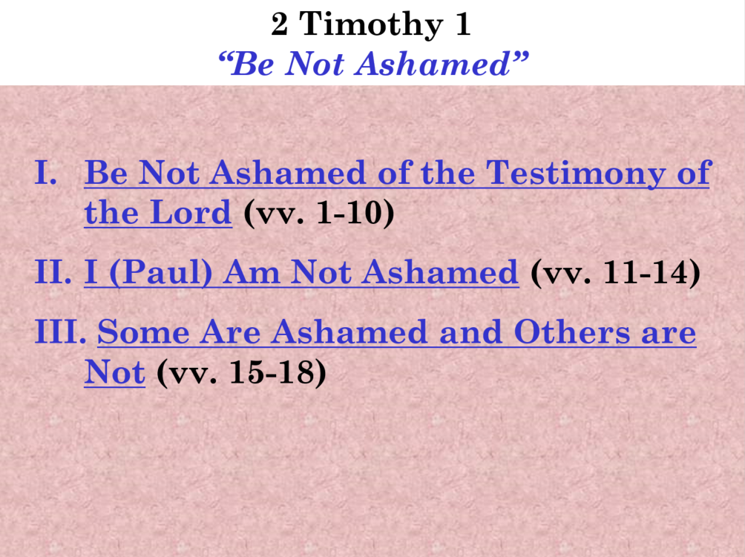

Slide 3
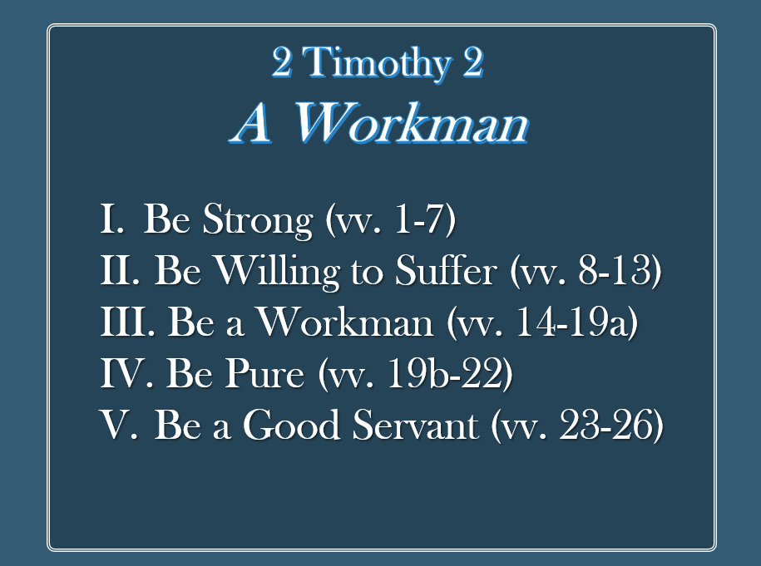

Slide 4
2 Timothy 3
Perilous Times
Key: Verse 1

Slide 5
“Perilous”
    “Grievous” (ASV)
    “Difficult” (NASV)
    “Terrible” (NIV)
    “Times of stress” (RSV; fn NKJV)
    “Times of difficulty” (ESV)
    “Fierce” (Mt. 8:28)

Slide 6
“Perilous, [chalepoi (NT:5467)] - 'difficult, embarrassing times,' in which it is difficult to know how to meet the dangers, spiritual and temporal.”
(Jamieson, Fausset, and Brown)
“Sin makes the times perilous. When there is a general corruption of manners, and of the tempers of men, this makes the times dangerous to live in; for it is hard to keep our integrity in the midst of general corruption.”
(Matthew Henry)
“You may as well know this too, Timothy, that in the last days it is going to be very difficult to be a Christian.”
TLB

Slide 7
2 Timothy 3
Perilous Times
Characteristics (vv. 2-5)
How Evil Men Advance/Promote Perilous Times (vv. 6-9)
Paul Conduct In The Midst Of Ungodliness (vv. 10-13)
Continue In The Faith (vv. 14-17)

Slide 8
2 Timothy 3
Perilous Times
Characteristics (vv. 2-5)

Slide 9
Characteristics (vv. 2-5)
  Emphasis on self (v. 2)
  Greedy (v. 2)

Slide 10
Characteristics (vv. 2-5)
  Emphasis on self (v. 2)
  Greedy (v. 2)
  Arrogant (vv. 2, 4)
    Boasters (v. 2)
    Proud (v. 2)
    High-minded (v. 4)

Slide 11
Characteristics (vv. 2-5)
  Emphasis on self (v. 2)
  Greedy (v. 2)
  Arrogant (vv. 2, 4)
  Disrespectful (vv. 2-3)
    Blasphemers (v. 2)
    Disobedient to parents (v. 2)
    Unthankful (v. 2)
    False accusers (v. 2)
    Despisers of good (v. 3)
    Without natural affection (v. 3)

Slide 12
Characteristics (vv. 2-5)
  Emphasis on self (v. 2)
  Greedy (v. 2)
  Arrogant (vv. 2, 4)
  Disrespectful (vv. 2-3)
  Unrestrained (vv. 2, 3, 4)
    Incontinent (v. 3)
    Fierce (v. 3)
    Unholy (v. 2)
    Heady (v. 4)

Slide 13
Characteristics (vv. 2-5)
  Emphasis on self (v. 2)
  Greedy (v. 2)
  Arrogant (vv. 2, 4)
  Disrespectful (vv. 2-3)
  Unrestrained (vv. 2, 3, 4)
  Can’t be trusted (vv. 3-4)
    Truce breakers (v. 3)
    Traitors (v. 4)

Slide 14
Characteristics (vv. 2-5)
  Emphasis on self (v. 2)
  Greedy (v. 2)
  Arrogant (vv. 2, 4)
  Disrespectful (vv. 2-3)
  Unrestrained (vv. 2, 3, 4)
  Can’t be trusted (vv. 3-4)
  Thrill seekers - lovers of pleasure (v. 4)
  Outward form of godliness (v. 5)

Slide 15
2 Timothy 3
Perilous Times
Characteristics (vv. 2-5)
How Evil Men Advance/Promote Perilous Times (vv. 6-9)

Slide 16
How Evil Men Advance / Promote Perilous Times (vv. 6-9)
  Privately - creep in (v. 6)
  Prey on unlearned and immature (v. 6)
  Prey on those interested in the novel (v. 7)

Slide 17
2 Timothy 3
Perilous Times
Characteristics (vv. 2-5)
How Evil Men Advance/Promote Perilous Times (vv. 6-9)
Paul Conduct In The Midst Of Ungodliness (vv. 10-13)

Slide 18
Paul Conduct In The Midst Of Ungodliness (vv. 10-13)
  Doctrine (v. 10)
  Manner of life (v. 10)
  Purpose (v. 10)
  Faith (v. 10)
  Longsuffering (v. 10)
  Charity (v. 10)
  Patience (v. 10)
  Persecutions (vv. 11-13)
Suffered – yet overcame (v. 11)
All will suffer (v. 12)
Reason (v. 13)

Slide 19
2 Timothy 3
Perilous Times
Characteristics (vv. 2-5)
How Evil Men Advance/Promote Perilous Times (vv. 6-9)
Paul Conduct In The Midst Of Ungodliness (vv. 10-13)
Continue In The Faith (vv. 14-17)

Slide 20
Continue In The Faith (vv. 14-17)
Remain in truth (vv. 14-15)
Perilous times comes because of a departure from truth (vv. 8, 16)
Remedy is to return to truth (vv. 16-17)

Slide 21
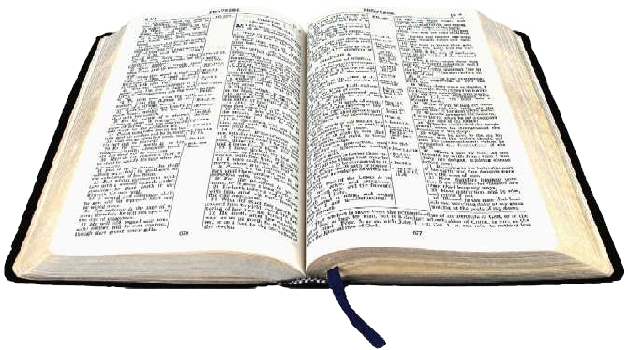
Verses 1-5 [The Problem]
Verse 8 [The Reason]
Verses 16-17 [The Answer]
Rejected
Return

Slide 22
The Scriptures
Tell Us:
Doctrine
  Tells us what is right
Reproof
  Tells us what is not right
Correction
  Tells us how to get right
Instruction in Righteousness
  Tells us how to stay right

Slide 23
2 Timothy 3
Perilous Times
Characteristics (vv. 2-5)
How Evil Men Advance/Promote Perilous Times (vv. 6-9)
Paul Conduct In The Midst Of Ungodliness (vv. 10-13)
Continue In The Faith (vv. 14-17)

