Slide 1
A Workman That Needs Not Be Ashamed
I. Be Not Ashamed (1)
II. A Workman (2)
III. Perilous Times (3)
IV. Continue To Preach The Word (4)

Slide 2
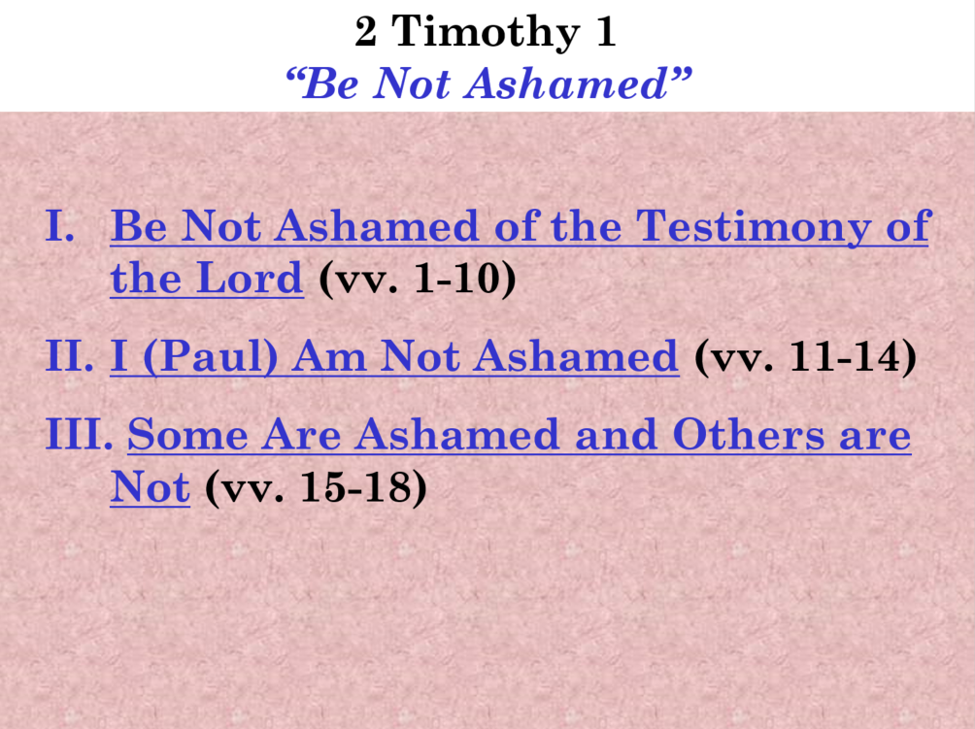

Slide 3
2 Timothy 2
A Workman
Key: Verse 15

Slide 4
2 Timothy 2
A Workman
Be Strong (vv. 1-7)
Be Willing to Suffer (vv. 8-13)
Be a Workman (vv. 14-19a)
Be Pure (vv. 19b-22)
Be a Good Servant (vv. 23-26)

Slide 5
2 Timothy 2
A Workman
Be Strong (vv. 1-7)

Slide 6
Be Strong (vv. 1-7)
As a teacher (vv. 1-2)
As a soldier (vv. 3-4)
  Endure hardness (v. 3)
  Don’t entangle self in this life (v. 4)
  Please your master (v. 4)
As an athlete (v. 5)
As a farmer (vv. 6-7)

Slide 7
2 Timothy 2
A Workman
Be Strong (vv. 1-7)
Be Willing to Suffer (vv. 8-13)

Slide 8
Be Willing to Suffer (vv. 8-13)
I am suffering for preaching the resurrection of Christ (vv. 8-9)
Suffer for the sake of saving souls (v. 10)
Through suffering we gain victory (vv. 11-13)

Slide 9
2 Timothy 2
A Workman
Be Strong (vv. 1-7)
Be Willing to Suffer (vv. 8-13)
Be a Workman (vv. 14-19a)

Slide 10
Be a Workman (vv. 14-19a)
Do not strive about words (v. 14)
Be diligent to be approved of God (v. 15a)
Handle the word properly (v. 15b)
Avoid empty chatter (vv. 16-19a)
  Leads people astray (vv. 16-18)
  In contrast: the foundation of God stands sure (v. 19)

Slide 11
2 Timothy 2
A Workman
Be Strong (vv. 1-7)
Be Willing to Suffer (vv. 8-13)
Be a Workman (vv. 14-19a)
Be Pure (vv. 19b-22)

Slide 12
Be Pure (vv. 19b-22)
Depart from iniquity (v. 19b)
Be a vessel of honor (vv. 20-21)
Flee youthful lust (v. 22a)
Pursue purity (v. 22b)

Slide 13
2 Timothy 2
A Workman
Be Strong (vv. 1-7)
Be Willing to Suffer (vv. 8-13)
Be a Workman (vv. 14-19a)
Be Pure (vv. 19b-22)
Be a Good Servant (vv. 23-26)

Slide 14
Be a Good Servant (vv. 23-26)
Avoid foolish disputes & quarreling (vv. 23-24)
Must be gentle to all (v. 24)
Must be able to teach (v. 24)
Must be patient (v. 24)
Must humbly deal with opposition (vv. 25-26)

Slide 15
2 Timothy 2
A Workman
Be Strong (vv. 1-7)
Be Willing to Suffer (vv. 8-13)
Be a Workman (vv. 14-19a)
Be Pure (vv. 19b-22)
Be a Good Servant (vv. 23-26)

