Slide 1
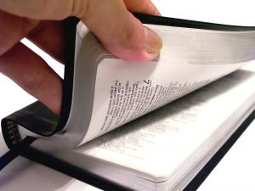
Mark Your Bible
For Today’s Reading
Psalm 103

Slide 2

Group # 1
Will Meet Tonight After Services

Slide 3
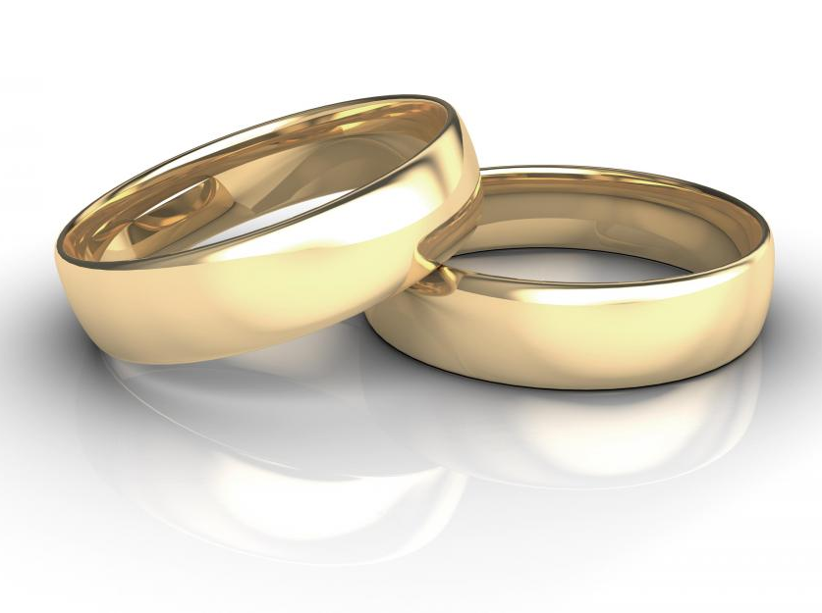
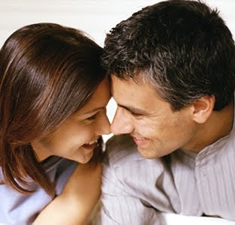
Building & Maintaining
A
Great Marriage
Making Your Marriage Last And Affair Proof
For Ages
40 and under
Six Classes – Sunday Afternoons 4:00 PM
April 9, 16, 30
May 7, 21, 28

Slide 4
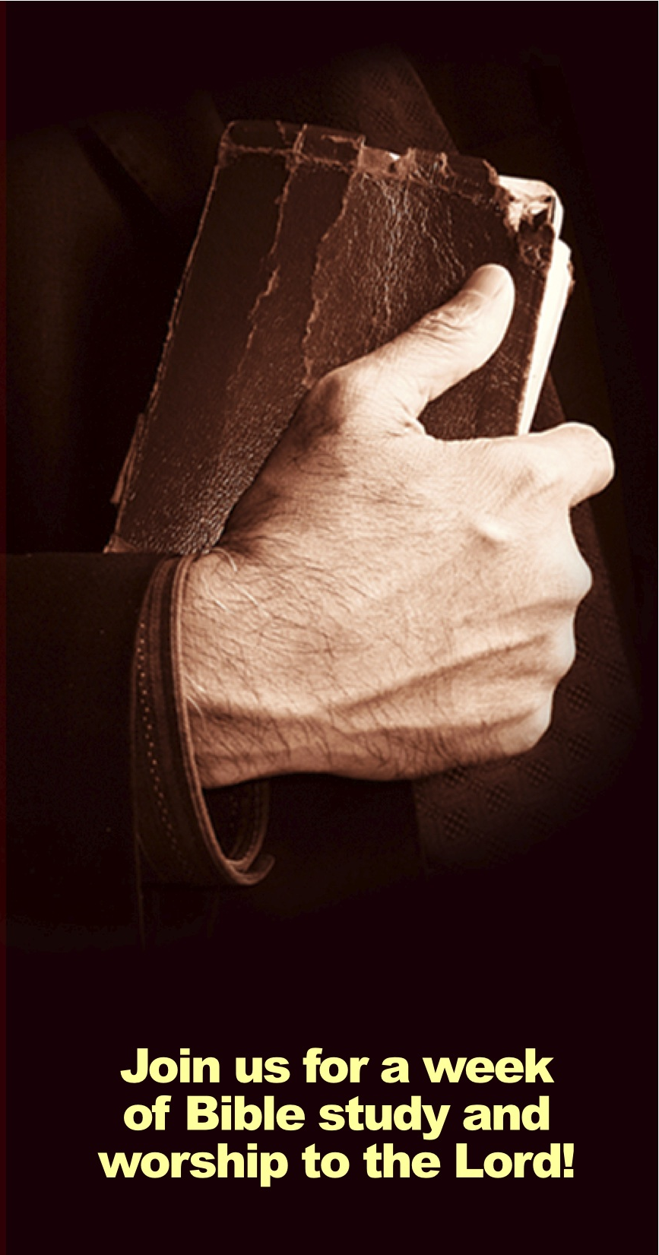
Gospel
Meeting
May 28 – June 2, 2017
Speaker:
Tim Shepherd
(Knoxville, TN)

Slide 5

Let’s Prepare
Our Minds
For Worship
of the
Almighty God!
Quiet Please!

Slide 7
Records of the
Great Commission
Matt. 28:19-20
Mark 16:15-20
Luke 24:47-48
John 20:21-23

Slide 8
Records of the
Great Commission
Matthew | Teach |  |  | Baptize | Into Name
Mark | Preach | Believe |  | Baptized | Saved
Luke | Preached |  | Repentance |  | Remission of Sins
Summary | Teach | Believe | Repent | Baptized | Saved

Slide 9
The Book of Acts
is a Book of Conversions
An inspired commentary on the commission
Fulfillment of prophecy (i.e. Isaiah 2)
More teaching on conversion in this book that any other book
It tells us:
  Actual cases
  Type of people (common, high rank)
  Numbers (single conversion or thousands)
  What they were taught & what they did

Slide 10
Conversion of the 3,000
(Acts 2)
Up till now – preached only in promise – now it is fact!
Called “The beginning” (Acts 11:15)
Called the “hub of the Bible”

Slide 11
Pentecost
One of three annual Jewish festivals
Observed on the 50th day (7 weeks) from Paschal Feast [7 Sabbaths + 1 day = 1st day]
Called “Feast of Harvest” (Exo. 23:16), “Feast of Weeks” (Num. 28:16; Lev. 23:17)
Fell in 3rd month (Sivan) = our late May

Slide 12
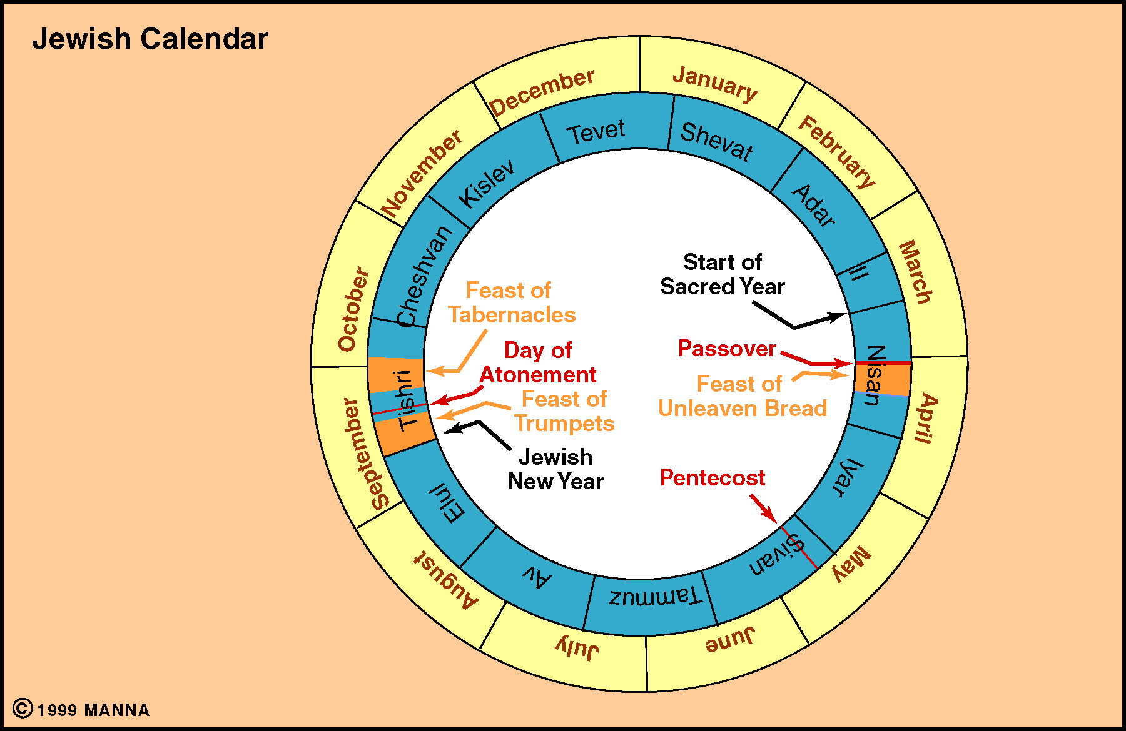

Slide 13
Conversion of the 3,000
(Acts 2)
The Account (Acts 2)

Slide 14
Acts 2
“The Beginning”
The Reception Of The Holy Spirit (vv. 1-13)
Peter’s Sermon (vv. 14-36)
Response Of The Multitude (vv. 37-41)
The Disciples Continued In The Apostles Doctrine (vv. 42-47)

Slide 15
The Reception Of The Holy Spirit (vv. 1-13)
  The apostles receive the Spirit and speak in tongues (vv. 1-4)
  The multitude is amazed (vv. 5-13)
The Audience:
In Sin
Think they are okay
Have some knowledge

Slide 16
Acts 2
“The Beginning”
The Reception Of The Holy Spirit (vv. 1-13)
Peter’s Sermon (vv. 14-36)
Response Of The Multitude (vv. 37-41)
The Disciples Continued In The Apostles Doctrine (vv. 42-47)

Slide 17
Peter’s Sermon (vv. 14-36)
A. Explanation of the events (vv. 14-21)

Slide 18
17'And it shall come to pass in the last days, says God,
That I will pour out of My Spirit on all flesh;
Your sons and your daughters shall prophesy,
Your young men shall see visions,
Your old men shall dream dreams.
18 And on My menservants and on My maidservants
I will pour out My Spirit in those days;
And they shall prophesy.
19 I will show wonders in heaven above
And signs in the earth beneath:
Blood and fire and vapor of smoke.
20 The sun shall be turned into darkness,
And the moon into blood,
Before the coming of the great and awesome day of the LORD.
21 And it shall come to pass
That whoever calls on the name of the LORD
Shall be saved.'
Revelation
Confirmation
Salvation

Slide 19
Peter’s Sermon (vv. 14-36)
Explanation of the events (vv. 14-21)
Jesus is raised from the dead (vv. 22-36)
  The one you crucified is raised (vv. 22-24)
  David prophesied of this (vv. 25-31)
  He is now exalted as both Lord & Christ (vv. 32-26)
What they heard:
Conviction of sin
Evidence of Res. of Christ

Slide 20
Acts 2
“The Beginning”
The Reception Of The Holy Spirit (vv. 1-13)
Peter’s Sermon (vv. 14-36)
Response Of The Multitude (vv. 37-41)
The Disciples Continued In The Apostles Doctrine (vv. 42-47)

Slide 21
Response Of The Multitude (vv. 37-41)
A. They asked what to do (vv. 37-40)
1. The question (v. 37)
2. The answer (vv. 38-40)
a. Repent & be baptized for rem. (vv. 38-39)
b. Save yourself (v. 40)
B. They gladly received word & obeyed (v. 41)
What they were told:
Repent
Be Baptized

Slide 22
Records of the
Great Commission
Matthew | Teach |  |  | Baptize | Into Name
Mark | Preach | Believe |  | Baptized | Saved
Luke | Preached |  | Repentance |  | Remission of Sins
Acts 2 | Hear (v. 22) | Know (v. 36) | Repent (v. 38) | Baptized (v. 38) | Rem of sin (v. 38)

Slide 23
Acts 2
“The Beginning”
The Reception Of The Holy Spirit (vv. 1-13)
Peter’s Sermon (vv. 14-36)
Response Of The Multitude (vv. 37-41)
The Disciples Continued In The Apostles Doctrine (vv. 42-47)

Slide 24
The Disciples Continued In The Apostles Doctrine (vv. 42-47)
Followed apostles authority (v. 42)
Were steadfast (v. 42)
Worshiped (v. 42)
Feared (v. 43)
Took care of needy (vv. 44-45)
Served daily (v. 46)
Grew (v. 47)
What did they become?
Active Christians
Worshiped, Dedicated, Active

Slide 25
Conversion of the 3,000
(Acts 2)
The Account (Acts 2)
The Summary

Slide 26
Summary of Their Conversion
They were in sin
Jesus was raised from dead
Must Repent & Be Baptized
What Were
They Told?
What Did They
Understand?
That they needed to be saved
That Jesus is Son of God
That they must repent & bapt.
How Did They
Respond?
Gladly, willingly obeyed

Slide 27
Records of the
Great Commission
Matthew | Teach |  |  | Baptize | Into Name
Mark | Preach | Believe |  | Baptized | Saved
Luke | Preached |  | Repentance |  | Remission of Sins
Acts 2 | Hear (v. 22) | Know (v. 36) | Repent (v. 38) | Baptized (v. 38) | Rem of sin (v. 38)

Slide 28
Conversion of the 3,000
(Acts 2)
The Account (Acts 2)
The Summary

