Slide 1
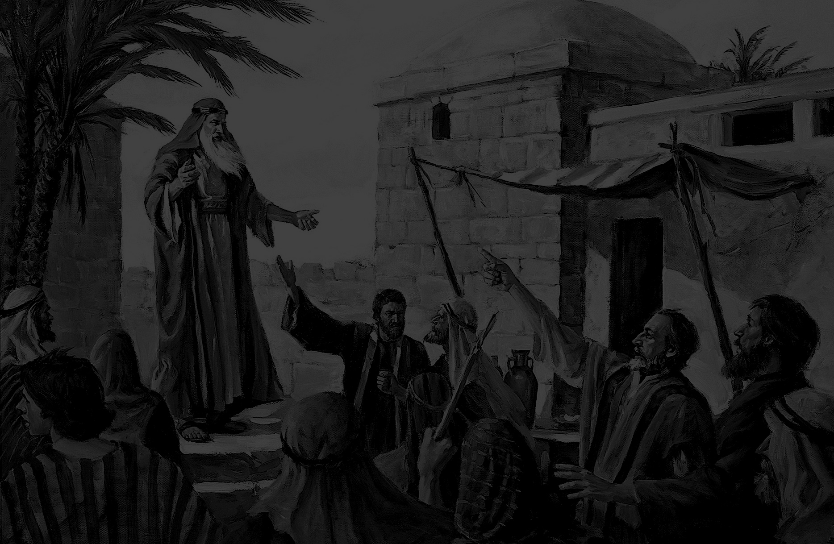
Godly Living
in an
Ungodly World

Slide 2
The Standard:
Jehovah God

Slide 3
“You shall be holy, for I am holy.”

Slide 4
The Rejection of the Standard

Slide 5
Rejection:
In Religion

Slide 6
Rejection:
In Leadership

Slide 7
Rejection:
In Society

Slide 8
The Consequence of Rejection
Judgement

Slide 9
The message
of God:
Repent!

Slide 10
“You shall be holy, for I am holy.”

