Slide 1
What About
The Prom?
Is it wrong to dance?
Is it wrong to go to the prom?

Slide 2
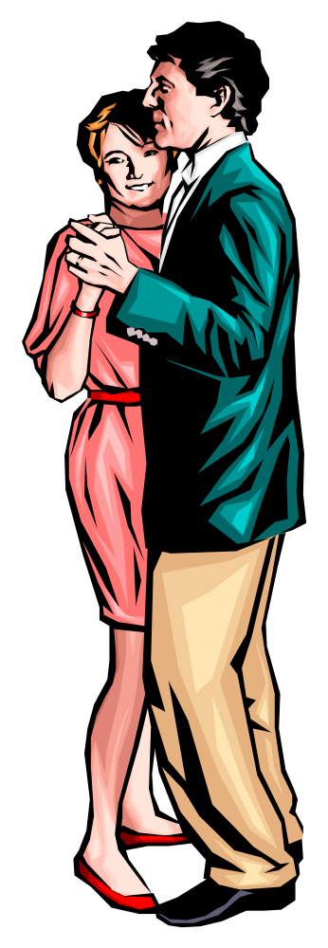
Why Can’t Christian Dance Or Go To The Prom?
How can we say it is wrong when no passage specifically forbids it?
Why some Christians see nothing wrong with dancing & encourage it?
World thinks it is an innocent thing.
Is it wrong to go to school prom?
Many know it is wrong – can’t prove it.

Slide 3
People Often Live Like They Want
Judges 21:25 (17:6)
In those days there was no king in Israel; everyone did what was right in his own eyes.
Isaiah 5:20
Woe to those who call evil good, and good evil;
Who put darkness for light, and light for darkness;
Who put bitter for sweet, and sweet for bitter!
Christians Are Not Exempt!

Slide 4
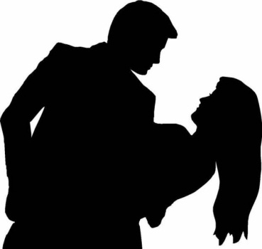
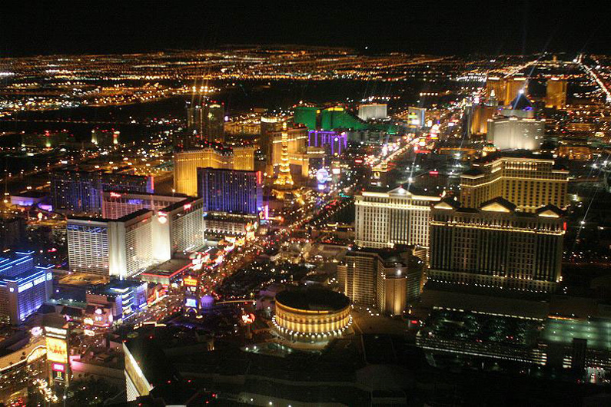
What About The Prom?
What Is Dancing?

Slide 5
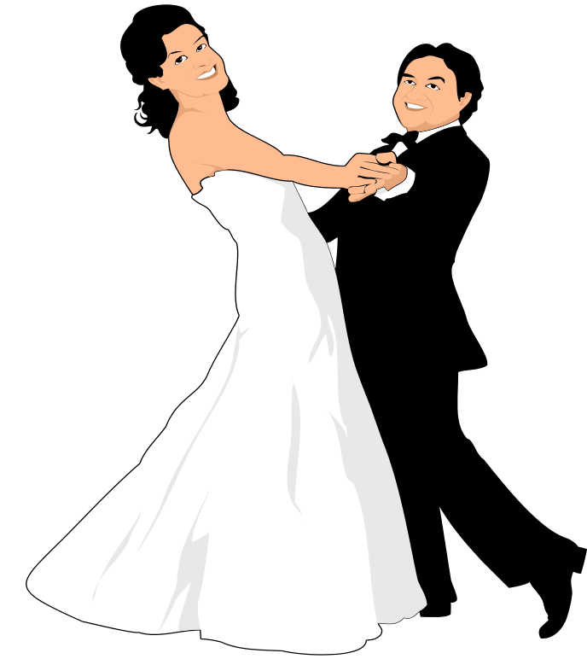
What Is Dancing?
Dance is an expression in rhythmic movement of an intensified sense of life, arising from an inner perception that stimulates both mind and body. -Grolier
To move rhythmically to music, using prescribed or improvised steps and gestures. -American Heritage Dictionary

Slide 6

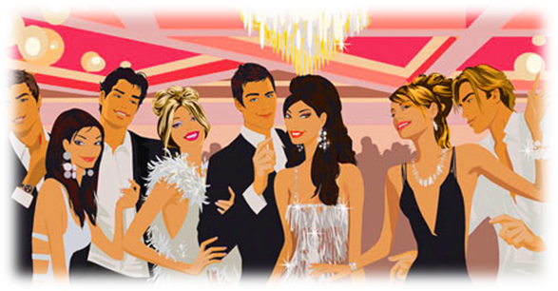
Close Bodily Contact
Moving in Rhythm To The Music
Romantic Atmosphere: Lights, Music, Revealing Attire

Slide 7
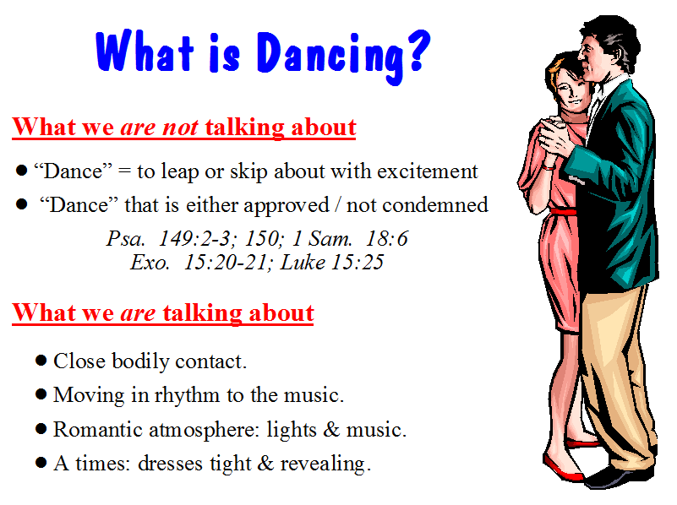
At times: dresses tight & revealing.

Slide 8
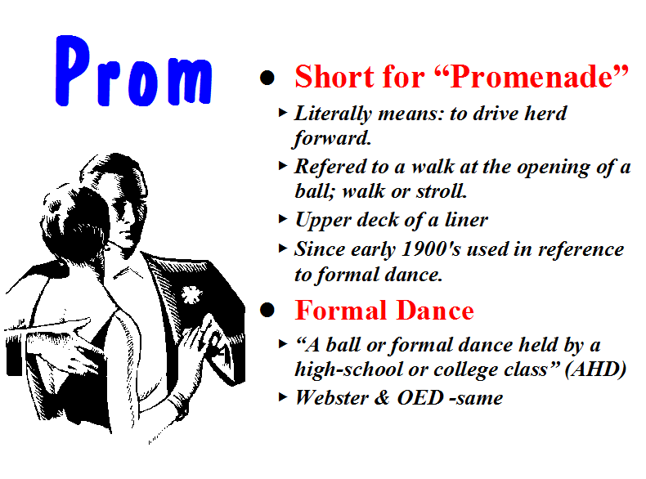

Slide 9
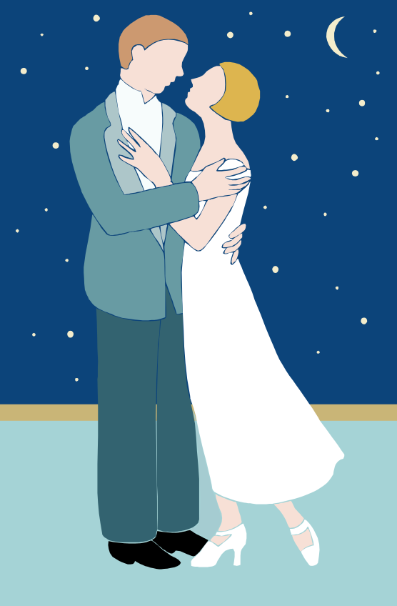
Various Types of Dancing
Waltz
Disco
Ballroom
Dirty Dancing
Prom
At Some Party

Slide 10
What About The Prom?
What Is Dancing?
What Is The Appeal?

Slide 11
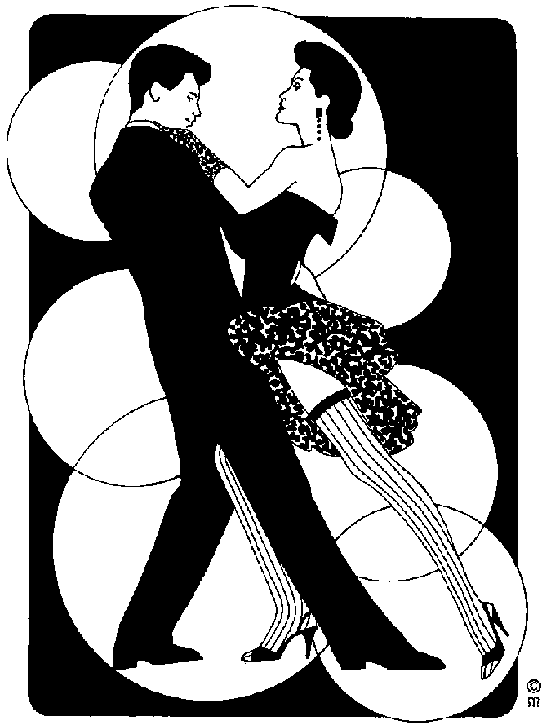
The Testimony of The World
The Appeal:
Sexual

Slide 12

Testimony of the World
J. Edgar Hoover: “Most juvenile crime has its inception in the dance hall, either public or private.”
Prof. W. C. Wilkerson of Chicago University: it is a “system of means, contrived with more than human ingenuity, to excite the instinct of sex action.”
T. A. Vogner, former supervisor of the Dancing Academy in CA: “No woman can waltz well and waltz virtuously.”
J. P. Gibson, MD: “Among those who dance it is noteworthy that very few girls spend much time dancing with other girls. Neither do men dance very much with own wives, nor brothers with their own sisters...the secret of the popularity of dancing (or is it a secret) is the exciting, sexual stimulation resulting from the close embrace of male and female whether it be with music in dancing or without music in petting and necking.”
Homer Hailey: “It is true that only a minority of church members dance, and possibly a small minority; but to whatever degree dancing is tolerated among members of the body, to just that degree the church tends toward the world, and allows the spirit of the world to infiltrate it.”

Slide 13
Testimony of the World
"Another motive for the dance is the sexual motive - the dance has always been used as a means of expressing sexual desire and as a means of wooing...We find this same sex motive in the modern ballroom dance, which has now degenerated into dull and stupid forms, but it is a legitimate opportunity for contact." - Dance We Must (1938, reprinted 1950), p. 6 (from a series of lectures given by Ted Shawn at George Peabody College For Teachers

Slide 14
Testimony of the World
Interview with Arthur Murray: “Why has ballroom dancing declined? Murray responds: ‘Since dancing is based on sexual flirtation and since young people have no problem with sexual flirtation; dancing has taken a back seat to the back seat’. This only confirms what we all know, dancing leads from the ballroom to the bedroom – L.A. radio host Ervin Edwards [Big E.].”
Mark Weisner, Ph.D. in his article “When the Answer is Not Tonight” – “Think about activities that lead to sex. A dark crowded room with whispers of delight, the dance floor, a proven place for the struggling couple. A romantic dinner with a band, candles, and ‘the right foods’.” –

Slide 15
Testimony of the World
“We are all men. We know the natural desires of youth. We know that sex is the strongest impulse Implanted in the human race. You can picture the effect on a boy or girl of eighteen or twenty, when this hunger is the keenest, when knowledge and experience are lacking in formation of judgment, of one of these dances which call for close abdominal contact and frequently brings the cheeks together and entwine the limbs ... There is left but one reason for the popularity of the dance, and that is sex appeal. I hasten to assure you that I do not believe the dancers are always conscious that this is the reason they enjoy this position and the steps that go with it. But this lack of consciousness is merely an added factor of danger ... when you are told that

Slide 16
Testimony of the World
youth of both sexes can survive this experience without mental, moral, or physical pollution, you know the teller lies ... If you can believe youth is the same after this experience as before, then God help your child or your charge, for you are not mentally fit for your responsibility. If you do not believe I have correctly described the modern dances and their effects, you either have not seen them performed or you are willfully blind to their true nature. “ – Louis Guyon, owner and operator of Chicago’s largest dance hall

Slide 17
Testimony of the World
“There can scarcely be any doubt that dancing came about as an adjunct of sexual stimulation” (Medical Review of America)
The drawing power of the discos attributed to its “progressive sexuality” and the promoters pin-pointing “sex-appeal” as the life-blood of the fad (The New York Times Magazine)
"I don't think ballroom dancing will ever return to popularity. People always thought it was a prelude to sex, but people don't need preludes anymore" (Arthur Murray, Chicago Tribune, "No Prelims, All Main Event")

Slide 18
Testimony of the World
"All ballroom dancing in pairs looks toward intercourse. In this respect the Puritans were dead right....The development of no-contact dances has come about because one doesn't now need a social excuse to embrace a girl, but as an excitant it need not involve contact at all - in fact, dances like flamenco or the twist are far more erotic than a clinch because you aren't too close to see one another. At its best this sort of dance is simply intercourse by remote control." – (The Joy Of Sex, Alex Comfort, p. 162, 1972)

Slide 19
If a young man takes
your daughter to the
Prom –
The parents are proud!
If they engage in the same
action in the
Living room –
Send him home!
The Testimony of The World
If Remove Sexual – Kill Dance:
  Bodily Contact
  Lewd Movements
  Boys w/ girls
If Stop the Music – same actions would be called “petting”
The Appeal:
Sexual

Slide 20
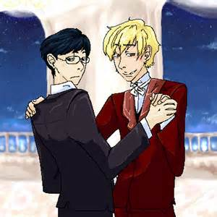
If you were to walk into a room where boys were dancing with each other
What conclude?
Would assume gay?
Why?
The Appeal:
Sexual

Slide 21
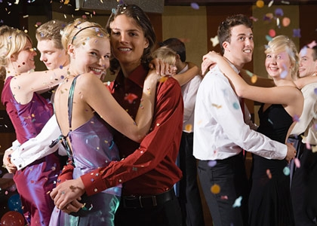
Close – Inappropriate Bodily Contact

Slide 22
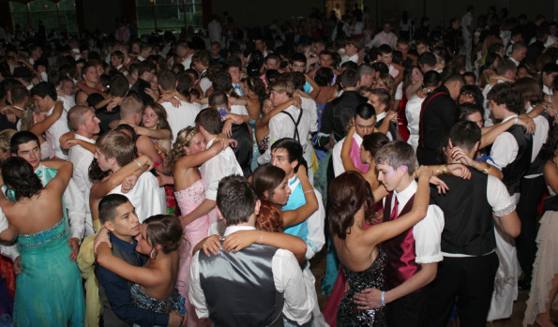
Close – Inappropriate Bodily Contact

Slide 23
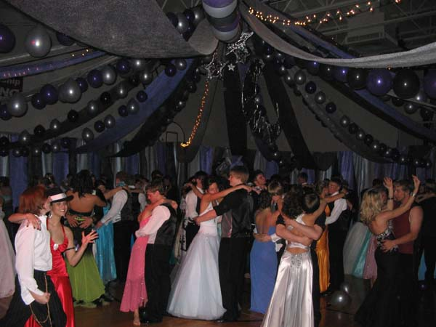
Close – Inappropriate Bodily Contact

Slide 24
What About The Prom?
What Is Dancing?
What Is The Appeal?
Principles That Condemn The Dance

Slide 25
Luke 7:18-22
18 Then the disciples of John reported to him concerning all these things.
19 And John, calling two of his disciples to him, sent them to Jesus, saying, "Are You the Coming One, or do we look for another?"
20 When the men had come to Him, they said, "John the Baptist has sent us to You, saying, 'Are You the Coming One, or do we look for another?' "
21 And that very hour He cured many of infirmities, afflictions, and evil spirits; and to many blind He gave sight.
22 Then Jesus answered and said to them, "Go and tell John the things you have seen and heard: that the blind see, the lame walk, the lepers are cleansed, the deaf hear, the dead are raised, the poor have the gospel preached to them.
No Direct
Statement
Rather
Evidence
From
Which To
Draw
Conclusion
Question: “Are you coming one?”
Response: Worked Miracles!
Conclusion: He is the coming one!

Slide 26

Bible
Principles
That
Condemn
Dancing
Lasciviousness

Slide 27
Lasciviousness
(aselgeia)
Passages:
Gal. 5:19
1 Pet. 4:3
Rom. 13:13
2 Pet. 2:7
Defined
“Unbridled lust…
wantoness
shamelessness…wanton
(acts or) manners, as
filthy words, indecent
bodily movements,
unchaste handling of
males and females, etc.
(Thayer, p. 79-80)
How Used
Sensuality
Bauer 114
NASV
That which
leads to lust

Slide 28
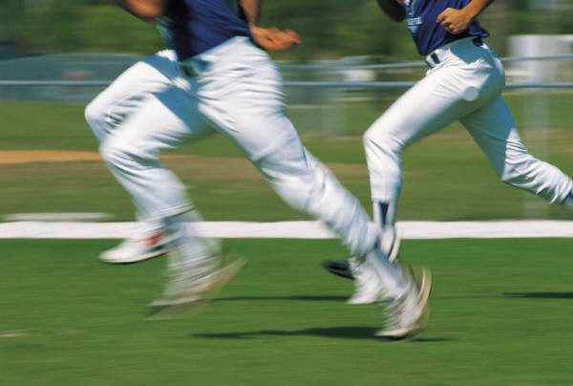
Bible
Principles
That
Condemn
Dancing
Lasciviousness
Flee Lust
Flee: To run away,
shun or escape
(Strongs)
2 Tim. 2:22
1 Thess. 4:3-6
Col. 3:5

Slide 29
Bible
Principles
That
Condemn
Dancing
Lasciviousness
Flee Lust
Flee Fornication
1 Cor. 6:18

Slide 30
Bible
Principles
That
Condemn
Dancing
Lasciviousness
Flee Lust
Flee Fornication
Revelries

Slide 31
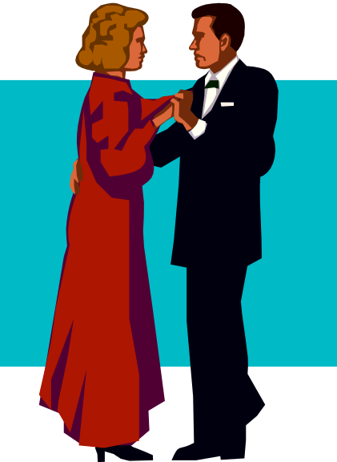
Revelries
“feast and drinking parties that protracted till late at night and indulge in revelry” (Thayer)
“carousal, merrymaking, with music and dancing” (Liddell and Scott Greek Lexicon)
Scott's Bible - "'Revelings' were such feasts, as were accompanied with music and dancing, and whatever could promote hilarity and sensual gratification."

Slide 32
What About The Prom?
What Is Dancing?
What Is The Appeal?
Principles That Condemn The Dance
Attempts to Justify

Slide 33
Attempts to Justify
“Even If It Excites Others Sexually - It Does Not Effect Me That Way – I Can Control My Thinking”
  I doubt that this is usually the case – we sometimes overestimate our strength
  Even if you are not so affected – what about the one you are with?

Slide 34
Attempts to Justify
”I Can’t Control What Others Think”
  We are responsible when we influence a person in the wrong direction

Slide 35
Attempts to Justify
“Men & Women Danced in the Bible”

Slide 36
Dancing in the Bible
Four Categories Of Dancing in the Bible
  “religious” dances of the O.T. – Exo.15:20-21; 2 Sam.6:14
  expression of rejoicing – 1 Sam.18:6
  play of children – Luke 7:32; Job 21:11
  the dance of Salome – Matt.14:6
The First Three Categories Do Not Resemble the Dancing that We Are Talking About

Slide 37
Dancing in the Bible
"While the mode of dancing is not known in detail, it is clear that men and women did not generally dance together, and there is no real evidence that they ever did. Social amusement was hardly a major purpose of dancing, and the modern method of dancing by couples is unknown." - Zondervan Pictorial Encyclopedia Of The Bible, "Dancing“
"Women seemed generally to have danced by themselves... Of the social dancing of couples in the modern fashion there is no trace." – ISBE
"There is no evidence of couples dancing together, however; that was to happen much later, probably in Provence in the 12th Century." - Encyclopedia Britannica, "The Art Of Dance",

Slide 38
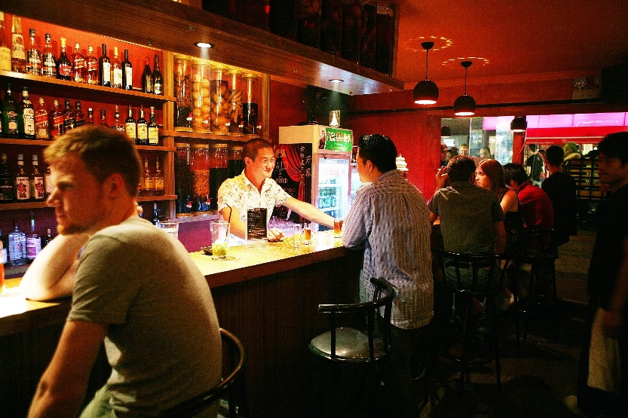
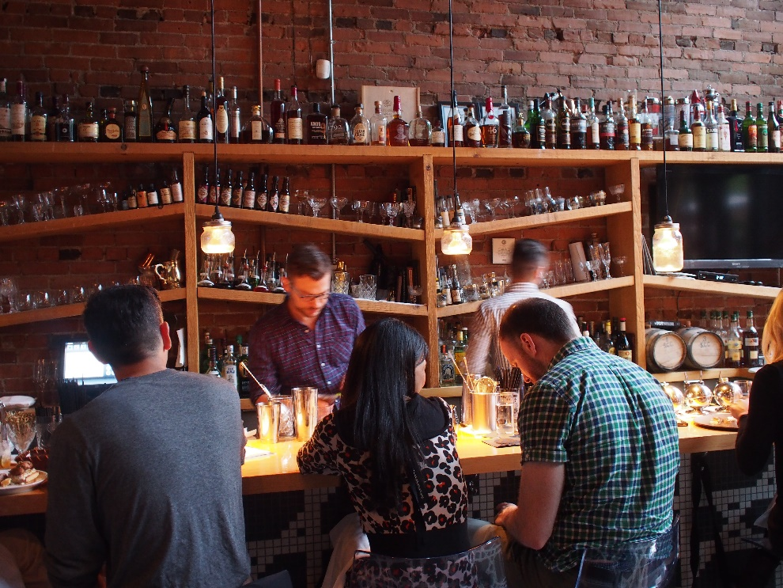
What if I go but don’t dance?
What would you think of a Christian sitting at a bar?
Not drinking alcohol
Seen going into bar – sitting on stool
His friends are drinking
Doesn’t tell everyone – is not drinking
Not clear to all – not drinking
Is in middle of where people are drinking
Would it leave the wrong impression?

Slide 39
What About The Prom?
What Is Dancing?
What Is The Appeal?
Principles That Condemn The Dance
Attempts to Justify

