Slide 1
John 12:20–26
²⁰ And there were certain Greeks among them that came up to worship at the feast:
²¹ The same came therefore to Philip, which was of Bethsaida of Galilee, and desired him, saying, Sir, we would see Jesus.
²² Philip cometh and telleth Andrew: and again Andrew and Philip tell Jesus.
²³ And Jesus answered them, saying, The hour is come, that the Son of man should be glorified.
²⁴ Verily, verily, I say unto you, Except a corn of wheat fall into the ground and die, it abideth alone: but if it die, it bringeth forth much fruit.
²⁵ He that loveth his life shall lose it; and he that hateth his life in this world shall keep it unto life eternal.
²⁶ If any man serve me, let him follow me; and where I am, there shall also my servant be: if any man serve me, him will my Father honour.

Slide 2
John 12:20-26
Greeks (Gentiles -7:35) came to temple area (v. 20)
  Probably proselytes (former pagans) who now worship the God of the Jews
  Uncircumcised – thus not accepted into full association in the synagogues
  Practice was to come to Jerusalem to worship (like the Eunuch – Acts 8:27)
  Likely Galilean Gentiles who may have known Philip (Greek name)

Slide 3
John 12:20-26
Greeks (Gentiles -7:35) came to temple area (v. 20)
Request: “Sir, we would see Jesus” (v. 21)
  Not merely wanting to see what all the excitement is about
  Not merely wanting to see him at a distance
  Asking for a private meeting with the Master
  Purpose: come to Jesus for answer – perhaps about salvation.
  May have heard of his dealing with non-Jews (John 4)

Slide 4
John 12:20-26
Greeks (Gentiles -7:35) came to temple area (v. 20)
Request: “Sir, we would see Jesus” (v. 21)
Philip’s Response (v. 22)
  Was not eager to take some Gentiles to Jesus
    Had instructed them not to go in the way of the Gentiles (Matt. 10:1-5)
    Yet, said that others not of this fold (John 10:16)
  Went and told Andrew (name also Greek)
  Andrew was perhaps more forward (cf. Jno 1:41; 6:8-9)
  Both went to the Lord
  They brought the problem / question (not the Gentiles) to the Lord.

Slide 5
John 12:20-26
Greeks (Gentiles -7:35) came to temple area (v. 20)
Request: “Sir, we would see Jesus” (v. 21)
Philip’s Response (v. 22)
Lord’s Response (vv. 23-ff)
  No record of conversation or question from Greeks or Philip
  Answer addressed the concerns of the Greeks (who gave emphasis to physical life) saying that true life comes through death
  Safe to assume that they heard the answer

Slide 6
“…We Would
See Jesus…”
John 12:21

Slide 7
“…We Would See Jesus…”
Context of John 12
John 12:21
In His Worship (vv. 1-8)
In His Miracles (vv. 9-11)
In His Triumphal Entry (vv. 12-19)
In His Death (vv. 20-36)
In His Distractors (vv. 37-43)
In His Mission & Message (vv. 44-50)

Slide 8
“…We Would See Jesus…”
John 12:21
In the Pulpit & Classroom

Slide 9
“…We Would See Jesus…”
In the Pulpit & Classroom
The Message Should Exalt Jesus Christ
  New Testament is the revelation of Jesus Christ (Heb. 1:1; John 12:48)
  To preach gospel is to preach Christ (Acts 8:35; 1 Cor. 2:2)
  Jesus came to redeem (Lk. 19:10), thus a redemptive message
  Preacher’s /Teacher’s job: preach the word (2 Tim. 4:2)

Slide 10
“…We Would See Jesus…”
In the Pulpit & Classroom
The Message Should Exalt Jesus Christ
We Would See Jesus
  Leave the hearer with an impression of Jesus – not you / your opinion
  Not your stories or experience
  Careful that our desire to be “different” doesn’t cloud the message of Christ!
  As a listener – want to hear truth (more than the person, the voice, the stories…)

Slide 11
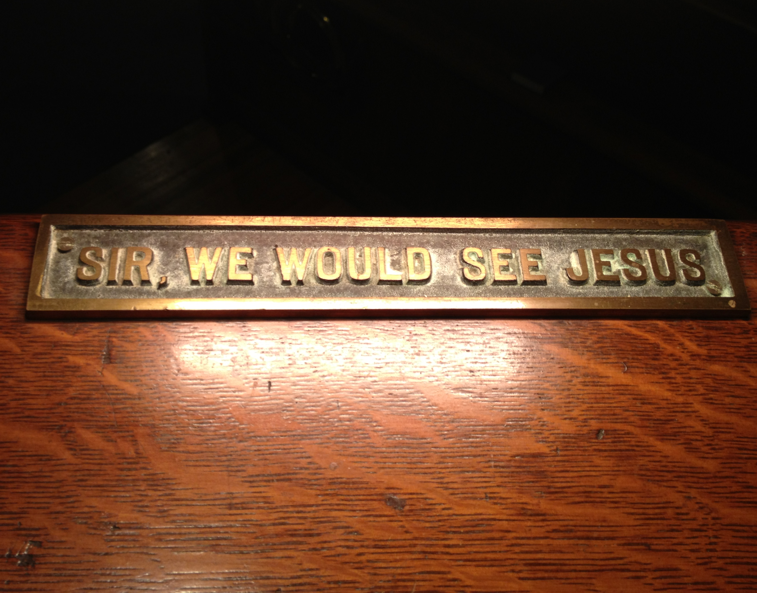

Slide 12
“…We Would See Jesus…”
John 12:21
In the Pulpit & Classroom
In Our Worship

Slide 13
“…We Would See Jesus…”
In Our Worship
Worship Service is to Praise & Honor God
  Purpose is to worship (John 4:23-24; Rev. 22:9)
  Jesus is deity – worthy of worship (John 1:1; Heb. 1:8)
  He accepted worship (John 12:1-8)

Slide 14
“…We Would See Jesus…”
In Our Worship
Worship Service is to Praise & Honor God
We Would See Jesus
  In purpose – to worship, praise & honor Jesus!
    Focus on “going to church” is visiting, talking & enjoying relationships
    “Worship” is very important, but becomes secondary
    “Church” is place to meet friends, develop social circle
  In attention – focus on what doing (John 4:24; 1 Cor. 11:29)
  In enthusiasm (Psa. 122:1; Rom. 12:11)

Slide 15
“…We Would See Jesus…”
John 12:21
In the Pulpit & Classroom
In Our Worship
In the Home

Slide 16
“…We Would See Jesus…”
In the Home
Home & Family Should Reflect the Influence of Christ
  Creator of marriage & home (Gen. 1:26; 2:18-ff)
  Marriage involves man, woman & God (Rom. 7:1-4)
  Last will & testament of Christ leaves instructions for:
    Marriage (1 Pet. 3:1-7)
    Parenting (Eph. 6:1-4)
  Focus goal – walk in truth (3 John 4)

Slide 17
“…We Would See Jesus…”
In the Home
Home & Family Should Reflect the Influence of Christ
We Would See Jesus
  In commitment to follow Christ (Matt. 19:4-6)
  In love like Christ loved Church (Eph. 5:25)
  In way treat one another (Matt. 7:12)
  In how view children – blessing (Psa. 127:3-5; Gen. 48:9)
  In discipline of the children (Prov. 22:15)
  In teaching children (2 Tim. 3:14-17)
  In the emphasis on spirituality (1 Pet. 3:1-6)
  In doing things together (Matt. 19:6)
  In respecting roles (Eph 5)

Slide 18
“…We Would See Jesus…”
John 12:21
In the Pulpit & Classroom
In Our Worship
In the Home
In the Workplace

Slide 19
“…We Would See Jesus…”
In the Workplace
Christianity Governs Our Conduct on the Job
  Do what your are told (Tit. 2:9-10; Col. 3:22)
  Work hard – do your best (Col. 3:23)
  Honorable (Tit. 2:10)
  Make effort to get along with others (Rom. 12:18)
  Part of service to Christ (Col. 2:23; Eph. 6:5, 7)

Slide 20
“…We Would See Jesus…”
In the Workplace
Christianity Governs Our Conduct on the Job
We Would See Jesus
  In your attitude as you work
  In your diligence – do your job
  In the quality of work you do
  In how you get along with others
  In what are your priorities (service to God / family)

Slide 21
“…We Would See Jesus…”
John 12:21
In the Pulpit & Classroom
In Our Worship
In the Home
In the Workplace
In Our Daily Lives

Slide 22
“…We Would See Jesus…”
In Our Daily Lives
Following Christ is a Daily Commitment
  Don’t continue to practice sin (Rom. 6; 1 John 3:6, 9)
  Includes - how treat neighbor (Matt. 7:12; Matt. 22:39)
  Includes - our relationship to others (Rom. 12)
  Includes - the words we speak (Matt. 12:36-37)
  Includes – our thoughts (Rom. 2:15; 2 Cor. 10:5; Matt. 5:28)
  Includes – new attitudes (Gal. 5:22-23)

Slide 23
“…We Would See Jesus…”
In Our Daily Lives
Following Christ is a Daily Commitment
We Would See Jesus
  How you interact with others
  How you react to “life” and its problems (worry / content)
  When you are entertained
  When you are involved in sports & recreation
  In the language you use – things that you tell
  In the friends you choose

Slide 24
“…We Would See Jesus…”
John 12:21
In the Pulpit & Classroom
In Our Worship
In the Home
In the Workplace
In Our Daily Lives

