Slide 1
Bible Hermeneutics
Tonight’s Lesson:
Words
March 1, 2023

Slide 2
Bible Study - Challenge
Read 1, 2 & 3 John
At least 50 times
by the end of April
Can be read in 15 minutes
With each reading you will see more
May try another translation a few times
Take note of key concepts / words / contrast

Slide 3
Jan. 4 – Introduction to Inductive Bible Study
Jan. 11 – Background – Intro Information
Jan. 18 – Context
Jan. 25 – Context
Feb. 1 – Outlining the Text
Feb. 8 – Outlining the Text
Feb. 15 – Bible Study Aids
Feb. 22 – Use of Translations
Mar. 1 – Words
Mar. 8 – Hebrew / Greek Words
Mar. 15 – Hebrew / Greek Words
Mar. 22 – Use of Commentaries
Mar. 29 – Figurative Language
Apr. 5 – Figurative Language
Apr. 12 – Apocalyptic Literature & Numbers
Apr. 19 – Hebrews and Hermeneutics
Apr. 26 – Application / Practical Lessons
Bible Hermeneutics

Slide 4
Two Levels Going Throughout
Basic Level
Deeper Dives

Slide 5
Basic Level
The Text (Read, Read, & Read)
What is the Context?
Structure / Thought Patterns
Check Translations
Word meaning
What Did This Mean to Original Audience?
Application

Slide 6
Words
The means God used to reveal his mind through the Holy Spirit is WORDS (Eph. 3:3-5)
Words carefully chosen by the Holy Spirit (1 Cor. 2:13)
Language was not English
  Hebrew
  Aramaic
  Koine’ Greek

Slide 7
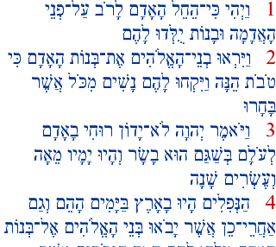

Languages Used
Old Testament
  Hebrew
    Almost all of the 39 Old Testament books
    Written “backwards” (to us) – Right to Left
    Sample see in Psa. 119 in KJV, ASV, NKJV
Gen. 6:1-4

Slide 8
Languages Used
Old Testament
  Hebrew
  Aramaic
    Kin to the Hebrew language
    After the time of Exile (500 BC) become the tongue of the common man in Palestine
    Aramaic Sections of the OT:
Place name (Gen. 31:47)
One verse (Jer. 10:11)
Six chapters in Daniel (2:4b – 7:28)
Several chapters in Ezra (4:8 – 6:18; 7:12-26)

Slide 9
Aramaic in the NT
Mark 5:41 – “Talitha cumi”
Mark 7:34 – “Ephphatha”
Matt. 27:46 – “Eli, Eli, lama sabachthani”
Rom. 8:15; Gal. 4:6 - “ Abba”
1 Cor. 16:22 – “Marana tha”
“little girl”
“be opened”
“my God, my God..”
“father”
“come Lord”

Slide 10
Languages Used
Old Testament
New Testament
  Koine’ Greek
  Richard Rothe (German Scholar) in 1863 called this “the language of the Holy Ghost”
  Koine’ Period – 330 BC to 333 AD
    Following this period the universality of the language ceased – Definitions are more certainly established
    Meaning of the words “frozen”

Slide 11
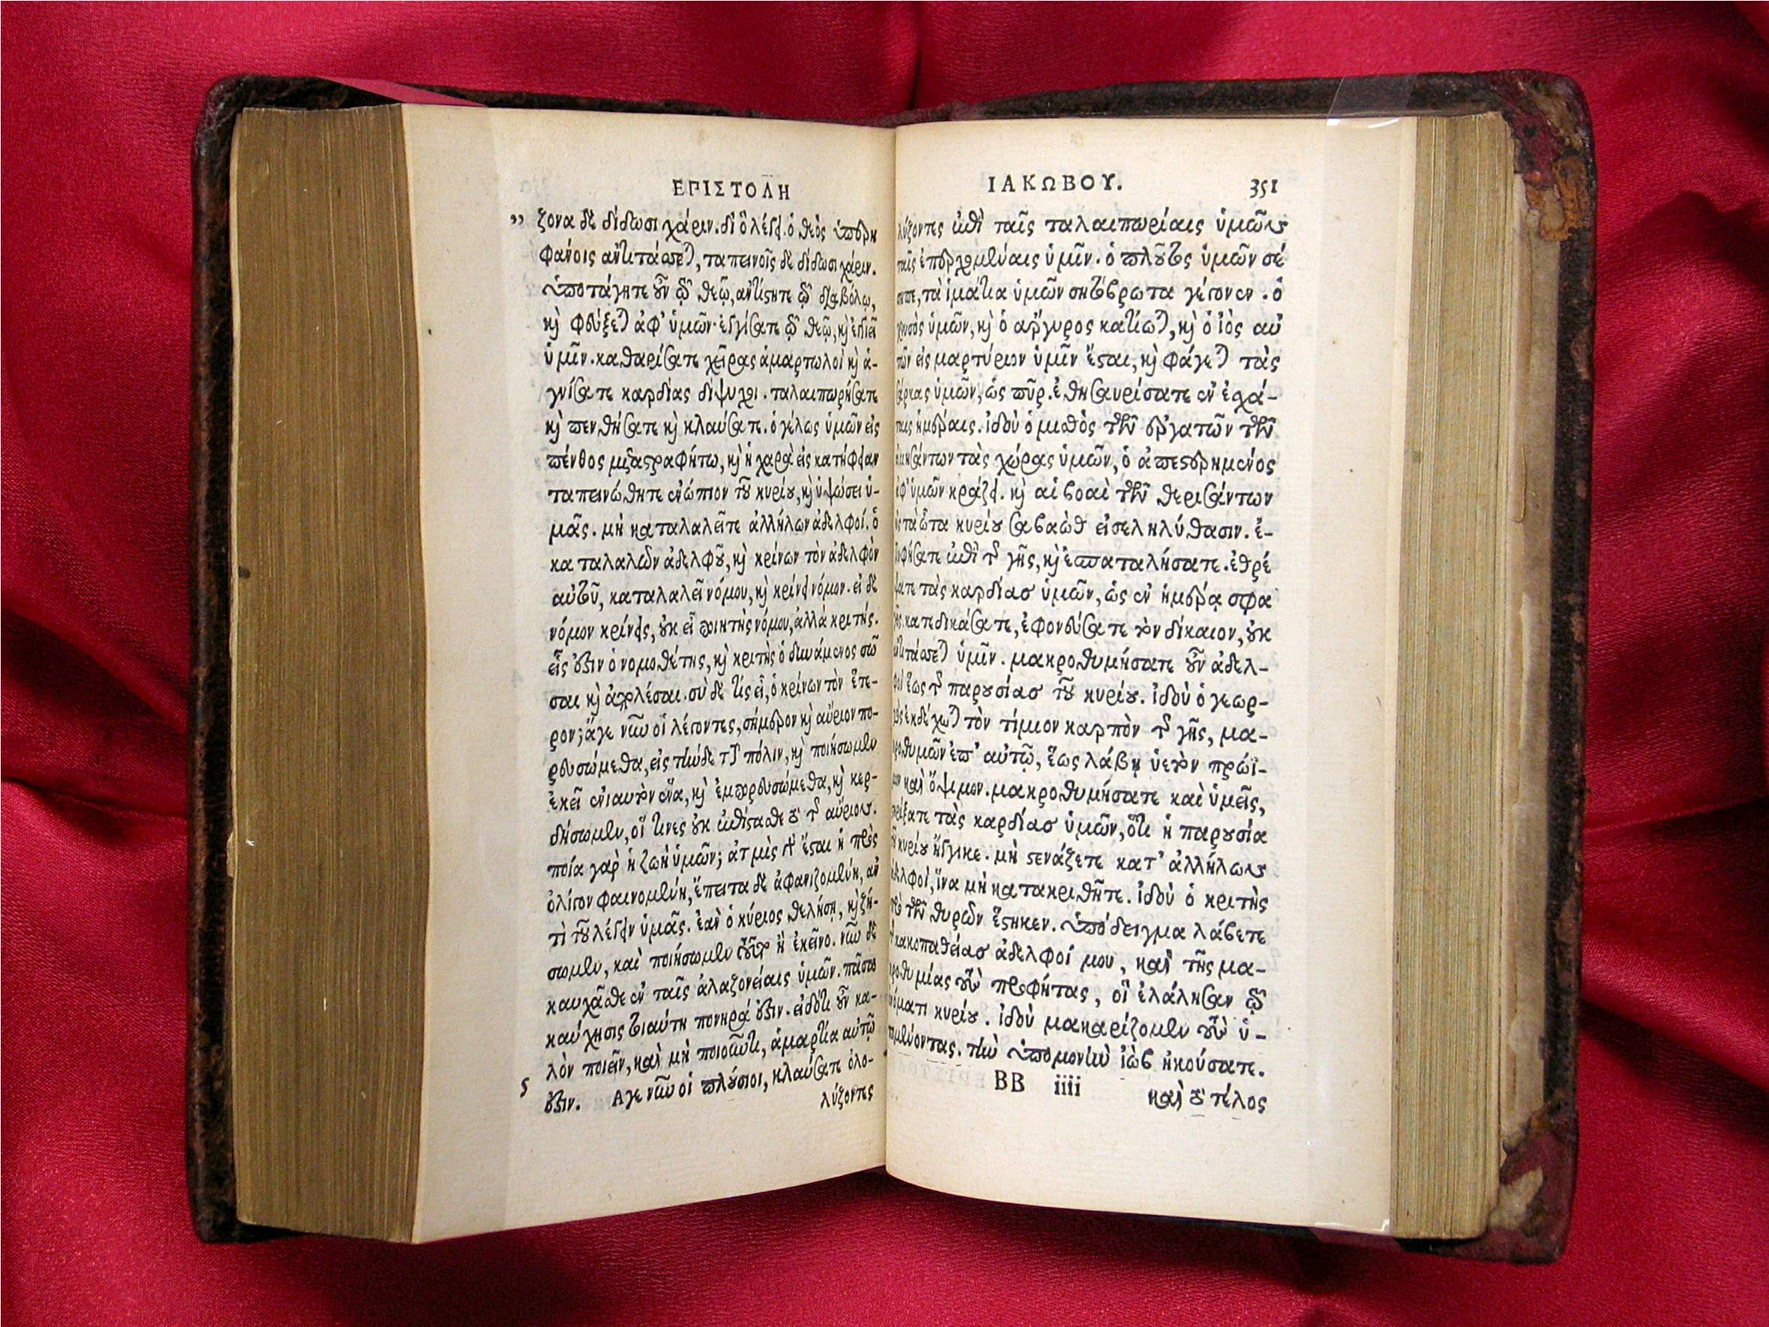

Slide 12
Languages Used
Old Testament
New Testament
Greek Manuscripts
  Uncial Manuscripts
    All upper case letters
    No punctuation – no spacing
    Used during the 3rd t0 10th centuries
    Example:
INTHEBEGINNINGGODCREATEDTHEHEAVENSANDTHEEARTH

Slide 13
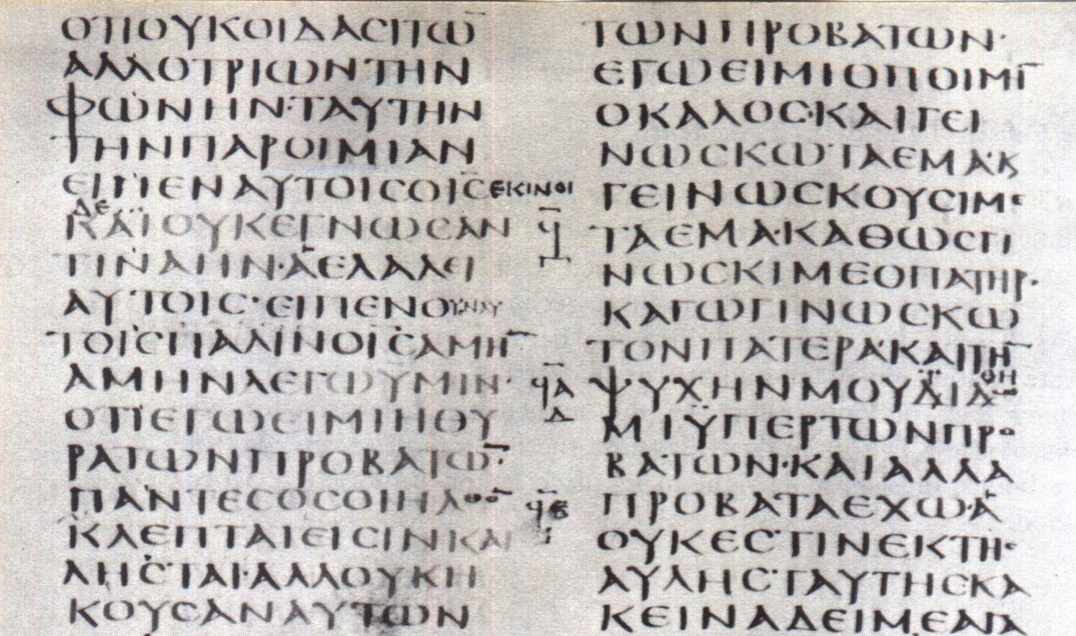
Uncial Manuscript

Slide 14
Languages Used
Old Testament
New Testament
Greek Manuscripts
  Uncial Manuscripts
  Minuscule Manuscripts
    Used from 9th to 13th centuries
    Cursive – script of smaller letters in running hand
    Occupied less space & easier to write
    Ex: inthebeginninggodcreatedtheheavensandtheearth

Slide 15
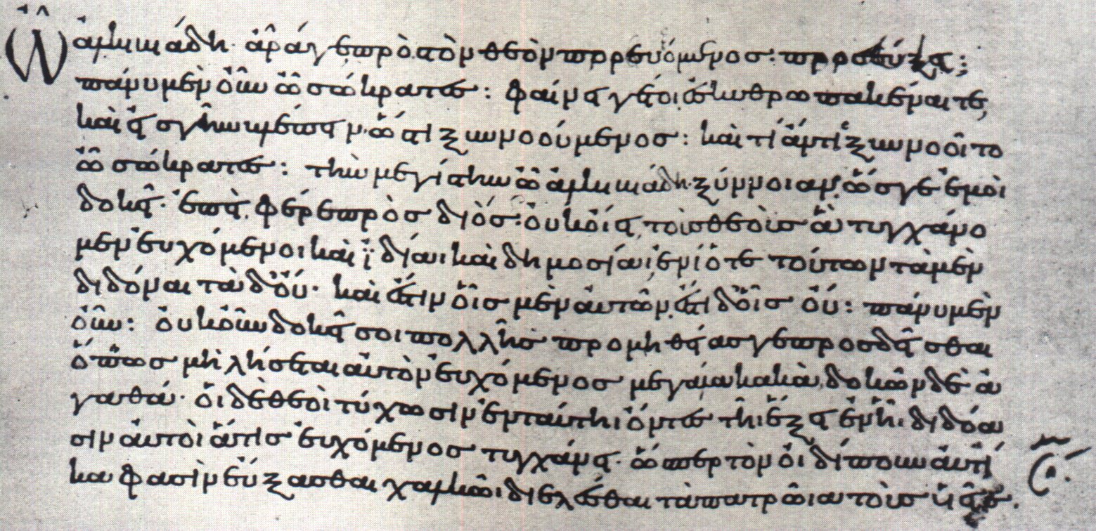
Minuscle Manuscript

Slide 16
Form of the Greek NT Explains Some Translation Questions
Different punctuation – (Question or statement?)
One sentence or two?
Should word be capitalized or not (i.e. spirit or Spirit)?

Slide 17
Words
The means God used to reveal his mind through the Holy Spirit is WORDS (Eph. 3:3-5)
Words carefully chosen by the Holy Spirit (1 Cor. 2:13)
Language was not English
  Hebrew
  Aramaic
  Koine’ Greek
Explains some problems / puzzles
  Mistranslation
  Transliteration (baptize, Christ, angel, apostle)
  Difficulty getting the full meaning (i.e. meekness, love)
  Translation may have archaic words (KJV; Josh 17:2 “to wit”)

Slide 18
Words
Words are Vehicles of Thought
Lack of Understanding of Words
Determining the Meaning of Words

Slide 19
Words
Words are Vehicles of Thought

Slide 20

Words are Vehicles of Thought
Thought
Words
Only as words convey their meaning to us (revealing the thoughts of God) are we Bible Learners
Words = symbols (useful to convey to us the things / ideas for which they stand)
  If use / understand word properly – understand text
  If have improper understanding – miss the understanding

Slide 21
Words are Vehicles of Thought
Thought
Words
Only as words convey their meaning to us (revealing the thoughts of God) are we Bible Learners
Words = symbols (useful to convey to us the things / ideas for which they stand)
Word is useless when divorced from meaning
Can’t profit from text – if don’t know meaning
  Example: “without dissimulation” (Rom. 12:9 KJV)
  Means: without hypocrisy (NKJV; NASB) – sincere (NIV)
Cannot put own meaning on words

Slide 22
Words
Words are Vehicles of Thought
Lack of Understanding of Words

Slide 23
Lack of Understanding of Words
Possible to memorize, quote & use words we don’t understand
Do we understand these words?
  Virtue (2 Pet. 1:5-7)
  Poor in spirit (Matt. 5:3-ff)
  Meek (Matt. 5:3-ff)
  Lasciviousness (Gal. 5:19-ff)
  Uncleanness (Gal. 5:19-ff)
  Jesus (Matt. 1:21)
  Christ (Acts 2:36)
  Propitiation (Rom. 3:25)
  Repentance (Acts 2:38)

Slide 24
Words
Words are Vehicles of Thought
Lack of Understanding of Words
Determining the Meaning of Words

Slide 25
Determining the Meaning of Words
Look at the context for a clue
  Usually, the immediate context helps
    Rom. 10:13, 16 - Call
    Rom. 14:1-2 – Doubtful things
    1 Cor. 7:10-11 - Depart
  Also, the remote context will help (“body” Eph. 4:4 – cf. 1:22-23)

Slide 26
Determining the Meaning of Words
Look at the context for a clue
Check another translation
  2 Pet. 1:5 – virtue; “moral excellence” NASB95; “excellence of character” LEB
  1 Tim. 2:9 – propriety; “shamefastness” ASV; “modesty” ESV

Slide 27
Determining the Meaning of Words
Look at the context for a clue
Check another translation
Check an English dictionary
  Very helpful on a common word
  Could be wrong on biblical words (i.e. baptism)

Slide 28
Determining the Meaning of Words
Look at the context for a clue
Check another translation
Check an English dictionary
Check the original word and lexicons (next 2 lessons)
Use basic rules of grammar
  Pronoun refers to nearest antecedent (Acts 1:26 – 2:1)
  Future tense: I will build… (Matt. 16:18)
  Adverb – describing manner “unworthy” (1 Cor. 11:27)
  Coordinating conjunction “and” (Acts 2:38)

Slide 29
Determining the Meaning of Words
Look at the context for a clue
Check another translation
Check an English dictionary
Check the original word and lexicons (next 2 lessons)
Use basic rules of grammar
Look for words used interchangeably

Slide 30
Words Used Interchangeably
Rom. 10:13, 16 – Call, obey, believe
1 Tim. 1:10-11 – Gospel, doctrine
Acts 2:4, 6, 8 – Tongues, language
Deut. 6:1 – Commandment, statute, judgment
Psa. 51 – various terms for sin & forgiveness

Slide 31
Determining the Meaning of Words
Look at the context for a clue
Check another translation
Check an English dictionary
Check the original word and lexicons
Use basic rules of grammar
Look for words used interchangeably
Look for words that are contrasted
  Hate vs love (1 John 3:14-15)
  Carnal vs spiritual (Rom. 8:6)

Slide 32
Determining the Meaning of Words
Look at the context for a clue
Check another translation
Check an English dictionary
Check the original word and lexicons
Use basic rules of grammar
Look for words used interchangeably
Look for words that are contrasted
Consider the etymology of a word
  Refers to the origin of a word
  Example: Humble from Latin “humus” – earth or ground

Slide 33
Words
Words are Vehicles of Thought
Lack of Understanding of Words
Determining the Meaning of Words

Slide 34
Deut 24: 1-4 – What was the law concerning divorce? Did God approve of divorce for uncleanness? Was this passage about divorce for fornication? What should happen if a man put away his wife for uncleanness?

Slide 35
Deut. 24:1-4
1 When a man hath taken a wife, and married her, and it come to pass that she find no favour in his eyes, because he hath found some uncleanness in her: then let him write her a bill of divorcement, and give it in her hand, and send her out of his house.
2 And when she is departed out of his house, she may go and be another man's wife.
3 And if the latter husband hate her, and write her a bill of divorcement, and giveth it in her hand, and sendeth her out of his house; or if the latter husband die, which took her to be his wife;
4 Her former husband, which sent her away, may not take her again to be his wife, after that she is defiled; for that is abomination before the LORD: and thou shalt not cause the land to sin, which the LORD thy God giveth thee for an inheritance.
KJV

Slide 36
Deut. 24:1-4
1 When a man hath taken a wife, and married her, and it come to pass that she find no favour in his eyes, because he hath found some uncleanness in her: then let him write her a bill of divorcement, and give it in her hand, and send her out of his house.
2 And when she is departed out of his house, she may go and be another man's wife.
3 And if the latter husband hate her, and write her a bill of divorcement, and giveth it in her hand, and sendeth her out of his house; or if the latter husband die, which took her to be his wife;
4 Her former husband, which sent her away, may not take her again to be his wife, after that she is defiled; for that is abomination before the LORD: and thou shalt not cause the land to sin, which the LORD thy God giveth thee for an inheritance.
KJV

Slide 37
Deut. 24:1-4
1 "When a man takes a wife and marries her, and it happens that she finds no favor in his eyes because he has found some indecency in her, and he writes her a certificate of divorce and puts it in her hand and sends her out from his house,
2 and she leaves his house and goes and becomes another man's wife,
3 and if the latter husband turns against her and writes her a certificate of divorce and puts it in her hand and sends her out of his house, or if the latter husband dies who took her to be his wife,
4 then her former husband who sent her away is not allowed to take her again to be his wife, since she has been defiled; for that is an abomination before the LORD, and you shall not bring sin on the land which the LORD your God gives you as an inheritance.
NASV

Slide 38
Deut. 24:1-4
1 "When a man takes a wife and marries her, and it happens that she finds no favor in his eyes because he has found some uncleanness in her, and he writes her a certificate of divorce, puts it in her hand, and sends her out of his house,
2 when she has departed from his house, and goes and becomes another man's wife,
3 if the latter husband detests her and writes her a certificate of divorce, puts it in her hand, and sends her out of his house, or if the latter husband dies who took her as his wife,
4 then her former husband who divorced her must not take her back to be his wife after she has been defiled; for that is an abomination before the LORD, and you shall not bring sin on the land which the LORD your God is giving you as an inheritance.
NKJV

Slide 39
Deut. 24:1-4
Nothing is said to encourage divorce & remarriage
This is a simple prohibition: the put away woman cannot remarry 1st husband
Casuistic Law
IF…(vv. 1-3) - Protasis
  Put her away for “uncleanness”
  She becomes another man’s wife
  The second man puts her away or dies
THEN … (v. 4) - Apodosis
  May not remarry her first husband

Slide 40
Deut. 24:1-4
Nothing is said to encourage divorce & remarriage
This is a simple prohibition: the put away woman cannot remarry 1st husband
There is no command to divorce.
This was to discourage frivolous divorces
Matters little what the “uncleanness” is
  Not adultery – for she would be stoned (Deut. 22)
  Not suspicion of adultery (Num. 5)
  Not evidence that she was not a virgin (Deut 22)
  Perhaps – some “flaw” he finds in her (cf. Gen. 49:9, 12)
Jesus said Moses “suffered” them to put away wives

Slide 41
“Suffered”
There is a difference
Commanded?
No
Allowed?
(with approval)
No
Allowed?
(tolerated)
Yes

Slide 42
1 Cor.5:11; 2 Thess. 3:14 – What does it mean to keep “company”?

Slide 43
“Not to keep company”
  Translations:
    “Company” (KJV; ASV; NKJV; MEV; YLT)
    “Associate” (ESV; NASB; RSV; NIV; NET; NCV; Footnote NJKV)
    “Not to mix with" (LBP, v. 9; Darby)
  Defined:
    Strong’s: “4874….from 4862 and a comp. of 303 and 3396; to mix up together, i.e. (fig.) associate with:—(have, keep) company (with)”
    Thayer: “to mix up together”
    Vincent: “The word is compounded of σύν together, ἀνά up and down among, and μίγνυμι to mingle. It denotes, therefore, not only close, but habitual, intercourse.”
    Lenski: “Mix yourselves - up – with”
    Vine’s: “to mix up with” (sun, “with,” ana, “up,” mignumi, “to mix, mingle”), signifies “to have, or keep, company with,”
The Meaning of “Company”

Slide 44
“Not to keep company”
“Not even to eat”
  Not referring to the Lord’s Supper
    How could the faithful keep the unfaithful from partaking of LS?
    The association forbidden here – is permitted with the world (v. 10) – is that the LS?
    Part of “keeping company” – thus a common meal
  Just one part of “company”
The Meaning of “Company”

Slide 45
“Company” Involves More Than Eating
Visit (Social)
Shop With…
Play Games
Eat
Company
(General)
Eating is just one specific of company!
Eating shows some degree of approval
(Gal. 2:11-14)

