Slide 1
Bible Hermeneutics
Tonight’s Lesson:
Bible Study Aids
February 15, 2023

Slide 2
Bible Study - Challenge
Read 1, 2 & 3 John
At least 50 times
by the end of April
Can be read in 15 minutes
With each reading you will see more
May try another translation a few times
Take note of key concepts / words / contrast

Slide 3
Jan. 4 – Introduction to Inductive Bible Study
Jan. 11 – Background – Intro Information
Jan. 18 – Context
Jan. 25 – Context
Feb. 1 – Outlining the Text
Feb. 8 – Outlining the Text
Feb. 15 – Bible Study Aids
Feb. 22 – Use of Translations
Mar. 1 – Words
Mar. 8 – Hebrew / Greek Words
Mar. 15 – Hebrew / Greek Words
Mar. 22 – Use of Commentaries
Mar. 29 – Figurative Language
Apr. 5 – Figurative Language
Apr. 12 – Apocalyptic Literature & Numbers
Apr. 19 – Hebrews and Hermeneutics
Apr. 26 – Application / Practical Lessons
Bible Hermeneutics

Slide 4
Bible Study Aids
The Text
Concordance
Dictionaries
Commentaries
Atlas / Maps
Handbooks
Electronic

Slide 5
Important!
Important!
The Bible is the only book we MUST have!
Bible Study AIDS – are just that: AIDS
Much of this lesson involves SUGGESTIONS

Slide 6
Not every suggestion is for everyone
Some will want a lot of aids
Some will want only 1 or 2
Some will be adapt easily to a Bible program – others will not

Slide 7
Not a Rebuke – But a Challenge
Fishing
Hunting
Woodworking
Horseback Riding
Sewing
Cooking / Grilling
Video Games
Gardening
Travel
Music
Camping
Think nothing of spending $100’s – even $1000’s
Yet not willing to spend even a fraction of that on Bible study helps!

Slide 8
Bible Study Aids
The Text

Slide 9
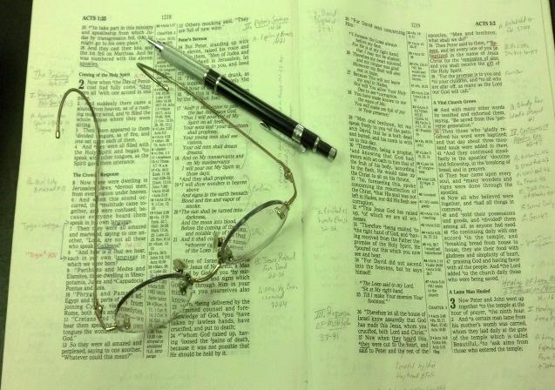
The Text
Invest in a good study text
  Good reliable translation
    Good: KJV, NKJV, ASV, ESV, NASB
    Not as reliable: LBP, NIV, NCV, Moffat, Williams, Phillips, etc.
  Center column reference
  Wide margin for notes
  Careful of notes in study Bibles

Slide 10

The Text
Invest in a good study text
Comparative translations
  Not all translations are equal
  Several are good – seek to translate
  Many are mere paraphrase
  Yet – may use several for comparison
  Many are available on-line

Slide 11
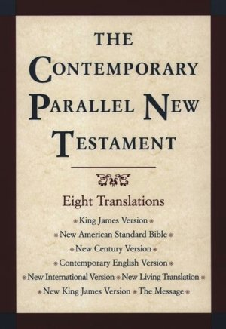
Do a search for:
“parallel Bible”
“parallel translations”
Get more for less
on Bible app
$50

Slide 12
Bible Study Aids
The Text
Concordance

Slide 13
Concordance
Value of a concordance
  Help find a passage
  Find how many times a word is used
  Find which original word was used (with Strong’s)
  Find Strong’s definition of word

Slide 14
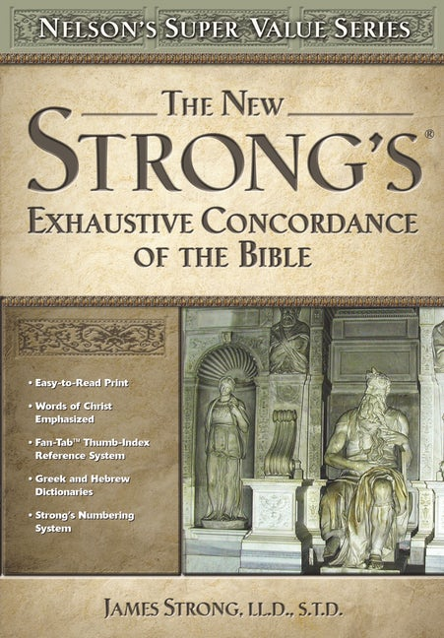
Concordance
Value of a concordance
Suggestions
  Get one specific to your translation
  Strong’s Exhaustive Concordance
$35-45

Slide 15
Bible Study Aids
The Text
Concordance
Dictionaries

Slide 16
Dictionaries
Bible Dictionary
  Not a word dictionary
  More like an encyclopedia – people, places, topics, money, timelines, etc.
  Suggestions:

Slide 17
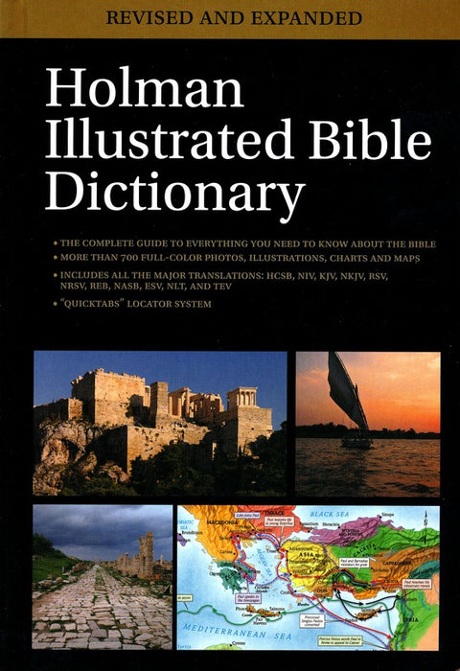
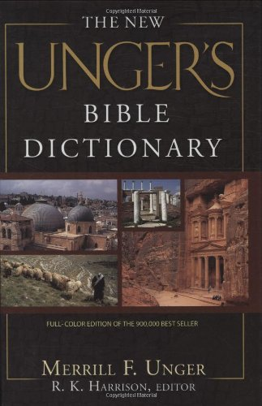
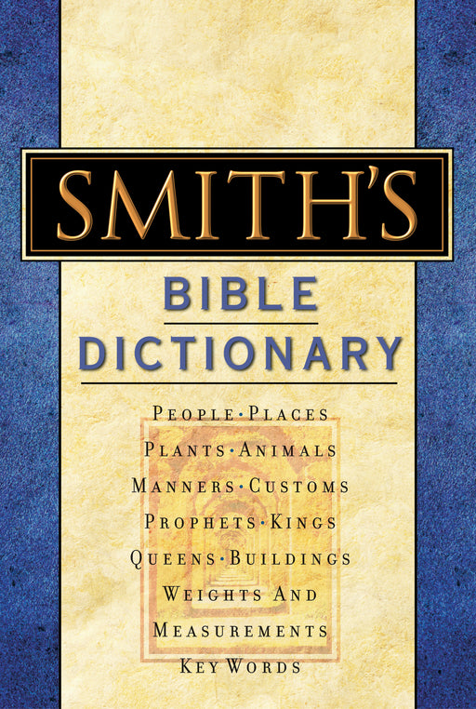
$35
$45
$15

Slide 18
Dictionaries
Bible Dictionary
Dictionary of Bible Words
  Defines the Hebrew / Greek words
  Look the word up in English
  Suggestion:

Slide 19

$20-$45

Slide 20
Bible Study Aids
The Text
Concordance
Dictionaries
Commentaries

Slide 21
Commentaries
Basic commentaries
  Get recommended commentaries rather than a set
  Buy as we are studying each book
  Careful of denominational doctrines

Slide 22
Commentaries
Basic commentaries
Commentary-Workbooks
  Bible Text-Book Series (Truth)
  Harkrider Series
  Onestone.com Series

Slide 23
Commentaries
Basic commentaries
Commentary-Workbooks
Harmony studies
  Harmony of the Gospels
  Helps with chronology & whether the accounts are parallel
  Suggestions:

Slide 24

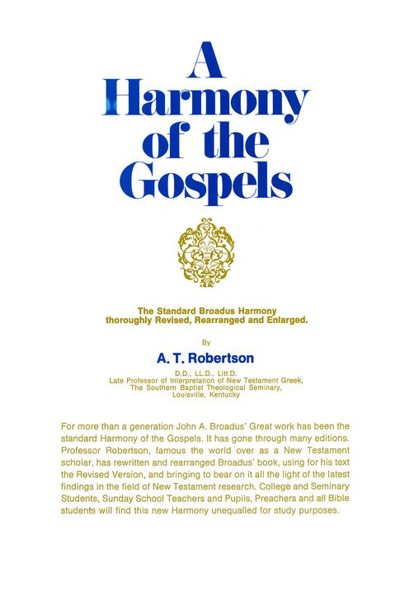
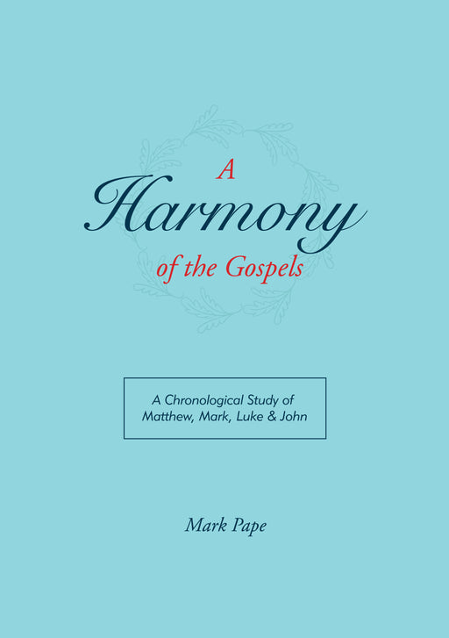
$25
$25
$10

Slide 25
Bible Study Aids
The Text
Concordance
Dictionaries
Commentaries
Atlas / Maps

Slide 26
Atlas / Maps
Value / use of an atlas
  Mapping journeys (i.e. wilderness, missionary, etc)
  Locating nations, cities, rivers, tribes, etc.
Suggestions:

Slide 27
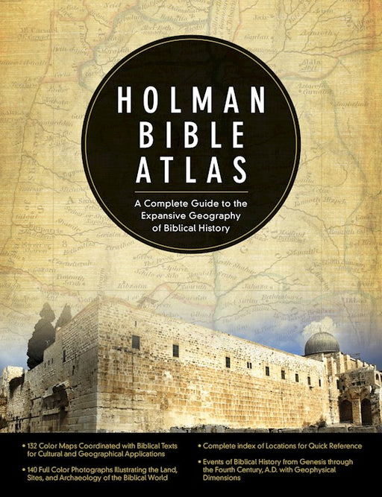
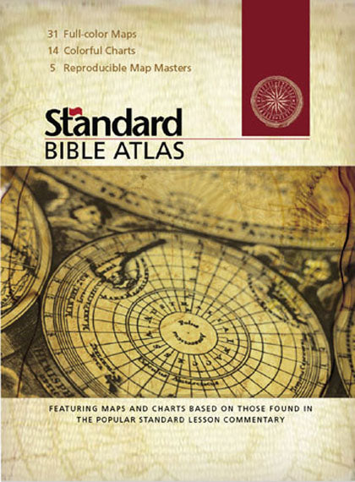

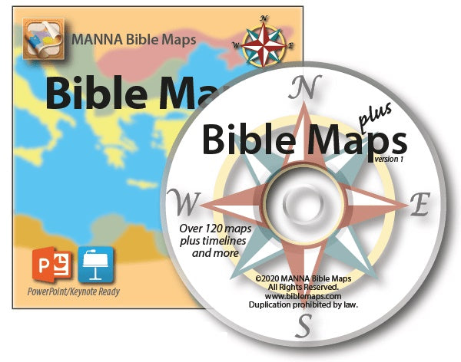
$30
$15
$20
$80

Slide 28
Bible Study Aids
The Text
Concordance
Dictionaries
Commentaries
Atlas / Maps
Handbooks

Slide 29
Handbooks
What is a handbook?
  Gives introductory / summary information for each book of Bible
  Some maps
  Deals with some customs, archaeological notes
Suggestions:

Slide 30
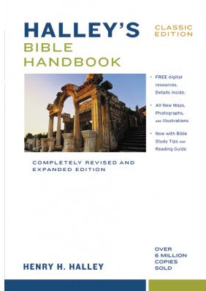


$30
$18
$34

Slide 31
Bible Study Aids
The Text
Concordance
Dictionaries
Commentaries
Atlas / Maps
Handbooks
Electronic

Slide 32
Electronic
Good Bible program / app
  Not all Bible programs are equal
  What you can do with program / app
    See various translations (compare)
    Search for words or phrases
    Check original words, where it is found, how its is translated, what it means (multiple sources)
    Check commentaries
    See how names are pronounced
    Maps / atlas
    Dictionaries / Encyclopedias

Slide 33
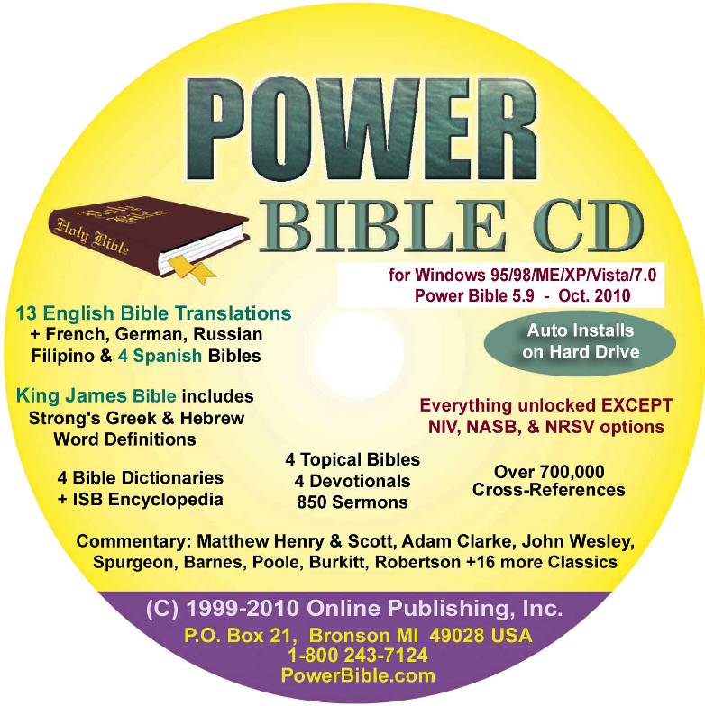
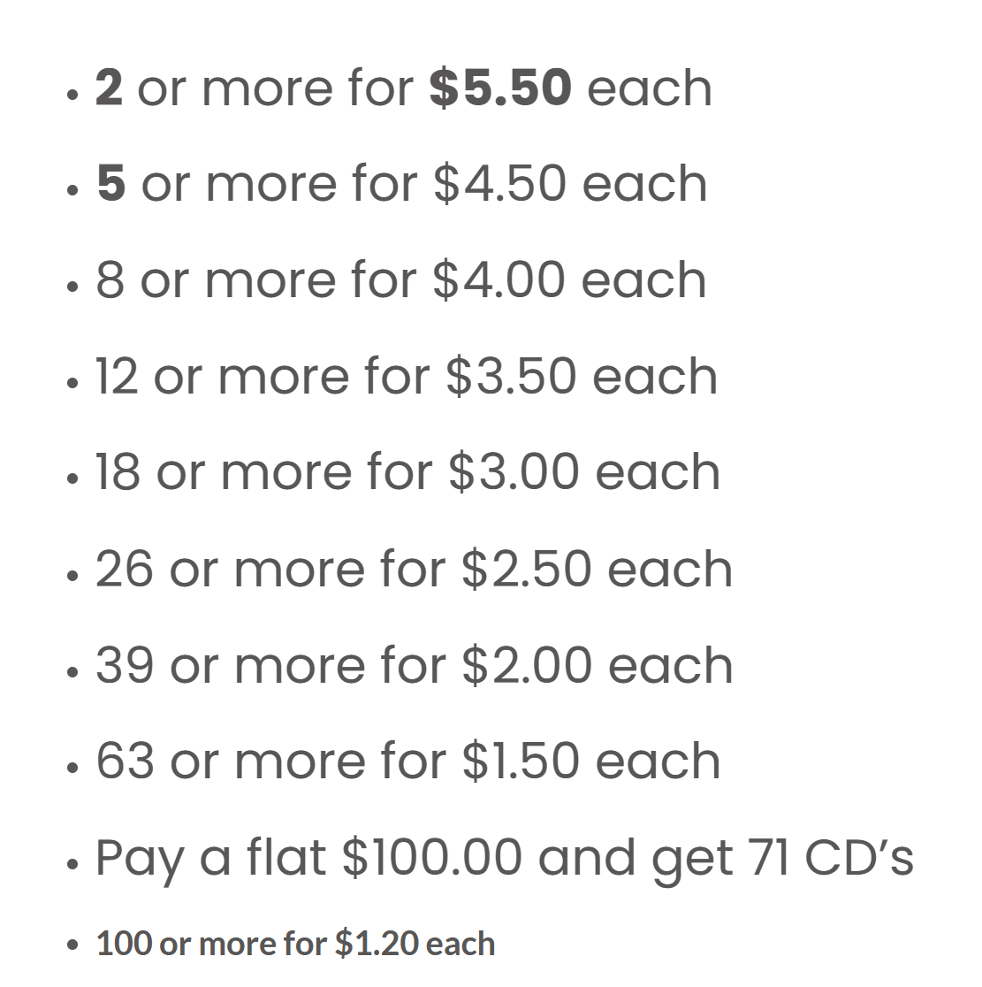
Powerbible.com
$7.00

Slide 34

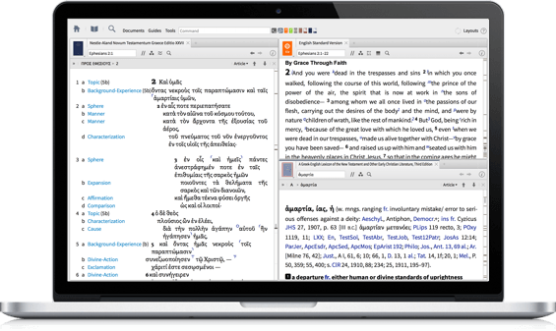
LOGOS BIBLE SOFTWARE
www.logos.com

Slide 35

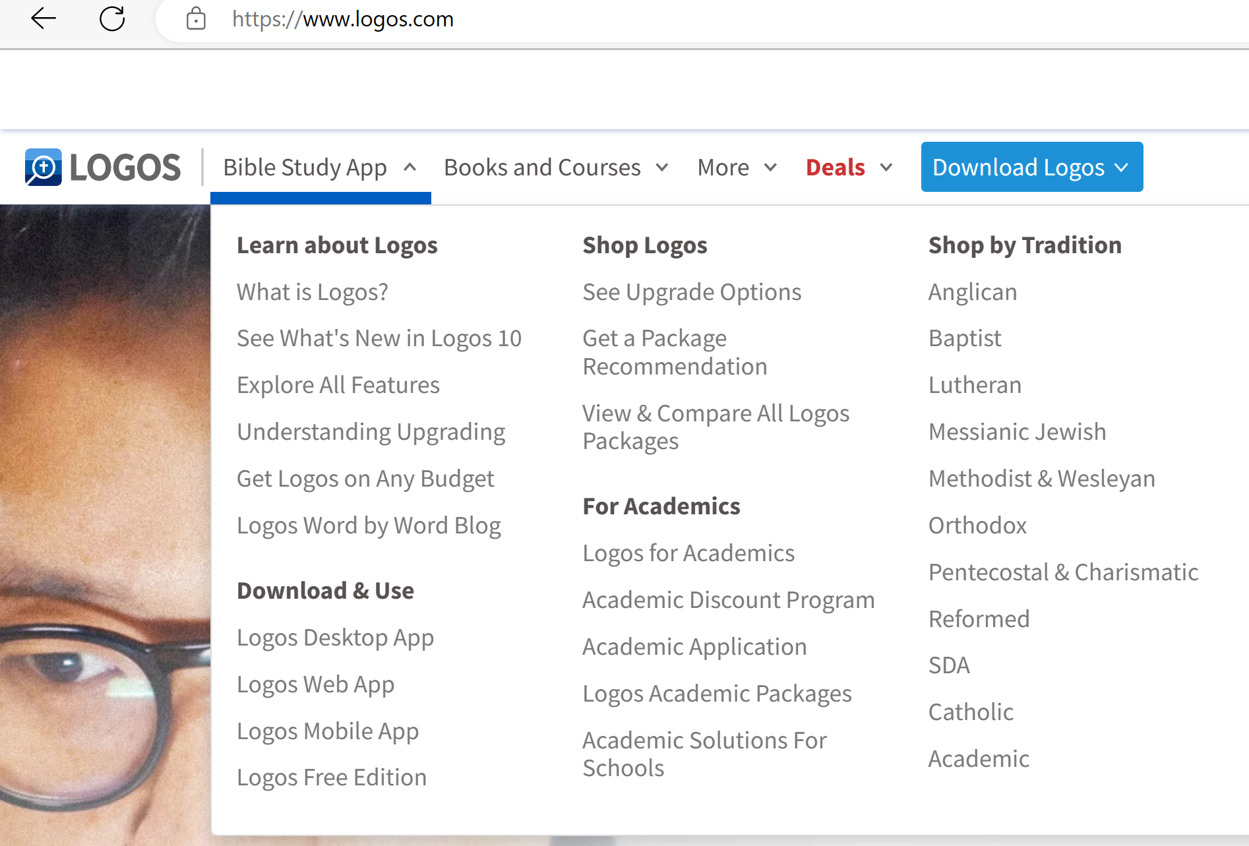

Slide 36

www.accordancebible.com
Various price options

Slide 37
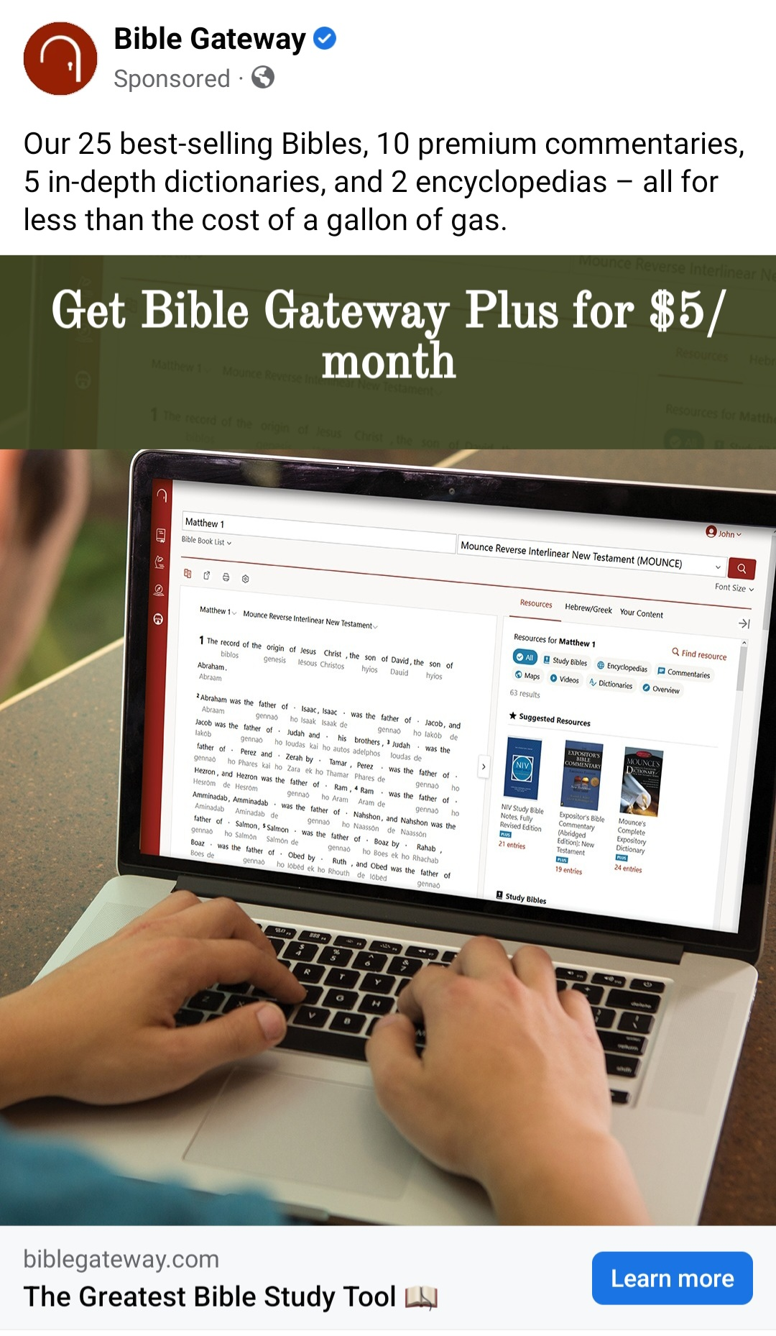
www.biblegateway.com

Slide 38
Electronic
Good Bible program / app
Online Bible tools
  Blueletterbible.org

Slide 39
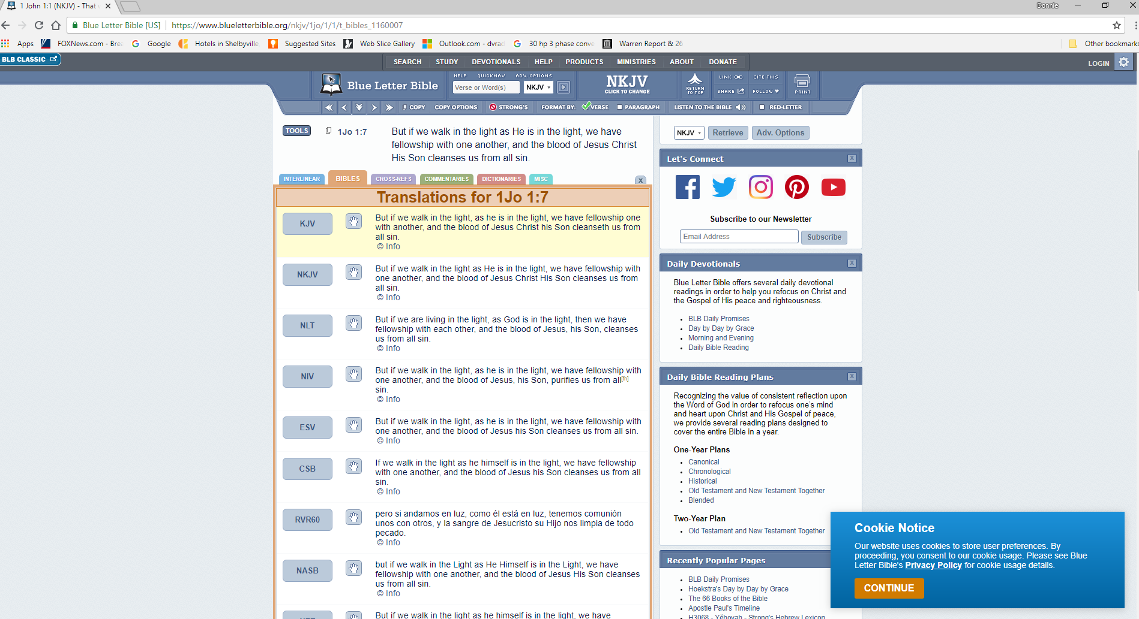
Blueletterbible.org

Slide 40
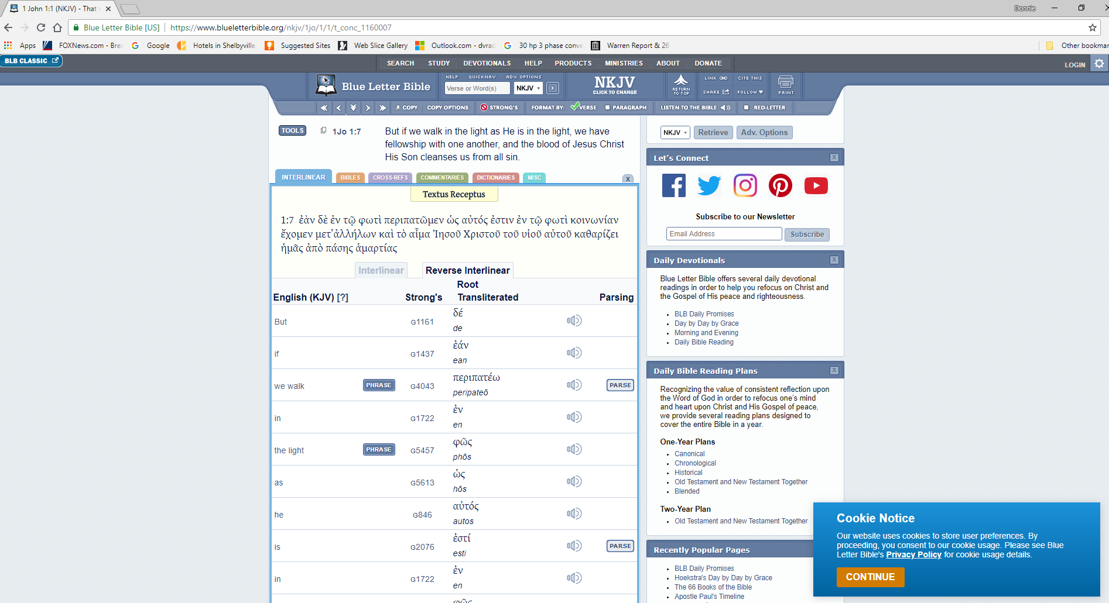
Blueletterbible.org

Slide 41
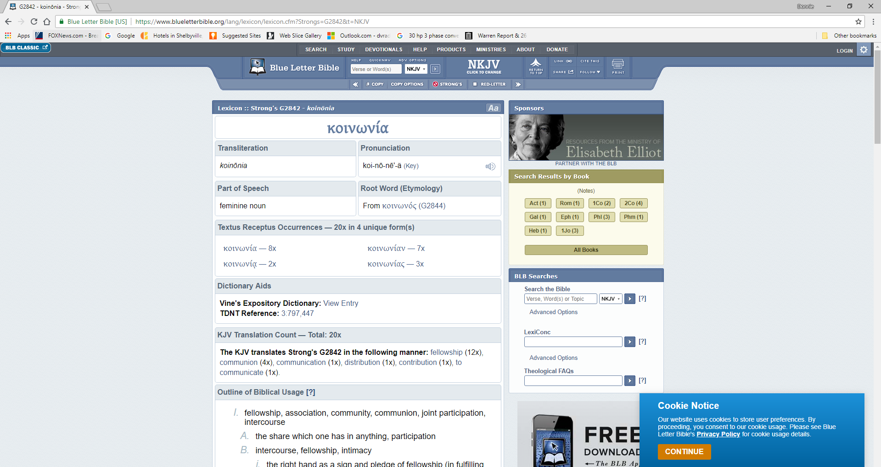
Blueletterbible.org

Slide 42
Electronic
Good Bible program / app
Online Bible tools
  Blueletterbible.org
  Biblestudytools.com

Slide 43
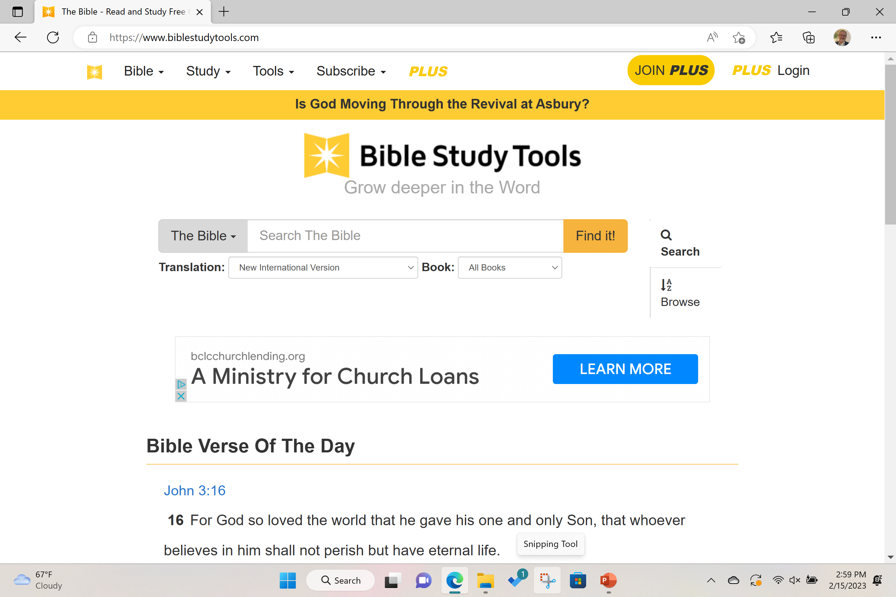

Slide 44
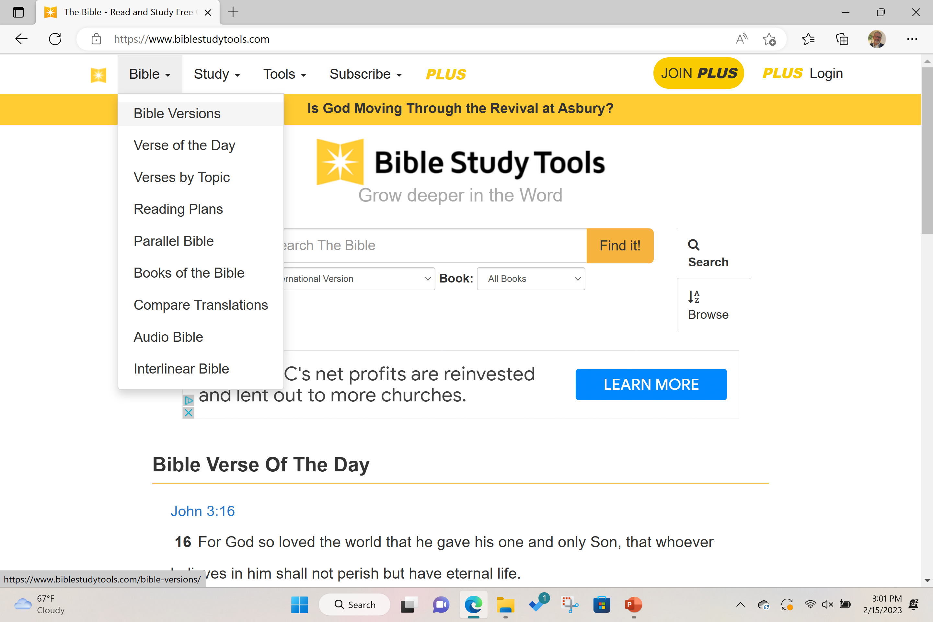

Slide 45
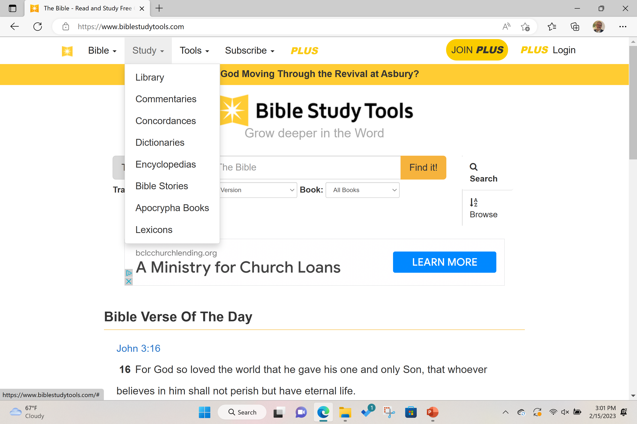

Slide 46
Electronic
Good Bible program / app
Online Bible tools
Websites
  Our site (elbethelchurchofchrist.com) – oral commentary every book (adult class)
  Outlines (executableoutlines.com)

Slide 47
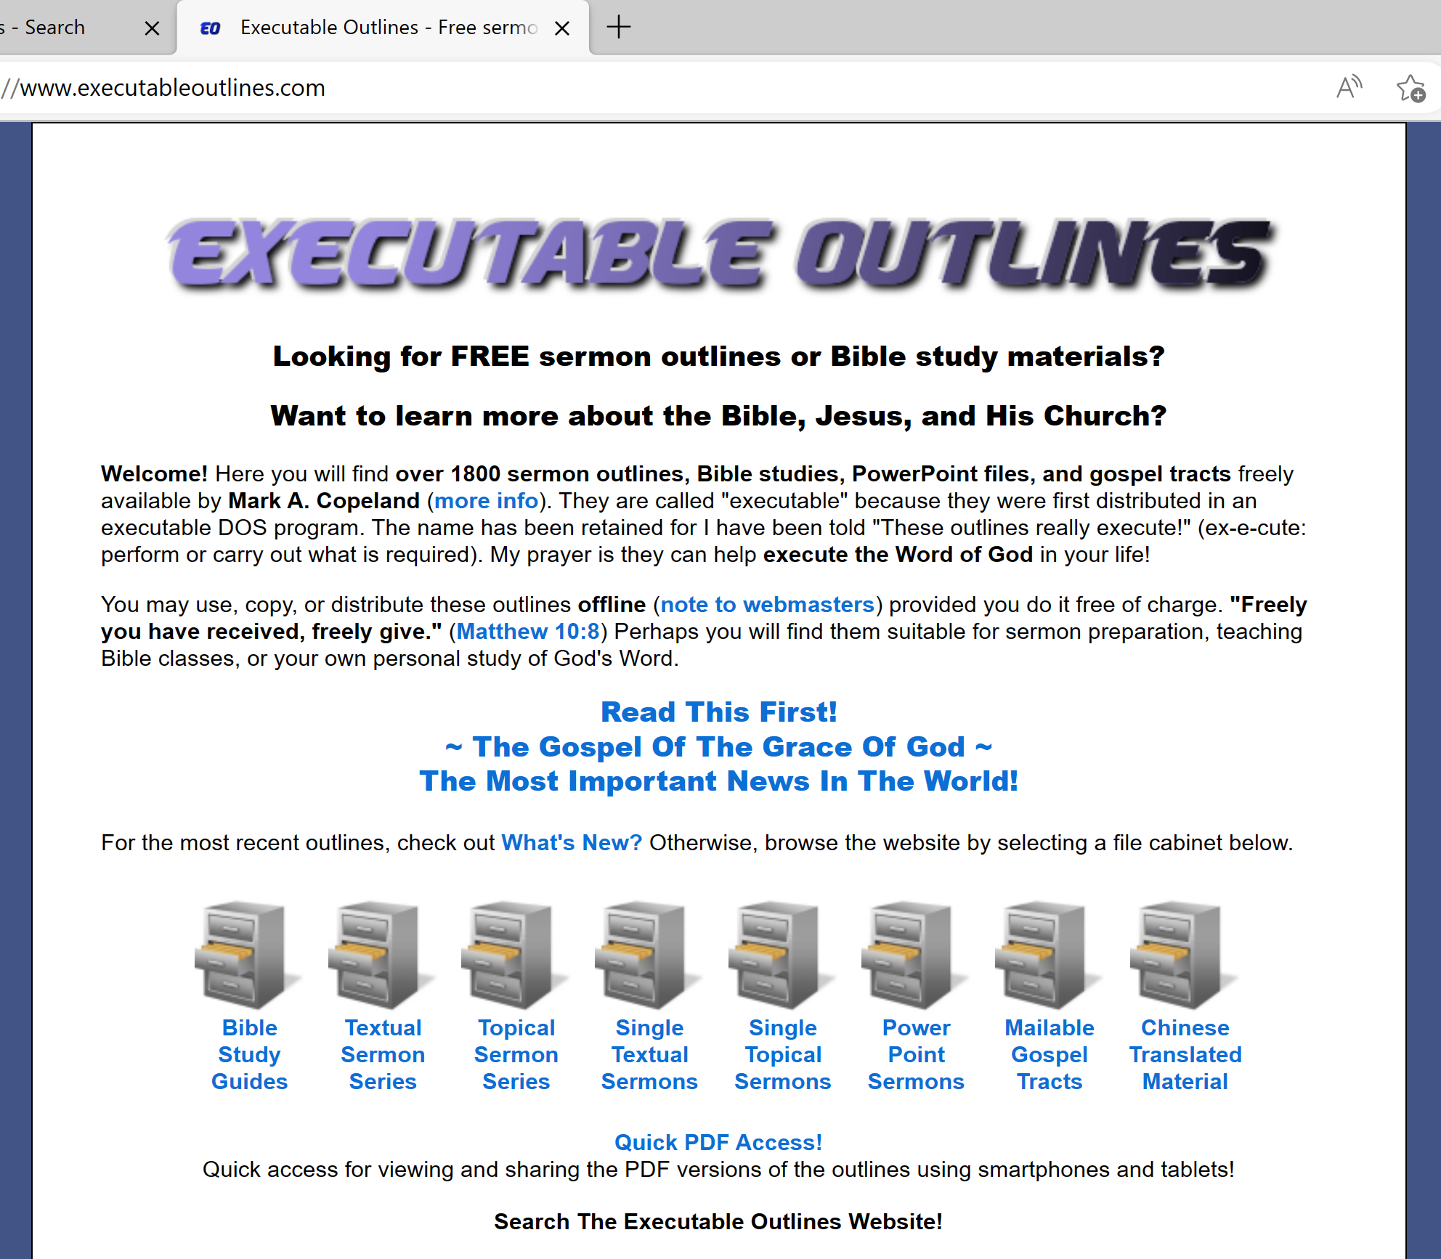

Slide 48
Bible Study Aids
The Text
Concordance
Dictionaries
Commentaries
Atlas / Maps
Handbooks
Electronic

Slide 49
1 Peter 3:19 – What is meant by preaching to the spirits in prison? Where they in prison at the time when the message was preached to them?
Context:
More Duties of Holiness
Duties of Wives (vv. 1-6)
Duties of Husbands (v. 7)
Duties of Christians to Each Other (vv. 8-12)
Duties When Persecuted (vv. 13-17)
Christ As An Example of Suffering (vv. 18-22)

Slide 50
1 Peter 3:19 – What is meant by preaching to the spirits in prison? Where they in prison at the time when the message was preached to them?
Context:
Christ As An Example Of Suffering (vv. 18-22)
  Innocent (v. 18)
  Patient (vv. 19-21)
  Victorious (v. 22)

Slide 51
1 Peter 3:19 – What is meant by preaching to the spirits in prison? Where they in prison at the time when the message was preached to them?
Context:
“Prison” – realm of departed spirits
  Verse 19 – “spirits in prison”
  Compare Jude 6; 2 Pet. 2:4
Example given – days of Noah (vv. 20-21)
  Christ preached through Noah (v. 20)
  Christ preached through Paul (Eph. 2:17)
Not said that the spirits were in prison at the time of the preaching (cf. NASB95 – “now in prison”

