Slide 1
Bible Hermeneutics
Tonight’s Lesson:
Outlining the Text (Part 2)
February 8, 2023

Slide 2
Bible Study - Challenge
Read 1, 2 & 3 John
At least 50 times
by the end of April
Can be read in 15 minutes
With each reading you will see more
May try another translation a few times
Take note of key concepts / words / contrast

Slide 3
Jan. 4 – Introduction to Inductive Bible Study
Jan. 11 – Background – Intro Information
Jan. 18 – Context
Jan. 25 – Context
Feb. 1 – Outlining the Text
Feb. 8 – Outlining the Text
Feb. 15 – Bible Study Aids
Feb. 22 – Use of Translations
Mar. 1 – Words
Mar. 8 – Hebrew / Greek Words
Mar. 15 – Hebrew / Greek Words
Mar. 22 – Use of Commentaries
Mar. 29 – Figurative Language
Apr. 5 – Figurative Language
Apr. 12 – Apocalyptic Literature & Numbers
Apr. 19 – Hebrews and Hermeneutics
Apr. 26 – Application / Practical Lessons
Bible Hermeneutics

Slide 4
Outlining the Text (part 1)
What is an Outline?
The Value of an Outline
Goal: True Textual Outline
How to Make an Outline
Examples of Outlines

Slide 5
Outlining the Text (part 1)
What is an Outline?
The Value of an Outline
Goal: True Textual Outline
How to Make an Outline
Examples of Outlines

Slide 6
Outlining the Text (part 1)
What is an Outline?

Slide 7
What is an Outline?
What is an outline?
  Defined:
    “a summary of a written work or speech, usually analyzed in headings and subheadings” (The American Heritage Dictionary Second College Edition, p. 882)
    “a short summary of the main topics or principal ideas of a written work or speech” (World Book Encyclopedia, 1989, Vol. 14, p. 887)

Slide 8
What is an Outline?
What is an outline?
  Defined:
  Way of organizing ideas or thoughts
    A writer may make an outline (an organized collection of what he wants to say) from which he will write his article or book. This takes the ideas from an outline to a written document
    This can also be done in reverse: taking the thoughts or idea from a written document to an outline. This is what we do when we outline the writings of the New Testament.
Outline Written Text
Outline Written Text

Slide 9
What is an Outline?
What is an outline?
Chapter Title
Main Point
  Subpoint
  Subpoint
Main Point
  Subpoint
  Subpoint
Main Point
  Subpoint
  Subpoint
List of thought patterns
Organizing thought patterns
Summary:
  Preview
  Guide
  Review

Slide 10
Outlining the Text (part 1)
What is an Outline?
The Value of an Outline

Slide 11
The Value of an Outline
Organizes the information – makes it more useful
Identifies boundaries
Helps gain “control” of the text
Shows the relationship of things in the text
Gives you a better view of the text
Aid to interpretation
½ of job of interpreting
is accomplished!

Slide 12
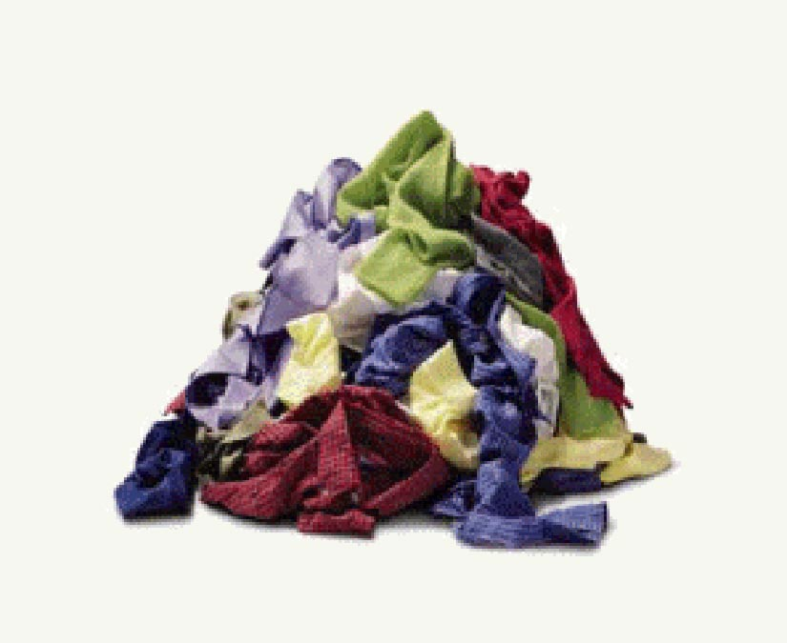

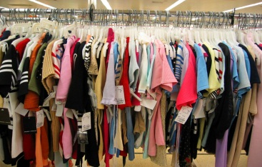
Men
Women
Children
Suits / Shirts /
Pants / Casual
Dresses / Skirts /
Pants / Tops
Dress / play /
Pants / Shirts
Arrange by size
Arrange by size
Arrange by size

Slide 13
Outlining the Text (part 1)
What is an Outline?
The Value of an Outline
Goal: True Textual Outline

Slide 14
Goal: True Textual Outline
What is a “true textual outline”?
  Not merely some points you see in the text
  Maps the flow of thought of the author
  Make every verse a part of the outline
  Analyzes the complete chapter (text)

Slide 15
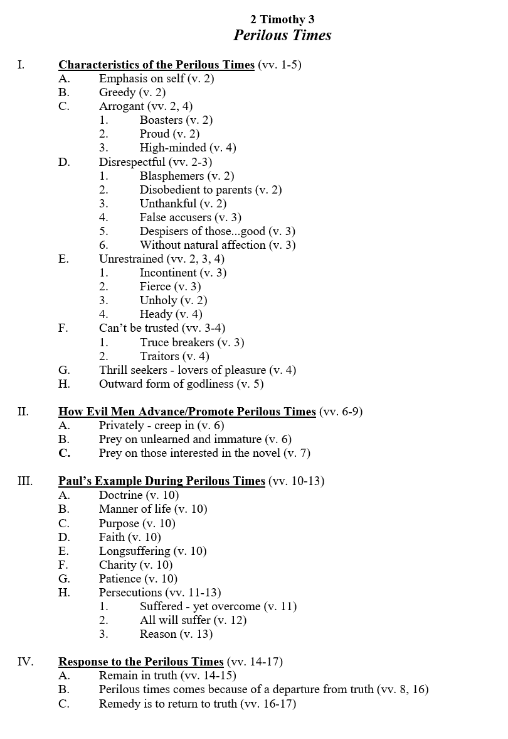

Slide 16

Goal: True Textual Outline
What is a “true textual outline”?
Create an outline from which the author may have worked
Chapter Title
Main Point
  Subpoint
  Subpoint
Main Point
  Subpoint
  Subpoint
Main Point
  Subpoint
  Subpoint
Chapter Title
Main Point
  Subpoint
  Subpoint
Main Point
  Subpoint
  Subpoint
Main Point
  Subpoint
  Subpoint
Agree?

Slide 17
Goal: True Textual Outline
What is a “true textual outline”?
Create an outline from which the author may have worked
Basic rules for true textual outline:
  Outline as it was intended for the original reader
  Seek to fit every verse and thought into the outline
  Not making up an outline – you “find” it

Slide 18
Outlining the Text (part 1)
What is an Outline?
The Value of an Outline
Goal: True Textual Outline
How to Make an Outline
Examples of Outlines

Slide 19
How to Make an Outline
The principle of outlining
  Seeking to identify main ideas (major points) and subordinate ideas (supporting points)
  Doesn’t have to be formal
  Formal outline:
Main Point
  Subpoint
  Subpoint
Main Point
  Subpoint
  Subpoint
Main Point
  Subpoint
  Subpoint

Slide 20
How to Make an Outline
The principle of outlining
How do we determine what is major point and what is subpoint?
  Like we did in our letter

Slide 21
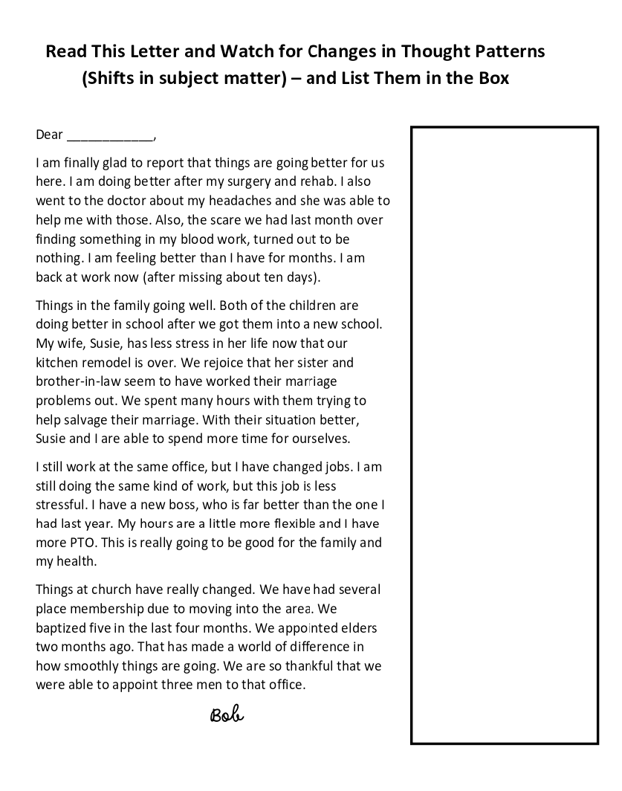

Slide 22
Things Are Much Better
Health
Family
Work
Church

Slide 23
Things Are Much Better
Health
Family
Work
Church
Recovered from surgery
Headaches are better
Scare (bloodwork) was nothing
Children better in school
Susie’s stress is better
More time together
Changed jobs
A better job
Several placed membership
Baptized 5 in 4 months
Appointed 3 elders

Slide 24
How to Make an Outline
The principle of outlining
How do we determine what is major point and what is subpoint?
  Like we did in our letter
  If there is not a “B” or “2” – must be a major point
  There is a lot of room of varying judgment here

Slide 25
How to Make an Outline
The principle of outlining
How do we determine what is major point and what is subpoint?
The process:
  Read and reread – watching for thought patterns
    Looking for shift in subject
    Start writing down what “seems” or “appears” to be major points
    Example: Verse 1-4 – is about the need for faith; vv. 5-11 is about the need for growth
    Your first impression may not be your final outline

Slide 26
How to Make an Outline
The principle of outlining
How do we determine what is major point and what is subpoint?
The process:
  Read and reread – watching for thought patterns
  Check sources for other people’s outlines to compare
    Commentaries
    Introductions to OT or NT
    Some translations (i.e. NKJV show pericopes)
    Bible handbooks
    Online search

Slide 27
How to Make an Outline
The principle of outlining
How do we determine what is major point and what is subpoint?
The process:
  Read and reread – watching for thought patterns
  Check sources for other people’s outlines to compare
  Settle on major divisions (points) first
  Then, subdivide those sections
    Like we did the letter
    Like we did the clothes

Slide 28
Outlining the Text (part 1)
What is an Outline?
The Value of an Outline
Goal: True Textual Outline
How to Make an Outline
Examples of Outlines

Slide 29
Examples Outlines
2 Thess. 1

Slide 30
2 Thessalonians 1
“Enduring Persecutions”
Greetings (vv. 1-2)
Thanks to God for the Thessalonians’ Faithfulness and Endurance (vv. 3-4)
Looking Toward the Judgment Will Help You Endure (vv. 5-10)
Prayer That Thessalonians Will Continue to Endure (vv. 11-12)

Slide 31
2 Thessalonians 1
“Enduring Persecutions”
Greetings (vv. 1-2)
Thanks to God for the Thessalonians’ Faithfulness and Endurance (vv. 3-4)
  Faith grows exceedingly (v. 3)
  Love abounds (v. 3)
  Patient in persecution and tribulation (v. 4)

Slide 32
2 Thessalonians 1
“Enduring Persecutions”
Looking Toward the Judgment Will Help You Endure (vv. 5-10)
  God will vindicate the persecuted (vv. 5, 7, 10)
  God will punish the persecutor (vv. 6-9)
Prayer That Thessalonians Will Continue to Endure (vv. 11-12)
  That you may be counted worthy (v. 11)
  That the name of the Lord will be glorified in you (v. 12)

Slide 33
Examples Outlines
2 Thess. 1
1 John 2

Slide 34
1 John 2
Contrasted Darkness
Not Sin –vs- Sin (vv. 1-2)
Keep Commandments –vs- Not Keeping Commandments (vv. 3-6)
Love –vs- Hate (vv. 7-11)
Love of Father –vs- Love of World (vv. 12-17)
Anti-Christ –vs- Acknowledging Son (vv. 18-23)
Let Truth Abide in You –vs- Let Lie Abide in You (vv. 24-29)

Slide 35
Examples Outlines
2 Thess. 1
1 John 2
Acts 2

Slide 36
Acts 2
The Beginning
The Reception of the Holy Spirit (vv. 1-13)
Peter’s Sermon (vv. 14-36)
Response of the Multitude (vv. 37-41)
The Disciples Continued in the Apostles Doctrine (vv. 42-47)

Slide 37
Acts 2
The Beginning
The Reception of the Holy Spirit (vv. 1-13)
  The apostles receive the Spirit and speak in tongues (vv. 1-4)
  The multitude is amazed (vv. 5-13)

Slide 38
Acts 2
The Beginning
The Reception of the Holy Spirit (vv. 1-13)
Peter’s Sermon (vv. 14-36)
  Explanation of the events (vv. 14-21)
  Jesus is raised from the dead (vv. 22-36)
    The one you crucified is raised (vv. 22-24)
    David prophesied of this (vv. 25-31)
    He is now exalted as both Lord and Christ (vv. 32-36)

Slide 39
Acts 2
The Beginning
The Reception of the Holy Spirit (vv. 1-13)
Peter’s Sermon (vv. 14-36)
Response of the Multitude (vv. 37-41)
  They asked what to do (vv. 37-40)
    The question (v. 37)
    The answer (vv. 38-40)
      Repent and be baptized for the remission of sins (vv. 38-39)
      Save yourself (v. 40)
  They gladly received the word and obeyed (v. 41)

Slide 40
Acts 2
The Beginning
The Reception of the Holy Spirit (vv. 1-13)
Peter’s Sermon (vv. 14-36)
Response of the Multitude (vv. 37-41)
The Disciples Continued in the Apostles Doctrine (vv. 42-47)
  Followed the apostles’ authority (v. 42)
  Were steadfast (v. 42)
  Worshiped (v. 42)
  Feared (v. 43)
  Took care of the needy (vv. 44-45)
  Served daily (v. 46)
  Grew (v. 47)

Slide 41
Examples Outlines
2 Thess. 1
1 John 2
Acts 2
1 Thess. 1

Slide 42
1 Thessalonians 1
“The Effect of the Gospel At Thessalonica”
Greetings and Salutations (v. 1)
Thanksgiving for the Thessalonians and Their Faithfulness (vv. 2-4)
The Powerful Effect of the Gospel at Thessalonica (vv. 5-10)
  Became followers (vv. 5-6)
  Became examples to others (vv. 7-8)
  Turned from idols to God (v. 9)
  Caused them to watch and wait for the coming of the Christ (v. 10)

Slide 43
Outlining the Text (part 1)
What is an Outline?
The Value of an Outline
Goal: True Textual Outline
How to Make an Outline
Examples of Outlines

Slide 44
James 5:14 – What is the anointing with oil that elders are do to the sick? Is this a literal oil that is literally anointed? If not, what is it and how do we know?
Context: Encouragement in midst of oppression
  Opposition condemned (vv. 1-6)
  Be patient (vv. 7-11)
  Don’t swear (v. 12)
  Pray (vv. 13-18)
    Sick or afflicted (vv. 13-15a)
    Sin (vv. 15b-16a)
    Does good (vv. 16b-18)
  Keep each other in the truth(vv. 19-20)

Slide 45
James 5:14 – What is the anointing with oil that elders are do to the sick? Is this a literal oil that is literally anointed? If not, what is it and how do we know?
Context: Encouragement in midst of oppression
“Sick”
  Physical - contrasted to spiritual – sin (v. 15)
  Seems to be some extreme problem (not minor ailment)

Slide 46
James 5:14 – What is the anointing with oil that elders are do to the sick? Is this a literal oil that is literally anointed? If not, what is it and how do we know?
Context: Encouragement in midst of oppression
“Sick”
“Elders”
  Call for elders (not physician)
  Something they can do – others could not do (why not call for any brother or sister?)

Slide 47
James 5:14 – What is the anointing with oil that elders are do to the sick? Is this a literal oil that is literally anointed? If not, what is it and how do we know?
Context: Encouragement in midst of oppression
“Sick”
“Elders”
“Oil”
  Could be medicinal (Luke 10:34; Isa. 1:6)
  Could be symbolic
    Of God’s healing (Woods)
    Of God’s approval (1 Sam. 10:1; Psa. 89:20)
  Emphasis is on prayer – more than oil (cf. v. 15a)

Slide 48
James 5:14 – What is the anointing with oil that elders are do to the sick? Is this a literal oil that is literally anointed? If not, what is it and how do we know?
Context: Encouragement in midst of oppression
“Sick”
“Elders”
“Oil”
Possibly could be miraculous gifts of healing
  Mark 6:13 – as apostles
  Why elders?
    Elders (as elders) had no miraculous powers
    Those on whom apostles laid hands could receive spiritual gifts (Acts 8:17)
    Assumed /likely that those who received spiritual gifts would be among the elders

