Slide 1
Bible Hermeneutics
Tonight’s Lesson:
Outlining the Text (Part 1)
February 1, 2023

Slide 2
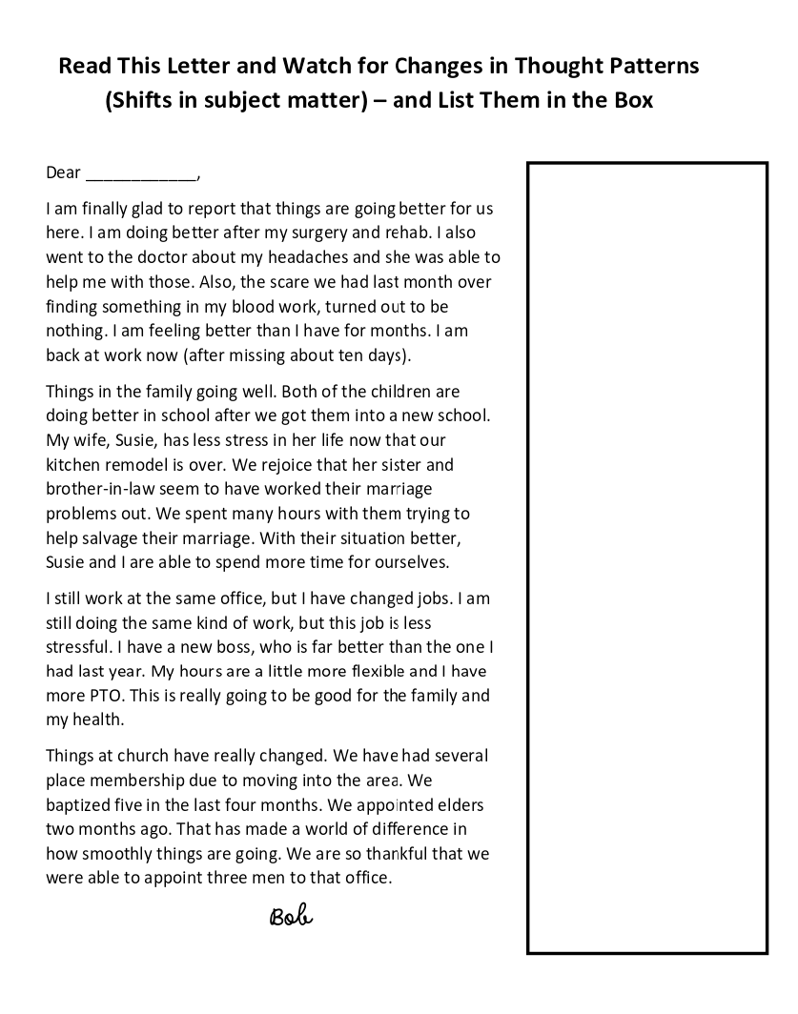

Slide 3
Things Are Much Better
Health
Family
Work
Church

Slide 4
Things Are Much Better
Health
Family
Work
Church
Recovered from surgery
Headaches are better
Scare (bloodwork) was nothing
Children better in school
Susie’s stress is better
More time together
Changed jobs
A better job
Several placed membership
Baptized 5 in 4 months
Appointed 3 elders

Slide 5
Bible Study - Challenge
Read 1, 2 & 3 John
At least 50 times
by the end of April
Can be read in 15 minutes
With each reading you will see more
May try another translation a few times
Take note of key concepts / words / contrast

Slide 6
Two Levels Going Throughout
Basic Level
Deeper Dives

Slide 7
Basic Level
The Text (Read, Read, & Read)
What is the Context?
Structure / Thought Patterns
Check Translations
Word meaning
What Did This Mean to Original Audience?
Application

Slide 8
Jan. 4 – Introduction to Inductive Bible Study
Jan. 11 – Background – Intro Information
Jan. 18 – Context
Jan. 25 – Context
Feb. 1 – Outlining the Text
Feb. 8 – Outlining the Text
Feb. 15 – Bible Study Aids
Feb. 22 – Use of Translations
Mar. 1 – Words
Mar. 8 – Hebrew / Greek Words
Mar. 15 – Hebrew / Greek Words
Mar. 22 – Use of Commentaries
Mar. 29 – Figurative Language
Apr. 5 – Figurative Language
Apr. 12 – Apocalyptic Literature & Numbers
Apr. 19 – Hebrews and Hermeneutics
Apr. 26 – Application / Practical Lessons
Bible Hermeneutics

Slide 9
Outlining the Text (part 1)
What is an Outline?
The Value of an Outline
Goal: True Textual Outline
How to Make an Outline
Examples of Outlines

Slide 10
Outlining the Text (part 1)
What is an Outline?
The Value of an Outline
Goal: True Textual Outline
How to Make an Outline
Examples of Outlines

Slide 11
Outlining the Text (part 1)
What is an Outline?

Slide 12
What is an Outline?
What is an outline?
  Defined:
    “a summary of a written work or speech, usually analyzed in headings and subheadings” (The American Heritage Dictionary Second College Edition, p. 882)
    “a short summary of the main topics or principal ideas of a written work or speech” (World Book Encyclopedia, 1989, Vol. 14, p. 887)

Slide 13
What is an Outline?
What is an outline?
  Defined:
  Way of organizing ideas or thoughts
    A writer may make an outline (an organized collection of what he wants to say) from which he will write his article or book. This takes the ideas from an outline to a written document
    This can also be done in reverse: taking the thoughts or idea from a written document to an outline. This is what we do when we outline the writings of the New Testament.
Outline Written Text
Outline Written Text

Slide 14
What is an Outline?
What is an outline?
Chapter Title
Main Point
  Subpoint
  Subpoint
Main Point
  Subpoint
  Subpoint
Main Point
  Subpoint
  Subpoint
List of thought patterns
Organizing thought patterns
Summary:
  Preview
  Guide
  Review

Slide 15
Outlining the Text (part 1)
What is an Outline?
The Value of an Outline

Slide 16
“There must be high demand for Bible outlines, since they show up everywhere. Almost every study Bible outlines each book. Almost every commentary has a central outline. Most sermons and study guides outline their passages. And most introductory essays on books of the Bible share a few key topics: date, author, audience, key themes, and—you guessed it—outline.”
Peter Krol
Two Ways to Outline a Bible Passage (knowableword.com)
Notes:
Two Ways to Outline a Bible Passage (knowableword.com)

Slide 17
The Value of an Outline
Organizes the information – makes it more useful

Slide 18
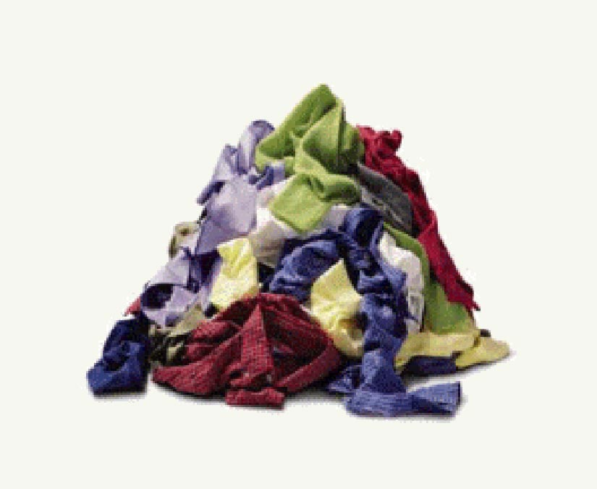

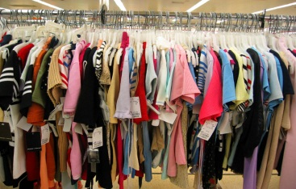
Men
Women
Children
Suits / Shirts /
Pants / Casual
Dresses / Skirts /
Pants / Tops
Dress / play /
Pants / Shirts
Arrange by size
Arrange by size
Arrange by size

Slide 19
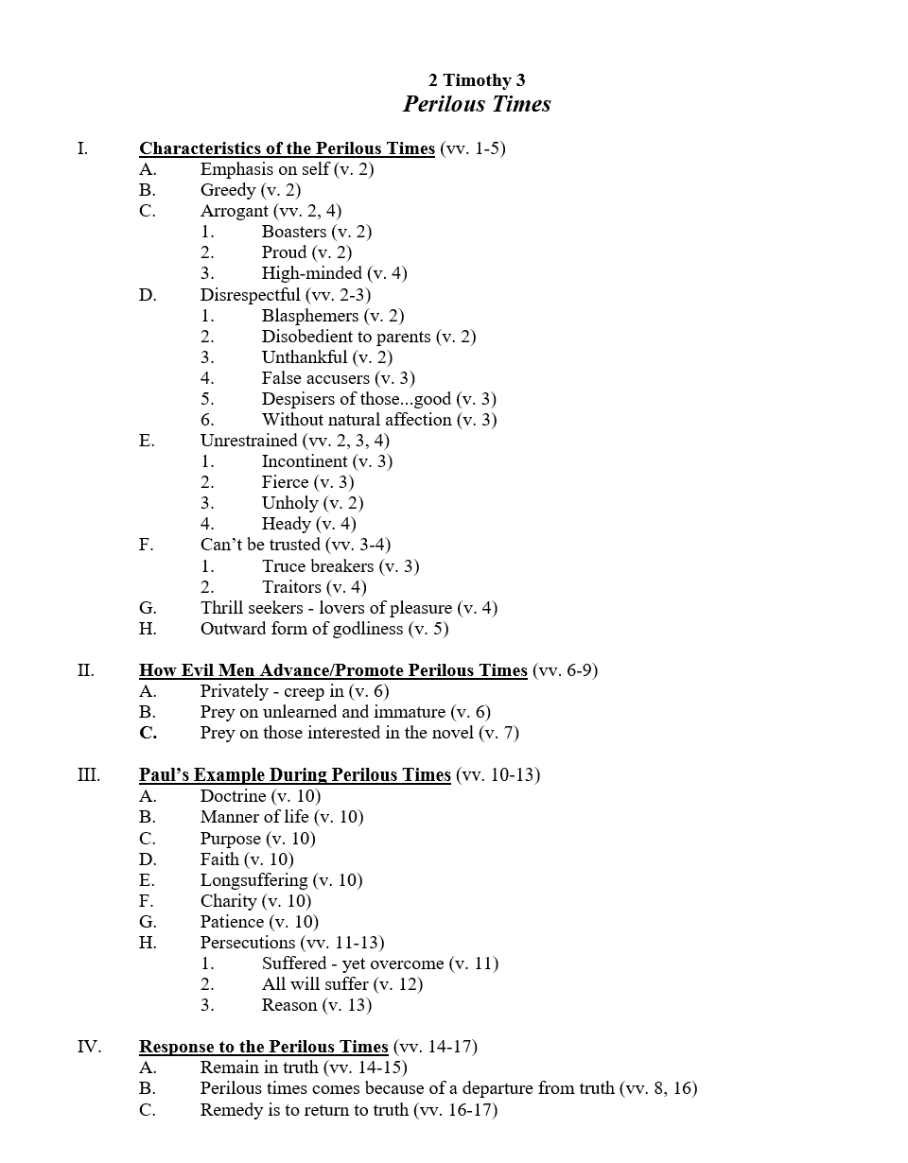
See what you have in the text
Connects thoughts together
Get to know text in context
Makes driving point home easier
Helps in deciding what to say next (teacher)

Slide 20
The Value of an Outline
Organizes the information – makes it more useful
Identifies boundaries
  Does this discussion go on into next several verses?
  Was this thought introduced earlier?
  Have we shifted thought patterns?

Slide 21
The Value of an Outline
Organizes the information – makes it more useful
Identifies boundaries
Helps gain “control” of the text
  Until I have an outline – I feel like text is a little “out of control” (i.e. pile of clothes)
  Once I have an outline – I feel like I have control!

Slide 22
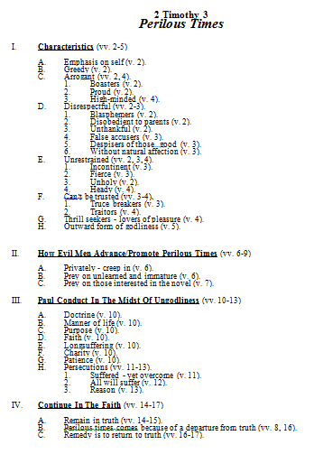
Puts Handles On

Slide 23
The Value of an Outline
Organizes the information – makes it more useful
Identifies boundaries
Helps gain “control” of the text
Shows the relationship of things in the text
  Chapter to the book
  Section to the chapter
  Verse to the section or the chapter

Slide 24
The Value of an Outline
Organizes the information – makes it more useful
Identifies boundaries
Helps gain “control” of the text
Shows the relationship of things in the text
Gives you a better view of the text
  Preview of what you are going to study
  View (guide, map, or compass) as you study
  Review that ties all together what you’ve just studied

Slide 25
The Value of an Outline
Organizes the information – makes it more useful
Identifies boundaries
Helps gain “control” of the text
Shows the relationship of things in the text
Gives you a better view of the text
Aid to interpretation
½ of job of interpreting
is accomplished!

Slide 26
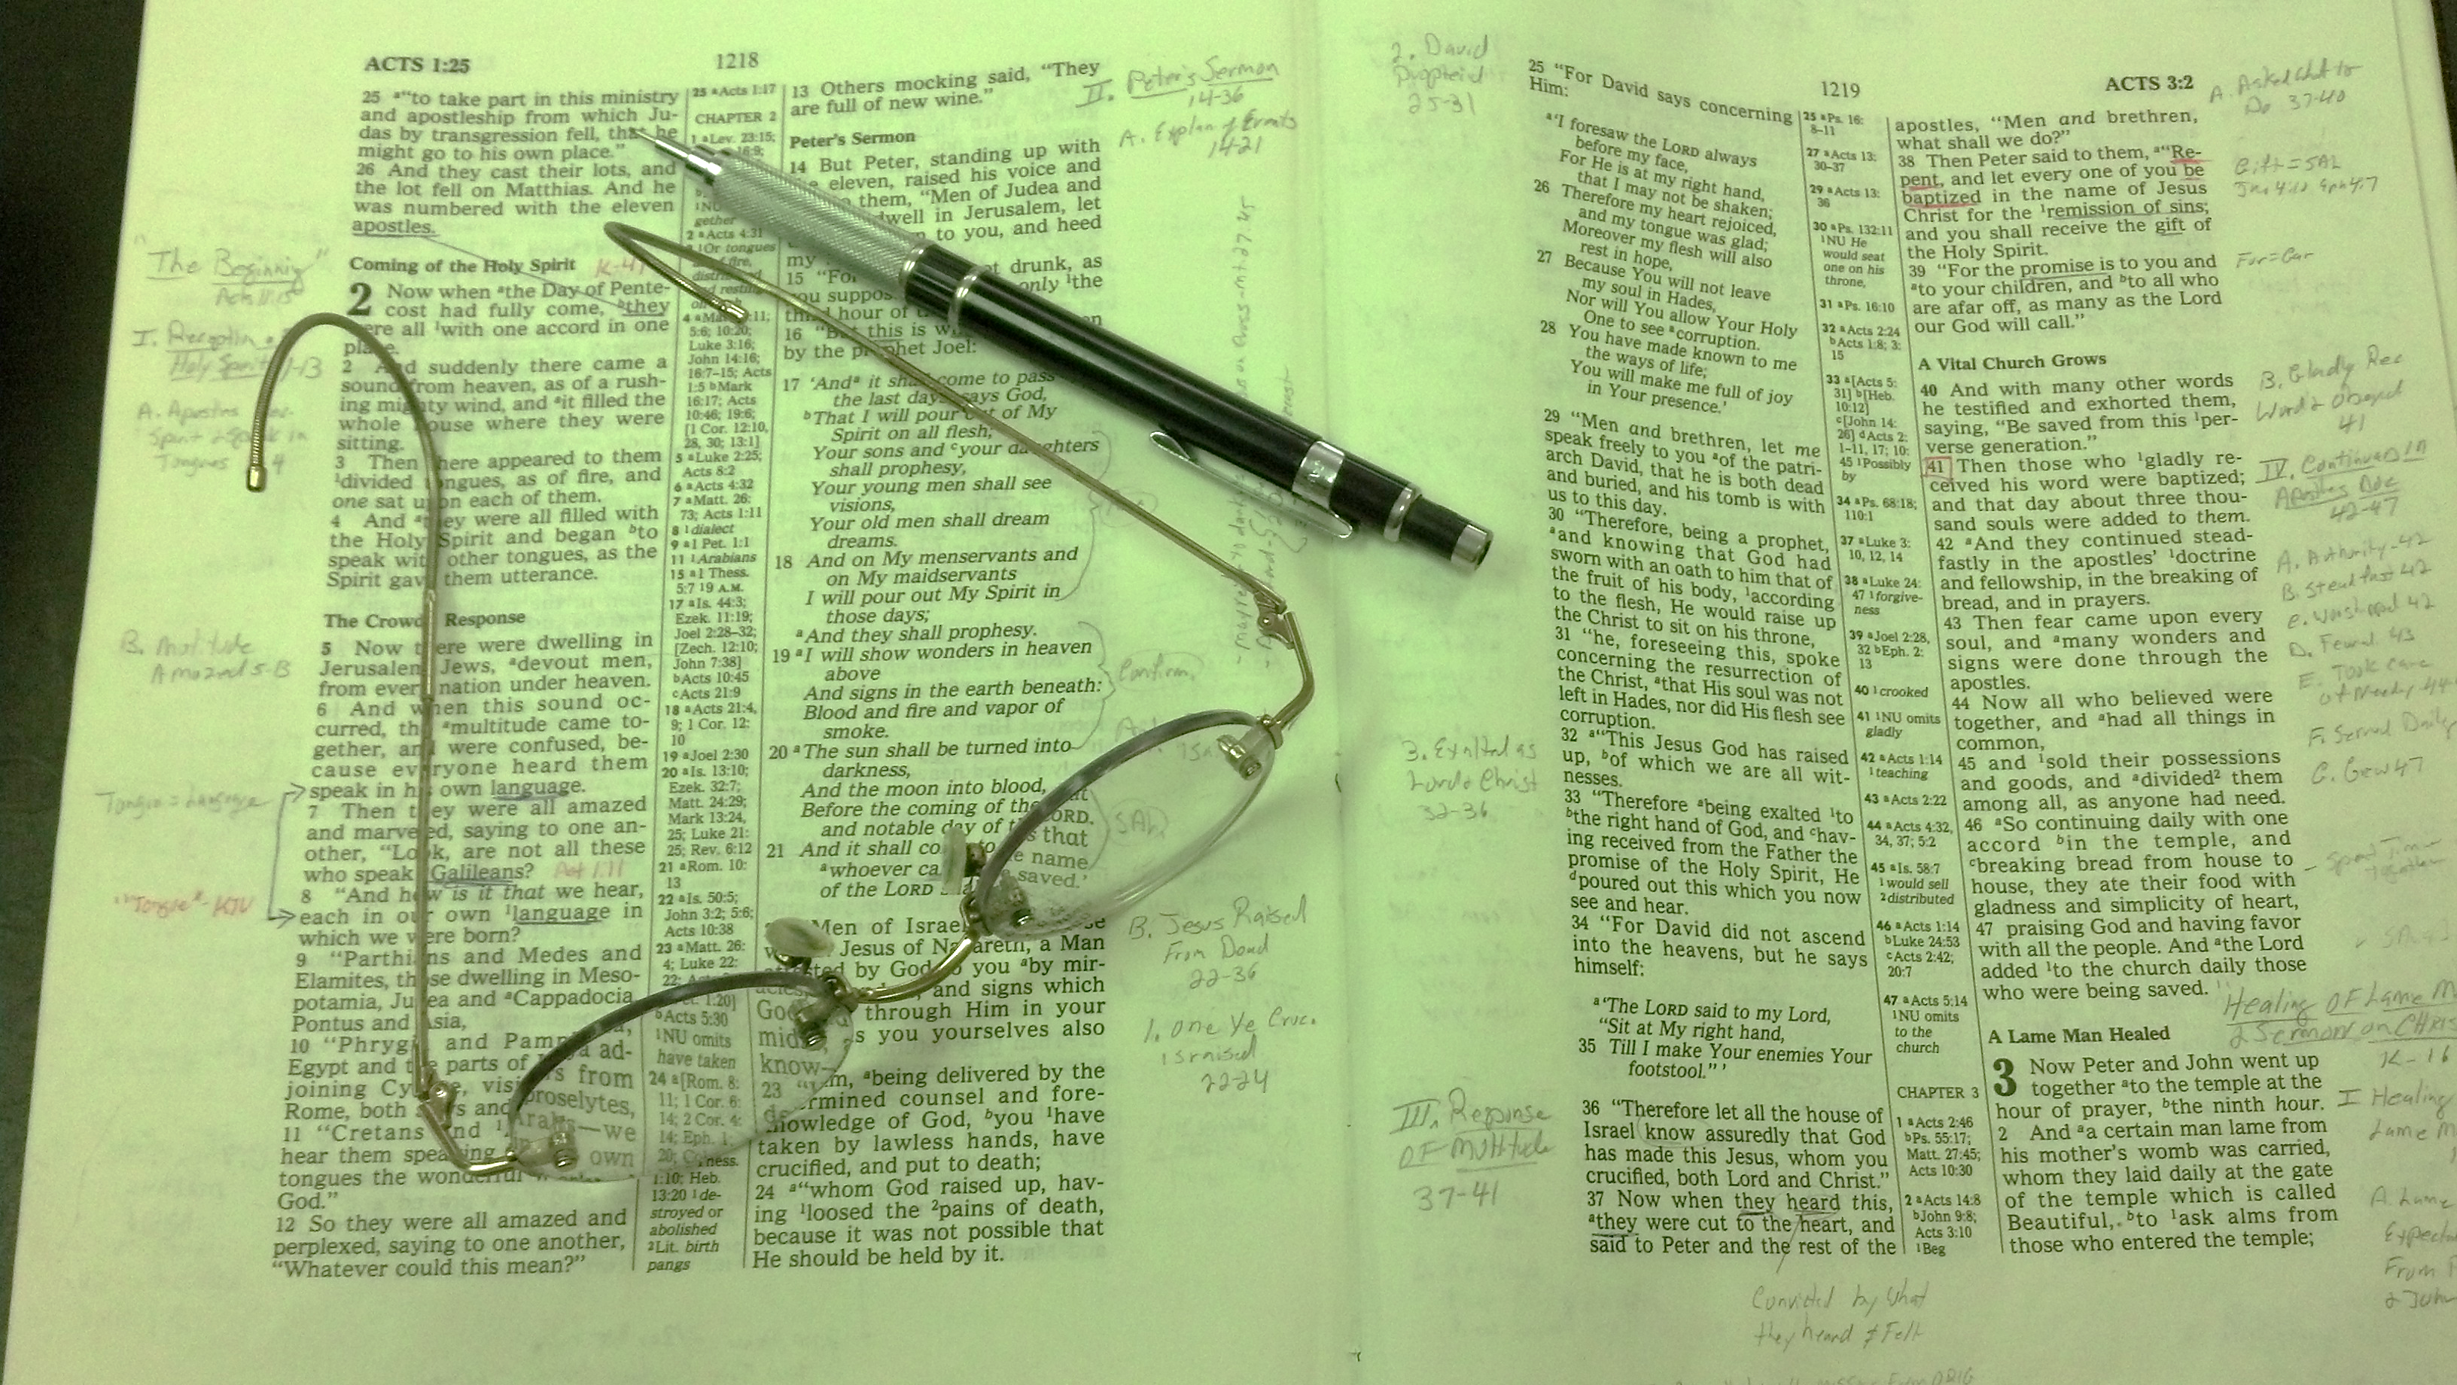
Write An Outline in Margin of the Text

Slide 27
Outlining the Text (part 1)
What is an Outline?
The Value of an Outline
Goal: True Textual Outline

Slide 28
Goal: True Textual Outline
What is a “true textual outline”?
  Not merely some points you see in the text
  Maps the flow of thought of the author
  Make every verse a part of the outline
  Analyzes the complete chapter (text)

Slide 30

Goal: True Textual Outline
What is a “true textual outline”?
Create an outline from which the author may have worked
Chapter Title
Main Point
  Subpoint
  Subpoint
Main Point
  Subpoint
  Subpoint
Main Point
  Subpoint
  Subpoint
Chapter Title
Main Point
  Subpoint
  Subpoint
Main Point
  Subpoint
  Subpoint
Main Point
  Subpoint
  Subpoint
Agree?

Slide 31
Goal: True Textual Outline
What is a “true textual outline”?
Create an outline from which the author may have worked
Basic rules for true textual outline:
  Outline as it was intended for the original reader
  Seek to fit every verse and thought into the outline
  Not making up an outline – you “find” it

Slide 32
Outlining the Text (part 1)
What is an Outline?
The Value of an Outline
Goal: True Textual Outline
How to Make an Outline
Examples of Outlines

Slide 33
1 Cor. 11:14-15 – Do these verses teach that it is wrong for a man to have long hair? Is it wrong for a woman to have short hair? Does this apply today? Is it just cultural?
Context:
  Verse 2-16 – Headship / submission to authority shown by wearing the head covering
  Argues that even nature teaches that woman’s head should be covered (vv. 14-15)

Slide 34
1 Cor. 11:14-15 – Do these verses teach that it is wrong for a man to have long hair? Is it wrong for a woman to have short hair? Does this apply today? Is it just cultural?
Context:
God established a distinction in men and women
  OT – Deut. 22:5 - not wear what pertains to another
  NT – 1 Cor. 6:9 – “effeminate” (feminine looking boys)
  1 Cor. 11 – shows the difference

Slide 35
1 Cor. 11:14-15 – Do these verses teach that it is wrong for a man to have long hair? Is it wrong for a woman to have short hair? Does this apply today? Is it just cultural?
Context:
God established a distinction in men and women
The word “Nature” (v. 14)
  Nature teaches that if man has long hair – dishonor
  Nature teaches that if woman has long hair – her glory
  Much hinges on the definition of “nature”

Slide 36
“Nature”
“The recognized constitution of things” (M. R. Vincent)
“Here it means native sense of propriety (cf. Rom. 2:14) in addition to mere custom, but one that rests on the objective difference in the constitution of things” (A. T. Robertson)
“Regular or established order of things” (BDAG)
Nature makes a natural distinction in hair length of men and women

Slide 37
In regard to “nature,” the question arises whether the word is to be taken in the objective sense, as denoting the order and laws of nature, or in the subjective sense, as denoting the instinctive feelings and sentiments, the native sense of propriety existing in every individual, and which may have been more or less affected by custom and habit. The latter interpretation cannot be altogether established from the meaning of the word. But the former yields good sense, as we understand by it here to denote the natural constitution of the sexes, and the richer growth of hair in the woman.
  John Peter Lange et al., A Commentary on the Holy Scriptures: 1 Corinthians 227.

Slide 38
1 Cor. 11:14-15 – Do these verses teach that it is wrong for a man to have long hair? Is it wrong for a woman to have short hair? Does this apply today? Is it just cultural?
Context:
God established a distinction in men and women
The word “Nature” (v. 14)
If the passage has no application today then:
  Man can wear hair to half-way down his back – be approved
  Woman can shave her head (bald) – be approved

Slide 39
1 Cor. 11:14-15 – Do these verses teach that it is wrong for a man to have long hair? Is it wrong for a woman to have short hair? Does this apply today? Is it just cultural?
Context:
God established a distinction in men and women
The word “Nature” (v. 14)
If the passage has no application today then:
How long is long? How short is short?
  Not measured by inches – but by comparison
  Some judgment is involved

