Slide 1
Bible Hermeneutics
Tonight’s Lesson:
Application / Practical Lessons
April 26, 2023

Slide 2
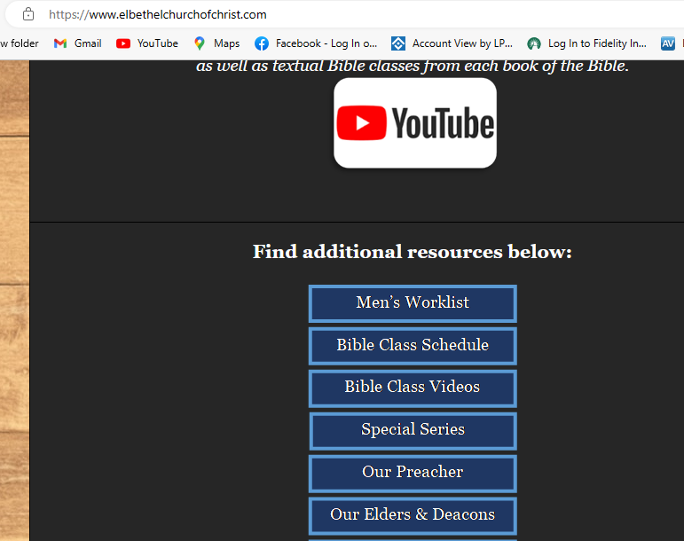

Slide 3
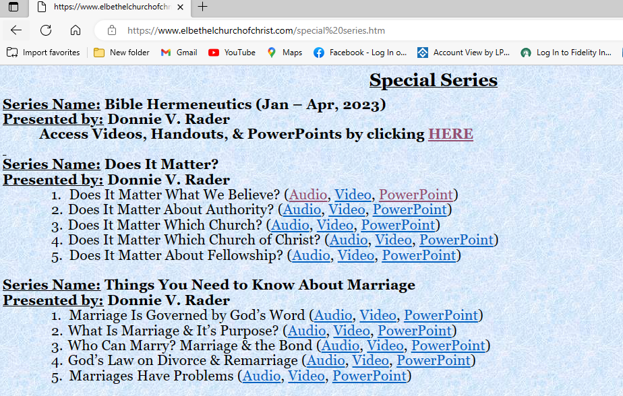

Slide 4
Bible Study - Challenge
Read 1, 2 & 3 John
At least 50 times
by the end of April
Can be read in 15 minutes
With each reading you will see more
May try another translation a few times
Take note of key concepts / words / contrast

Slide 5
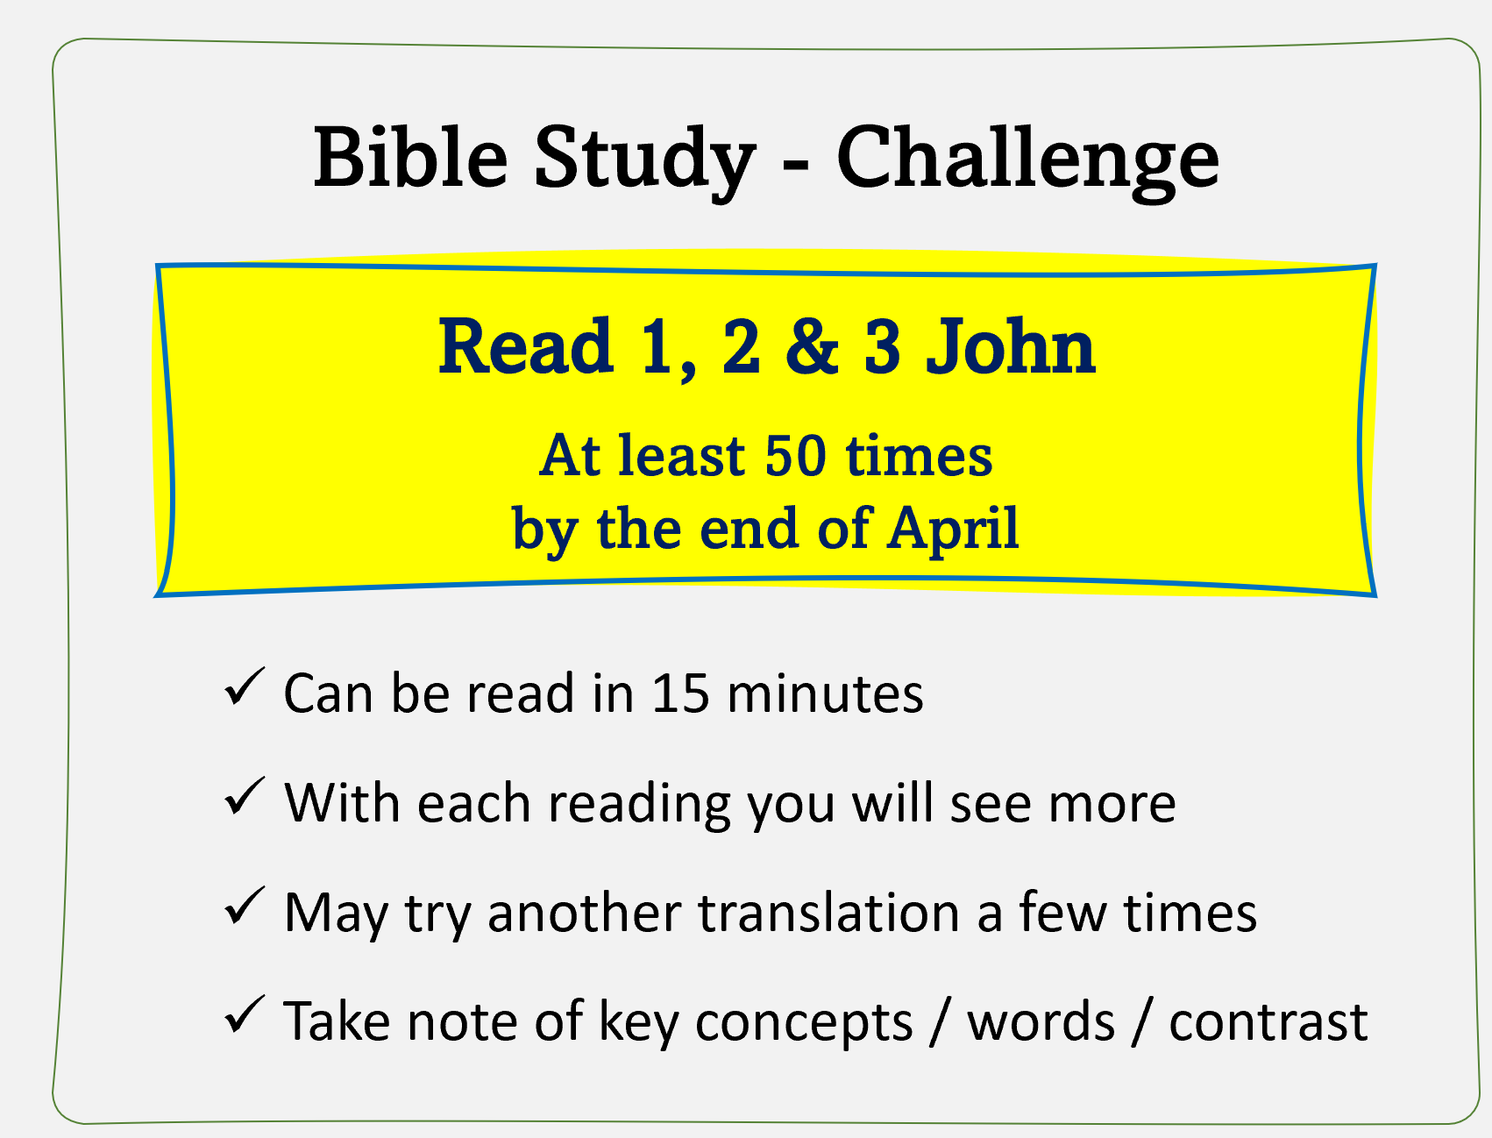
What Was the Value of
The Reading Challenge?
What did you notice / see that didn’t see before?
Change your view at all?
See words, themes or concepts repeated?
How did reading 50 times help?

Slide 6
Jan. 4 – Introduction to Inductive Bible Study
Jan. 11 – Background – Intro Information
Jan. 18 – Context
Jan. 25 – Context
Feb. 1 – Outlining the Text
Feb. 8 – Outlining the Text
Feb. 15 – Bible Study Aids
Feb. 22 – Use of Translations
Mar. 1 – Words
Mar. 8 – Hebrew / Greek Words
Mar. 15 – Hebrew / Greek Words
Mar. 22 – Use of Commentaries
Mar. 29 – Figurative Language
Apr. 5 – Figurative Language
Apr. 12 – Apocalyptic Literature & Numbers
Apr. 19 – Hebrews and Hermeneutics
Apr. 26 – Application / Practical Lessons
Bible Hermeneutics

Slide 7
Application / Practical Lessons
Bible study without application is useless
This is how I approach Bible study
  Read, read, and read
  Outline the text
  Check translations
  Define words
  What is message to the first recipients?
  Application:
    What does it demand of me?
    What practical lessons do I learn?

Slide 8
Application / Practical Lessons
How Does it Apply to Me?
How Do I Find /See Practical Lessons?
Examples
Sources

Slide 9
Application / Practical Lessons
How Does it Apply to Me?
How Do I Find /See Practical Lessons?
Examples
Sources

Slide 10
How Does it Apply to Me?
Jesus took a principle and made application (Luke 10)
  Principle: Love your neighbor (v. 27)
  Application:
    “Do this” (v. 28)
    Question: “Who is my neighbor?” (v. 29)
    Jesus told of Good Samaritan (vv. 30-37a)
    Added: “Go and do likewise” (v 37b)

Slide 11
How Does it Apply to Me?
Jesus took a principle and made application (Luke 10)
Study should lead to being doers of the word
  Jas. 1:22
  Ezra. 7:10
  1 Tim. 1:5

Slide 12
How Does it Apply to Me?
Jesus took a principle and made application (Luke 10)
Study should lead to being doers of the word
Need to ask, “What does this text demand of me?”
  Is there something I need to believe or accept?
  Do I need to change the way I think (about God, others, self)?
  Is there something I need to stop or quit?
  Is there something I need to start doing that I’m not doing?
  With every text / study need to ask:
    “So what?”
    “Then, what?”

Slide 13
How Does it Apply to Me?
Jesus took a principle and made application (Luke 10)
Study should lead to being doers of the word
Need to ask, “What does this text demand of me?”
Continue to ask, “Where does this fit?”
  That’s the point of Deut. 6:7
  Examples:
    Matt. 7:12
    1 Cor. 13:7
    Prov. 18:13, 17

Slide 14
Application / Practical Lessons
How Does it Apply to Me?
How Do I Find /See Practical Lessons?
Examples
Sources

Slide 15
How Do I Find /See Practical Lessons?
We are looking for lessons beyond what they text may demands of me
Develop a practice of looking for the practical, useful principles
  Not necessarily specifically stated
  Look for parallels to us today
  Think of how the example, story or text contrasts to today
  Notice examples of how far faith took them

Slide 16
How Do I Find /See Practical Lessons?
We are looking for lessons beyond what they text may demands of me
Develop a practice of looking for the practical, useful principles
Questions to ask
  “Therefore, what?”
  “How can I summarize or reword the text in simple terms?” [i.e. 1 Tim. 1:5]
  “What false doctrine is refuted?”
  “What common practice / thought is condemned?”
Make sure your application / practical lesson doesn’t violate the context or another Bible passage!

Slide 17
Application / Practical Lessons
How Does it Apply to Me?
How Do I Find /See Practical Lessons?
Examples
Sources

Slide 18
Examples
Heb. 10:2 – Connection between forgiveness and conscience
Heb. 10:25 – Contrast persecution to excuses today
Psa. 106:34-37 – Progression into sin – gets worse
Rev. 3:19 – Love doesn’t just commend – it rebukes
Lev. 19:14, 32 – Fear of God means treat others right
Acts 2:21-47 – What they did = calling on name of the Lord
Acts 15:31 – Seeing truth contrasted to error = encouraging
Luke 16:27-31 – Lost loved ones want you to be saved – even if they are lost / If one will not hear word – even a miracle wouldn’t convince

Slide 19
Application / Practical Lessons
How Does it Apply to Me?
How Do I Find /See Practical Lessons?
Examples
Sources

Slide 20
Sources
Pulpit Commentary (Homiletic section
Homiletic Commentary
Warren Weirsbe
Sermons on the text being studied (verse or chapter)

Slide 21
Rom. 12:1 – Check the NASB and ESV on this verse. Does it teach (as some argue) that all of life is worship (in contrast to acts of worship that we offer on the Lord’s day)?
Why is this point often made?
  I am worshipping God – even thought I don’t attend
  Can do things in worship that are not authorized

Slide 22
Rom. 12:1 – Check the NASB and ESV on this verse. Does it teach (as some argue) that all of life is worship (in contrast to acts of worship that we offer on the Lord’s day)?
Why is this point often made?
Fails to distinguish “service” and “Worship”
  All worship is service – but all service is not worship
  Dan. 3 – Daniel’s friends served the king – but would not worship him
  We serve others – but don’t worship them
  Jesus cleansed the temple of those doing service – but in wrong place – not worship (Jno. 2:14-16; Matt. 26:12-13)

Slide 23
Rom. 12:1 – Check the NASB and ESV on this verse. Does it teach (as some argue) that all of life is worship (in contrast to acts of worship that we offer on the Lord’s day)?
Why is this point often made?
Fails to distinguish “service” and “Worship”
Worship is more specific than service
  Gen. 22:5
  2 Sam. 12:20
  Acts 8:37

Slide 24
Rom. 12:1 – Check the NASB and ESV on this verse. Does it teach (as some argue) that all of life is worship (in contrast to acts of worship that we offer on the Lord’s day)?
Why is this point often made?
Fails to distinguish “service” and “Worship”
Worship is more specific than service
Romans 12:1
  ESV fn “or your rational service”
  Term – is more general term for service that includes worship

Slide 25
Scribal Errors & Inspiration
How errors occurred
  Some unintentional:
    Error of the eye – letters look alike / pick up on wrong line with the same word or phrase
    Error of the ear – words sound alike
  Some intentional:
    Scribe adds, omits or corrects what he thinks was done in error
In the O.T.
may have
variation in numbers
In the N.T.
may have
textual variation

Slide 26
Scribal Errors & Inspiration
How errors occurred
Significance of these errors
  Most of the errors are trivial
  May have some verses or part of verses missing (Mk. 16:9-20; Acts 8:37; John 7:53 – 8:11, etc.)
  No doctrine rest on questionable text

Slide 27
Only Involves 1/1000th of the Whole
“If comparative trivialities, such as changes of order, the insertion or omission of the article with proper names, and the like, are set aside, the words in our opinion still subject to doubt can hardly amount to more than a thousandth part of the whole New Testament”
B. F. Westcott and F. J. A. Hort, The New Testament in the Original Greek, 1911, p. 565

Slide 28
Scribal Errors Happen in Other Documents
“Even the earliest and best manuscripts that we possess are not totally free of transmissional errors. Numbers are occasionally miscopied, the spelling of proper names is occasionally garbled, and there are examples of the same types of scribal error that appear in other ancient documents as well”
(Gleason Archer 1982, p. 27).
Notes:
Inspired Writers and Competent Copyists - Apologetics Press

Slide 29
Other Documents Have Changes
“There is not a writing of antiquity which has come down to our age without many such changes”
J. W. McGarvey, 1886, 1:7-8).
Notes:
Inspired Writers and Competent Copyists - Apologetics Press

Slide 30
Errors are Usually Easily Settled
“We possess so many MSS., and are aided by so many versions, that we are never left to the need of conjecture as the means of removing errata.”
Philip Schaff
Chairman translating committee for ASV

