Slide 1
Bible Hermeneutics
Tonight’s Lesson:
Hebrews and Hermeneutics
April 19, 2023

Slide 2
Bible Study - Challenge
Read 1, 2 & 3 John
At least 50 times
by the end of April
Can be read in 15 minutes
With each reading you will see more
May try another translation a few times
Take note of key concepts / words / contrast

Slide 3
Jan. 4 – Introduction to Inductive Bible Study
Jan. 11 – Background – Intro Information
Jan. 18 – Context
Jan. 25 – Context
Feb. 1 – Outlining the Text
Feb. 8 – Outlining the Text
Feb. 15 – Bible Study Aids
Feb. 22 – Use of Translations
Mar. 1 – Words
Mar. 8 – Hebrew / Greek Words
Mar. 15 – Hebrew / Greek Words
Mar. 22 – Use of Commentaries
Mar. 29 – Figurative Language
Apr. 5 – Figurative Language
Apr. 12 – Apocalyptic Literature & Numbers
Apr. 19 – Hebrews and Hermeneutics
Apr. 26 – Application / Practical Lessons
Bible Hermeneutics

Slide 4
Hebrews and Hermeneutics
The book of Hebrews quotes from the Old Testament
  Approximately 40 times
  Doesn’t include allusions that are not direct quotes
How does the Hebrew writer use, treat and interpret those text?
  What hermeneutical principles does he use?
  How does he reason / draw conclusions from the text?

Slide 5
Hebrews and Hermeneutics
Respects Inspiration
Draws Inferences
Notices - Addressed
Looks at Timing
Makes Application

Slide 6
Hebrews and Hermeneutics
Respects Inspiration

Slide 7
Respects Inspiration
God spoke to the prophets (1:1)
Attributes OT quotes to God
  1:5 – Psa. 2:7; 2 Sam. 7:14
  1:6 – Deut. 32:43 (LXX)
  1:7 – Psa. 104:4
  1:8 – Psa. 45:6-7
  1:13 – Psa. 110:1
  4: 3 – Psa. 95:11
  4:4 – Gen. 2:2
  5:5 – Psa. 2:7
  5:6 – Psa. 110:4
  6:13-14 – Gen. 22:16-17

Slide 8
Respects Inspiration
God spoke to the prophets (1:1)
Attributes OT quotes to God
Writers wrote by the Holy Spirit
  David - Compare 3:7 and 4:7
  Moses - 10:15-16
If we respect the text as inspired,
We will be most careful how we handle and interpret it!

Slide 9
Hebrews and Hermeneutics
Respects Inspiration
Draws Inferences

Slide 10
Draws Inferences
Amazing how some Christians
can’t look at a text and draw a conclusion that is not specifically stated!
The “New Hermeneutics” rejects necessary inference as binding authority

Slide 11
Draws Inferences
Draws conclusions that are not specifically stated
  Christ is better than angels (1:4)
    V. 5 (Psa. 2:7)
    V. 5 (2 Sam. 7:14)
    V. 6 (Deut. 32:43 LXX)
    V. 13 (Psa. 110:1)

Slide 12
Draws Inferences
Draws conclusions that are not specifically stated
  Christ is better than angels (1:4)
  Christ is one with those he saves (2:11-13)
    V. 12 (Psa. 22:22)
    V. 13 (2 Sam. 22:3; Psa. 18:2)
    V. 13 (Isa. 8:18)

Slide 13
Draws Inferences
Draws conclusions that are not specifically stated
  Christ is better than angels (1:4)
  Christ is one with those he saves (2:11-13)
  Rest remains for those who believe (4:1)
    Vv. 3, 5 (Psa. 95:11)
    V. 4 (Gen. 2:2)

Slide 14
Draws Inferences
Draws conclusions that are not specifically stated
  Christ is better than angels (1:4)
  Christ is one with those he saves (2:11-13)
  Rest remains for those who believe (4:1)
  Christ was appointed of God as High Priest (5:4)
    V. 5 (Psa. 2:7)
    V. 6 (Psa. 110:4)

Slide 15
Draws Inferences
Draws conclusions that are not specifically stated
  Christ is better than angels (1:4)
  Christ is one with those he saves (2:11-13)
  Rest remains for those who believe (4:1)
  Christ was appointed of God as High Priest (5:4)
  Change in priesthood means change in law (7:12)
    V. 17 (Psa. 110:4)
    V. 21 (Psa. 110:4)

Slide 16
Draws Inferences
Draws conclusions that are not specifically stated
  Christ is better than angels (1:4)
  Christ is one with those he saves (2:11-13)
  Rest remains for those who believe (4:1)
  Christ was appointed of God as High Priest (5:4)
  Change in priesthood means change in law (7:12)
  Must follow the pattern for the real and true (8:5)
    V. 5 (Exo. 25:40)

Slide 17
Draws Inferences
Draws conclusions that are not specifically stated
  Christ is better than angels (1:4)
  Christ is one with those he saves (2:11-13)
  Rest remains for those who believe (4:1)
  Christ was appointed of God as High Priest (5:4)
  Change in priesthood means change in law (7:12)
  Must follow the pattern for the real and true (8:5)
  Old Testament is now old and obsolete (8:13)
    Vv. 8-12 (Jer. 31:31-34)

Slide 18
Draws Inferences
Draws conclusions that are not specifically stated
  Christ is better than angels (1:4)
  Christ is one with those he saves (2:11-13)
  Rest remains for those who believe (4:1)
  Christ was appointed of God as High Priest (5:4)
  Change in priesthood means change in law (7:12)
  Must follow the pattern for the real and true (8:5)
  Old Testament is now old and obsolete (8:13)
  He took away the first covenant to establish second (10:9)
    Vv. 5-7 (Psa. 40:6-8)
    V. 8 (Psa. 40:6)
    V. 9 (Psa. 40:7-8)

Slide 19
Draws Inferences
Draws conclusions that are not specifically stated
  Christ is better than angels (1:4)
  Christ is one with those he saves (2:11-13)
  Rest remains for those who believe (4:1)
  Christ was appointed of God as High Priest (5:4)
  Change in priesthood means change in law (7:12)
  Must follow the pattern for the real and true (8:5)
  Old Testament is now old and obsolete (8:13)
  He took away the first covenant to establish second (10:9)
  Enoch had faith (11:5)
    V. 5 (Gen. 5:24)

Slide 20
Draws Inferences
Draws conclusions that are not specifically stated
  Christ is better than angels (1:4)
  Christ is one with those he saves (2:11-13)
  Rest remains for those who believe (4:1)
  Christ was appointed of God as High Priest (5:4)
  Change in priesthood means change in law (7:12)
  Must follow the pattern for the real and true (8:5)
  Old Testament is now old and obsolete (8:13)
  He took away the first covenant to establish second (10:9)
  Enoch had faith (11:5)
  Spiritual matters – more important (13:5)
    V. 5 (Deut. 31:6; Josh 1:5; 1 Chron. 28:20)

Slide 21
Draws Inferences
Draws conclusions that are not specifically stated
Takes a principle – sees a contrast
  What is said to Christ – vs – said to angels (chapter 1)
  God put all things under man (2:5-8 [Psa. 8:4-6]) – vs – dominion lost because of sin (2:8b)
  Terror of those under the OT – vs – those under the NT (12:20-21 [Exo. 19:12-13; Deut. 9:19])

Slide 22
Draws Inferences
Draws conclusions that are not specifically stated
Takes a principle – sees a contrast
Reasons “if…then…”
  If God called him priest, then he is not self appointed
    5:5 (Psa. 2:7)
    5:6 (Psa. 110:4)

Slide 23
Draws Inferences
Draws conclusions that are not specifically stated
Takes a principle – sees a contrast
Reasons “if…then…”
  If God called him priest, then he is not self appointed
  If change priesthood, then change law (7:12, 17 [Psa. 110:4])
  If have better High Priest, then have a better covenant (7:21-22 [Psa. 110:4])

Slide 24
Hebrews and Hermeneutics
Respects Inspiration
Draws Inferences
Notices - Addressed

Slide 25
Notices Who is Addressed
Makes all the difference in the world in who is being addressed
  OT Israel (Sabbath – Deut. 5)?
  King of Babylon (“Lucifer” – Isa. 14:12)?
  Apostles (John 14-16; Acts 1:5-ff; 2:1-ff)?
  Individual or church (1 Tim. 5:16)?

Slide 26
Notices Who is Addressed
Makes all the difference in the world in who is being addressed
What said to Christ – not addressed to angels
  V. 5 (Psa. 2:7; 2 Sam 7:14)
  V. 6 (Deut. 32:43 LXX)
  V. 7 (Psa. 104:4)
  V. 8 (Psa. 45:6-7)
  V. 13 (Psa. 110:1)

Slide 27
Hebrews and Hermeneutics
Respects Inspiration
Draws Inferences
Notices - Addressed
Looks at Timing

Slide 28
Looks at Timing
Why is timing important?
Was this event before or after a law became effective? (Thief on cross)
A promise spoken after some event must point to something in future

Slide 29
Looks at Timing
Promise of rest after entered Caanan (4:7-9)
  Joshua and Israel entered promise land (v. 8)
  David spoke “after a long time” (v. 7; Psa. 95)
  Therefore, there is a rest that remains (v. 1, 8-9)

Slide 30
Time Line
Heaven
After long time
(v. 7)
Spoke of another day (v. 8)
Hebrews 4
God
rested on
7th Day
(Gen. 2:2)
Those who came out of Egypt did not enter
(Num. 14)
Joshua led
Israel into
Canaan
(Joshua)
David said
“today” & pointed to rest
(Psa. 95)

Slide 31
Looks at Timing
Promise of rest after entered Caanan (4:7-9)
Promise of a priest after Melchizedek (5:6; 7:17, 21)
  Psa. 110:4
  Spoken after institution of Lev. priesthood – shows there was a change intended

Slide 32
Looks at Timing
Promise of rest after entered Caanan (4:7-9)
Promise of a priest after Melchizedek (5:6; 7:17, 21)
Promise of a new law after old was established (8:8-12)
  Jer. 31:31-34 – promise of new covenant
  Spoken after old was established and still in force

Slide 33
Hebrews and Hermeneutics
Respects Inspiration
Draws Inferences
Notices - Addressed
Looks at Timing
Makes Application

Slide 34
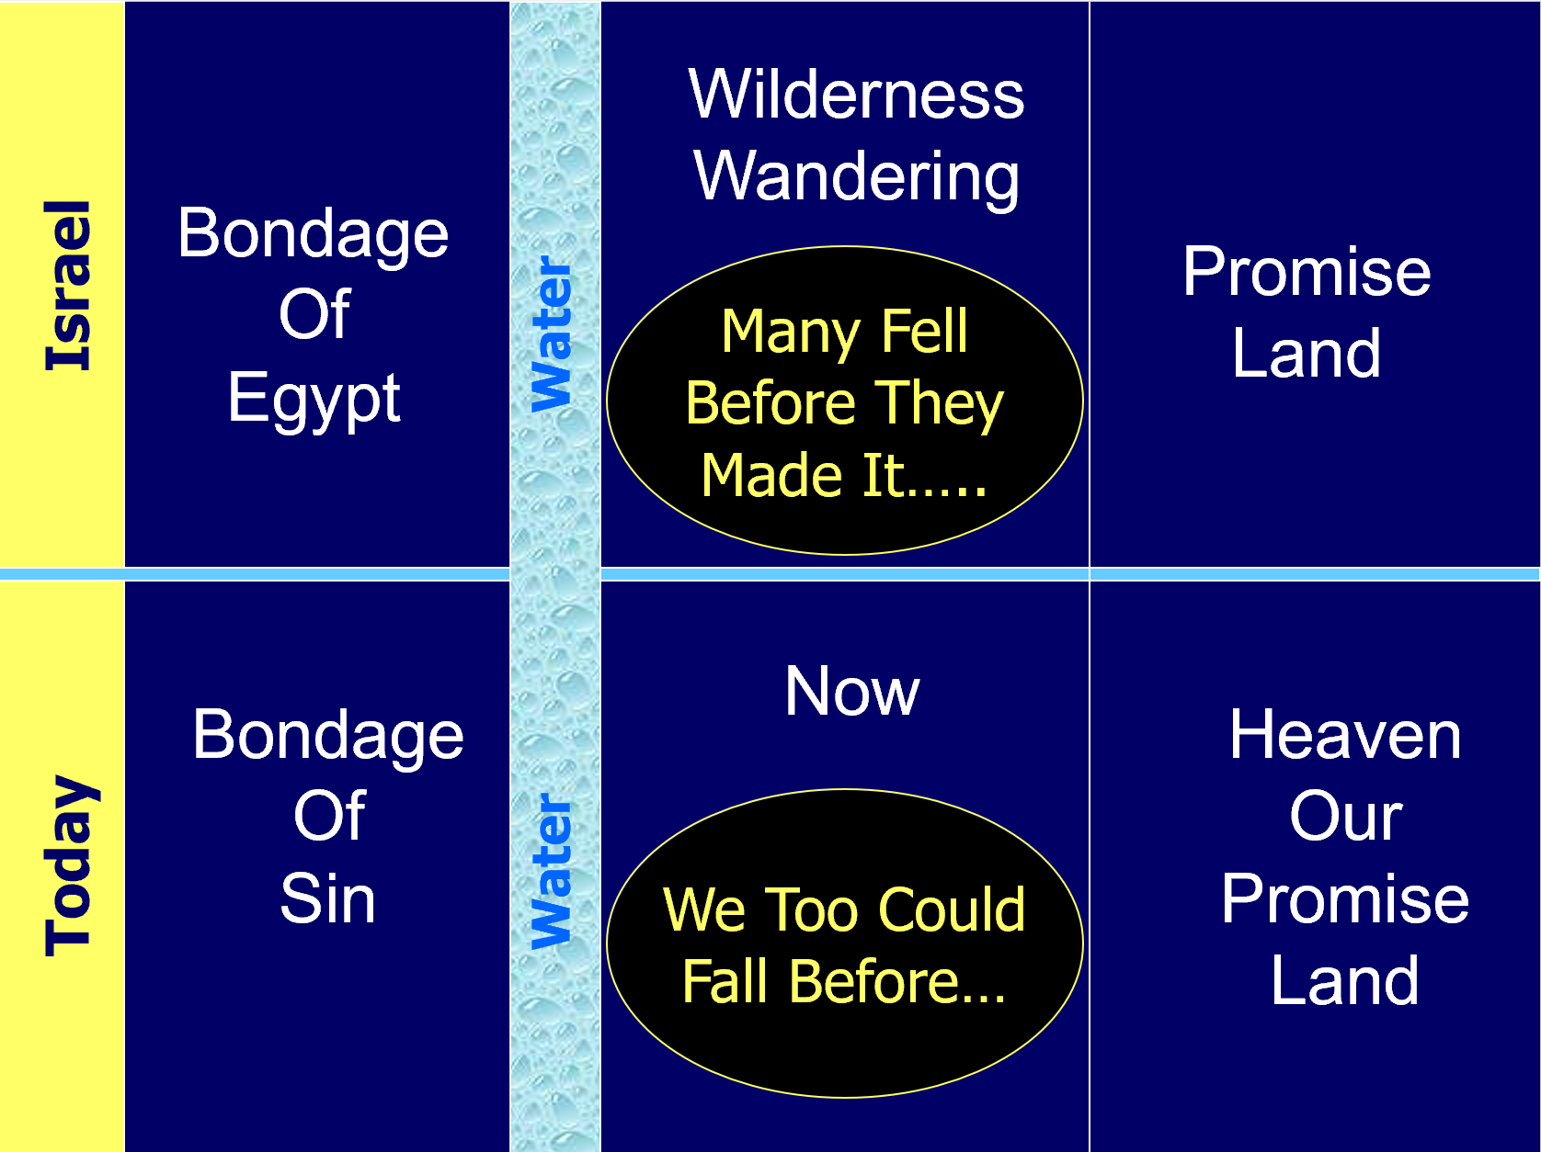
Makes Application
Draws a parallel to us today (3, 4)

Slide 35
Makes Application
Draws a parallel to us today (3, 4)
Examples for us
  Abraham (6:14 [Gen. 22:16-17]) – Abraham paitiently waited for the promise – Thus, we are to do same
  Moses (8:5 [Exo. 25:40]) – If copy had to be according to the pattern - Thus, the real and true must be too!

Slide 36
Makes Application
Draws a parallel to us today (3, 4)
Examples for us
General principle specifically applied
  Lord will punish those who turn from him (10:30 [Deut. 32:35-36])
  Judgment is coming (10:37-39 [Hab. 2:3-4]) – Coming in judgment on Babylon (Hab. 2) – applies it to Rome coming in judgment on Jerusalem

Slide 37
Hebrews and Hermeneutics
Respects Inspiration
Draws Inferences
Notices - Addressed
Looks at Timing
Makes Application

Slide 38
Matt. 12:31-32 – What is the unpardonable sin?

Slide 39
Foundation for Interpretation
All sin can be forgiven
  1 John 1:7 – blood cleanses from all…
  John 1:29 – take away sin of the world
  Any passage that promises forgiveness
    Matt. 26:28 – for remission of sins
    Eph. 1:7 – forgiveness of sins
    1 Jno. 2:1-2 – if sins –advocate…
  Must interpret difficult passages in light of the simple
  Can’t find any sin in NT that not forgiven when repent (No example)

Slide 40
Foundation for Interpretation
All sin can be forgiven
Repentance is essential
  Acts 17:30-31 – God commands all…
  Acts 2:38 – alien sinner
  Acts 8:22 – erring Christian
  Repentance involves ceasing the sin
    Rom. 6 – can’t continue in it
    1 Jno. 3:6, 9 – not practice sin
Conclusion:
Any Sin Can Be Forgiven – When Repent

Slide 41
Text in Context
Parallel Passages
  Mark 3:28-30
  Luke 12:10

Slide 42
Mark 3:28-30
28 "Assuredly, I say to you, all sins will be forgiven the sons of men, and whatever blasphemies they may utter;
29 but he who blasphemes against the Holy Spirit never has forgiveness, but is subject to eternal condemnation"--
30 because they said, "He has an unclean spirit."
Luke 12:10
10 And anyone who speaks a word against the Son of Man, it will be forgiven him; but to him who blasphemes against the Holy Spirit, it will not be forgiven.

Slide 43
Text in Context
Parallel Passages
Context – Miracle & Reaction

Slide 44
Facts – From Context
Healing (Miracle)
Accused Jesus of working by power of Devil
Knew a miracle – yet rejected it
Rejection of Holy Spirit
Thus, they spoke against & worked against power of the Holy Spirit

Slide 45
Text in Context
Parallel Passages
Context – Miracle & Reaction
Context of Luke 12:10
Context of denying Christ before men

Slide 46
Luke 12
Warnings & Instructions to Disciples
  I. Beware of hypocrisy of Pharisees (vv. 1-3)
  II. Fear God (vv. 4-7)
  III. Confess Christ before men (vv. 8-12)
  IV. Value of spiritual over material things (vv. 13-34)
  A. Parable of rich fool (vv. 13-21)
  B. Worry (vv. 22-34)
  V. Parable of evil & faithful servant (vv. 35-48)
  VI. Christ brings division (vv. 49-53)
  VII. Discerning the time (vv. 54-56)
  VIII. Turn to God before too late (vv. 57-59)

Slide 47
Conclusions
Seeing what is right – rejecting it and persisting in what is wrong
Don’t care (what Spirit says) sin anyway
Rebellion against the word of the Spirit
Why is it unforgiven?
  Not repent – as long as have attitude
  Rejected evidence for faith
Possible:
Limited to saying the work of Spirit is by the power of Satan
- cf. Kyle Butts, Apologetics Press

