Slide 1
Bible Hermeneutics
Tonight’s Lesson:
Apocalyptic Literature & Numbers
April 12, 2023

Slide 2
Bible Study - Challenge
Read 1, 2 & 3 John
At least 50 times
by the end of April
Can be read in 15 minutes
With each reading you will see more
May try another translation a few times
Take note of key concepts / words / contrast

Slide 3
Jan. 4 – Introduction to Inductive Bible Study
Jan. 11 – Background – Intro Information
Jan. 18 – Context
Jan. 25 – Context
Feb. 1 – Outlining the Text
Feb. 8 – Outlining the Text
Feb. 15 – Bible Study Aids
Feb. 22 – Use of Translations
Mar. 1 – Words
Mar. 8 – Hebrew / Greek Words
Mar. 15 – Hebrew / Greek Words
Mar. 22 – Use of Commentaries
Mar. 29 – Figurative Language
Apr. 5 – Figurative Language
Apr. 12 – Apocalyptic Literature & Numbers
Apr. 19 – Hebrews and Hermeneutics
Apr. 26 – Application / Practical Lessons
Bible Hermeneutics

Slide 4
Apocalyptic Literature & Numbers
Highly symbolic books terrify some students
Are extreme approaches:
  Can’t be understood at all – so why try?
  Means whatever we can imagine (spaceships in Ezek)
False doctrine comes from misunderstanding of such books as Revelation (premillennialism)

Slide 5
Apocalyptic Literature & Numbers
Apocalyptic Literature
Numbers

Slide 6
Apocalyptic Literature
What is it?
  “Revelation” (Rev. 1:1) – from Greek word Apocalypse (making fully known, revelation, disclosure –BDAG)
  “…(b) of revelations of a particular kind, through visions, etc.” BDAG
  Revealing of a message from God – through symbolism – visions
  This type of literature is not unique to the Bible – a great mass of apocalyptic-style literature arose between 150 BC and AD 100 (King, 64-65)

Slide 7
Apocalyptic Literature
What is it?
Books of Bible (or sections) that are apocalytpic
  Daniel (7-12), Ezekiel & Zechariah (12-14)
  Parts of Isaiah (24-27) & Joel
  Matt. 24; Mark 13, Luke 21
  Revelation

Slide 8
Apocalyptic Literature
What is it?
Books of Bible (or sections) that are apocalyptic
Why write in this form?
  Gives a vivid picture of the message (conflict & victory)
  Dramatic effect –
    Nations pictured as wild animals (Daniel 7)
    Upheaval of nations – Sun turned dark (Luke 24:29)
  In the NT – gives reader a reminder of OT parallel (by borrowing similar imagery
  Message is “protected” (the writer and recipient)

Slide 9
Message is “Protected”
Easy to instruct & encourage God’s people without playing into the hand of the enemy
Danger to the writer and recipient if understood
This method is both “prudent and brilliant” –Homer Hailey
To conceal and reveal
Somewhat comparable to parables (Mt. 13:10-15)
Illustration:
Brethren in China: “Ate more bread today and three more
went swimming.”

Slide 10
Apocalyptic Literature
What is it?
Books of Bible (or sections) that are apocalyptic
Why write in this form?
Characteristics of apocalyptic literature
  Conditions out of which this generally grew
    Trials, suffering, adversity, & enemy oppression
    Pictures present suffering in contrast the future victory

Slide 11
“It is essentially a literature of the oppressed who saw no hope for the nation simply in terms of politics or on the plane of human history.”
- D. S. Russell, as quoted by Ferrell Jenkins, Old Testament in the Book of Revelation, 35

Slide 12
Apocalyptic Literature
What is it?
Books of Bible (or sections) that are apocalyptic
Why write in this form?
Characteristics of apocalyptic literature
  Conditions out of which this generally grew
  Suggests that in some way God intends to act on behalf of his people
  A reminder that the outcome is dependent upon their steadfastness
  “Limited prophetic” (Revelation) -1:1, 3; 22:6, 10
  Symbolic (Rev. 1:1; beast Dan. 7)
  Use of visions (in which anything is possible)

Slide 13
Characteristics of Apocalyptic Literature
Imagery
Visions
Predictive Element
Dramatic

Slide 14
Apocalyptic Literature
What is it?
Books of Bible (or sections) that are apocalyptic
Why write in this form?
Characteristics of apocalyptic literature
Rules for interpreting apocalyptic literature
  Symbolism can’t be interpreted too literally
    Star = angels & lampstands = churches (Rev. 1:20)
    Dragon = devil (Rev. 12:9)
    Bowls of incense = prayers (Rev. 5:8)
    Horns = kings (Rev. 17:12)

Slide 15
Apocalyptic Literature
What is it?
Books of Bible (or sections) that are apocalyptic
Why write in this form?
Characteristics of apocalyptic literature
Rules for interpreting apocalyptic literature
  Symbolism can’t be interpreted too literally
  Put it in historical setting – then the imagery better understood
Not left to wild guesses!

Slide 16
Illustration – King, Commentary on Revelation, 68
Political cartoon in newspaper 1989
Large bear extending an olive branch in his paw to a bald eagle
Out of context, seems mysterious – even confusing
Obviously, the bear and eagle are symbols of something else
In historical context: Bear = Soviet Union that extends overtures of peace to eagle = United States

Slide 17
Apocalyptic Literature
What is it?
Books of Bible (or sections) that are apocalyptic
Why write in this form?
Characteristics of apocalyptic literature
Rules for interpreting apocalyptic literature
  Symbolism can’t be interpreted too literally
  Put it in historical setting – then the imagery better understood
  The “signs” or imagery is pointing to something else

Slide 18
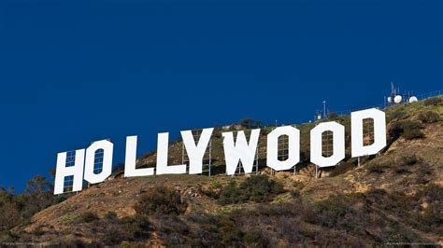
Foolish to think the wooden letters = Hollywood, CA
The “sign” merely points to Hollywood, CA
Cf. King, 74

Slide 19
Apocalyptic Literature
What is it?
Books of Bible (or sections) that are apocalyptic
Why write in this form?
Characteristics of apocalyptic literature
Rules for interpreting apocalyptic literature
  Symbolism can’t be interpreted too literally
  Put it in historical setting – then the imagery better understood
  The “signs” or imagery is pointing to something else
  Realize that none of the books were “to” us about our age
  Look for the big picture – apocalyptic material is not detailed reporting

Slide 20
Warning!
Very easy to let Apocalytic Literature become the foundation of fallacious interpretations

Slide 21
Apocalyptic Literature & Numbers
Apocalyptic Literature
Numbers

Slide 22
Numbers
1 – Unity (cf. Deut. 6:24; Mt. 19:6)
2 – Strength (cf. Ecc. 4:12)
3 – Divine number (cf. Matt. 28:19)
4 – Nature, Creation, world (four beasts)
5 – half of 10, short but definite period
6 – Short of 7 – failure
7 – Completeness – totality
10 – Power – world power / Completeness
12 – Religious number (tribes, apostles, gates, foundations)
3 ½ - Broken 7 – incomplete – associated with trials
144 – 12 x 12 – (12 intensified)

Slide 23
1 Cor. 13:8-10 – What is “that which is perfect”?
Context:

Slide 24
Spiritual Gifts
(12-14)
Enumeration of the Gifts
(Chapter 12)
Duration of the Gifts
(Chapter 13)
Regulation of the Gifts
(Chapter 14)

Slide 25
8 Love never fails. But whether there are prophecies, they will fail; whether there are tongues, they will cease; whether there is knowledge, it will vanish away.
9 For we know in part and we prophesy in part.
10 But when that which is perfect has come, then that which is in part will be done away.

Slide 26
1 Cor. 13:8-10 – What is “that which is perfect”?
Context:
Define “perfect”

Slide 27
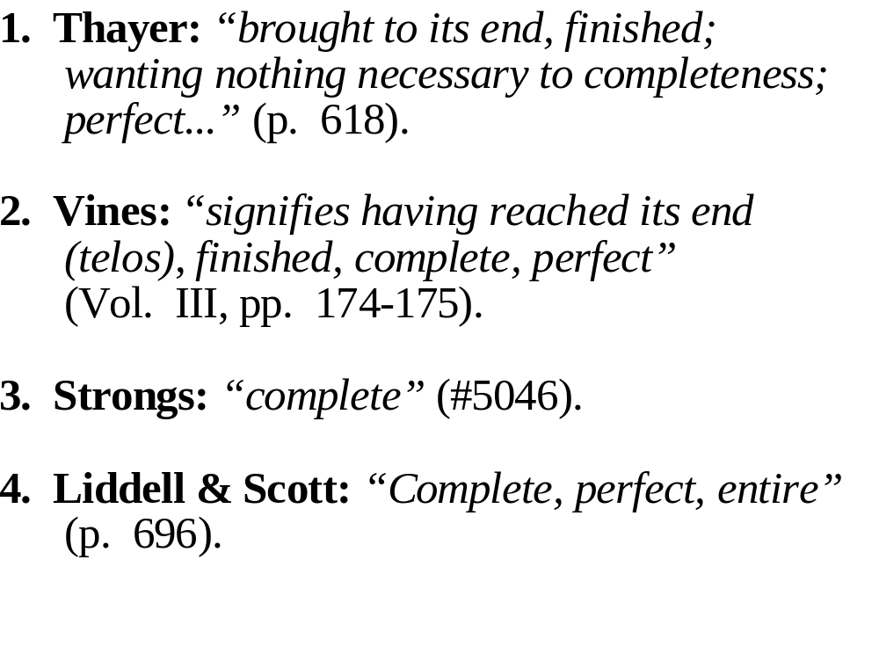
“Perfect”

Slide 28

Part

Slide 29
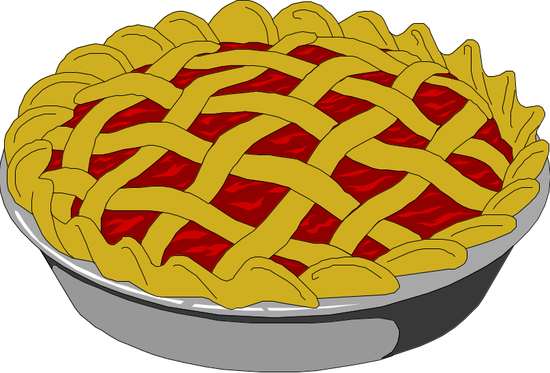
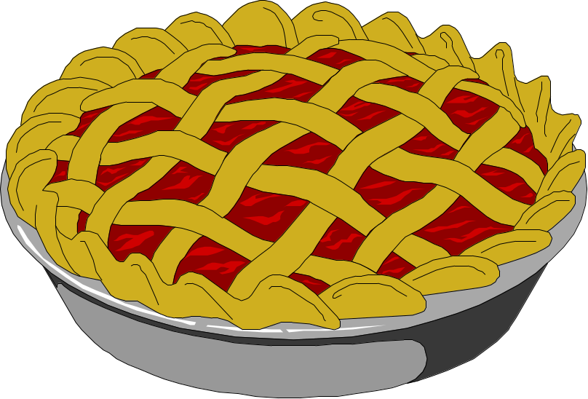

Slide 30
1 Cor. 13:8-10 – What is “that which is perfect”?
Context:
Define “perfect”
Context define how “perfect” is used

Slide 31
8 Love never fails. But whether there are prophecies, they will fail; whether there are tongues, they will cease; whether there is knowledge, it will vanish away.
9 For we know in part and we prophesy in part.
10 But when that which is perfect has come, then that which is in part will be done away.

Slide 32

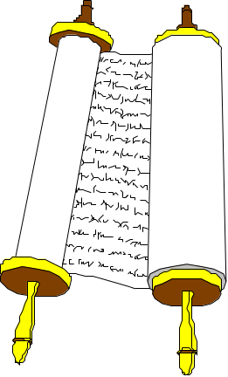
In Part
Perfect
Knowledge (v. 9)
Prophecy (v. 9)
Knowledge
Prophecy
God’s
Revelation
God’s
Revelation

Slide 33
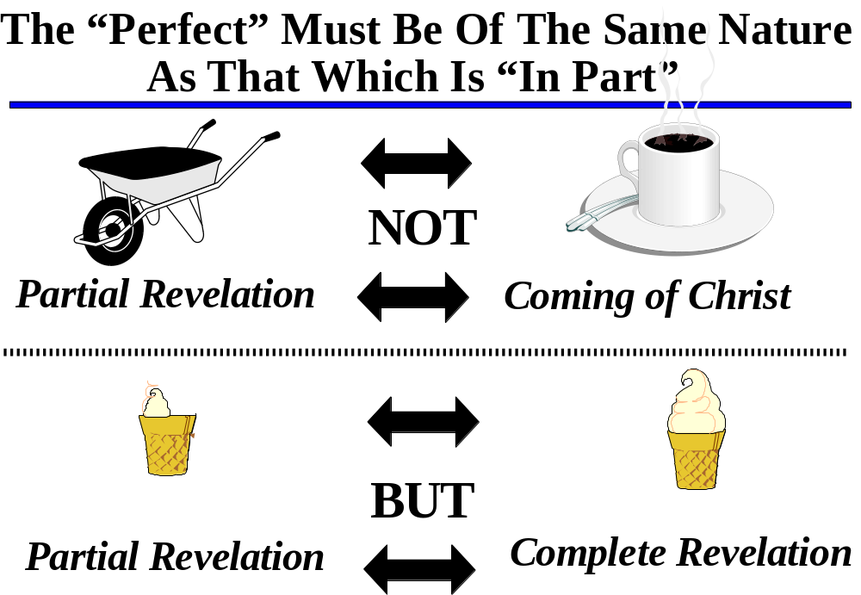

Slide 34
