Slide 1
Bible Hermeneutics
Tonight’s Lesson:
Use of Commentaries
March 22, 2023

Slide 2
Bible Study - Challenge
Read 1, 2 & 3 John
At least 50 times
by the end of April
Can be read in 15 minutes
With each reading you will see more
May try another translation a few times
Take note of key concepts / words / contrast

Slide 3
Jan. 4 – Introduction to Inductive Bible Study
Jan. 11 – Background – Intro Information
Jan. 18 – Context
Jan. 25 – Context
Feb. 1 – Outlining the Text
Feb. 8 – Outlining the Text
Feb. 15 – Bible Study Aids
Feb. 22 – Use of Translations
Mar. 1 – Words
Mar. 8 – Hebrew / Greek Words
Mar. 15 – Hebrew / Greek Words
Mar. 22 – Use of Commentaries
Mar. 29 – Figurative Language
Apr. 5 – Figurative Language
Apr. 12 – Apocalyptic Literature & Numbers
Apr. 19 – Hebrews and Hermeneutics
Apr. 26 – Application / Practical Lessons
Bible Hermeneutics

Slide 4

Use of Commentaries
What we are not saying:
  That one must have a commentary to understand the Bible
  That commentaries are the only way to know what a difficult passage means
  That must use commentaries written by brethren
What we are saying:
  Commentaries are mere “tools” or “aids”
  Commentaries can be helpful
  Commentaries need to be used properly

Slide 5
Use of Commentaries
Extremes (views & uses)
Different Types
Information Found in Commentaries
Know What you Have
How to Use a Commentary

Slide 6
Use of Commentaries
Extremes (views & uses)

Slide 7
Extremes (view & use)
Accept whatever it says
  Use it to do my work for me
  Accept the interpretation without question

Slide 8
Extremes (view & use)
Accept whatever it says
No need for a commentary – “I don’t use them”
  This person will be inconsistent – for they will offer THEIR comments on any passage
  Commentary = a written class / textual study
  Could you benefit from a class (or several) taught on the passage you want to learn?

Slide 9
Extremes (view & use)
Accept whatever it says
No need for a commentary – “I don’t use them”
There is a place for comments
  Neh. 8:8 – “gave the sense” [“explained what it meant”-NCV]
  Possible that someone has some information that I’ve not considered:
    Another passage
    Something in the context (connecting thoughts)
    The point (vs what thought the point was)
    An application

Slide 10
Use of Commentaries
Extremes (views & uses)
Different Types

Slide 11
Different Types
All Commentaries Are Not Equal
Different Levels
  Very scholarly (“Exegetical”)
    Will often deal with original language
    Example: Keil & Delitcsch
  Written for common man (“Expository”)
    Cf. Mk. 12:37
    Doesn’t wade too deep for common reader
  Some are thorough / some are brief

Slide 12
Different Types
All Commentaries Are Not Equal
Different Levels
Different Styles
  Language commentaries (Robertson, Vincent, Barclay)
  Homiletic commentaries (sermon and application) – (Weirsbe; part of Pulpit; Preacher’s Homiletical)
  Verse by verse (Pulpit, Barnes, Truth, Truth for Today, GA, and most commentaries)
  Summary of sections (Matthew Henry)

Slide 13
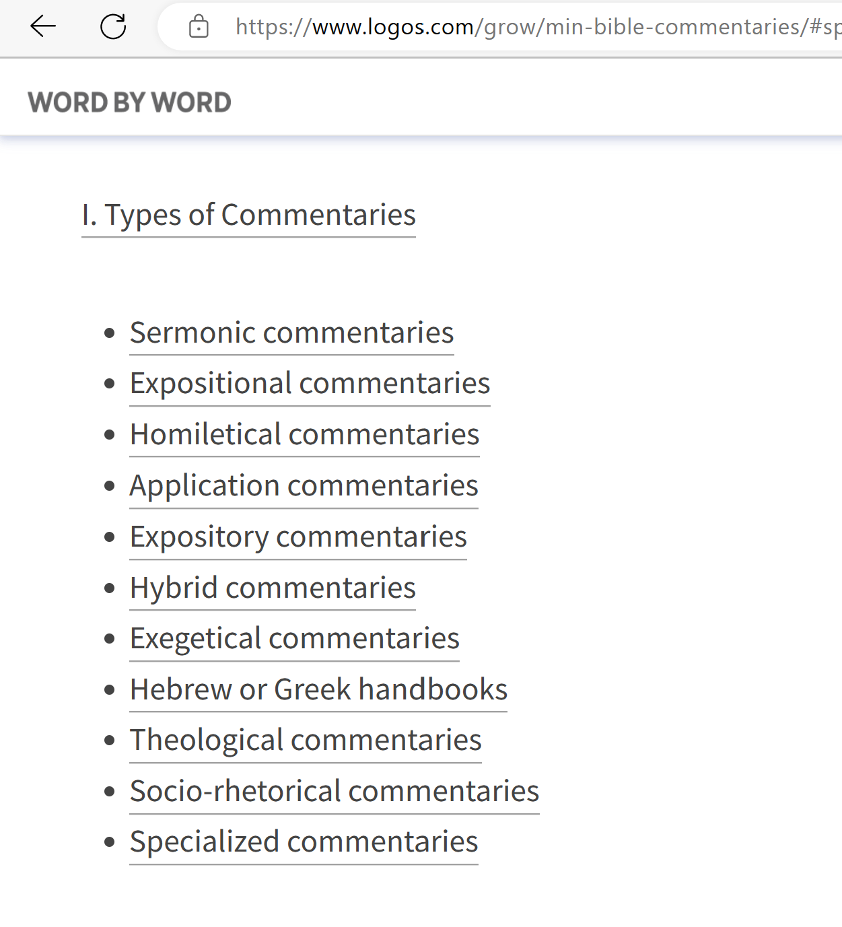

Slide 14
Use of Commentaries
Extremes (views & uses)
Different Types
Information Found in Commentaries

Slide 15
Information Found in Commentaries
Introductory Information
An Outline of Book & Chapters / Sections
Historical / Cultural Background
Verse by verse comments & how the text “flows”
Application
How “Hermeneutics” works – see how reached conclusion

Slide 16
Use of Commentaries
Extremes (views & uses)
Different Types
Information Found in Commentaries
Know What you Have

Slide 17
Know What you Have
Be Careful – This Involves Man’s Thoughts
Know Something of the Commentator
  Is he a brother (conservative or institutional)?
  What is the denominational bend? (i.e. Barnes)
  Is he a modernist (denies inspiration?)

Slide 18
Know What you Have
Be Careful – This Involves Man’s Thoughts
Know Something of the Commentator
Best if Get a Commentary Based on Recommendation
  Don’t worry about a “set”
  Buy individual volumes that are highly recommended on the book you are studying

Slide 19
Know What you Have
Be Careful – This Involves Man’s Thoughts
Know Something of the Commentator
Best if Get a Commentary Based on Recommendation
Several commentaries are available in electronic form
  Most Bible programs come with several commentaries
  Truth commentaries are available in PDF
  Many commentaries are on-line (free)
    Blueletterbible.org
    Biblestudytools.com
    Biblehub.com

Slide 20
Use of Commentaries
Extremes (views & uses)
Different Types
Information Found in Commentaries
Know What you Have
How to Use a Commentary

Slide 21
How to Use a Commentary
Turning to a commentary is not the first thing I do!

Slide 22
How to Use a Commentary
Recognize that written by man – can be wrong
See if the commentator can move me or change my mind
Watch for EVIDENCE for the interpretation
  God’s people are told to look for evidence
    Establish charges – 2-3 witnesses (Deut. 17:6; Matt. 18:16; 1 Tim. 5:19)
    Search Scriptures to see if true (Acts 17:11)
    Don’t accept all you hear (Prov. 18:13, 17)
  Did he give proof of his explanation?
  Was the evidence convincing?

Slide 23
How to Use a Commentary
Recognize that written by man – can be wrong
See if the commentator can move me or change my mind
Watch for EVIDENCE for the interpretation
Don’t depend on just one commentary

Slide 24
Use of Commentaries
Extremes (views & uses)
Different Types
Information Found in Commentaries
Know What you Have
How to Use a Commentary

Slide 25
1 Timothy 5:17 – Does this passage authorize elders to be paid by the local congregation they shepherd?
“Double honor” – something in addition to honor shown because of his role
Verse 18: Two quotations that have to do with pay (Deut. 25:4; Luke 10:7)
Same argument used for paying preachers (1 Cor. 9:1-14)

