Slide 1
Bible Hermeneutics
Tonight’s Lesson:
Hebrew / Greek Words (2)
March 15, 2023

Slide 2
Bible Study - Challenge
Read 1, 2 & 3 John
At least 50 times
by the end of April
Can be read in 15 minutes
With each reading you will see more
May try another translation a few times
Take note of key concepts / words / contrast

Slide 3
Jan. 4 – Introduction to Inductive Bible Study
Jan. 11 – Background – Intro Information
Jan. 18 – Context
Jan. 25 – Context
Feb. 1 – Outlining the Text
Feb. 8 – Outlining the Text
Feb. 15 – Bible Study Aids
Feb. 22 – Use of Translations
Mar. 1 – Words
Mar. 8 – Hebrew / Greek Words
Mar. 15 – Hebrew / Greek Words
Mar. 22 – Use of Commentaries
Mar. 29 – Figurative Language
Apr. 5 – Figurative Language
Apr. 12 – Apocalyptic Literature & Numbers
Apr. 19 – Hebrews and Hermeneutics
Apr. 26 – Application / Practical Lessons
Bible Hermeneutics

Slide 4
Two Levels Going Throughout
Basic Level
Deeper Dives

Slide 5
Hebrew / Greek Words
Knowing Hebrew or Greek is not essential to understand the word of God
No doctrine has to be established by looking at Hebrew or Greek
Why even talk about Hebrew or Greek?
  Not that we need to learn Hebrew or Greek
  Not that we have to know all about the tools of the languages (interlinears, lexicons, parsing guides, etc.)
  Will clarify or enhance our understanding
  Be familiar enough when others use them (sermon or class)

Slide 6
Hebrew / Greek Words
Clarification of Meaning
Enhancement of Understanding
How Do I Find the Original Word?
Examples

Slide 7
Clarification of Meaning
Clarify = see the meaning (may be different from our understanding of the English word)
  Sometimes due to archaic words used in English
  Sometimes due to difficulty in translating into English with one word (i.e. word for meek)
  Sometimes due to common use of English word in religious world (i.e. impute)

Slide 8
Hebrew / Greek Words
Clarification of Meaning
Enhancement of Understanding

Slide 9
Enhancement of Understanding
Enhance = not changing what we think it means – but improves our understanding
  Understanding is different now – but not a new meaning
  Understanding is richer and deeper

Slide 10
Hebrew / Greek Words
Clarification of Meaning
Enhancement of Understanding
How Do I Find the Original Word?

Slide 11
How Do I Find the Original Word?
Bible program / app – real easy
Strong’s – look up English – find the number
  That number leads to definition in back
  That number is a key to other works
Vine’s Expository Dictionary of OT and NT Words
Blueletterbible.org
Interlinear

Slide 12
Hebrew / Greek Words
Clarification of Meaning
Enhancement of Understanding
How Do I Find the Original Word?
Examples

Slide 13
Examples
Hebrew Words
  Gen. 1:1 – “God” (Hebrew: Elohim) - used of gods, idols and Yahweh / “The word literally means ‘gods”….” (Lexham Theological Wordbook)
  Deut. 1:37 – “for your sake”

Slide 14
Comments at Deut. 1:37
“For your sakes; rather, because of you, on account of you. The Hebrew word (גָלָל) comes from a root meaning to roll, and signifies primarily a turn in events, a circumstance, an occasion or reason. Moses reminds the Israelites that the misconduct of the people was what led to God’s being angry also with him (see Numb. 20:7, etc.; comp. Ps. 106:32, 33)”
Pulpit Commentary (p. 18)

Slide 15
Examples
Hebrew Words
  Gen. 1:1 – “God” (Hebrew: Elohim) - used of gods, idols and Yahweh / “The word literally means ‘gods”….” (Lexham Theological Wordbook)
  Deut. 1:37 – “for your sake”
  Zeph. 1:12 – “settled in complacency” [BDB – “thicken, condense, congeal”

Slide 16
“Settled in complacency” (NKJV)
NKJV fn. “Lit. on their lees; like the dregs of wine”
ESV – “men who are complacent” fn. Hebrew are thickening on the dregs [of their wine]
KJV & ASV – “settled on their lees”
NASB95 – “Stagnant in spirit”
HCSB – “men who settle down comfortably”
NIV – “who are complacent who are like wine left on its dregs”
NRSV – “who rest complacently on their dregs”
NLT – “sit complacent in their sins”
Lexham – “Whose senses are dulled from drinking”
NET – “entrenched in their sins”
RSV – “thickening upon their lees”
YLT – “hardened on their preserved things”

Slide 17
I will punish the men who are thickening upon their lees: the Hebrew metaphor is drawn from the process of wine-making. When the wine has fermented, it has to be poured from one vessel to another to separate the wine from the sediment which is called lees. This process is described in Jeremiah 48:11. If this is not done, the wine becomes too sweet and spoils. The verb translated thickening means “condense” or “congeal.” The men who are thickening upon their lees are people who have enjoyed uninterrupted wealth for too long and have thus become “self-satisfied and confident” (tev). “Self-satisfied” can be rendered idiomatically in many languages; for example, “filled-up-breast-filled-up-heart.” “Confident” can be translated as “trusting in oneself completely.” Material prosperity has made such people forgetful of God and led them to say in their hearts that the Lord has no interest in them. In cultures where winemaking is a well-known process, one may be able to keep the Hebrew figure of speech. Otherwise, it will be better to follow the example of tev and use nonfigurative language.
Clark, D. J., & Hatton, H. A. (1989). A translator’s handbook on the book of Zephaniah (p. 156). New York: United Bible Societies.

Slide 18
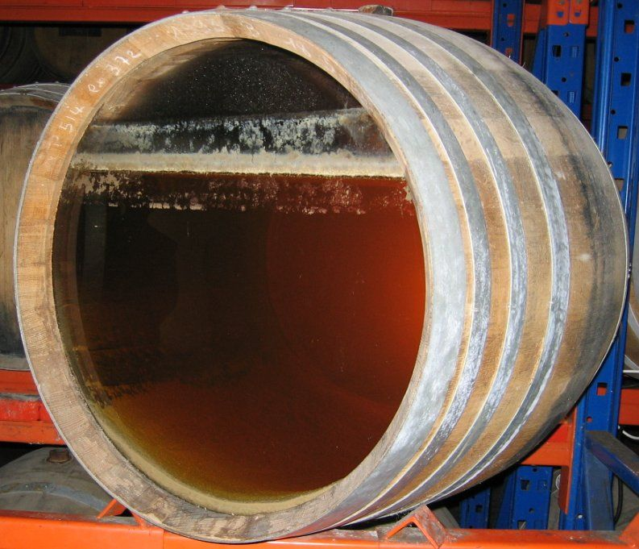
Lees / Dregs

Slide 19
Examples
Hebrew Words
  Gen. 1:1 – “God” (Hebrew: Elohim) - used of gods, idols and Yahweh / “The word literally means ‘gods”….” (Lexham Theological Wordbook)
  Deut. 1:37 – “for your sake”
  Zeph. 1:12 – “settled in complacency” [BDB – “thinken, condense, congeal”
  Josh 7:1 – “accursed” – devoted, banned goods
  Josh 1:8 – “meditate” – to growl, mutter to read in undertone
  Prov. 22:15 – “rod” – stick, branch, staff
  Gen. 3:1 – “cunning” – crafty – skill in deception

Slide 20
Examples
Hebrew Words
  Isa. 52:15 – “sprinkle” the nations
    Fn: “startle”; NET
    BDB: “spring, leap…leap in joyful surprise or = startle”
    Gensenius: “to exult with joy”… “to fill any one with joy”

Slide 21
Examples
Hebrew Words
Greek Words
  Rom. 8:19 – “earnest expectation” – Vine’s: outstretched head
  1 Cor. 7:15 – “bondage” – not same word for bond of marriage – means enslaved
  Titus 2:15 – “despise” – disregard, go around, overlook
  1 Pet. 2:21 – “example” – writing copy – imitate
  Gal. 2:13 – “hypocrite” – “acting of a stage player”
  2 Pet. 1:21 – “moved” – borne along – propelled or driven i.e. Acts 27:15 “let her drive”

Slide 22
Examples
Hebrew Words
Greek Words
  2 Thess. 3:6 – “disorderly” – out of rank

Slide 23
“Disorderly” (atakōs)
A. Adjective.
ataktos (ἄτακτος, 813) signifies “not keeping order” (a, negative, tasso, “to put in order, arrange”); it was especially a military term, denoting “not keeping rank, insubordinate”; it is used in 1 Thess. 5:14, describing certain church members who manifested an insubordinate spirit, whether by excitability or officiousness or idleness. See unruly.¶
B. Adverb.
ataktos (ἀτάκτως, 814) signifies “disorderly, with slackness” (like soldiers not keeping rank) 2 Thess. 3:6; in v. 11 it is said of those in the church who refused to work, and became busybodies (cf. 1 Tim. 5:13).¶
W. E. Vine

Slide 24
“Disorderly” (atakōs)
C. Verb.
atakteo (ἀτακτέω, 812) signifies “to be out of rank, out of one’s place, undisciplined, to behave disorderly”: in the military sense, “to break rank”; negatively in 2 Thess. 3:7, of the example set by the apostle and his fellow missionaries, in working for their bread while they were at Thessalonica so as not to burden the saints. See behave.¶
  Vine, W. E., Unger, M. F., & White, W., Jr. (1996). Vines Complete Expository Dictionary of Old and New Testament Words (Vol. 2, p. 174). Nashville, TN: T. Nelson.
W. E. Vine

Slide 25
Examples
Hebrew Words
Greek Words
  2 Thess. 3:6 – “disorderly” – out of rank
  Mark 14:51-52 – “naked” – no clothing or scantly clothed
  John 21:15-17 – “love” (agape & phileo)
    Agape – highest form of love – doesn’t always run with feelings (God’s love for us, our love for God)
    Phileo – have affection for / love for a friend / same word for “kiss” (Rom. 16:16)

Slide 26
Terms
That
Refer
To
The
Elders
Presbuterion
Means:
1. Eldership; elderhood, etc.
2. One older - “bearded one”
3. Suggests maturity in judgment/
experience / wisdom
Translated
1. Elder (Acts 14:23; 1 Tim. 5:1, 17)
2. Presbyter (1 Tim. 4:14)

Slide 27
Terms
That
Refer
To
The
Elders
Presbuterion
Episcopos
Means
1. Overseer, superintendant
2. One charged with duty of seeing
that things are done by others
(Thayer)
3. Epi = over; skep = to look at
Translated
1. Overseer (Acts 20:28)
2. Bishop (1 Tim. 3:1)

Slide 28
Terms
That
Refer
To
The
Elders
Presbuterion
Episcopos
Poiman
Means
1. One who keeps, guards sheep.
2. To feed flock.
3. Work of shepherd: feed, guard,
guide & protect
Translated
1. Shepherd - feed (Acts 20:28)
2. Pastor (Eph. 4:11)

Slide 29
Terms
That
Refer
To
The
Elders
Elder / Presbyter
Maturity
Overseer / Bishop
Administrative Role
Shepherd / Pastor
Teaching Role

Slide 30
Terms
That
Refer
To
The
Elders
All Three Terms
In Acts 20
Elders or Presbyters (v. 17)
Overseers or Bishops (v. 28)
Shepherd or Pastor (v. 28)

Slide 31
Hebrew / Greek Words
Clarification of Meaning
Enhancement of Understanding
How Do I Find the Original Word?
Examples

Slide 32
Rom. 2:13-15 – The Gentiles “do by nature the things contained in the law” and “are a law unto themselves”. What are these verses saying? Does this refer to some kind of “unknown” law of nature the Gentiles were under?
Context:
  Chapter: Jews are in sin just like the Gentiles
  (vv. 6-16 – all will be judged)
  (vv. 12-15) – will be judged by own law

Slide 33
Rom. 2:13-15 – The Gentiles “do by nature the things contained in the law” and “are a law unto themselves”. What are these verses saying? Does this refer to some kind of “unknown” law of nature the Gentiles were under?
Context:
Work of the law and not the law itself – written in their hearts (v. 15)
The law was the law of Moses (vv. 12-14) – what ever law the Gentiles did not have – Jews did
When – time this is discussing? Before the NT was effective
“Nature”: same word in Eph. 2:3 – long establish practice:“habit has become nature” (Thayer)

