Slide 1
Bible Hermeneutics
Tonight’s Lesson:
Hebrew / Greek Words
March 8, 2023

Slide 2
Bible Study - Challenge
Read 1, 2 & 3 John
At least 50 times
by the end of April
Can be read in 15 minutes
With each reading you will see more
May try another translation a few times
Take note of key concepts / words / contrast

Slide 3
Jan. 4 – Introduction to Inductive Bible Study
Jan. 11 – Background – Intro Information
Jan. 18 – Context
Jan. 25 – Context
Feb. 1 – Outlining the Text
Feb. 8 – Outlining the Text
Feb. 15 – Bible Study Aids
Feb. 22 – Use of Translations
Mar. 1 – Words
Mar. 8 – Hebrew / Greek Words
Mar. 15 – Hebrew / Greek Words
Mar. 22 – Use of Commentaries
Mar. 29 – Figurative Language
Apr. 5 – Figurative Language
Apr. 12 – Apocalyptic Literature & Numbers
Apr. 19 – Hebrews and Hermeneutics
Apr. 26 – Application / Practical Lessons
Bible Hermeneutics

Slide 4
Two Levels Going Throughout
Basic Level
Deeper Dives

Slide 5
Words
Words are Vehicles of Thought
Lack of Understanding of Words
Determining the Meaning of Words

Slide 6

Words are Vehicles of Thought
Thought
Words
Only as words convey their meaning to us (revealing the thoughts of God) are we Bible Learners
Words = symbols (useful to convey to us the things / ideas for which they stand)
Word is useless when divorced from meaning
Can’t profit from text – if don’t know meaning
Cannot put own meaning on words

Slide 7
Lack of Understanding of Words
Possible to memorize, quote & use words we don’t understand
Do we understand these words?
  Virtue (2 Pet. 1:5-7)
  Poor in spirit (Matt. 5:3-ff)
  Meek (Matt. 5:3-ff)
  Lasciviousness (Gal. 5:19-ff)
  Uncleanness (Gal. 5:19-ff)
  Jesus (Matt. 1:21)
  Christ (Acts 2:36)
  Propitiation (Rom. 3:25)
  Repentance (Acts 2:38)

Slide 8
Determining the Meaning of Words
Look at the context for a clue
Check another translation
Check an English dictionary
Check the original word and lexicons
Use basic rules of grammar
Look for words used interchangeably
Look for words that are contrasted
Consider the etymology of a word

Slide 9
Hebrew / Greek Words
Knowing Hebrew or Greek is not essential to understand the word of God
No doctrine has to be established by looking at Hebrew or Greek
  May use the original language to make a point
  May use the original language to answer an argument
  Bible doctrine can be established by the English text!

Slide 10
Hebrew / Greek Words
Knowing Hebrew or Greek is not essential to understand the word of God
No doctrine has to be established by looking at Hebrew or Greek
Why even talk about Hebrew or Greek?
  Not that we need to learn Hebrew or Greek
  Not that we have to know all about the tools of the languages (interlinears, lexicons, parsing guides, etc.)
  Will clarify or enhance our understanding
  Be familiar enough when others use them (sermon or class)

Slide 11
Hebrew / Greek Words
Clarification of Meaning
Enhancement of Understanding
How Do I Find the Original Word?
Examples

Slide 12
Hebrew / Greek Words
Clarification of Meaning

Slide 13
Clarification of Meaning
Clarify = see the meaning (may be different from our understanding of the English word)
  Sometimes due to archaic words used in English
  Sometimes due to difficulty in translating into English with one word (i.e. word for meek)
  Sometimes due to common use of English word in religious world (i.e. imput)

Slide 14
Clarification of Meaning
Clarify = see the meaning (may be different from our understanding of the English word)
Examples
  Hospitality (Rom. 12:13) – love of strangers
  Scarcely (1 Pet. 4:18) with difficulty or toil
  Banqueting (1 Pet.4:3) – drinking
  Depart (1 Cor. 7:10-11) – divorce
  Hell (Acts 2:31) – hades
  Baptism (1 Pet. 3:21) – immerse, submerge, plunge
  Church (Acts 2:47) – Ekklesia = called out (same word for assembly)

Slide 15
Hebrew / Greek Words
Clarification of Meaning
Enhancement of Understanding

Slide 16
Enhancement of Understanding
Enhance = not changing what we think it means – but improves our understanding
  Understanding is different now – but not a new meaning
  Understanding is richer and deeper

Slide 17
Enhancement of Understanding
Enhance = not changing what we think it means – but improves our understanding
Examples:
  “Fervent” (Rom. 12:11) – to burn, to be hot, or boil
  “Peculiar people” (1 Pet. 2:9; Titus 2:13-14) – own possession
  “Earnest” (Eph. 1:12-14) – caution money, deposit, promise…
  “Subject” (Eph. 5:24) – Military term – line up under authority of…
  “End” (Rom. 10:4) - aim

Slide 18
Hebrew / Greek Words
Clarification of Meaning
Enhancement of Understanding
How Do I Find the Original Word?

Slide 19
How Do I Find the Original Word?
Bible program / app – real easy
Strong’s – look up English – find the number
  That number leads to definition in back
  That number is a key to other works
Vine’s Expository Dictionary of OT and NT Words
Blueletterbible.org

Slide 20
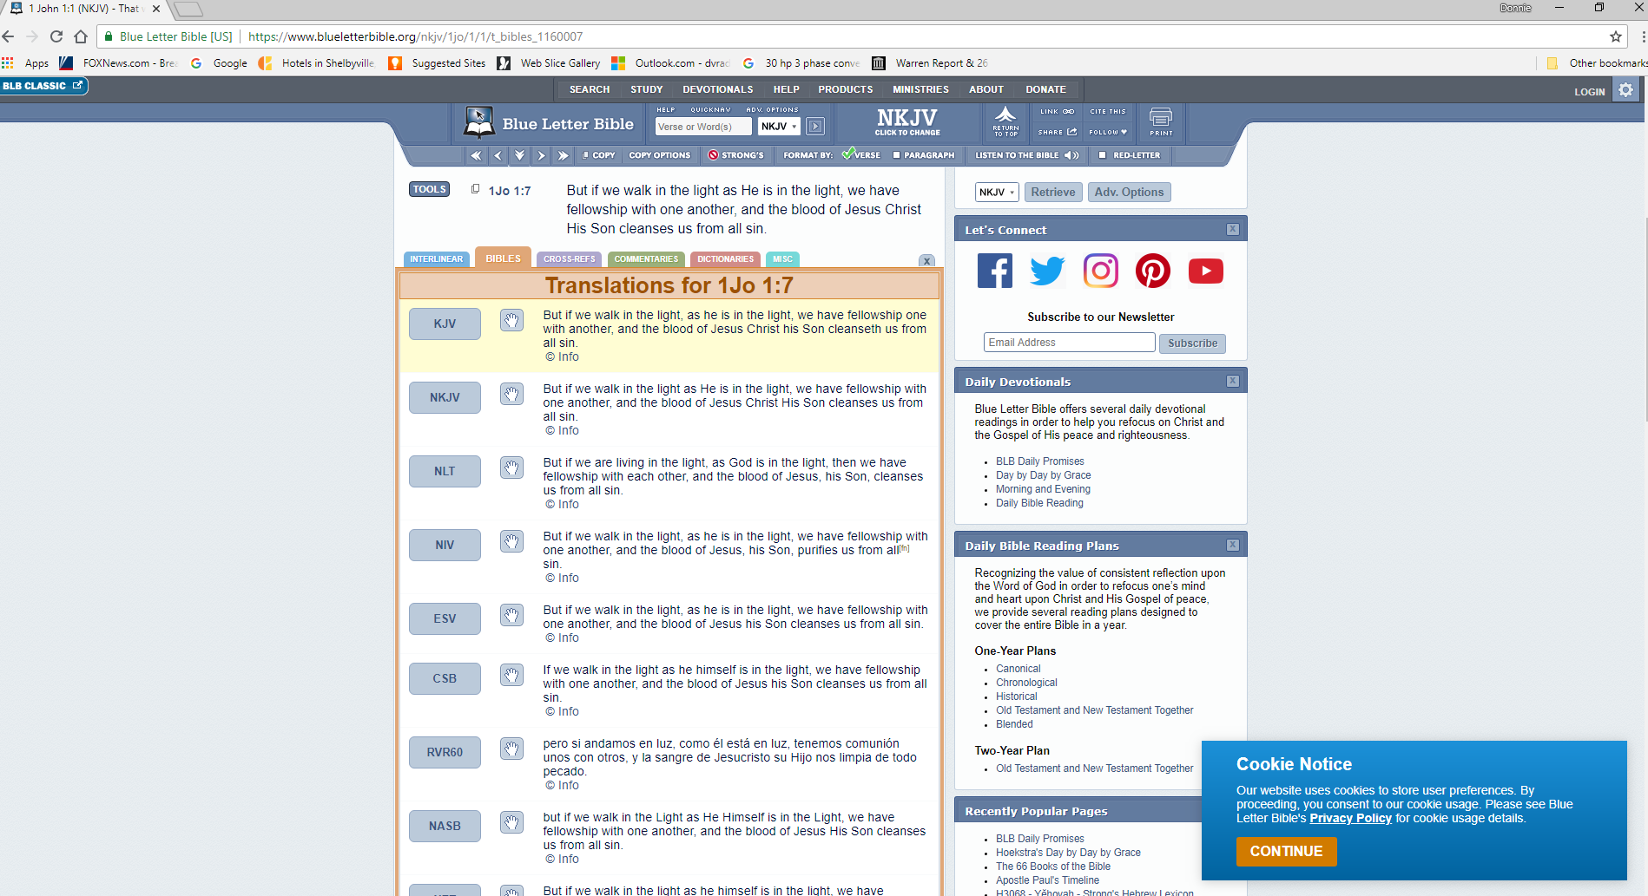
Blueletterbible.org

Slide 21
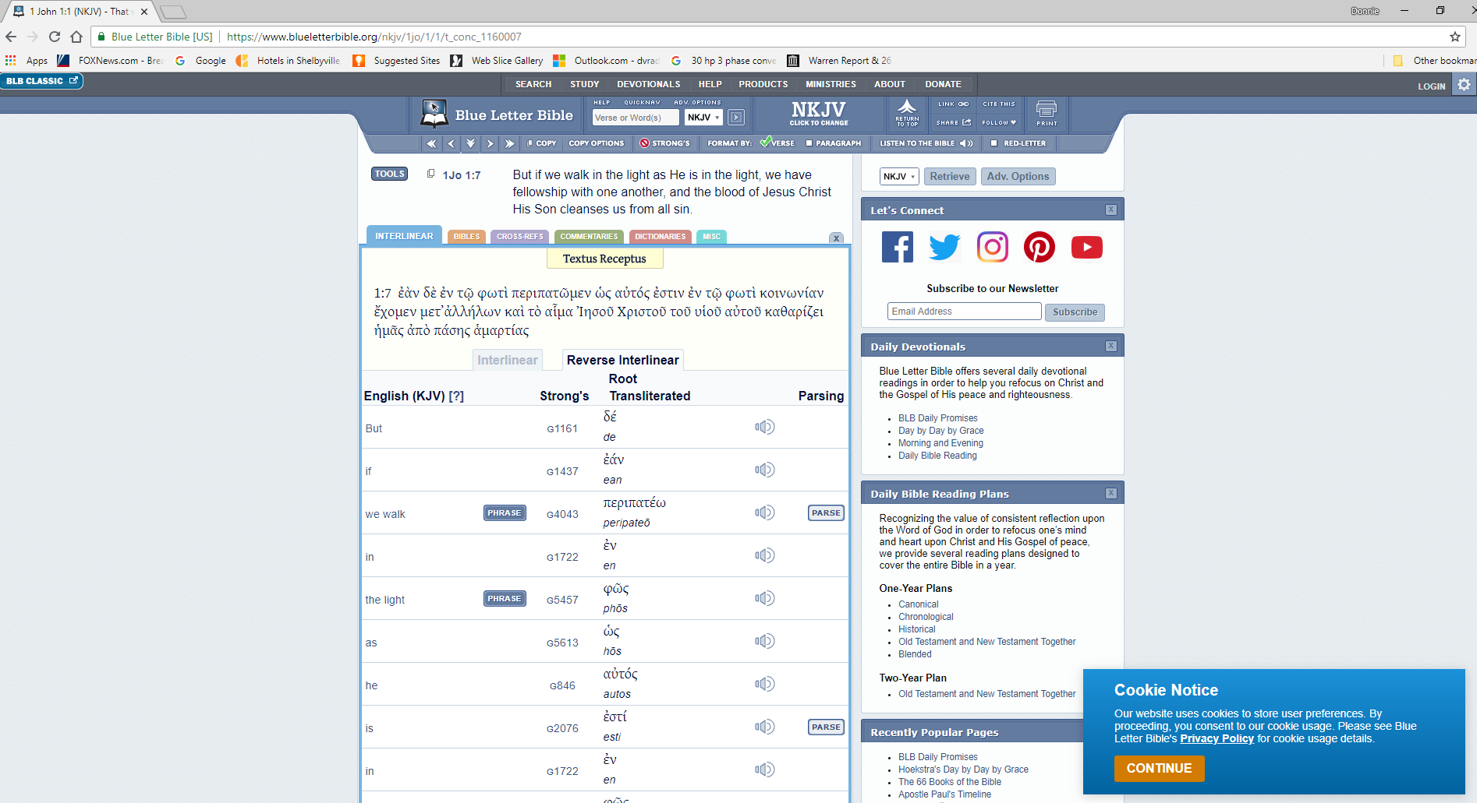
Blueletterbible.org

Slide 22
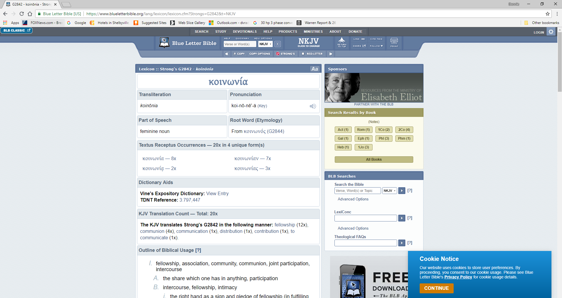
Blueletterbible.org

Slide 23
How Do I Find the Original Word?
Bible program / app – real easy
Strong’s – look up English – find the number
  That number leads to definition in back
  That number is a key to other works
Vine’s Expository Dictionary of OT and NT Words
Blueletterbible.org
Interlinear

Slide 24
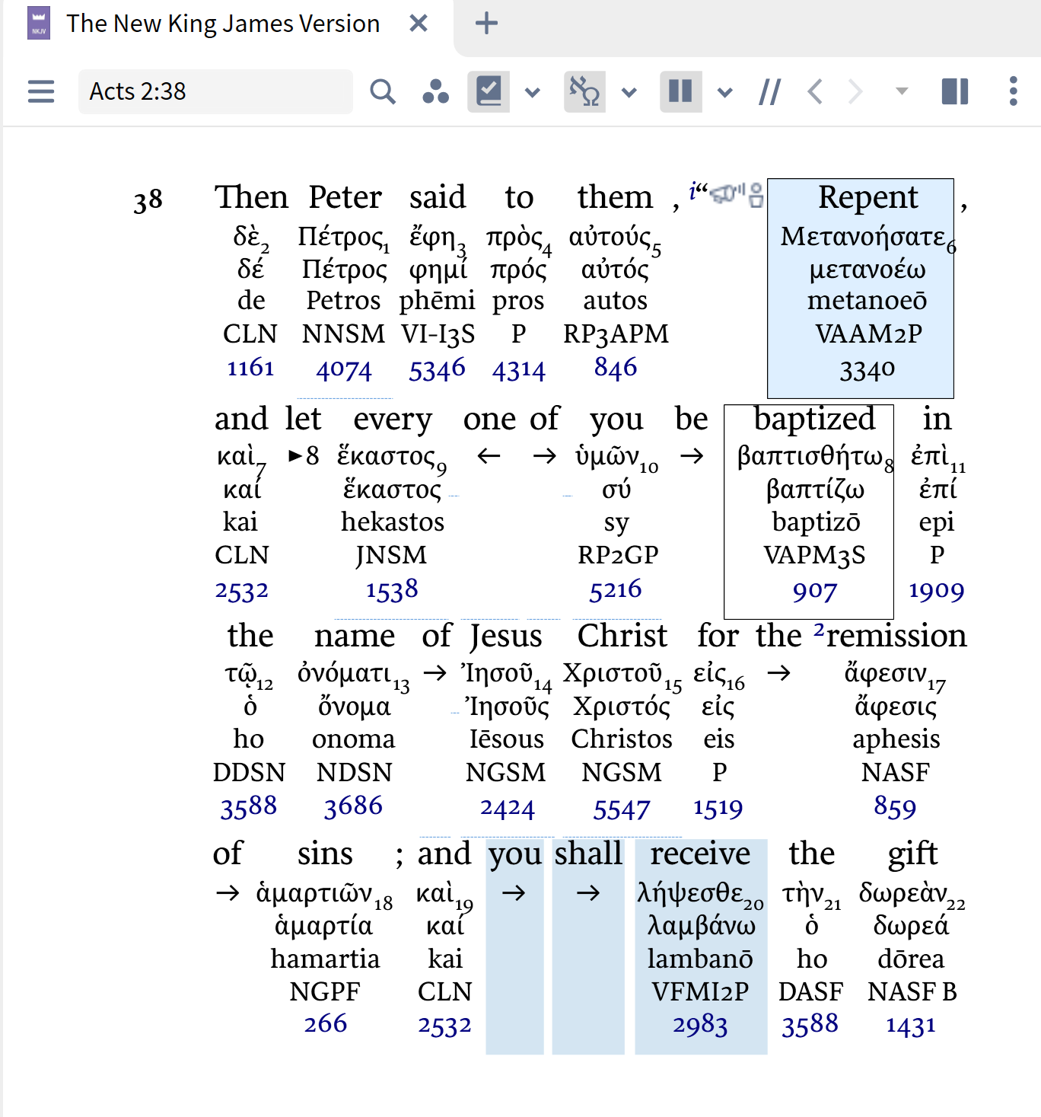
An In-line
Interlinear

Slide 25
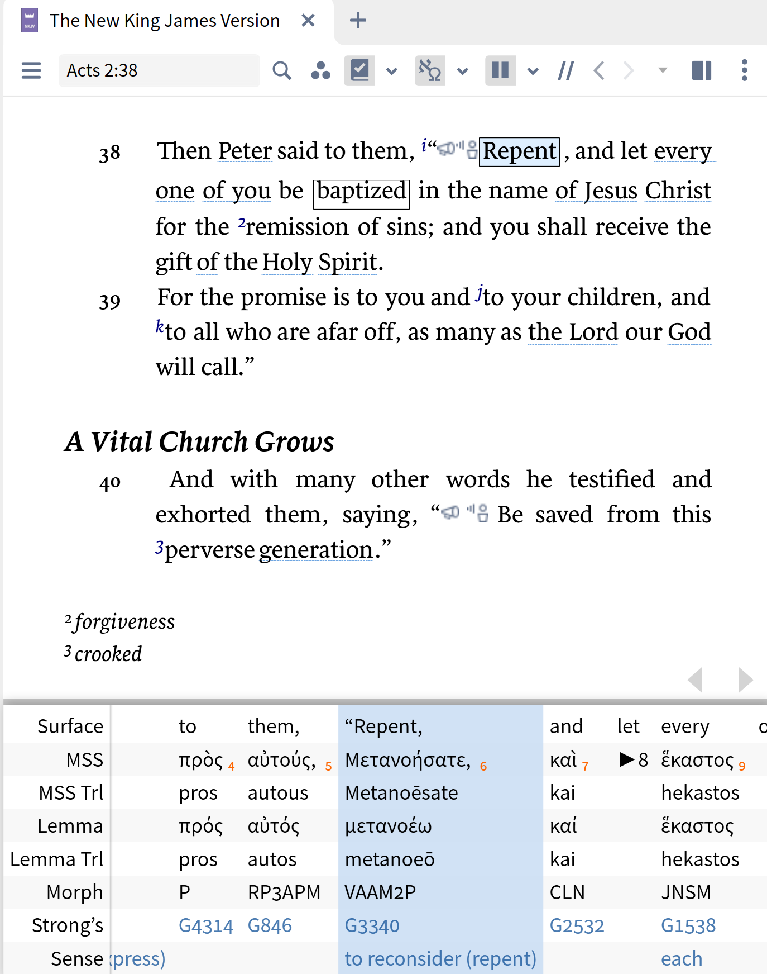
A Reverse
Interlinear

Slide 26
Hebrew / Greek Words
Clarification of Meaning
Enhancement of Understanding
How Do I Find the Original Word?
Examples

Slide 27
Examples
Hebrew Words
  Gen. 1:1 – “God” (Hebrew: Elohim) - used of gods, idols and Yahweh / “The word literally means ‘gods”….” (Lexham Theological Wordbook)
  Deut. 1:37 – “for your sake”

Slide 28
Comments at Deut. 1:37
“For your sakes; rather, because of you, on account of you. The Hebrew word (גָלָל) comes from a root meaning to roll, and signifies primarily a turn in events, a circumstance, an occasion or reason. Moses reminds the Israelites that the misconduct of the people was what led to God’s being angry also with him (see Numb. 20:7, etc.; comp. Ps. 106:32, 33)”
Pulpit Commentary (p. 18)

Slide 29
Examples
Hebrew Words
  Gen. 1:1 – “God” (Hebrew: Elohim) - used of gods, idols and Yahweh / “The word literally means ‘gods”….” (Lexham Theological Wordbook)
  Deut. 1:37 – “for your sake”
  Zeph. 1:12 – “settled in complacency” [BDB – “thicken, condense, congeal”

Slide 30
“Settled in complacency” (NKJV)
NKJV fn. “Lit. on their lees; like the dregs of wine”
ESV – “men who are complacent” fn. Hebrew are thickening on the dregs [of their wine]
KJV & ASV – “settled on their lees”
NASB95 – “Stagnant in spirit”
HCSB – “men who settle down comfortably”
NIV – “who are complacent who are like wine left on its dregs”
NRSV – “who rest complacently on their dregs”
NLT – “sit complacent in their sins”
Lexham – “Whose senses are dulled from drinking”
NET – “entrenched in their sins”
RSV – “thickening upon their lees”
YLT – “hardened on their preserved things”

Slide 31
I will punish the men who are thickening upon their lees: the Hebrew metaphor is drawn from the process of wine-making. When the wine has fermented, it has to be poured from one vessel to another to separate the wine from the sediment which is called lees. This process is described in Jeremiah 48:11. If this is not done, the wine becomes too sweet and spoils. The verb translated thickening means “condense” or “congeal.” The men who are thickening upon their lees are people who have enjoyed uninterrupted wealth for too long and have thus become “self-satisfied and confident” (tev). “Self-satisfied” can be rendered idiomatically in many languages; for example, “filled-up-breast-filled-up-heart.” “Confident” can be translated as “trusting in oneself completely.” Material prosperity has made such people forgetful of God and led them to say in their hearts that the Lord has no interest in them. In cultures where winemaking is a well-known process, one may be able to keep the Hebrew figure of speech. Otherwise, it will be better to follow the example of tev and use nonfigurative language.
Clark, D. J., & Hatton, H. A. (1989). A translator’s handbook on the book of Zephaniah (p. 156). New York: United Bible Societies.

Slide 32
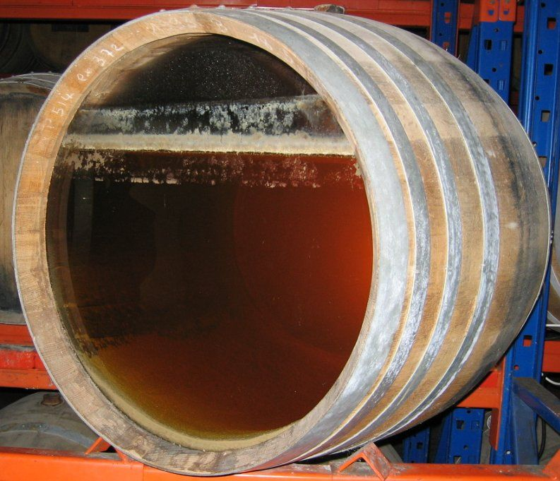
Lees / Dregs

Slide 33
Examples
Hebrew Words
  Gen. 1:1 – “God” (Hebrew: Elohim) - used of gods, idols and Yahweh / “The word literally means ‘gods”….” (Lexham Theological Wordbook)
  Deut. 1:37 – “for your sake”
  Zeph. 1:12 – “settled in complacency” [BDB – “thinken, condense, congeal”
  Josh 7:1 – “accursed” – devoted, banned goods
  Josh 1:8 – “meditate” – to growl, mutter to read in undertone
  Prov. 22:15 – “rod” – stick, branch, staff
  Gen. 3:1 – “cunning” – crafty – skill in deception

Slide 34
Examples
Hebrew Words
Greek Words
  Rom. 8:19 – “earnest expectation” – Vine’s: outstretched head
  1 Cor. 7:15 – “bondage” – not same word for bond of marriage – means enslaved
  Titus 2:15 – “despise” – disregard, go around, overlook

Slide 35
Hebrew / Greek Words
Clarification of Meaning
Enhancement of Understanding
How Do I Find the Original Word?
Examples

Slide 36
1 Cor.5:11; 2 Thess. 3:14 – What does it mean to keep “company”?

Slide 37
“Not to keep company”
  Translations:
    “Company” (KJV; ASV; NKJV; MEV; YLT)
    “Associate” (ESV; NASB; RSV; NIV; NET; NCV; Footnote NJKV)
    “Not to mix with" (LBP, v. 9; Darby)
  Defined:
    Strong’s: “4874….from 4862 and a comp. of 303 and 3396; to mix up together, i.e. (fig.) associate with:—(have, keep) company (with)”
    Thayer: “to mix up together”
    Vincent: “The word is compounded of σύν together, ἀνά up and down among, and μίγνυμι to mingle. It denotes, therefore, not only close, but habitual, intercourse.”
    Lenski: “Mix yourselves - up – with”
    Vine’s: “to mix up with” (sun, “with,” ana, “up,” mignumi, “to mix, mingle”), signifies “to have, or keep, company with,”
The Meaning of “Company”

Slide 38
“Not to keep company”
“Not even to eat”
  Not referring to the Lord’s Supper
    How could the faithful keep the unfaithful from partaking of LS?
    The association forbidden here – is permitted with the world (v. 10) – is that the LS?
    Part of “keeping company” – thus a common meal
  Just one part of “company”
The Meaning of “Company”

Slide 39
“Company” Involves More Than Eating
Visit (Social)
Shop With…
Play Games
Eat
Company
(General)
Eating is just one specific of company!
Eating shows some degree of approval
(Gal. 2:11-14)

Slide 40
John 2:1-11– What does the word “wine” refer to? Is it fermented or is it unfermented?
Word “wine” can mean fermented or unfermented

Slide 41
“Wine”
(Greek: Oinos)
Fermented
(Alcohol Content)
Eph. 5:18
“drunk with wine”
Unfermented
(No Alcohol Content)
Matt. 9:17
Mark 2:22
“new wine in new
bottles”

Slide 42
John 2:1-11– What does the word “wine” refer to? Is it fermented or is it unfermented?
Word “wine” can mean fermented or unfermented
If justifies social drinking (alcohol) – it justifies excessive drinking

Slide 43
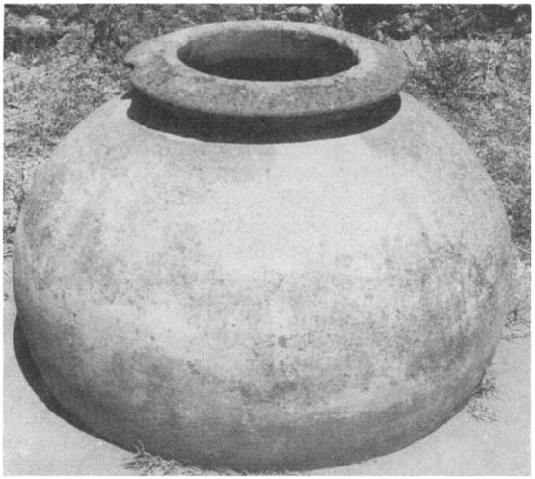
If justifies “moderate” drinking – would justify “heavy” drinking
6
Waterpots
20-30
Gallons ea.
120-180
Gallons
X
=

