Slide 1
Bible Hermeneutics
Tonight’s Lesson:
Introduction
Inductive Bible Study
The Basics
January 4, 2023

Slide 2
Galatians 1:6–7 (KJV)
⁶ I marvel that ye are so soon removed from him that called you into the grace of Christ unto another gospel:
⁷ Which is not another; but there be some that trouble you, and would pervert the gospel of Christ.

Slide 3
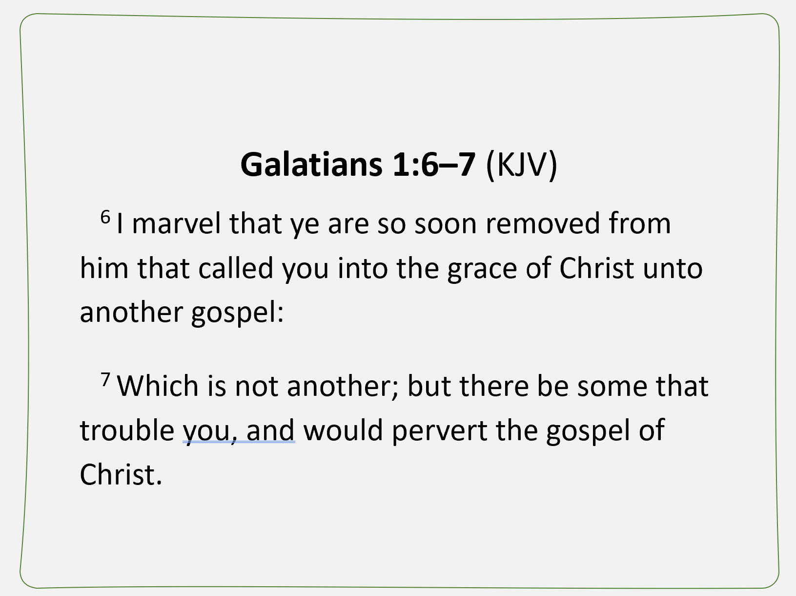
Snapshot of
“How We Study”
Read & reread text repeatedly
See what it meant to 1st recipient
Note what we learn from text
Compare translations
Check meaning of words
Benefit from what “others” found
That is what is involved in “Hermeneutics”

Slide 4
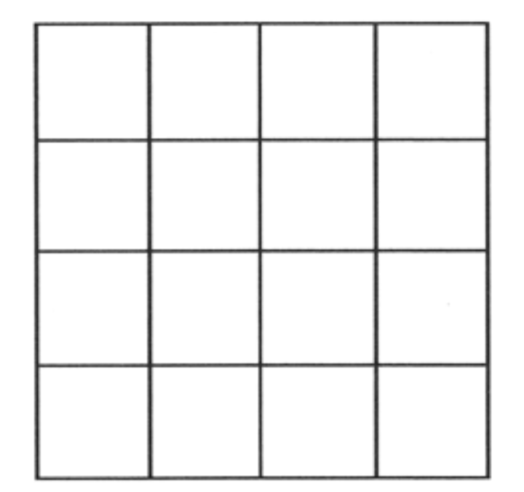
How Many Squares Do You See?
Richard Hayhue, How to Study the Bible

Slide 5
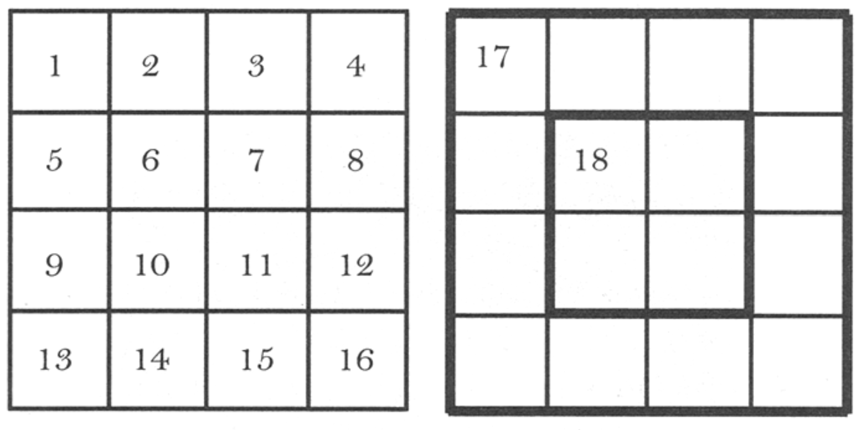
Richard Hayhue, How to Study the Bible

Slide 6
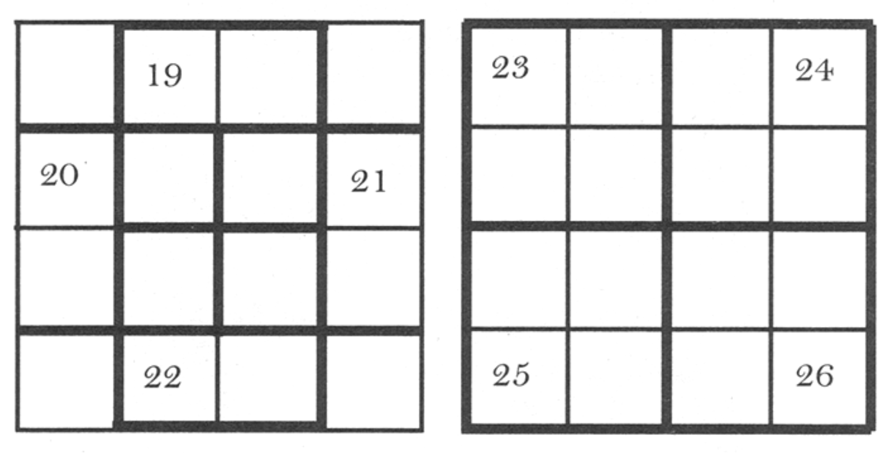
Richard Hayhue, How to Study the Bible

Slide 7
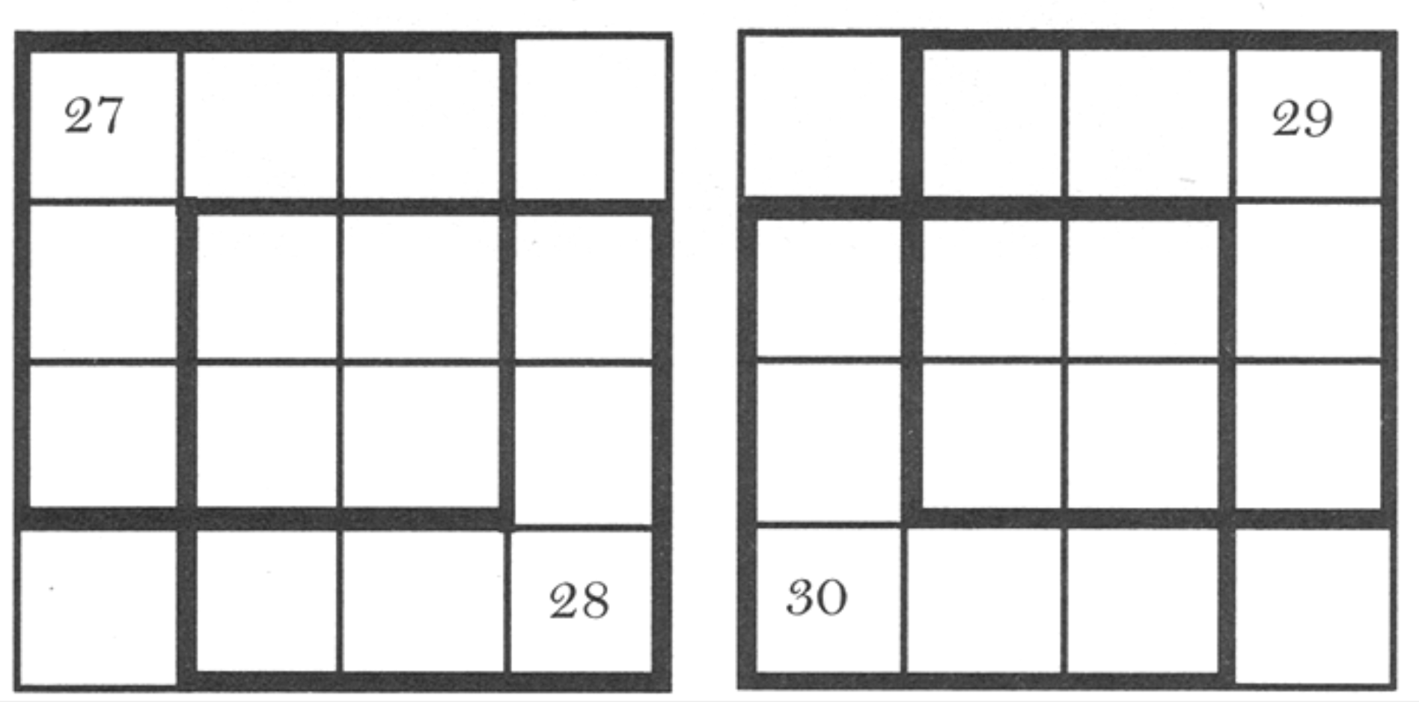
The More You Look – The More You See
With More Study, We See Things We Didn’t See Before
Richard Hayhue, How to Study the Bible

Slide 8

Point: You master the Bible by reading the Bible!
Preacher met a “layman” who seemed to have peace like he has not seen. When asked how – the man replied by reading Ephesians. Read it over and over in one setting – then again and again.
Read the Bible (just read)
Read it continuously (in single setting / ignore divisions)
Read repeatedly (goal: 50 times)
Read independently (of comments)

Slide 9
Bible Study - Challenge
Read 1,2 & 3 John
At least 50 times
by the end of April
Can be read in 15 minutes
With each reading you will see more
May try another translation a few times
Take note of key concepts / words / contrast

Slide 10
Introduction
Inductive Bible Study
The Basics
What is Hermeneutics?

Slide 11
What is Hermeneutics?
Simply put: The science of interpretation
  From Hermes (Greek Mythology) = messenger of the gods and interpreter of Jupiter (Dungan, 1)
  “Hermeneutics properly begins, and aims to establish the principles, methods, and rules which are needful to unfold the sense of what is written.” (Terry, 19)
  “In contemporary theological discourse the term ‘hermeneutics’ usually refers to the interpretive interaction set up by reason of the historical distance which intervenes between ourselves and the originating events on which the Christian faith depends.” (Hughes, 3)
  We all use “hermeneutics” in daily conversation

Slide 12
What is Hermeneutics?
Simply put: The science of interpretation
Exegesis
  “Exegesis (from ex, out, and egeisthas, to guide or lead), means to lead out. It is the application of the principles of hermeneutics in bringing out the meaning of any writing which might otherwise be difficult to understand.” (Dungan, 1)
  “…we should not fail to note that a science of interpretation must essentially depend on exegesis for the maintenance and illustration of its principles and rules.” (Terry, 20)

Slide 13
What is Hermeneutics?
Principles / Rules
Used to Interpret the Text

Slide 14

We Must be Taught &
We Must Learn
How to Study the Bible
“ We don’t need to be taught how to study or understand the Bible.”
Taught how to pray (Luke 11:1)
Need someone to guide us in understanding (Acts 8:31)
Need to give the sense –meaning (Neh. 8:8)
However, Bible was not written for scholars, but for everyone

Slide 15
Jan. 4 – Introduction to Inductive Bible Study
Jan. 11 – Background – Intro Information
Jan. 18 – Context
Jan. 25 – Context
Feb. 1 – Outlining the Text
Feb. 8 – Outlining the Text
Feb. 15 – Bible Study Aids
Feb. 22 – Use of Translations
Mar. 1 – Words
Mar. 8 – Hebrew / Greek Words
Mar. 15 – Hebrew / Greek Words
Mar. 22 – Use of Commentaries
Mar. 29 – Figurative Language
Apr. 5 – Figurative Language
Apr. 12 – Apocalyptic Literature & Numbers
Apr. 19 – Hebrews and Hermeneutics
Apr. 26 – Application / Practical Lessons
Bible Hermeneutics

Slide 16
Introduction
Inductive Bible Study
The Basics
What is Hermeneutics?
Inductive Bible Study

Slide 17
Inductive Bible Study
Defined
  “…seeks to discover the facts and details in a text and to draw conclusions about the meaning of a text from those observations” (West, 27)
  Simply put: Seeing what the text says and meant to original audience – then making application today

Slide 18
Deductive
Bible Study
Start with concept
and DEDUCE
that is in the text
Inductive
Bible Study
Look to the text
and let it
INDUCE
your understanding
“Spot verse”
Bible Study
Study various topics scattered through
a chapter

Slide 19
Inductive Bible Study
Defined
What it involves:
  Observation
  Interpretation
  Application

Slide 20
Observation
What does it say?
Read, Read, and Read the Text
This is not interpreting – just observing – gathering facts
Looking for:
  Who?
  What?
  Where?
  When?
  Why?
  How?
Watch for:
  Words repeated multiple times in a passage
  Anything that can be grouped together (list)
  Words that indicate a change in topic or time
  Any indication of reason (“for”) or cause and effect
  Any contrast

Slide 21
“…most read their Bibles like cows that stand in the thick grass, and trample under their feet the finest flowers and herbs.”
— Martin Boos

Slide 22
Interpretation
What does it mean?
Often start here – before observation
Historical:
  What is the cultural /or historical setting of this passage?
  What do I know about author & recipient(s)?
Context:
  What is the immediate context?
  What is the broader context?
Compatibility:
  Are there other passages that help with this one?
  Does my interpretation contradict other passages?
Textual:
  Am I making any assumptions?
  Let key words guide you: therefore, and, but, that, for, because, and if
Literal: What is the clearest meaning?

Slide 23
Application
What does it mean to me?
“We are not just trying to get through the Bible; we’re letting the Bible get through us.” (West, 36)
Would include:
  Promise – need to believe
  Command – need to obey
  Warning – need to heed
  Example – need to follow
  Doctrine – need to accept
Look for practical lessons

Slide 24
The Text Has Boundaries
The Text Has Limitations
Text cannot mean anything and everything
“Any word, any text, any statement which is not nonsense has somewhere a ‘boundary’ to its meaning.” (Hughes, 119)
There is only one meaning: what the original author intended
“Each verse of scripture has only one intended meaning even though there may be many applications. The Bible isn’t written to mean different things to different people. The issue in every verse is always what God means by it, not what it means to me.” (West, 23)

Slide 25
Introduction
Inductive Bible Study
The Basics
What is Hermeneutics?
Inductive Bible Study
How & Where Learn

Slide 26
How & Where Learn
This / other studies of hermeneutics
Every sermon & every class
  Every textual study uses and demonstrates hermeneutics
  Conclusions are driven by evidence provided
  Why are we not learning the principles of hermeneutics? We often listen for the conclusion & pay little or no attention to the evidence!

Slide 27
Introduction
Inductive Bible Study
The Basics
What is Hermeneutics?
Inductive Bible Study
How & Where Learn
The Basics

Slide 28
The Basics
The Text (Read, Read, & Read)
Check Translations
Word meaning
Structure / Thought Patterns
What Did This Mean to Original Audience?
  Look at this before application to us
  If the writer were here, would he recognize and give approval to your conclusion, interpretation and application?
Application

Slide 29
Two Levels Going Throughout
Basic Level
Deeper Dives

Slide 30
Introduction
Inductive Bible Study
The Basics
What is Hermeneutics?
Inductive Bible Study
How & Where Learn
The Basics

