Slide 1
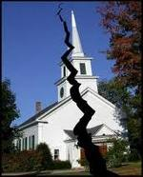
Divisions Within
The Church of Christ

Slide 2
Divisions Within The Church of Christ
April 5 – “Bible Authority – the Heart of all the Issues”
April 12 – “Division in the 1800’s – The Missionary Society”
April 19 – “Division in the 1800’s – Instrumental Music”
May 3 – “First of the Institutional Issues – The College in Church Budget”
May 10 – “The Major Dividing Issue – The Orphan Homes”
May 17 – “A Secondary Dividing Issue – The Sponsoring Church”
May 24 – “A Minor, but Real Issue – Limited Benevolence”
June 14 – “The Social Gospel – Clarifying Distinctions
June 21 – “The Social Gospel – What Builds Faith and Edifies”
July 5 – “The Social Gospel – The Many Faces of the Social System”

Slide 3
Divisions Within
The Church of Christ
Lesson # 10
The Social Gospel
The Many Faces of the Social System

Slide 4


A Great Shift
Spiritual
Social

Slide 5
Social Gospel – Many Faces
I. Institutional Churches – Emphasized Social
I. Institutional Churches – Emphasized Social

Slide 6
Institutional Churches
Emphasized Social
When the dust settled on division
  Church support of Colleges / homes (orphans, aged)
  Private schools / Day-care
  Fellowship halls / multipurpose buildings
  Bus ministries
  Gyms / ball teams
  Church dinners / kitchens
  Church camps / school camps (sponsored by the church)
  “Gimmicks” to draw crowds

Slide 7
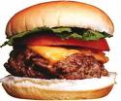





Institutional Churches
Emphasized Social
When the dust settled on division
Early forms focused on food and fun

Slide 8
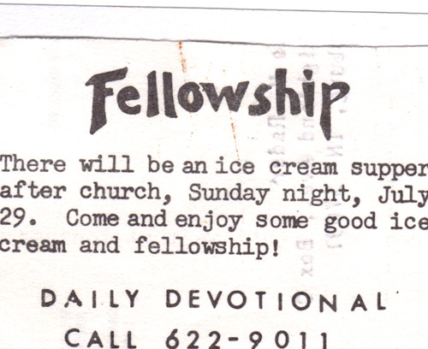
Ridgedale Church of Christ
Chattanooga, TN

Slide 9
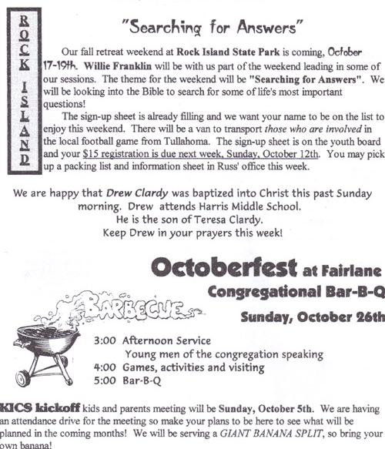
10-01-97

Slide 10
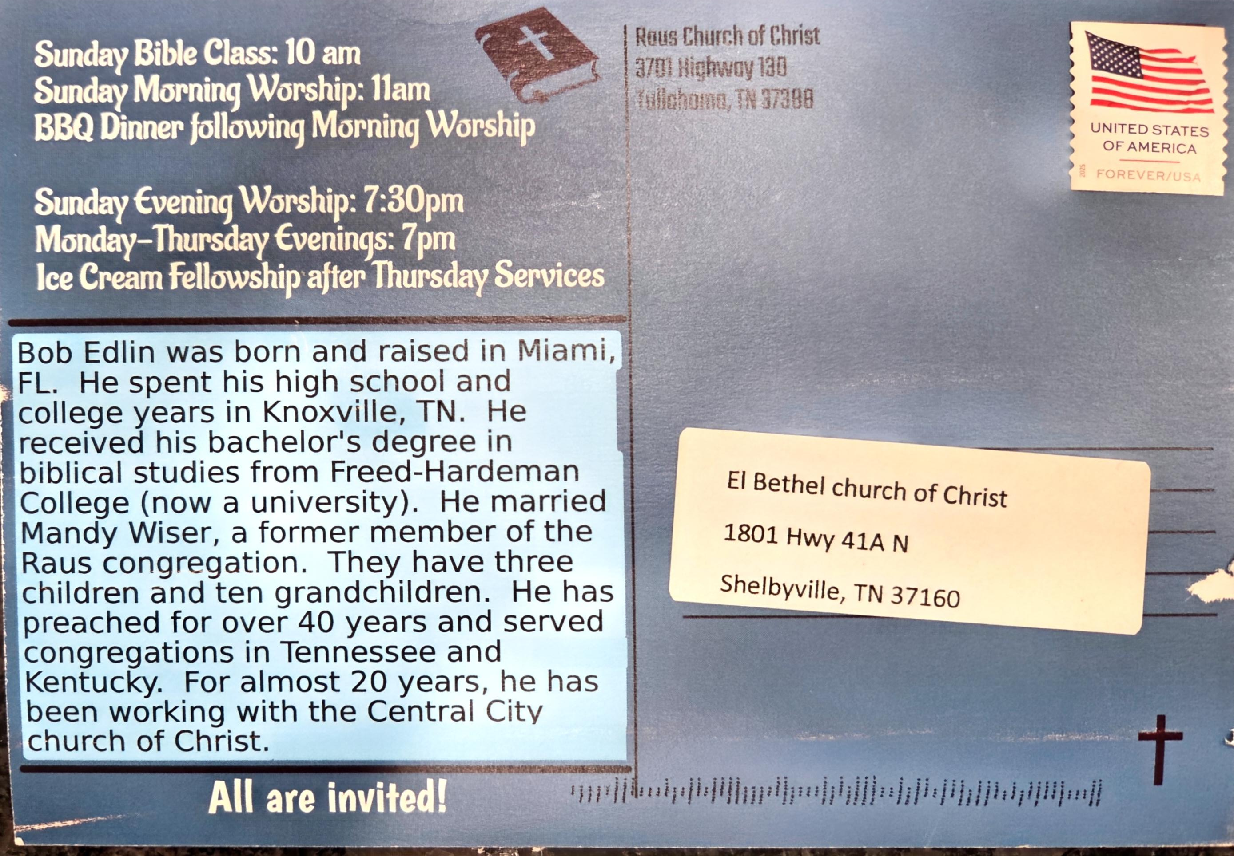

Slide 11
Institutional Churches
Emphasized Social
When the dust settled on division
Early forms focused on food and fun
Soon expanded to “anything goes”

Slide 12
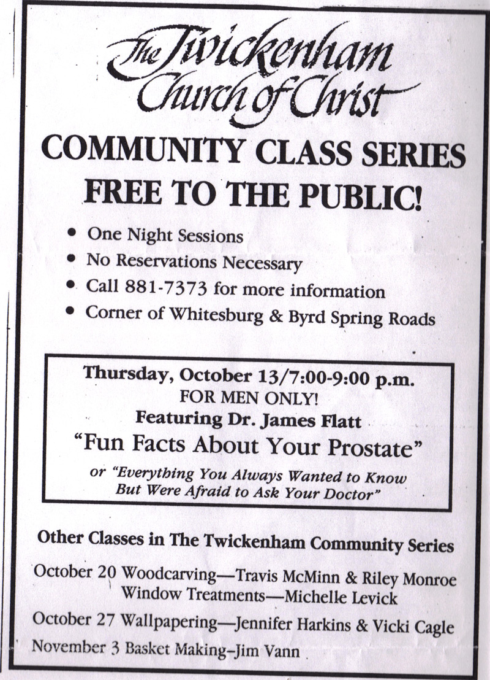

Slide 13
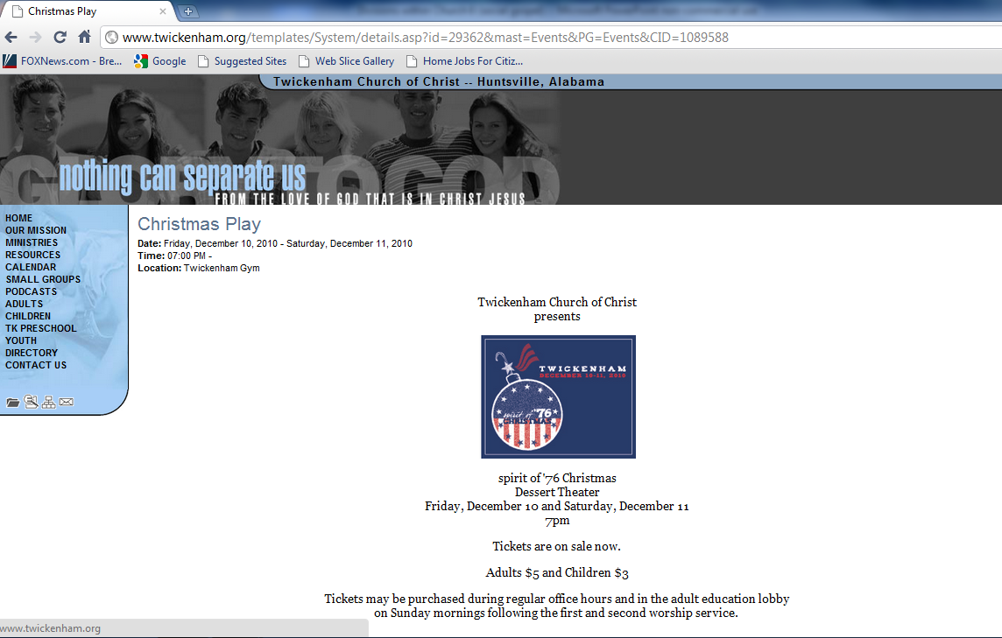

Slide 14
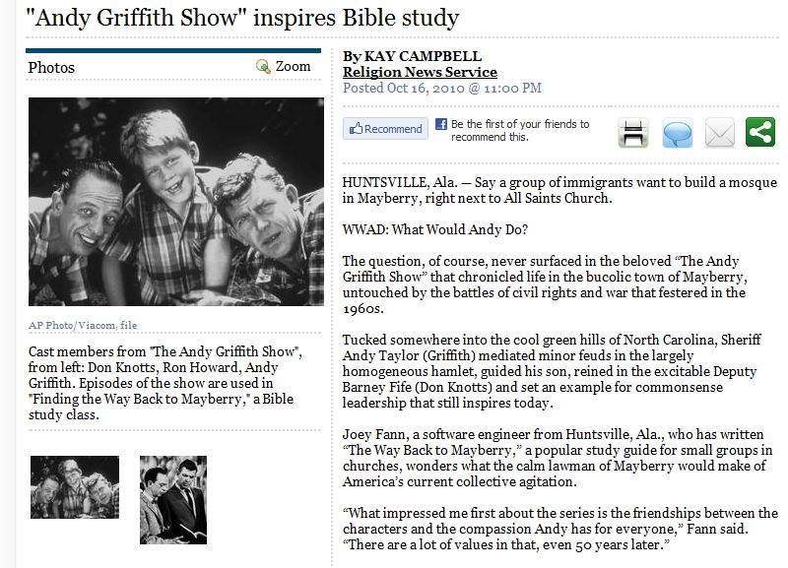

Slide 15
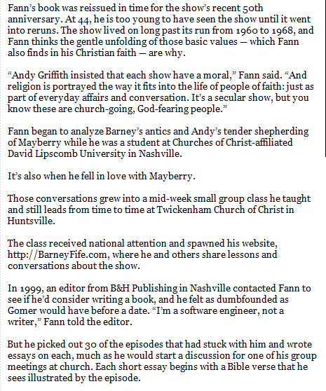


Slide 16
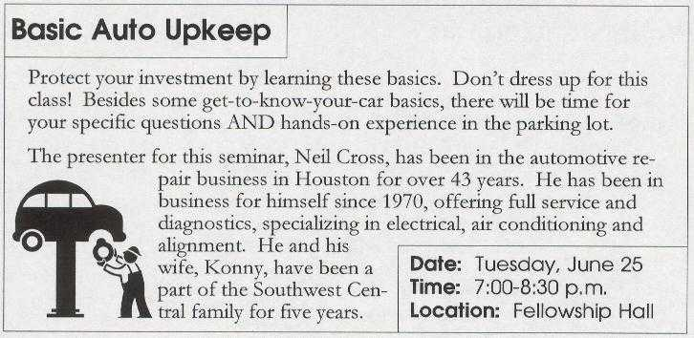
Southwest Central Church
(Houston, TX)

Slide 17
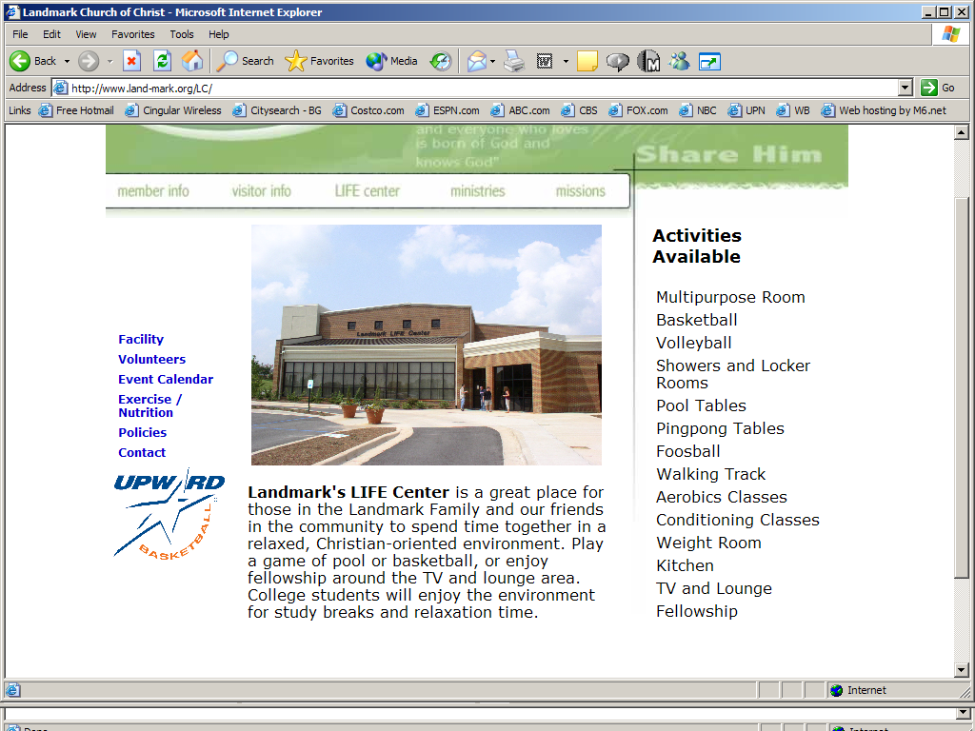
Issues that Separate Us Now

Slide 18
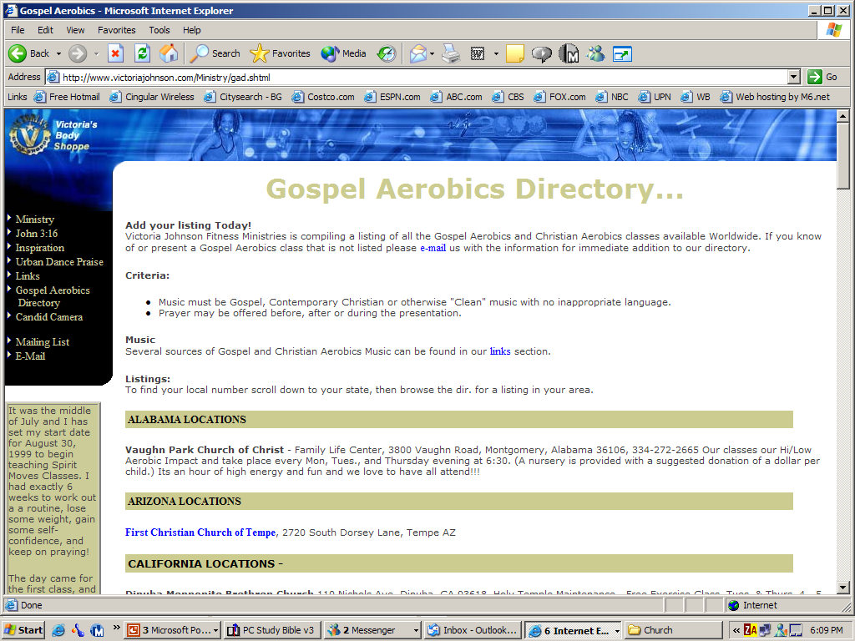

Slide 19
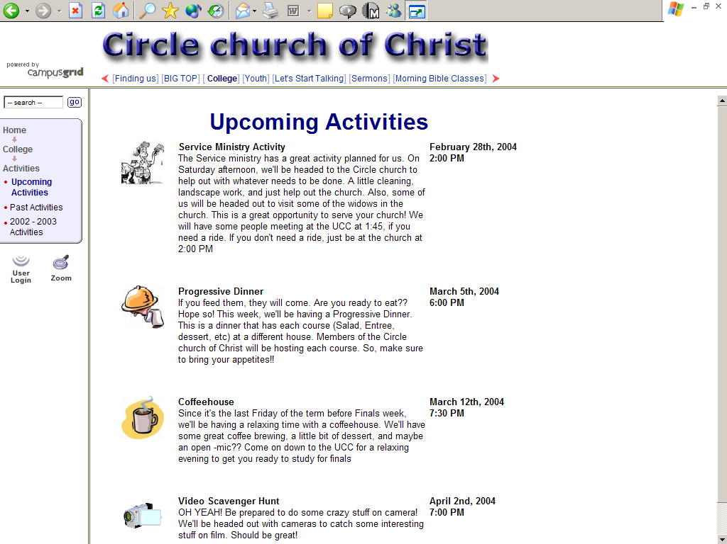
Issues that Separate Us Now

Slide 20
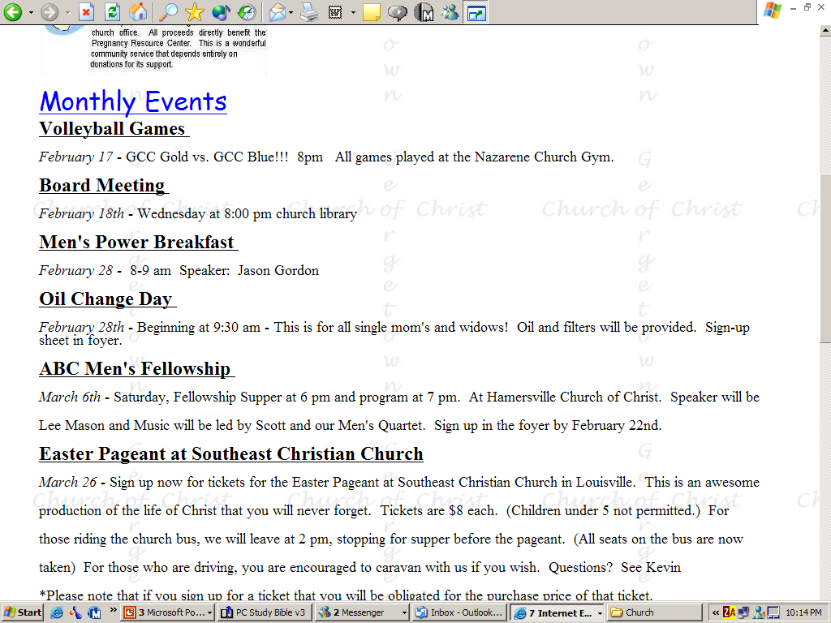
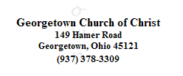
Issues that Separate Us Now

Slide 21
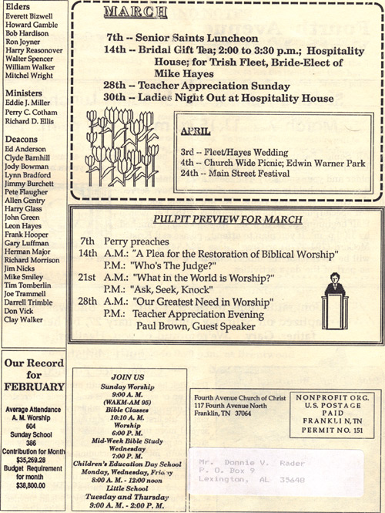

Slide 22
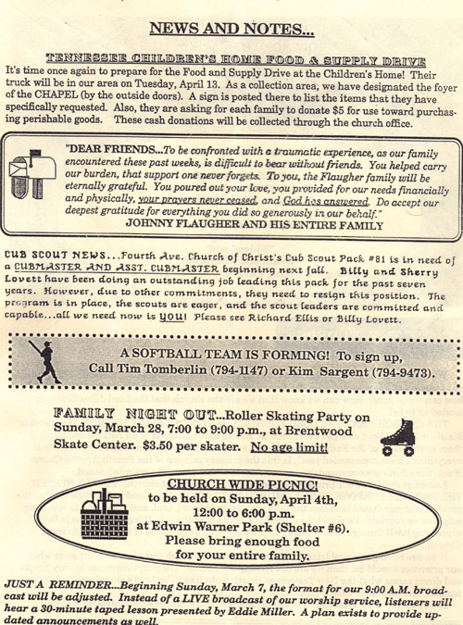
Fourth Ave
Franklin, TN

Slide 23
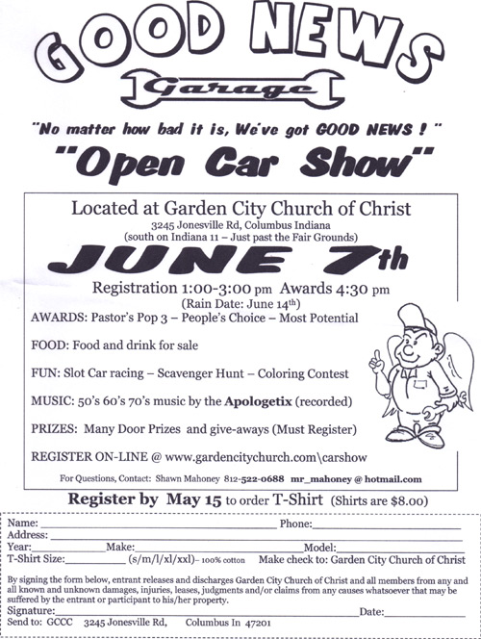

Slide 24
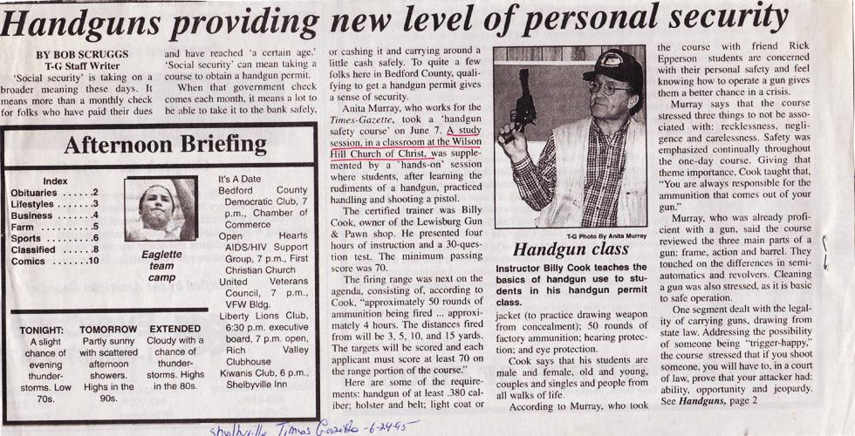

Slide 25

Southwest Central Church
(Houston, Texas)

Slide 26
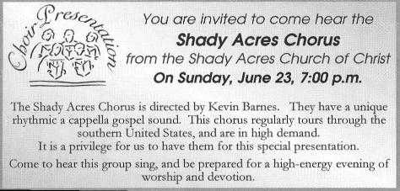
Southwest Central Church
(Houston, Texas)

Slide 27
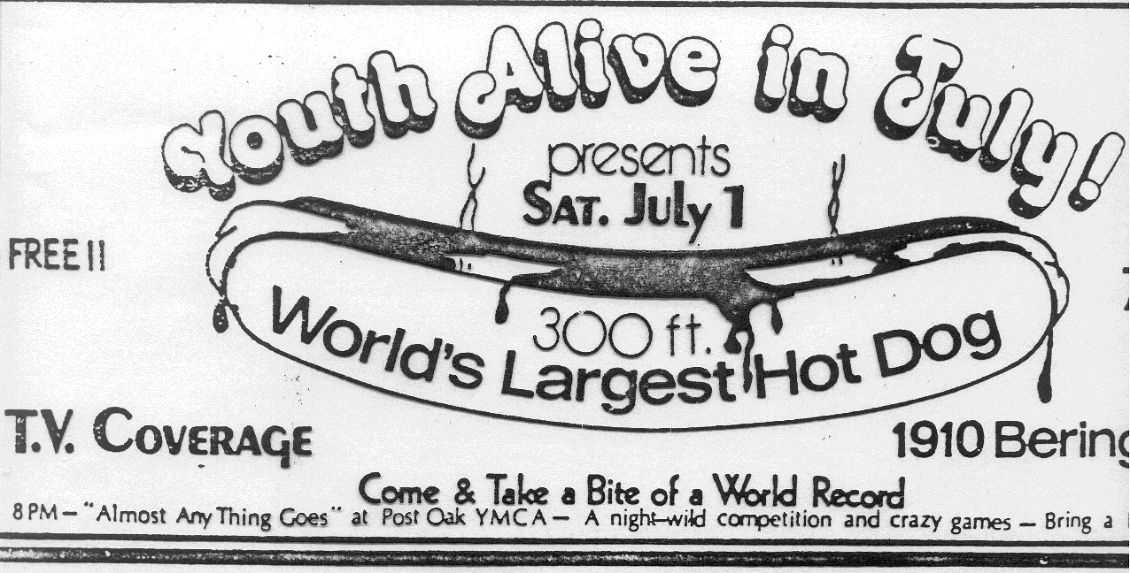
Bering Drive - Houston, TX

Slide 28
Social Gospel – Many Faces
I. Institutional Churches – Emphasized Social
I. Institutional Churches – Emphasized Social
II. Problems With the Social Gospel
II. Problems With the Social Gospel

Slide 29
Problems With the
Social Gospel
No Bible Authority
  There is no command
  There is no approved example
  There is no necessary inference
For the church to be involve in social and recreational activities.

Slide 30
Problems With the
Social Gospel
No Bible Authority
Not a Social Mission / Not a Social Message

Slide 31


Not a Social Order
Not a Social Gospel
The Church Is Not
A Social Order
Rom. 14:17
John 18:36
1 Pet. 2:5
The Gospel Is Not
A Social Gospel
John 6:26-27
Rom. 1:16-17
1 Cor. 1:18, 21;
2:2-5

Slide 32
Problems With the
Social Gospel
No Bible Authority
Not a Social Mission / Not a Social Message
Adding to the Work of the Church
  Church is authorized to engage in Evangelism (1 Tim. 3:15)
  Church is authorized to engage in Edification (Eph. 4:16)
  Church is authorized to engage in Benevolence (1 Tim. 5:16)
  Social and recreational activities is another work!

Slide 33
Social Gospel – Many Faces
I. Institutional Churches – Emphasized Social
I. Institutional Churches – Emphasized Social
II. Problems With the Social Gospel
II. Problems With the Social Gospel
III. Church Kitchen / Eating in the Building
III. Church Kitchen / Eating in the Building

Slide 34
Church Kitchen
Eating in Building
The issue

Slide 35
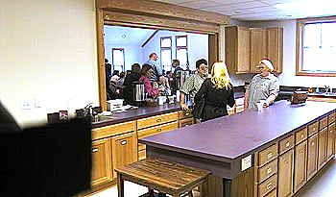
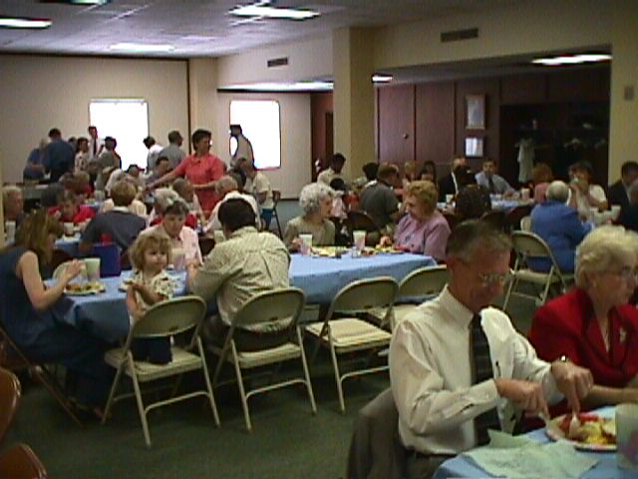
The Use of a
Church
Kitchen
Not Talking About:
A place to prepare LS
Place to wash LS trays
A place for taking care
of needy saints
Are Talking About:
Church providing a
place for meals for
social & recreational
purposes
Fellowship halls
Family Life Centers
Muti-Purpose blds

Slide 36

Eating In The Building
The Issue:
Was Not:
Is the bld sacred?
Can one eat inside
the Building?
Can one eat on
church property?
Was & Is:
Can the church
have a common
meal for social
and recreational
purposes?

Slide 37
Church Kitchen
Eating in Building
The issue
Common meals are individual matters

Slide 38
Common Meals – Individual Matters
1 Cor. 11
20 When ye come together therefore into one place, this is not to eat the Lord's supper.
21 For in eating every one taketh before other his own supper: and one is hungry, and another is drunken.
22 What? have ye not houses to eat and to drink in? or despise ye the church of God, and shame them that have not? What shall I say to you? shall I praise you in this? I praise you not.
More than an abuse of the Lord’s Supper!

Slide 39
Church Kitchen
Eating in Building
The issue
Common meals are individual matters
No authority for the church to engage in social / recreational activities

Slide 40
There Is No
}
Command
To authorize the church to arrange / support a common meal for social and recreational purposes
Example
Necessary
Inference
If there is, where is the passage?

Slide 41
Church Kitchen
Eating in Building
The issue
Common meals are individual matters
No authority for the church to engage in social / recreational activities
Not the work of the church

Slide 42
Work of the Local Church
Evangelism (1 Tim. 3:15)
Edification (Eph. 4:16)
Benevolence (1 Tim. 5:16)
Social / Recreation
(?? Where is the passage ??)

Slide 43
Aids Are Authorized Within The Command
Command | Aid
Eat Bread – 1 Cor. 11 | Table, plates …
Baptize – Matt. 28:19 | Baptistry, heater
Build an ark – Gen. 6:14 | Tool, Animal
Sing – Eph. 5:19 | Books, Tuner
Contribute – 1 Cor. 16 | Basket, Account
Meals for social & rec. purposes (???) | Kitchen, Fellowship Hall
Question:
Where is the
Authority?

Slide 44
A Church Kitchen
Is not the work of Evangelism
Is Not the work of Edification
Is Not the work of Benevolence

Slide 45
What About the “Love Feasts”?
Jude 12 & 2 Pet. 2:13
Little or no information about what they were
Little or no information about whether they were church sponsored or not
Assumption to say these were meals for social and recreational purposes – sponsored by the church

Slide 46
Church Kitchen
Eating in Building
The issue
Common meals are individual matters
No authority for the church to engage in social / recreational activities
Not the work of the church
Difference in incidentals and planned things

Slide 47
Incidental Matters
While at Building
Planned & Sponsored
By the Church
Talk about politics
Sell / deliver a sold item
Seek medical advice
Eating on property
Political rally
Church in business
Church hospital / clinic
Church kitchen / dinner

Slide 48
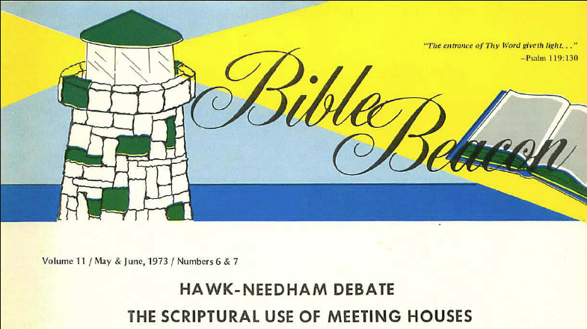
Written Debate
“The scriptures teach that the elders may call the church together to eat a common meal on church property, namely, in the church building or on church grounds when said meal is designed for social and/or recreational purposes.”
Ray Hawk, Affirmative
James P. Needham, Negative
For a PDF copy – email:
dvrader@live.com

Slide 49
Social Gospel – Many Faces
I. Institutional Churches – Emphasized Social
I. Institutional Churches – Emphasized Social
II. Problems With the Social Gospel
II. Problems With the Social Gospel
III. Church Kitchen / Eating in the Building
III. Church Kitchen / Eating in the Building
IV. How Far Some Progressives Have Gone
IV. How Far Some Progressives Have Gone

Slide 50
How Far Some Progressives
Have Gone
A rejection of authority – leads to greater rejection of authority
The issues / differences are different today

Slide 51
The Differences Now
Were:
Orphan Home
Sponsoring Church
Colleges
Are:
Orphan Home
Sponsoring Church
Colleges
Fellowship Halls
Social Programs
Involvement in…
Instruments of music
Women preachers
Notes:
Greg Tidwell (editor of Gospel Advocate) said there is not a single Bible Professor at Lipscomb that believes in the inerrancy of the Scriptures

Slide 52
How Far Some Progressives
Have Gone
A rejection of authority – leads to greater rejection of authority
The issues / differences are different today
Now issues of instrumental music / women preachers

Slide 53
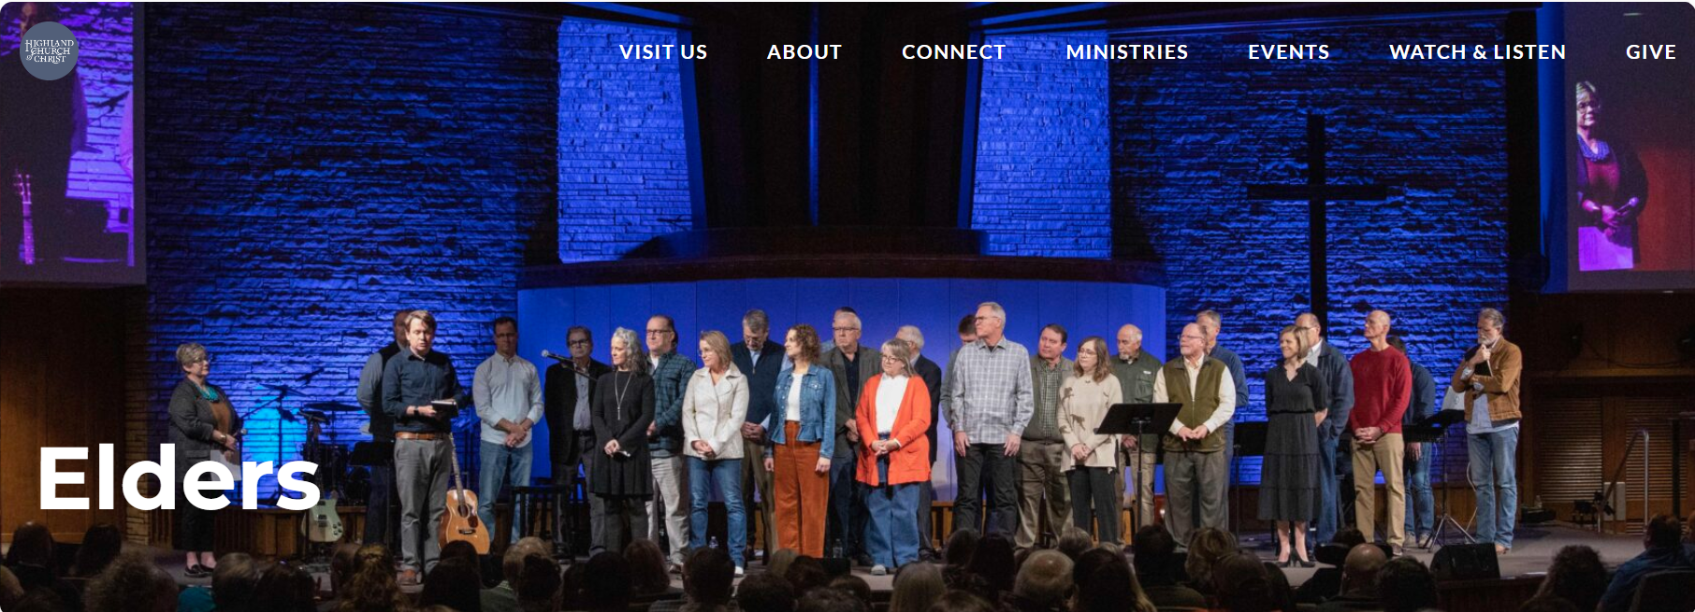
Highland Church of Christ
Abilene, TX
Women elders
Instrumental Music

Slide 54
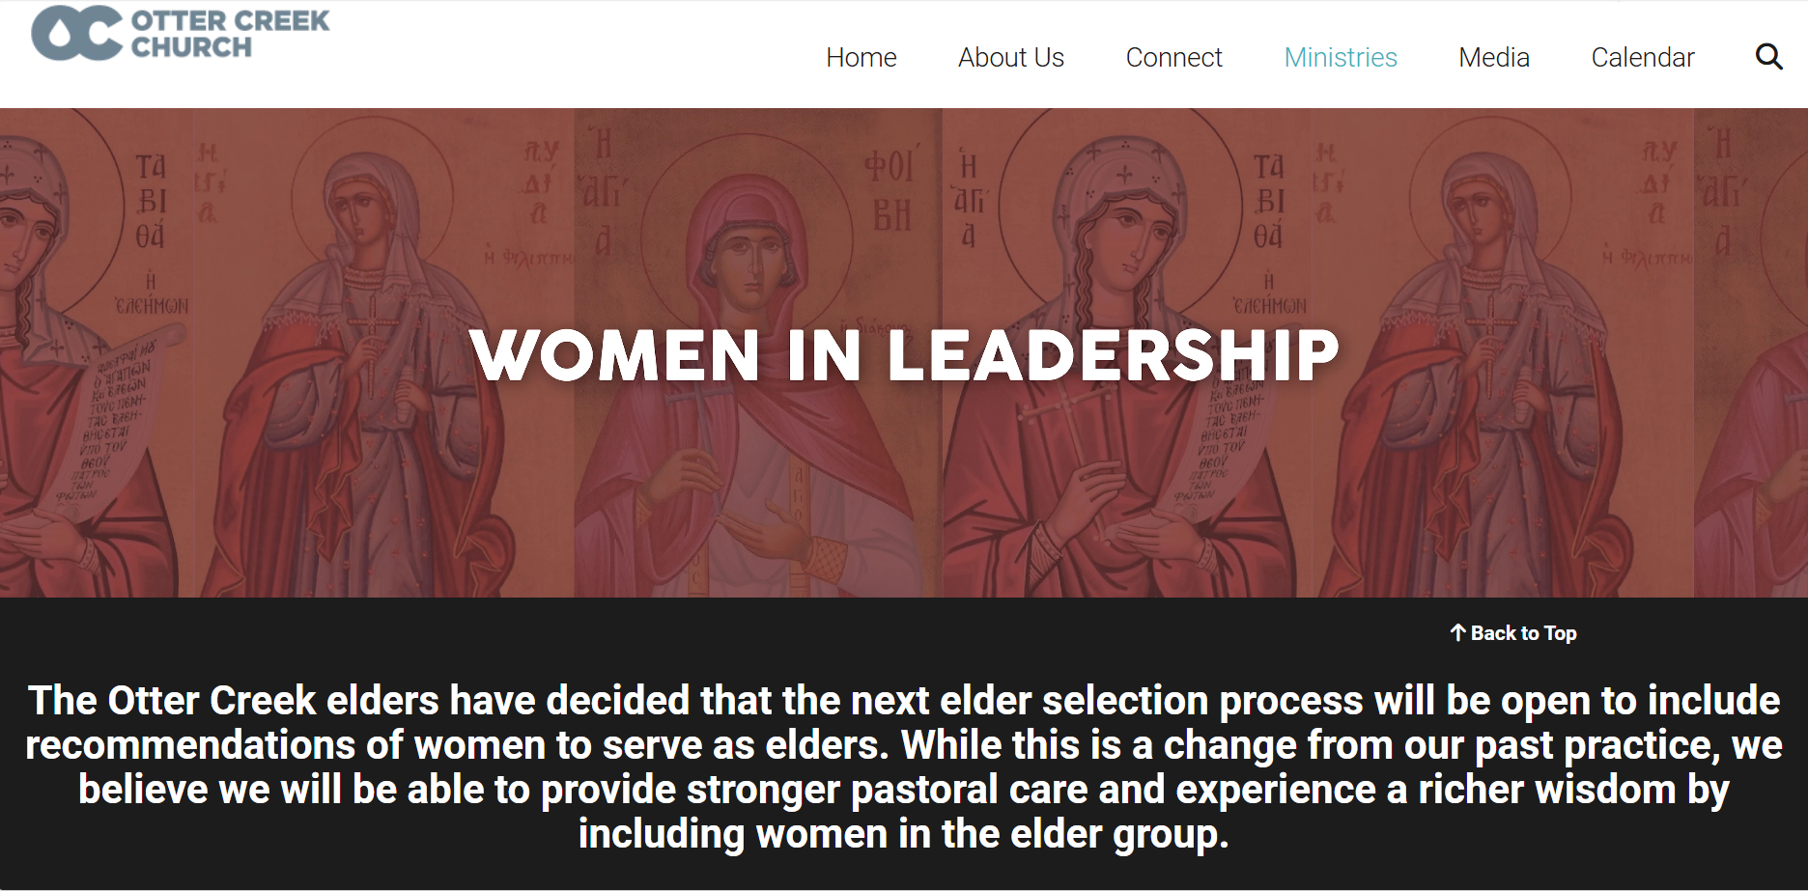

Slide 55
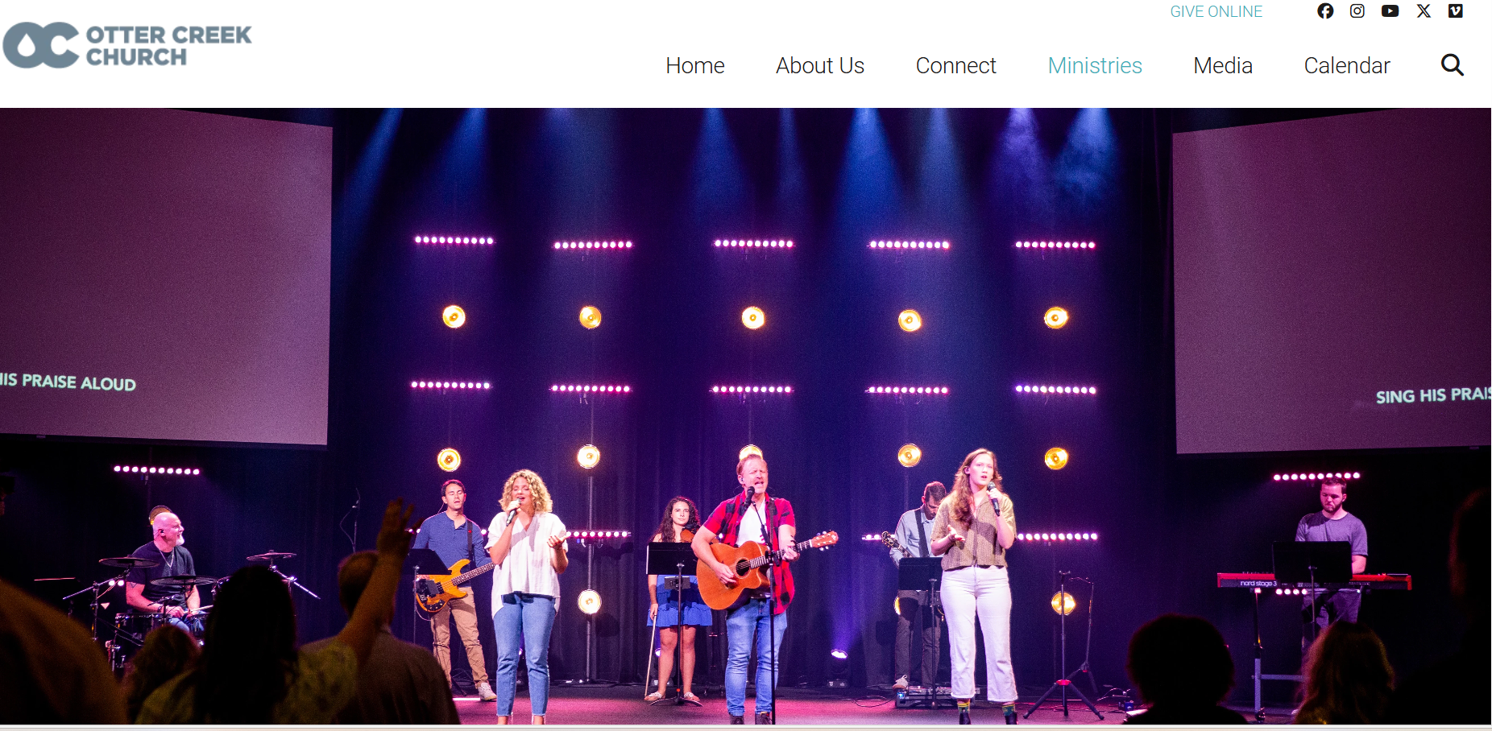

Slide 56

Trusting Women : The Way of Women in Churches of Christ
Author: Billie Silvey
Tells of the first women preachers among Churches of Christ
Katie Hayes – Preached at Cahaba Valley Church of Christ (Birmingham) – and West Islip Church of Christ (Long Island, NY)
Amy Henegar – Hospital chaplain preaches Sunday sermons
D’Esta Love (Chaplain of Pepperdine):
2002
“We are finding tools for the analysis of scripture which allow us to view the role of women in the larger context of the biblical witness, rather than allow two heavily disputed passages to relegate women to a silent role” (p. 130).

Slide 57
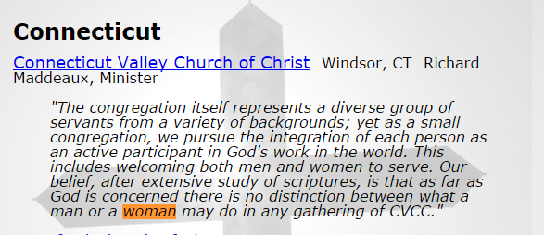
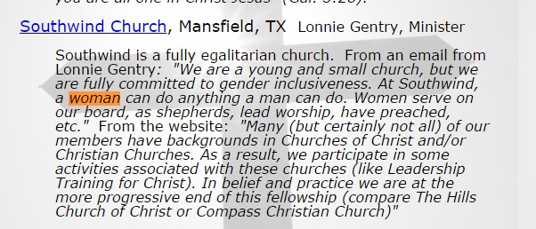
http://www.wherethespiritleads.org/gender_inclusive_churches.htm
Notes:
http://www.wherethespiritleads.org/gender_inclusive_churches.htm

Slide 58
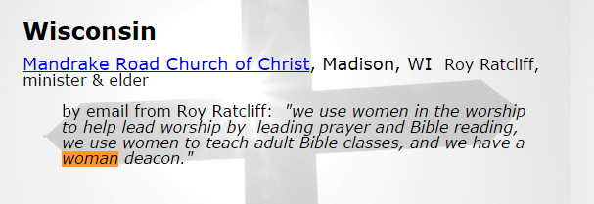
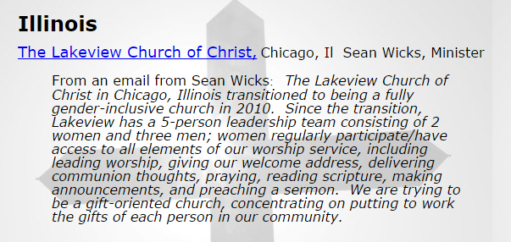

Slide 59
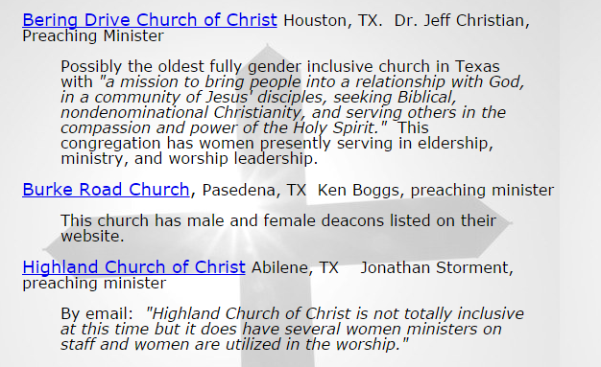

Slide 60
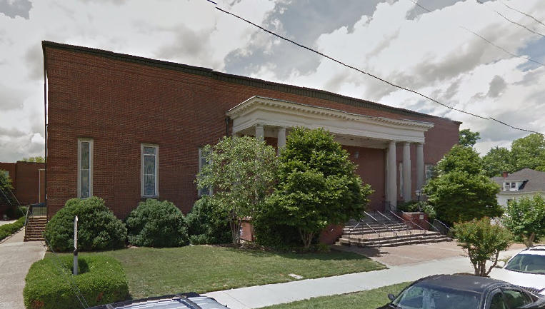
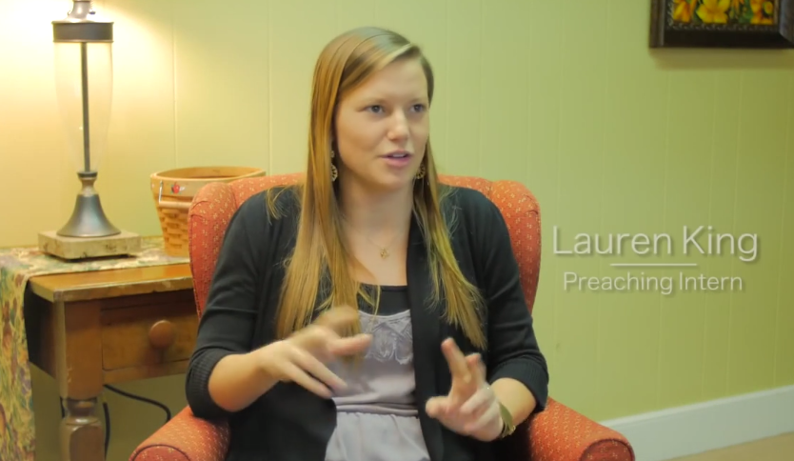
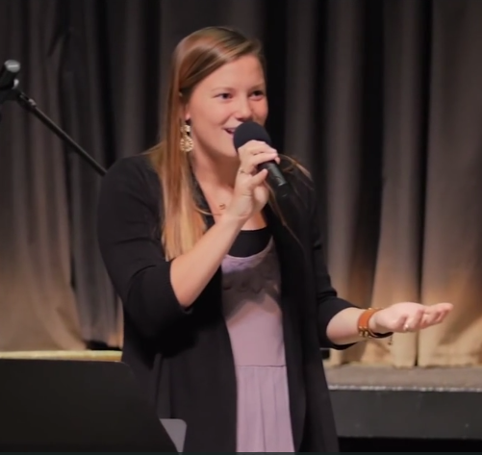
Fourth Ave. Church of Christ
Franklin, TN
Added a woman preacher (intern)
Dec. 2014
From Lipscomb University

Slide 61
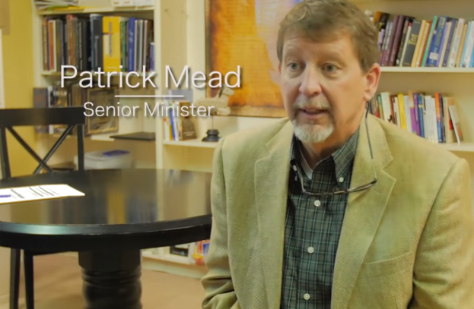
Argues that we do study Christ through Paul
We study Paul through Christ
Two passages were cultural.

Slide 62
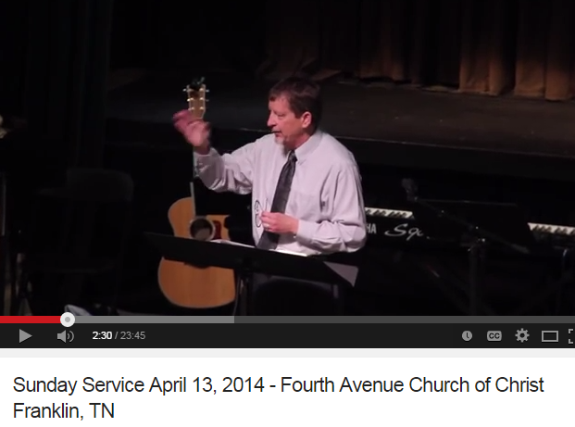

Slide 63
Social Gospel – Many Faces
I. Institutional Churches – Emphasized Social
I. Institutional Churches – Emphasized Social
II. Problems With the Social Gospel
II. Problems With the Social Gospel
III. Church Kitchen / Eating in the Building
III. Church Kitchen / Eating in the Building
IV. How Far Some Progressives Have Gone
IV. How Far Some Progressives Have Gone
V. Social Implications – Non-Institutional
V. Social Implications - Non-Institutional

Slide 64
Social Implications Among
Non-Institutional
Just because a church opposes institutionalism does not mean that there are not “liberal” / loose thinking there
Some non-institutional churches are failing to makes distinctions

Slide 65
Gospel Meeting
July 3-9
Speaker: John Doe
Time: Monday – Saturday 7:00pm
Sunday 9:00am; 10:00am & 6:00pm
123 Main Street
Somewhere, TN 37111
Saturday Fun For Teens
Volleyball, Softball
Pizza & Hamburgers
(at home of Jim Jones, 321 3rd St.)
* Not a work of the Main St. church

Slide 67
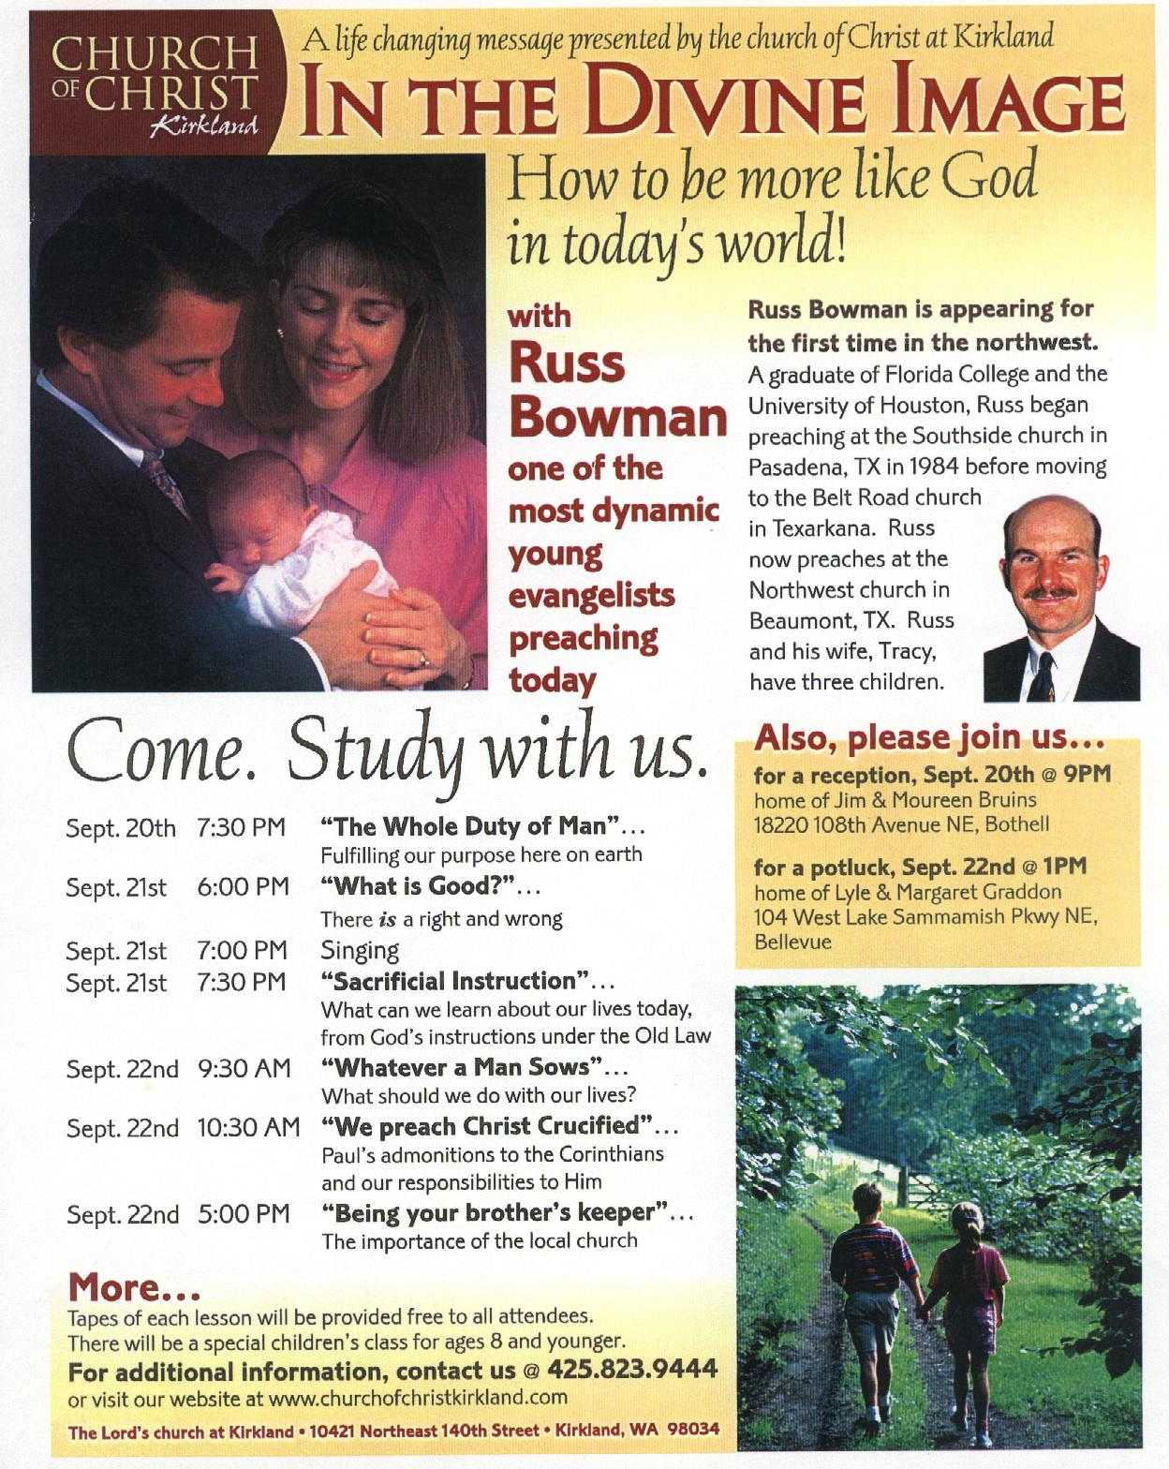

Slide 68


Slide 69
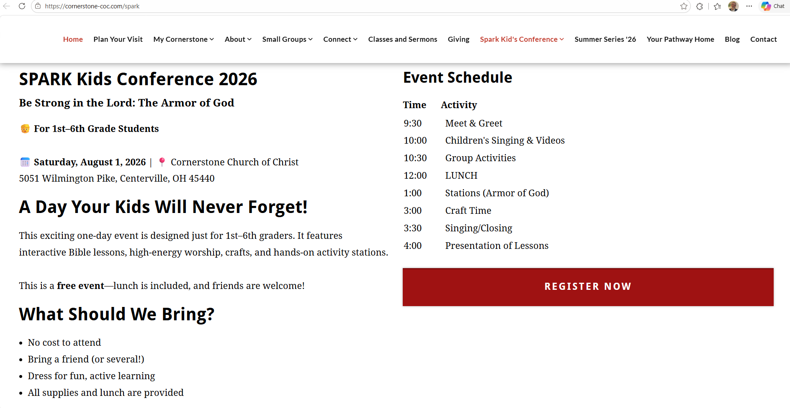

Slide 70
Social Implications Among
Non-Institutional
Just because a church opposes institutionalism does not mean that there are not “liberal” / loose thinking there
Some non-institutional churches are failing to makes distinctions
Danger:
The next generation will not know
the distinction!

Slide 71

Preach truth
No error
Not Deal with….
Non-Distinctive
Interesting speaker
Tells lot of stories
Preach truth
No error
Do Deal with….
Distinctive
Dry speaker
Gives a lot of scripture
Tolerate Sin
Tolerate Teachers of Error
Conservative Stand - Sin
Not Tolerate Teachers of Error
Social Activities
But not as much as others
Lot of Social Activities

Slide 72
Social Gospel – Many Faces
I. Institutional Churches – Emphasized Social
I. Institutional Churches – Emphasized Social
II. Problems With the Social Gospel
II. Problems With the Social Gospel
III. Church Kitchen / Eating in the Building
III. Church Kitchen / Eating in the Building
IV. How Far Some Progressives Have Gone
IV. How Far Some Progressives Have Gone
V. Social Implications – Non-Institutional
V. Social Implications - Non-Institutional

Slide 73
Divisions Within The Church of Christ
April 5 – “Bible Authority – the Heart of all the Issues”
April 12 – “Division in the 1800’s – The Missionary Society”
April 19 – “Division in the 1800’s – Instrumental Music”
May 3 – “First of the Institutional Issues – The College in Church Budget”
May 10 – “The Major Dividing Issue – The Orphan Homes”
May 17 – “A Secondary Dividing Issue – The Sponsoring Church”
May 24 – “A Minor, but Real Issue – Limited Benevolence”
June 14 – “The Social Gospel – Clarifying Distinctions
June 21 – “The Social Gospel – What Builds Faith and Edifies”
July 5 – “The Social Gospel – The Many Faces of the Social System”

