Slide 1
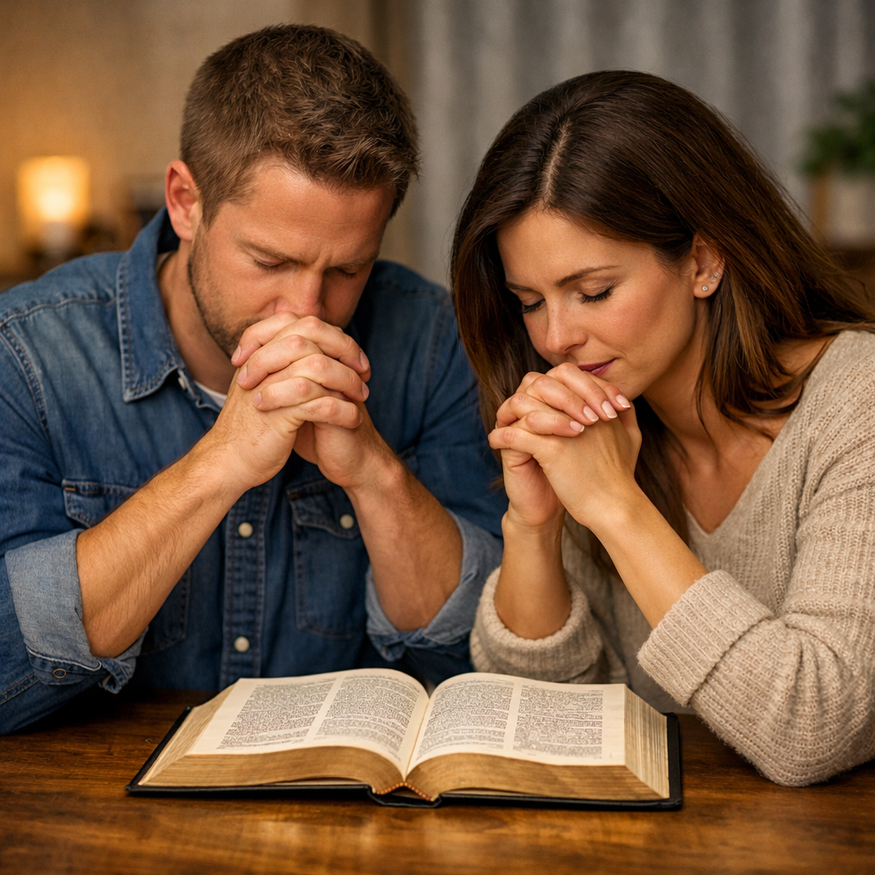
Every Religious Person
Has Some Interest in Prayer
Regardless of age
Regardless of gender
Regardless of spiritual strength
Regardless of abilities
Everyone “Prays”

Slide 2
There are many questions
people ask about prayer
What is prayer?
Why does God not answer my prayer?
Who can pray?
Must we kneel to pray?
Who can lead prayers for others?
How does God answer prayer?
Can we pray to Jesus?

Slide 3
Questions About Prayer
Lesson 1: The Basics of Prayer
Lesson 2: The Elements of Prayer
Lesson 3: God’s Answer to Prayer
Lesson 4: Misc. Questions About Prayer

Slide 4
The
Elements
of
Prayer
Questions About Prayer

Slide 5
The Elements of Prayer
For What Should We Pray?
Questions About Prayer

Slide 6
For What Should We Pray?
Definite things
  We sometimes pray in very general terms
    Making a request
    Giving thanks
    Praying for others
  We make specific request in dealing with people – likewise, we could be specific in praying to God (Luke 11:11-12)
  Elijah prayed that it would not rain – then prayed that it would (Jas. 5:17-18)
  Example: rather than pray for “all who are sick” – mention the sick by name

Slide 7
For What Should We Pray?
Definite things
Four elements in prayer
1 Timothy 2:1
Therefore I exhort first of all that supplications, prayers, intercessions, and giving of thanks be made for all men,

Slide 8
For What Should We Pray?
Definite things
Four elements in prayer
  Supplication
  Prayers
  Intercession
  Thanksgiving

Slide 9
Supplication
Asking a need, entreaty ■ Clarke: Request for averting of evil
Must ask to receive (1 John 5:15)
Pray for help in temptation (Matt. 6:13; Mark 14:38)
Pray for strength to overcome weakness and discouragement (Heb. 4:16)
Pray for our physical problems (Matt. 24:20; Jas. 5:13; Acts 12:5)
Request for protection and care through day or night (Matt. 24:20)
Many more things (Phil. 4:6)

Slide 10
For What Should We Pray?
Definite things
Four elements in prayer
  Supplication
  Prayers
  Intercession
  Thanksgiving

Slide 11
Prayers
Any discourse with God ■ Clarke: Request for good
Would include praise (Matt. 6:9, 13)
  Praised as the Almighty God (Rev. 4)
  Find expressions of praise in Isa. 40; Jer. 32; Rev. 4; the Psalms)
Ask for wisdom (Jas. 1:5)
Ask of forgiveness of sins (Acts 8:22)
Pray for furtherance of the gospel (2 Thess. 3:1; Col. 4:3)
Request the daily necessities (Matt. 6:9-13)
Pray for rain / weather (Jas. 5:16-18)
Pray God’s will be done (Matt. 6:10)

Slide 12
For What Should We Pray?
Definite things
Four elements in prayer
  Supplication
  Prayers
  Intercession
  Thanksgiving

Slide 13
Intercession
A plea to God on behalf of others
Can be more specific than, “pray for all for whom it is out duty to pray…”
  Lord prayer for Peter (Luke 22:32)
  Paul prayed for his brethren – specific (1 Cor. 1:4; Eph. 1:15-16; Phil. 1:3-5; Col. 1:3-9; 1 Thess. 1:2-3; 3:10-13; 2 Thess. 1:3, 11-12; 2:13-15)

Slide 14
Intercession
A plea to God on behalf of others
Can be more specific than, “pray for all for whom it is out duty to pray…”
Pray for brethren:
  For growth and development (Phil. 1:9; Col. 1:9; 1 Thess. 5:23; 2 Thess. 1:11; Col. 4:12; Eph. 6:18)
  When they have sinned or have a need (Jas. 5:16; 2 Thess. 3:1; 1 John 5:16; Acts 8:18-24)

Slide 15
Intercession
A plea to God on behalf of others
Can be more specific than, “pray for all for whom it is out duty to pray…”
Pray for brethren:
Pray for our enemies (Matt. 5:44-46; Acts 7:60; Luke 23:34)
Pray for rulers (1 Tim. 2:2)
  Doesn’t mean you agree or endorse
  Pray for their safety, wisdom in decisions they make

Slide 16
Intercession
A plea to God on behalf of others
Can be more specific than, “pray for all for whom it is out duty to pray…”
Pray for brethren:
Pray for our enemies (Matt. 5:44-46; Acts 7:60; Luke 23:34)
Pray for rulers (1 Tim. 2:2)
Pray for those that have not obeyed the gospel (Rom. 10:1)
Pray for the sick (Jas. 5:13-ff; 3 John 2)
Pray for elders and preachers (2 Thess. 3:1-2; Heb. 13:18)

Slide 17
For What Should We Pray?
Definite things
Four elements in prayer
  Supplication
  Prayers
  Intercession
  Thanksgiving

Slide 18
Thanksgiving
Expressing thanks for all blessings of life – physical and spiritual
We should be thankful (Col. 3:17; Phil. 4:6)
Endless list:
  Protection and care through the day or night
  Food (Acts 27:35; Luke 24:30; Matt. 15:36)
  Clothing
  House
  Money
  Transportation
  Modern conveniences (Heat, A/C, electricity, plumbing, appliances, etc.)
  Friends
  Brethren
  Family (parents, mate, children)

Slide 19
Thanksgiving
Expressing thanks for all blessings of life – physical and spiritual
  Remission of sins
  Sacrifice of the Christ – blood shed
  Hope of eternal life
  Clear conscience
  Mediator to plead our cause
  Revelation of the word (clarity & simplicity)
  Privilege of prayer
  Elders
  Deacons
  Freedom to worship and teach
  Things we need that are not pleasant (medicine, glasses, false teeth…)
  Even our trouble – produce patience & mature us
  Every blessing (Jas. 1:17)

Slide 20
The Elements of Prayer
For What Should We Pray?
When Should We Pray?
Questions About Prayer

Slide 21
When Should We Pray?
We should make time for prayer
  Should not pray only IF we have time for it
  Must MAKE time (schedule time) for prayer (Mark 1:35)
  Our “rat race” may make things too busy in the morning and too tired at night.
  We usually can make time to do what we WANT to do!

Slide 22
When Should We Pray?
We should make time for prayer
We should pray daily
  We ought to establish regular times for prayer
  David did – Psa. 55:16-17
  Daniel did – Dan. 6:10
  Millions of Muslims pray 5 times a day – surely, we can make some time for prayer!

Slide 23
When Should We Pray?
We should make time for prayer
We should pray daily
Pray when we are most alert
  Whatever time you choose – pick a time when you are most alert – to express your hearts desire to God (cf. Rom. 10:1)
  For some that might be in the early hours of the morning – for others late at night – even others in the middle of the day.

Slide 24
When Should We Pray?
We should make time for prayer
We should pray daily
Pray when we are most alert
We should pray always
  Pray without ceasing (1 Thess. 5:17)
  Praying always (Eph. 6:18)
  Men ought always to pray – connected with faith (Luke 18:1, 8)

Slide 25
The Elements of Prayer
For What Should We Pray?
When Should We Pray?
Where Should We Pray?
Questions About Prayer

Slide 26
Where Should We Pray?
We can pray anywhere
  Prayer is not some ritual that can only be done in a “sanctified” place
  We can pray anywhere at any time
  This is part of the beauty of prayer
  There are no restrictions about when and where we can approach God in prayer!
  No one can stop you!

Slide 27
Where Should We Pray?
We can pray anywhere
Jesus found a quiet solitary place to pray
  A place free from distractions (Mark 1:35)
  Went to the mountain to pray (Luke 6:12)
  Often went to Gethsemane (Luke 22:39)
  Find your place – in your environment that is your solitary place to pray
  Hard to concentrate in a noisy, crowded place – with many distractions

Slide 28
The Elements of Prayer
For What Should We Pray?
When Should We Pray?
Where Should We Pray?
Questions About Prayer

Slide 29
Questions About Prayer
Lesson 1: The Basics of Prayer
Lesson 2: The Elements of Prayer
Lesson 3: God’s Answer to Prayer
Lesson 4: Misc. Questions About Prayer

