Slide 1
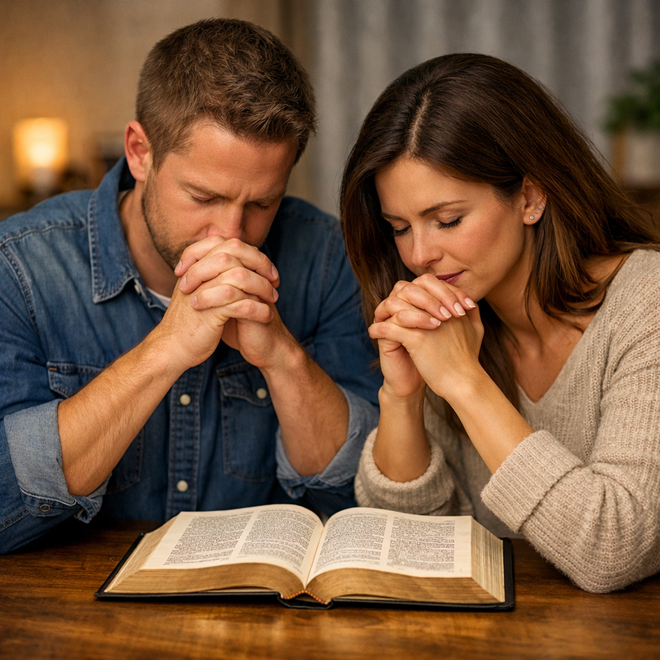
Every Religious Person
Has Some Interest in Prayer
Regardless of age
Regardless of gender
Regardless of spiritual strength
Regardless of abilities
Everyone “Prays”

Slide 2
There are many questions
people ask about prayer
What is prayer?
Why does God not answer my prayer?
Who can pray?
Must we kneel to pray?
Who can lead prayers for others?
How does God answer prayer?
Can we pray to Jesus?

Slide 3
Questions About Prayer
Lesson 1: The Basics of Prayer
Lesson 2: The Elements of Prayer
Lesson 3: God’s Answer to Prayer
Lesson 4: Misc. Questions About Prayer

Slide 4
God’s
Answer
to
Prayer
Questions About Prayer

Slide 5
Questions & Confusion about
Prayer & Providence
Does God work in the affairs of men today?
What is the difference in providence and miracles?
  If a prayer is answered – if it is not a miracle, how explained?
  If sick get better – is that not a miracle? If not, how explain it?
When things seem to just fall in place in my life – could that be God working that out?
When something goes south on me (seem defeated) – could that be God’s action?
A thorough study of prayer must include a study of providence
To understand providence, we must know the power of prayer

Slide 6
God’s Answer to Prayer
Does God Answer Every Prayer?
Questions About Prayer

Slide 7
Does God Answer Every Prayer?
God answers prayer
  Jas. 5:16-18
  1 Pet. 3:12
  1 John 5:14-15
  Luke 18:1, 8

Slide 8
Does God Answer Every Prayer?
God answers prayer
Prayer will do good
  Jas. 5:16 – avails much
  Williams’ translations: “very powerful”
  ASV: “in its working” (when it is exercised)
  May not accomplish what I want – but stills does good

Slide 9

James 5:16-18
16 Confess your trespasses to one another, and pray for one another, that you may be healed. The effective, fervent prayer of a righteous man avails much.
17 Elijah was a man with a nature like ours, and he prayed earnestly that it would not rain; and it did not rain on the land for three years and six months.
18 And he prayed again, and the heaven gave rain, and the earth produced its fruit.
Has force whether it hits the target or not!

Slide 10
Does God Answer Every Prayer?
God answers prayer
Prayer will do good
Every prayer receives an answer
  1 Pet. 3:12
  May not be the answer I want
Yes
No
Wait

Slide 11
Does God Answer Every Prayer?
God answers prayer
Prayer will do good
Every prayer receives an answer
Sometimes the answer is “no”
  Answer to Paul was “no” (2 Cor. 12:7-9)
  Answer to David was “no” (2 Sam. 12:15-23)

Slide 12
Does God Answer Every Prayer?
God answers prayer
Prayer will do good
Every prayer receives an answer
Sometimes the answer is “no”
Why is God not answering my prayer?
  He is – may not be the answer you want
  May not be asking according to his will (1 John 5:14)
  May be asking amiss (Jas. 4:2-3)

Slide 13
God’s Answer to Prayer
Does God Answer Every Prayer?
How Does God Answer Prayer?
Questions About Prayer

Slide 14
How Does God Answer Prayer?
God is in control
  God is involved in the operation of the universe now
    Acts 17:24-28
    Heb. 1:3 – Controls the universe
    Col. 1:17 – Controls the universe
    Neh. 9:6-9 – Preserves the world he made
    Dan. 4:25 – Still rules in the kingdoms of men
    Rev. 4:11 – still on his throne

Slide 15
How Does God Answer Prayer?
God is in control
  God is involved in the operation of the universe now
  God is concerned for man
    Matt. 6:30-32 – cares for the grass and us too
    Matt. 10:29-31- notices every sparrow that falls
    1 Pet. 5:7 – “for he cares for you”

Slide 16
How Does God Answer Prayer?
God is in control
  God is involved in the operation of the universe now
  God is concerned for man
  God’s will (intent) can be altered
    Doesn’t mean – can change his law or revelation
    God has changed his mind
      Abraham’s plea for Sodom (Gen. 18:23-ff)
      Moses’ plea for Israel (Exo. 32:9-14)
      Jonah’s plea for Nineveh (Jonah 3)

Slide 17
Summary Verse:
Revelation 4:11
“You are worthy, O Lord,
To receive glory and honor and power;
For You created all things,
And by Your will they exist and were created.”

Slide 18
How Does God Answer Prayer?
God is in control
The providence of God
  What is providence?
    Word means: “foresight, forethought” (BDAG)
    Word is used in Acts 24:2 (KJV, ASV) – foresight or providence of man
      Translated “foresight” (NKJV, ESV)
      Same word translated “provisions” (Rom. 13:14)
    Providence of God = God used forethought in creating a universe that he could control and use for his purpose
      It is the non-miraculous use of natural law and circumstance to accomplish his purpose
      Simply stated: God working through natural means

Slide 19
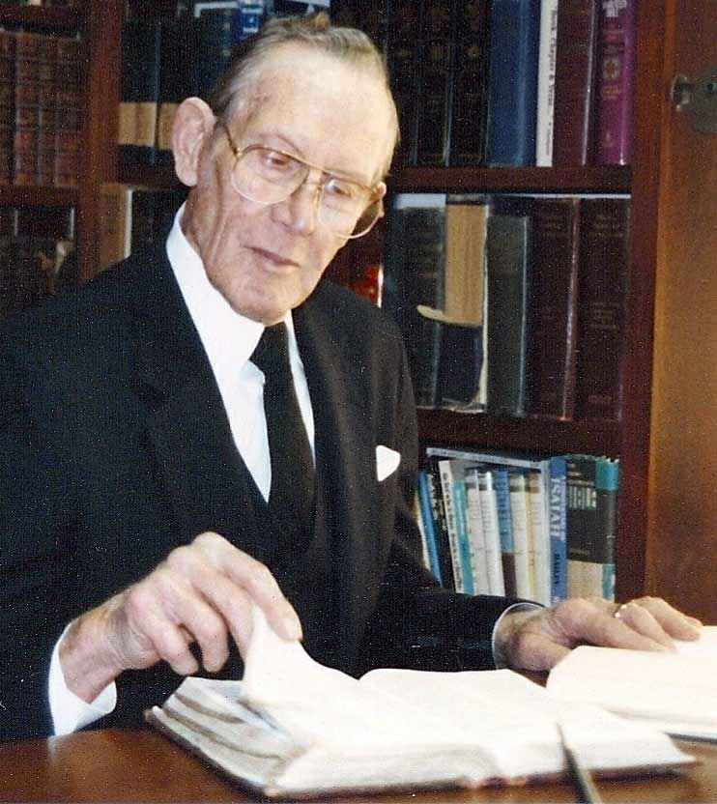
“The working of God through His provision in the natural and spiritual realms, and yet it is a control that violates neither the sovereignty of the human will nor the divine natural and spiritual laws.”
(Homer Hailey)

Slide 20
How Does God Answer Prayer?
God is in control
The providence of God
  What is providence?
  Contrasted to miracles

Slide 21
Providence – vs – Miracles
Providence
Birth of Child
Samuel
(1 Sam. 1:10-20)
Weather Change
Rain
(Jas. 5:16-17)
Miracle
Birth of Child
Jesus
(Matt. 1:23)
Weather Change
Calm Storm
(Matt. 8:26)
Natural Means
Supernatural Means

Slide 22
How Does God Answer Prayer?
God is in control
The providence of God
  What is providence?
  Contrasted to miracles
  God answers without violating human will
    Man is still a free moral agent (Rom. 6)
    Man still has freedom of choice
    Example: my prayer for someone to obey – will not violate their will.

Slide 23

How Does God Answer Prayer?
God is in control
The providence of God
  What is providence?
  Contrasted to miracles
  God answers without violating human will
  God answers without violating natural law
    To do otherwise – miracle! (Supernatural)
    God can operate within natural law and still be in the driver’s seat

Slide 24
How Does God Answer Prayer?
God is in control
The providence of God
  What is providence?
  Contrasted to miracles
  God answers without violating human will
  God answers without violating natural law
  God may simply bless man with the means
    Pray for necessities – may bless me with good health to work and provide (Eph. 4:28)
    Pray for patience – may allow trouble to build patience (Jas. 1)
    Pray for wisdom – may use to aged saint to teach me

Slide 25
How Does God Answer Prayer?
God is in control
The providence of God
  What is providence?
  Contrasted to miracles
  God answers without violating human will
  God answers without violating natural law
  God may simply bless man with the means
  We don’t know in specific cases

Slide 26
We Don’t Know In Specific Cases
Two specific cases – where they would not say for sure
  Esther 4:14 – “who knows”
  Philemon 15 – “perhaps”
Need to be careful
  We can know that God is at work – and his providence is active
  However, we cannot clearly identify “this is an act of providence”
  We are safe in saying:
    “Perhaps”
    “Who knows but…”
    “This very well could be providence”

Slide 27

Illustration
Preacher on way to meeting – had a flat just down the road from the building (in front of a house)
Man and wife came out to see if could help – man offered to take preacher to his appointment
  Preacher invited man to go and stay and hear preaching – man agreed
  Preacher suggested bring wife along with him – she went
They went every night – at end of week obeyed gospel
Years later preacher went for another meeting – still faithful
Was the flat tire – at that spot – an act of providence?

Slide 28
How Does God Answer Prayer?
God is in control
The providence of God
  What is providence?
  Contrasted to miracles
  God answers without violating human will
  God answers without violating natural law
  God may simply bless man with the means
  We don’t know in specific cases
  Examples of providence

Slide 29
Examples of Providence
Joseph
  God used the famine & misfortune upon Joseph to preserve his people
  Gen. 50:20
Esther
  Esther becomes queen and saves the Jews
  “If the name of God is not here, his finger is” (Matthew Henry)

Slide 30
Providence Passages in Esther
1:20 – Vashti Dismissed
2:17 – Esther becomes queen
2:20 – Mordecai’s favor to the king (reward?)
3:7 – Year delay
4:14 – Esther to the throne?
4:16 – Prayer implied
5:1-14 - Delay in time to build gallows
6:1 – Sleepless night
8:9 – Working within Persian law – giving Jews time to prepare
9:3-4 – Use of government power

Slide 31
How Does God Answer Prayer?
God is in control
The providence of God
It is not necessary to know all the details of how, just the fact
  We know very little about the how
    Example: Pray for the sick – they get better. How did God do that without a miracle?
    Example: Pray for wisdom – in time are wiser. How did God do that? Did God allow some difficulties to teach me?
  We can be assured that God hears and answers (1 Pet. 3:12; Jas. 5:16)

Slide 32
God’s Answer to Prayer
Does God Answer Every Prayer?
How Does God Answer Prayer?
Questions About Prayer

Slide 33
Questions About Prayer
Lesson 1: The Basics of Prayer
Lesson 2: The Elements of Prayer
Lesson 3: God’s Answer to Prayer
Lesson 4: Misc. Questions About Prayer

