Slide 1
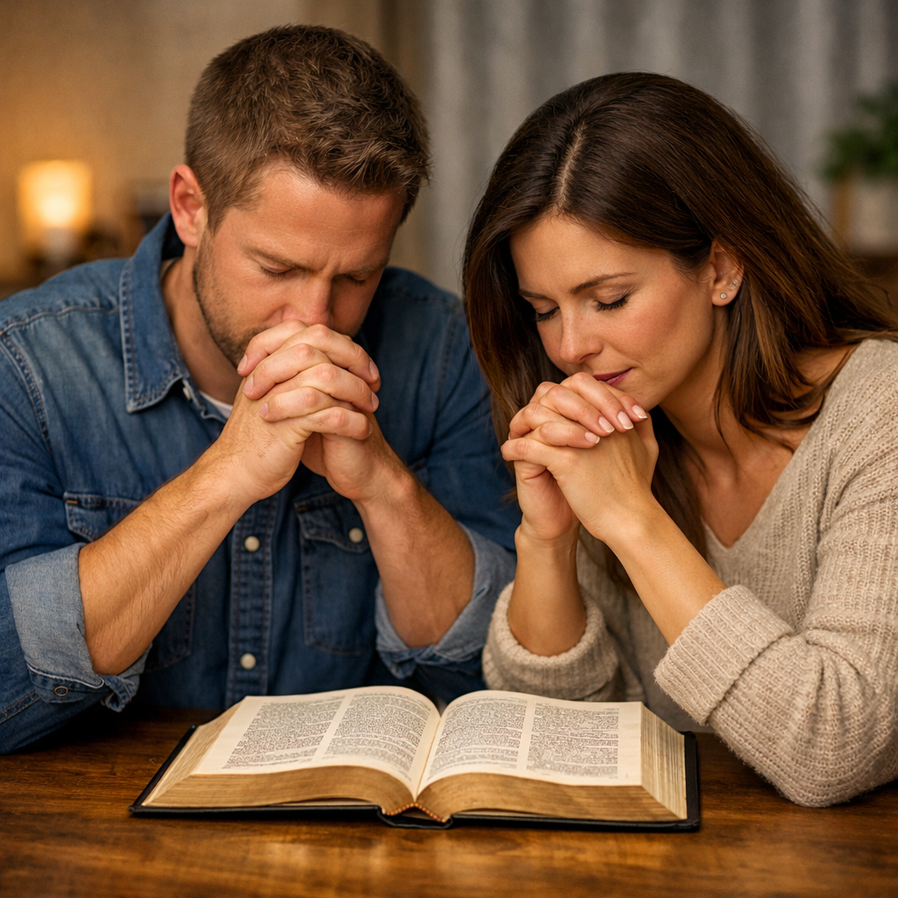
Every Religious Person
Has Some Interest in Prayer
Regardless of age
Regardless of gender
Regardless of spiritual strength
Regardless of abilities
Everyone “Prays”

Slide 2
There are many questions
people ask about prayer
What is prayer?
Why does God not answer my prayer?
Who can pray?
Must we kneel to pray?
Who can lead prayers for others?
How does God answer prayer?
Can we pray to Jesus?

Slide 3
Questions About Prayer
Lesson 1: The Basics of Prayer
Lesson 2: The Elements of Prayer
Lesson 3: God’s Answer to Prayer
Lesson 4: Misc. Questions About Prayer

Slide 4
The
Basics
of
Prayer
Questions About Prayer

Slide 5
The Basics of Prayer
What is Prayer?
Questions About Prayer

Slide 6
What is Prayer?
It is not:
  Merely wishing for something
  Merely thinking about something
  Merely reciting some phrases

Slide 7
What is Prayer?
It is not:
It is:
  Our means of talking to God (Luke 18:10-14)
  Act of communicating the thoughts of man to the infinite mind of God
    Rom. 10:1 – hearts desire expressed to God
    Phil. 4:6 – making our requests made known to God
    1 Sam. 1:12-13 – Hannah prayed…spoke…lips moved (talking to God)
  Statements for men – that capture the concept of prayer

Slide 8
What is Prayer?
“Prayer is the avenue through which one approaches the Almighty.”
Prayer is “making personal contact with power that transcends time, space, and matter.”
“Prayer is the voice of faith.” (Thomas Horne)
“Prayer is a correspondence fixed in heaven.” (Robert Burns)
“Prayer is so simple – it is like quietly opening a door and slipping into the very presence of God.”
“Prayer is so simple – it is like quietly opening a door and slipping into the very presence of God.”

Slide 9
What is Prayer?
It is not:
It is:
What a privilege it is:
  What an honor & privilege to have access to God (cf. 1 John 3:1)
  Imagine being invited into the throne room for a private discussion with the king / president
  We are invited to open our hearts to the creator and ruler of the universe!

Slide 10
The Basics of Prayer
What is Prayer?
Why Do We Need to Pray?
Questions About Prayer

Slide 11
Why Do We Need to Pray?
It is a command:
  1 Thess. 5:17
  Luke 18:1
  1 Tim. 2:8
  Matt. 6:9-13

Slide 12
Why Do We Need to Pray?
It is a command:
God is concerned with our wants and needs
  Matt. 7:9-11
  Luke 12:7

Slide 13
Why Do We Need to Pray?
It is a command:
God is concerned with our wants and needs
To find grace to help in time of need (Heb. 4:16)
  Because we as humans are weak and frail
  Dependent upon the assistance of divine power
  Stand continually in need of God’s care and protection
  1 Thess. 5:17 – pray without ceasing because of continual needs
  We can’t make it without God’s help (John 15:5; Phil. 4:13)

Slide 14
Why Do We Need to Pray?
It is a command:
God is concerned with our wants and needs
To find grace to help in time of need (Heb. 4:16)
God is the Almighty
  Matt. 19:26; Eph. 3:20-21
  He has the power to grant and do something about matters
  He knows all and controls all
  He can do something about: rulers, peace, cancer, sickness, storms, etc.

Slide 15
Why Do We Need to Pray?
It is a command:
God is concerned with our wants and needs
To find grace to help in time of need (Heb. 4:16)
God is the Almighty
God is willing to grant us good things
  Matt. 7:7-8
  What’s best for us – even “no”

Slide 16
Why Do We Need to Pray?
It is a command:
God is concerned with our wants and needs
To find grace to help in time of need (Heb. 4:16)
God is the Almighty
God is willing to grant us good things
Through prayer we express love and adoration
  Matt. 6:9
  1 Tim. 2:1 – an opportunity to express our appreciation to God
  Prayer is an act of worship (both public and private) – a time to praise God

Slide 17
Why Do We Need to Pray?
It is a command:
God is concerned with our wants and needs
To find grace to help in time of need (Heb. 4:16)
God is the Almighty
God is willing to grant us good things
Through prayer we express love and adoration
Need forgiveness (Acts 8:22-24)
Follow the example of Christ (1 Pet. 2:21)
Does good (Jas. 5:16)

Slide 18
The Basics of Prayer
What is Prayer?
Why Do We Need to Pray?
Who Can Pray?
Questions About Prayer

Slide 19
Who Can Pray?
God does not hear sinners
  John 9:31
    Though not an inspired man – he stated what is true!
    Didn’t say: “I think”, “we think” or even “I know” – but rather, “we know”
    It wasn’t denied!
    His statement was based upon some OT passages
  Isa. 59:1-2
  Psa. 34:15-16
  Prov. 28:9
  Psa. 66:18
  1 Pet. 3:7 – possible for prayers to be hindered

Slide 20
Who Can Pray?
God does not hear sinners
Children of God have that privilege
  John 9:31 – a worshipper of God & does his will
  Jas. 1:6 – prayer must be asked in faith
  Matt. 9:9-13 – “our Father”
  Jas. 5:16 – a righteous man
  1 John 3:22
  1 Pet. 3:12 (quotes Psa. 34:15)
  Prov. 15:29
  Rom. 8:14-15
  1 Tim. 2:8 – holy hands
Not Just a
Christian – But
A Faithful
Christian!

Slide 21
Who Can Pray?
God does not hear sinners
Children of God have that privilege
What about Cornelius & Saul and other alien sinners?
  Cornelius (Acts 10:4, 31) / Saul (Acts 9:11)
  Argument is made using John 9:31 saying it is not dealing with aliens
    True – it deals with rebellious covenant people
    Why would principle not apply to alien sinners?
    Would say God will hear the alien sinner but not the covenant sinner?

Slide 22
Who Can Pray?
God does not hear sinners
Children of God have that privilege
What about Cornelius & Saul and other alien sinners?
  Cornelius (Acts 10:4, 31) / Saul (Acts 9:11)
  Argument is made John 9:31 saying it is not dealing with aliens
  God may “hear” the prayer (knows what is prayed) - that not one denies
  God may even respond somehow to that prayer
    Not the same as saying God’s ears are open to their prayers
    If it does, then 1 Pet. 3:12 – is meaningless!

Slide 23
Who Can Pray?
God does not hear sinners
Children of God have that privilege
What about Cornelius & Saul and other alien sinners?
  Cornelius (Acts 10:4, 31) / Saul (Acts 9:11)
  Argument is made John 9:31 saying it is not dealing with aliens
  God may “hear” the prayer (knows what is prayed) - that not one denies
  God may even respond somehow to that prayer
  Certainly, couldn’t pray for salvation / forgiveness
    Saul: (Acts 9:11; 22:16)
    Cornelius (Acts 10:6; 11:14)

Slide 24
Who Can Pray?
God does not hear sinners
Children of God have that privilege
What about Cornelius & Saul and other alien sinners?
  Cornelius (Acts 10:4, 31) / Saul (Acts 9:11)
  Argument is made John 9:31 saying it is not dealing with aliens
  God may “hear” the prayer (knows what is prayed) - that not one denies
  God may even respond somehow to that prayer
  Certainly, couldn’t pray for salvation
  What passage tells the alien sinner to pray?

Slide 25
The Basics of Prayer
What is Prayer?
Why Do We Need to Pray?
Who Can Pray?
Questions About Prayer

