Slide 1
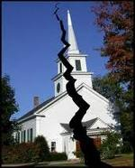
Divisions Within
The Church of Christ

Slide 2
Divisions Within The Church of Christ
April 5 – “Bible Authority – the Heart of all the Issues”
April 12 – “Division in the 1800’s – The Missionary Society”
April 19 – “Division in the 1800’s – Instrumental Music”
May 3 – “First of the Institutional Issues – The College in Church Budget”
May 10 – “The Major Dividing Issue – The Orphan Homes”
May 17 – “A Secondary Dividing Issue – The Sponsoring Church”
May 24 – “A Minor, but Real Issue – Limited Benevolence”
June 14 – “The Social Gospel – Clarifying Distinctions
June 21 – “The Social Gospel – What Builds Faith and Edifies”
July 5 – “The Social Gospel – The Many Faces of the Social System”

Slide 3
Divisions Within
The Church of Christ
Lesson # 8
The Social Gospel
Clarifying Distinctions

Slide 4
There are social implications of the gospel
When people become Christians, there will be:
  less crime
  more compassion
  greater honesty
  improved relationships
  honorable treatment of others

Slide 5






Social Gospel - Distinctions
Idea is: The purpose of Gospel Message – improve social circumstance of man
Includes Churches involved in:
  Colleges
  Schools / Day care
  Fellowship halls
  Bus Ministry
  Gyms – ball teams
  “Gimmicks” to draw crowd

Slide 6
Social Gospel - Distinctions
I. The History
I. The History

Slide 7
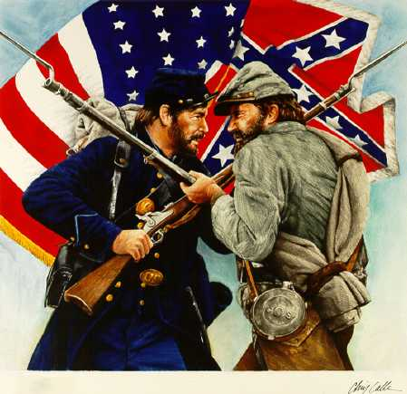
The Social Gospel
Didn’t start with Institutional movement in churches of Christ
Started in America in the years following the Civil War

Slide 8
I. The History
Born out of modernism
  Modernism: rejection of Bible fundamentals
  Denial of biblical record – i.e. Darwin’s theory

Slide 9
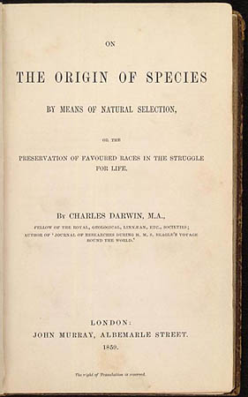
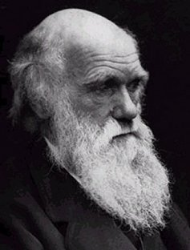
Charles Darwin
(1809 – 1882)
Evolution
(Survival of Fittest)

Slide 10
I. The History
Born out of modernism
  Modernism: rejection of Bible fundamentals
  Denial of biblical record – i.e. Darwin’s theory
  “The rise of the social gospel in this country was simultaneous with the rise of Biblical liberalism and modernistic religion” (Dr. David Harrell, FCC Lectures, March 23, 1960)

Slide 11
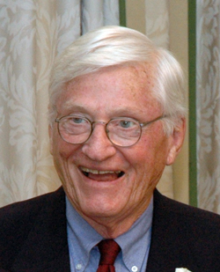
“It was quite natural that the leaders of the liberal religious movement should become active social gospelers. Indeed, the discovery of the church as a social institution filled a vacuum left by their rejection of the church as a significant spiritual institution. These liberals were also the most widely know clergymen of their day and when historians began to study the social gospel movement it was natural for them to emphasize the importance of the modernist proponents of social reform.”
- Dr. David Harrell, FCC Lectures, March 23, 1960

Slide 12
I. The History
Born out of modernism
  Modernism: rejection of Bible fundamentals
  Denial of biblical record – i.e. Darwin’s theory
  “The rise of the social gospel in this country was simultaneous with the rise of Biblical liberalism and modernistic religion” (Dr. David Harrell, FCC Lectures, March 23, 1960)
  Problems followed the Industrial Revolution
    Crime
    Poverty
    Inequality
    Drunkenness
    Etc.

Slide 13
“In the 1870’s and 1880’s the leaders of American society suddenly realized that they were faced with overwhelming social problems. The industrial revolution in this country raised problems in business and political ethics, employer-employee relationships, economic competition, and the nature of poverty and its remedy which shocked many American social philosophers out of a well-worn complacency. No less serious were the social maladjustments connected with the unparalleled rise of high cities. Slums, drunkenness, prostitution, organized crime, juvenile delinquency, abject poverty, and all other problems sprawling, filthy cities were convincing realities that demanded that something be done.”
Dr. David Harrell, FCC Lectures, March 23, 1960

Slide 14
“Out if this setting came the social gospel movement. Religious leaders were not the first to delve into these social evils but in the late 1870’s and in the 1880’s increasing numbers of them from almost every denomination began to offer suggestions for the solution of the new America’s social dilemma.”
Dr. David Harrell, FCC Lectures, March 23, 1960

Slide 15
I. The History
Born out of modernism
The social gospel concept
  A / the primary message of the gospel is social justice
    Church (institutional manifestation of Christianity) is obligated to do something about the social maladjustments
    Rejected idea: gospel has one primary intent: spiritual / salvation
    Thus: primary purpose of the social gospel is to improve social circumstances of man

Slide 16
I. The History
Born out of modernism
The social gospel concept
  A / the primary message of the gospel is social justice
  How it works:
    Evangelism /conversion culminates in the promised “kingdom of God” (i.e. better – more perfect society)
    When a businessman is converted:
      Primary concern is not his personal salvation
      Change in better business practices
      Even more: better business practices of others

Slide 17
I. The History
Born out of modernism
The social gospel concept
Impact on denominationalism
  Shift away from salvation to correcting social problems
  Shailer Matthews said in 1927, “the old individualism of evangelism is being supplemented by the social evangelism”
  Nearly all denominations developed social programs
Day Care
Schools / Colleges
Hospitals
Orphan Homes
Nursing Homes
Soup Kitchens
Clothes Closets
Gyms
Youth Ministries

Slide 18
I. The History
Born out of modernism
The social gospel concept
Impact on denominationalism
  Shift away from salvation to correcting social problems
  Shailer Matthews said in 1927, “the old individualism of evangelism is being supplemented by the social evangelism”
  Nearly all denominations developed social programs
  How did the more conservative denominations get involved?

Slide 19
“Conservative” Denominations Got Involved In Social Gospel
(i.e. Holiness)
“Doctrinally conservative, many of the revivalist leaders of the last century readily adjusted the principles of the social gospel into their conservative theology.”
- Dr. David Harrell, FCC Lectures, March 23, 1960
“Far from disdaining earthly affairs, the evangelists played a key role in the widespread attack upon slavery, poverty, and greed. They thus helped prepare the way both in theory and in practice for what would later become known as the social gospel.”
- Timothy L. Smith, Revivalism and Social Reform in the Mid-Nineteenth Century America, 8

Slide 20
“Conservative” Denominations Got Involved In Social Gospel
“By the 1880’s social gospelism had invaded the restoration movement. Leader of the Disciples of Christ, still Biblically conservative at this junction, such as Isaac Errett, Richard M. Bishop of Cincinnati, and Frederick Power of Washington D.C. participated in the earliest organized efforts of the social gospel leaders in the United States.”
- Dr. David Harrell, FCC Lectures, March 23, 1960

Slide 21
A Great Shift
Spiritual
Social

Slide 22
I. The History
Born out of modernism
The social gospel concept
Impact on denominationalism
In time churches of Christ were impacted
  Prior to the issues of the 1950’s and 1960’s there was a change in attitude toward authority
  Churches of Christ (by the turn of century – 1900) already taking on the social gospel concept

Slide 23

The Mirror of a Movement
Churches of Christ as seen through the Abilene Christian College Lectureship
William S. Banowsky, Ph.d.
“Although not directly involved with the social gospel tensions in the mainstream of national thought, some of the basic questions of the larger debate were essentially the ones at stake in the Abilene tributary: What is the extent of the church’s social responsibility? How can efforts at social betterment be related to the problems of individual salvation? Will the church forsake its spiritual purposes by becoming inordinately encumbered with social services? Among churches of Christ, these infectious questions gathered, festered, and erupted into one bitter, benevolent issue: In what way can the church scripturally provide for the needs of widows and orphans?”
(pp. 330-331)
1965

Slide 24
The Mirror of a Movement
Churches of Christ as seen through the Abilene Christian College Lectureship
William S. Banowsky, Ph.d.
“The benevolent battle among churches of Christ, then, was very definitely, if indirectly, related to the social gospel war being waged in contemporary protestantism.”
(p. 328)
“The overtones of the social gospel movement endowed the more sequestered conflict with a flavor of national relevancy. There is ample evidence that the Lectureship was the brotherhood’s most forceful and continuing voice urging a broader conception of the churches social responsibility.”
(pp. 341-342)
1965

Slide 25
I. The History
Born out of modernism
The social gospel concept
Impact on denominationalism
In time churches of Christ were impacted
By the time division was complete:
  Church colleges
  Orphan’s home
  Old folks home
  Youth camps
  Gyms
  Fellowship halls
  Ball teams

Slide 26
Social Gospel - Distinctions
I. The History
I. The History
II. The Social – Spiritual Distinction
II. The Social – Spiritual Distinction

Slide 27
II. The Social –Spiritual Distinction
Gospel has social implications
“The gospel is, in some respects, at any rate, social. To deny that there are social implications in the teachings of Jesus and the writers of the New Testament would be ridiculous.”
Dr. David Harrell, FCC Lectures, March 23, 1960

Slide 28
True: that the gospel instructions have far reaching effects on society and social relations
Far different thing: to say that the gospel has as its primary objective / concern social needs of man

Slide 29
The Shift Develops Subtly
The
True
Gospel
(Gal. 1:6-9)
The
Social
Gospel
(Gal. 1:6-9)
Shifting To:

Slide 30
A Contrast
True Gospel
Deals with the disease
Converts people to Christ
Makes society better by making Christians
Social Gospel
Deals with the symptoms
Converts people better way of life
Makes Christians by social reforms

Slide 31
Social Gospel - Distinctions
A Great Shift
Spiritual
Social

Slide 32
II. The Social –Spiritual Distinction
Gospel has social implications
The Gospel is a redemptive message
  It addresses man’s need: Sin
    Defines sin (1 John 3:4)
    Condemns immorality (Gal. 5:19-21; 1 Cor. 6:9-11)
    Convicts of sin (Rom. 3:23)
    Warns of consequences (Rom. 6:23; Rev. 21:8)

Slide 33
II. The Social –Spiritual Distinction
Gospel has social implications
The Gospel is a redemptive message
  It addresses man’s need: Sin
  It gives a remedy: Christ
    He is the answer (Rom. 7:24-25)
    He is the fulfillment of the OT (Acts 3; Rom. 10:4)
    Died for our sins (1 Pet. 1:19)

Slide 34
II. The Social –Spiritual Distinction
Gospel has social implications
The Gospel is a redemptive message
  It addresses man’s need: Sin
  It gives a remedy: Christ
  It has a message: Salvation
    Focus is on spiritual need (Mark 16:15-16)
    Every sermon in the book of Acts
    Gospel is power of God to salvation (Rom. 1:15-16)

Slide 35
II. The Social –Spiritual Distinction
Gospel has social implications
The Gospel is a redemptive message
Gospel does not address man’s social needs
  Poverty
  Hunger
  Sickness / Disease
  Social relationships
  Recreation
  Business essentials

Slide 36
When emphasis is given to the social over the spiritual,
We convert people to a party, or social circle, rather than to the Lord!
Matt 23:15
Woe to you, scribes and Pharisees, hypocrites! For you travel land and sea to win one proselyte, and when he is won, you make him twice as much a son of hell as yourselves.

Slide 37
Social Gospel - Distinctions
I. The History
I. The History
II. The Social – Spiritual Distinction
II. The Social – Spiritual Distinction
III. The Individual – Church Distinction
III. The Individual – Church Distinction

Slide 38
III. The Individual – Church Distinction
Differ in their nature

Slide 39









Individual
Church
Member
Many Members
“For as the body is one and has many members, but all the members of that one body, being many, are one body, so also is Christ” (1 Cor. 12:12).

Slide 40
Individual
Church
Member
Many Members
“For in fact the body is not one member but many” (1 Cor.12:14)

Slide 41
Individual
Church
Member
Many Members
“Now you are the body of Christ, and members individually” (1 Cor. 12:27)

Slide 42
Individual
Church
“I wrote to the church, but Diotrephes, who loves to have the preeminence among them, does not receive us.
(3 John 9)
Diotrephes

Slide 43
III. The Individual – Church Distinction
Differ in their nature
Differ in responsibility

Slide 44
Individual
Church
“If any believing man or woman has widows, let them relieve them…”
(1 Tim. 5:16)
“...and do not let the church be burdened, that it may relieve those who are really widows” (1 Tim. 5:16)

Slide 45
III. The Individual – Church Distinction
Differ in their nature
Differ in responsibility
Differ in getting money

Slide 46
Individual
Church
Get Money
Buy & Sell
(Jas. 4:13)
Get Money
Freewill Contribution
(1 Cor. 16:1-2)

Slide 47
III. The Individual – Church Distinction
Differ in their nature
Differ in responsibility
Differ in getting money
Differ in name

Slide 48
Individual
Church
Name
Christian
(Acts 11:26
1 Pet. 4:16)
Name
Church of God
(1 Cor. 1:2)
Church of Christ
(Rom. 16:16)

Slide 49
III. The Individual – Church Distinction
Differ in their nature
Differ in responsibility
Differ in getting money
Differ in name
Difference in individual, individuals & the church

Slide 50
Individual
Church
“Moreover if your brother sins against you, go and tell him his fault between you and him alone. If he hears you, you have gained your brother. But if he will not hear, take with you one or two more, that ‘by the mouth of two or three witnesses every word may be established’…”
“…And if he refuses to hear them, tell it to the church. But if he refuses even to hear the church, let him be to you like a heathen and a tax collector.
(Matt. 18:15-17)

Slide 51
Individual
Individuals
Church
“Moreover if your brother sins against you, go and tell him his fault between you and him alone. If he hears you, you have gained your brother.”
“…And if he refuses to hear them, tell it to the church. But if he refuses even to hear the church, let him be to you like a heathen and a tax collector.”
“But if he will not hear, take with you one or two more, that ‘by the mouth of two or three witnesses every word may be established’”

Slide 52
Conclusions:
Responsibility of the individual is not the responsibility of the church
The right of the individual is not the right of the church
What an individual / individuals do is not the church acting

Slide 53
Social Gospel - Distinctions
I. The History
I. The History
II. The Social – Spiritual Distinction
II. The Social – Spiritual Distinction
III. The Individual – Church Distinction
III. The Individual – Church Distinction

Slide 54
Divisions Within The Church of Christ
April 5 – “Bible Authority – the Heart of all the Issues”
April 12 – “Division in the 1800’s – The Missionary Society”
April 19 – “Division in the 1800’s – Instrumental Music”
May 3 – “First of the Institutional Issues – The College in Church Budget”
May 10 – “The Major Dividing Issue – The Orphan Homes”
May 17 – “A Secondary Dividing Issue – The Sponsoring Church”
May 24 – “A Minor, but Real Issue – Limited Benevolence”
June 14 – “The Social Gospel – Clarifying Distinctions
June 21 – “The Social Gospel – What Builds Faith and Edifies”
July 5 – “The Social Gospel – The Many Faces of the Social System”

