Slide 1
One of the hardest commands to obey
Repent
For The Non-Christian
Baptism is easy
once he repents
For The Christian
Confession is easy
once he repents
It is Hard Because:
It is the turning point – decision making point
It takes deep humility
It involves an admission of wrong

Slide 2
“The greatest obstacle to the salvation of men is the obstinacy of the human will.”
J. W. McGarvey
July 2, 1893

Slide 3
R
e
p
e
n
t
a
n
c
e
Often Misunderstood, Misdefined
& Even Feigned
“Change of Life”
May change – not repent
May be sorry – not repent
“Sorry”
May admit wrong – not repent
“Admit Wrong”

Slide 4
Repentance
Clarified
Repentance
Clarified

Slide 5
Repentance Clarified
Repentance Clarified
I. The Requirement of Repentance

Slide 6
I. The Requirement of Repentance
Nearly Every Sermon Mentioned it
John the Baptist (Matt. 3:2)
Jesus (Matt. 4:17)
Apostles to Jews – limited commission (Mark 6:12)
Apostles to World – great commission (Lk. 24:45-47)
- On Pentecost (Acts 2:38)
- On Mars Hill (Acts 17:30-31)
- Gentiles (Acts 11:18)

Slide 7
I. The Requirement of Repentance
Nearly Every Sermon Mentioned it
Required:
Alien Sinner (Acts 2:38; 17:30-31)
Erring Christian (Acts 8:22)
Before We Forgive Another (Luke 17:3-4)

Slide 8
I. The Requirement of Repentance
Nearly Every Sermon Mentioned it
Required:
Either Repent or Perish
Luke 13:3, 5
2 Pet. 3:9
Acts 17:30-31

Slide 9
Repentance Clarified
Repentance Clarified
I. The Requirement of Repentance
II. The Definition of Repentance

Slide 10
II. The Definition of Repentance
Word Defined
1. metanoeo NT:3340, lit., "to perceive afterwards" (meta, "after," implying "change," noeo, "to perceive"; nous, "the mind, the seat of moral reflection"), in contrast to pronoeo, "to perceive beforehand," hence signifies "to change one's mind or purpose," always, in the NT, involving a change for the better, an amendment, and always, except in Luke 17:3,4, of "repentance" from sin.
(Vine's Expository Dictionary of Biblical Words)

Slide 11
NT:3340
metanoeo (met-an-o-eh'-o); from NT:3326 and NT:3539; to think differently or afterwards, i.e. reconsider (morally, feel compunction):
(Strong’s)

Slide 12
Repent metanoeite (NT:3340). A word compounded of the preposition meta (NT:3326), "after, with;" and the verb noeoo (NT:3539), "to perceive," and "to think," as the result of perceiving or observing. In this compound the preposition combines the two meanings of time and change, which may be denoted by after and different; so that the whole compound means to think differently after. Metanoia (NT:3341) ("repentance") is therefore, primarily, an after thought, different from the former thought; then, a change of mind which issues in regret and in change of conduct. These latter ideas, however, have been imported into the word by scriptural usage, and do not lie in it etymologically nor by primary usage. Repentance, then, has been rightly defined as "Such a virtuous alteration of the mind and purpose as begets a like virtuous change in the life and practice." Sorrow is not, as is popularly conceived, the primary nor the prominent notion of the word. Paul distinguishes between sorrow lupee (NT:3077) and repentance metanoia (NT:3341), and puts the one as the outcome of the other. "Godly sorrow worketh repentance" (2 Cor 7:10).
(Vincent's Word Studies of the New Testament)

Slide 13
II. The Definition of Repentance
Word Defined
How Term is Used
God repented: regret / change of mind (Gen. 6:6; Exo. 32:14)
Change mind & conduct (1 Kings 8:47; Ezek. 14:6; 18:30)
Regret – different word (Matt. 21:28-29; Matt. 27:3)
Change of mind & life (Matt. 3:2; Acts 2:38; 8:22)

Slide 14
II. The Definition of Repentance
Word Defined
How Term is Used
Summary:
Change of mind
Look at sin differently than before
Think differently – about what you’ve done

Slide 15
Repentance Clarified
Repentance Clarified
I. The Requirement of Repentance
II. The Definition of Repentance
III. The Elements of Repentance

Slide 16
III. The Elements of Repentance
Godly Sorrow

Slide 17

Sorrow toward God
2 Cor 7:10
For godly sorrow produces repentance leading to salvation, not to be regretted; but the sorrow of the world produces death.
Godly Sorrow

Slide 18
Sorrow toward God
Deep Contrition
2 Cor. 2:7 – Danger of too much sorrow
Psa. 51:17 – David sorrowed over his sin
Psa. 34:18 - Those who fear have broken heart
Isa. 57:15; 66:2 – Lord favors a contrite heart
Matt. 26:75 – Peter wept bitterly
Godly Sorrow

Slide 19
Lacking Deep Contrition
Deep Sorrow
Laugh about our sin
Talk (unashamed) about what we did
Say, “I was wrong, but….”
Advertise our sin as if commonplace

Slide 20

A Careful Balance
Forgiving Self
Deep Contrition
Psalm 51
VV. 1-2
VV. 3-4
V. 10
V. 17

Slide 21
III. The Elements of Repentance
Godly Sorrow
Change of Mind
This is what
repentance
means!

Slide 22
III. The Elements of Repentance
Godly Sorrow
Change of Mind
Change of Life

Slide 23
Involves Turning From Evil
Thayer: “to change one’s mind for the better, heartily to amend with abhorrence of one’s past sins” (405).
W. E. Vine says “this change of mind involves both a turning from sin and a turning to God” (III: 281).
Kittel’s Theological Dictionary Of The New Testament suggest that repentance involves turning away from evil (IV: 1004).
A. T. Robertson said that when John called upon his hearers to repent, “John did not call on people to be sorry, but to change their mental attitudes and conduct” (Word Pictures In The New Testament, I: 24)
Change of Life

Slide 24
Involves Turning From Evil
Ceasing of Sin
Nineveh “…repented at the
preaching of Jonah…”
(Matt. 12:41)
Change of Life
“…they turned from their
evil way…”
(Jonah 3:10)

Slide 25
Involves Turning From Evil
Ceasing of Sin
Fruits of repentance (Matt. 3:8)
If No Change – No Repentance
  2 Cor. 12:20-21
  Rev. 9:20-21
New & Different Life (Rom. 6:4)
Change of Life

Slide 26
Produces
Godly
Sorrow
Deep
Contrition
Change
of
Life
Repentance
(Change
of Mind)
Produces

Slide 27
These Are Not Repentance
  Confession - (Possible to confess without repenting)
  Reporting - (come forward to report what done)
  Mere Regret - (Matt. 27:2-4; Change is missing)
  Mere Change – (Missing deep contrition)
  “Repent” but still justify action
  A ritual one goes through when he sins

Slide 28
Application of the Principle
Sin must cease
  One who drinks – stops drinking
  One who curses – stops cursing
  One who in adulterous marriage – ends marriage
  One commits fornication – stops the fornication
Change of Life

Slide 29
Application of the Principle
Sin must cease
Turn from wrong
  Give up / renounce wrong standard
  Give up / renounce wrong practice
  Give up / renounce wrong doctrine
  Give up / renounce wrong relationship
Change of Life

Slide 30
Application of the Principle
Sin must cease
Turn from wrong
Start doing what have not been doing
  Start worshipping / serving
  Start praying and studying
  Start living righteous & pure
Change of Life

Slide 31
Repentance Clarified
Repentance Clarified
I. The Requirement of Repentance
II. The Definition of Repentance
III. The Elements of Repentance
IV. The Causes of Repentance

Slide 32
IV. The Causes of Repentance
What Produces Repentance?
The Terror of the Lord
  2 Cor. 5:11 – know the terror…we persuade…
  Matt. 11:20-22 – woe to those that don’t repent
  Jonah 3:4 – “Yet forty days, and Nineveh…”
  Acts 17:30-31 –Repent for judgment to come
  Rom. 2:4-5 – Repent – day of wrath

Slide 33
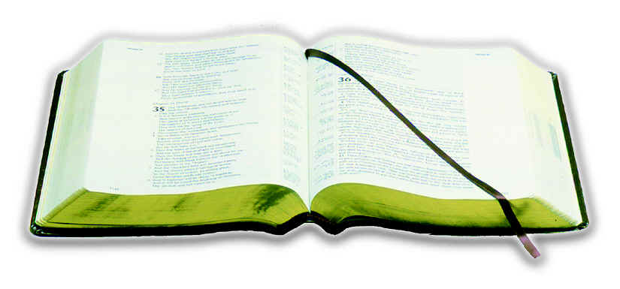
IV. The Causes of Repentance
What Produces Repentance?
The Terror of the Lord
Goodness of God
  Rom. 2:4-5 – goodness leads to repentance
  God’s longsuffering, patience, blessings.
By The Word
Luke 16:29-31
If not by Word
Nothing Will

Slide 34
Not By:
Good feelings
Pat on back
Defending the sinner
Getting caught
Terror of
the Lord
Goodness
of God
Repentance

Slide 35
Repentance Clarified
Repentance Clarified
I. The Requirement of Repentance
II. The Definition of Repentance
III. The Elements of Repentance
IV. The Causes of Repentance

