Slide 1
2 Peter 2:1-3
1 But there were also false prophets among the people, even as there will be false teachers among you, who will secretly bring in destructive heresies, even denying the Lord who bought them, and bring on themselves swift destruction.
2 And many will follow their destructive ways, because of whom the way of truth will be blasphemed.
3 By covetousness they will exploit you with deceptive words; for a long time their judgment has not been idle, and their destruction does not slumber.

Slide 2
A Contrast to Previous Point
19 And so we have the prophetic word confirmed, which you do well to heed as a light that shines in a dark place, until the day dawns and the morning star rises in your hearts;
20 knowing this first, that no prophecy of Scripture is of any private interpretation,
21 for prophecy never came by the will of man, but holy men of God spoke as they were moved by the Holy Spirit.
Men spoke by inspiration
Lest reader think all who claim to be prophets are inspired
2 Peter 2
1 But there were also false prophets among the people, even as there will be false teachers among you, who will secretly bring in destructive heresies, even denying the Lord who bought them, and bring on themselves swift destruction.
2 And many will follow their destructive ways, because of whom the way of truth will be blasphemed.
3 By covetousness they will exploit you with deceptive words; for a long time their judgment has not been idle, and their destruction does not slumber.

Slide 3
FACT:
Are False Teachers
Old Testament
Deut. 18:20-22
1 Kings 13:18
Jer. 6:14; 8:11
New Testament
Matt. 7:15

Slide 4
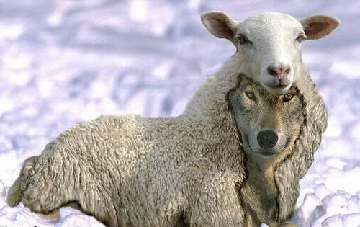
Matt 7:15
Beware of false prophets, who come to you in sheep's clothing, but inwardly they are ravenous wolves.

Slide 5
FACT:
Are False Teachers
Old Testament
Deut. 18:20-22
1 Kings 13:18
Jer. 6:14; 8:11
New Testament
Matt. 7:15
1 Cor. 15
2 Pet. 2:1; 3

Slide 6
FACT:
Are False Teachers
Old Testament
Deut. 18:20-22
1 Kings 13:18
Jer. 6:14; 8:11
New Testament
Matt. 7:15
1 Cor. 15
2 Pet. 2:1; 3
Today
Just as many – In fact more!
In World Religions
In Denominations
In Institutional Churches of Christ
In Non-Institutional Churches of Christ

Slide 7
“False Teacher” Defined
1 But there were also false prophets among the people, even as there will be false teachers among you, who will secretly bring in destructive heresies, even denying the Lord who bought them, and bring on themselves swift destruction.
A movement that abuses this text in two ways:
“False” identifies the teacher – not their doctrine
One teaching error must have deceitful character and evil motives before can mark him as a “false teacher”
Effort to broaden realm of fellowship
“Unity in Diversity”

Slide 8
“False Teacher” Defined
1 But there were also false prophets among the people, even as there will be false teachers among you, who will secretly bring in destructive heresies, even denying the Lord who bought them, and bring on themselves swift destruction.
False teacher is one who teaches false doctrine
“One who teaches falsehoods” (Louw-Nida; Thayer)
Test: replace “true” for “false”:
  Can a kind man teach error and be called “true teacher”?
  Can a loving man teach error and be called a “true teacher”?
Nothing in context that limits “false teacher” as such

Slide 9
2 Peter 2:1-3
1 But there were also false prophets among the people, even as there will be false teachers among you, who will secretly bring in destructive heresies, even denying the Lord who bought them, and bring on themselves swift destruction.
2 And many will follow their destructive ways, because of whom the way of truth will be blasphemed.
3 By covetousness they will exploit you with deceptive words; for a long time their judgment has not been idle, and their destruction does not slumber.

Slide 10
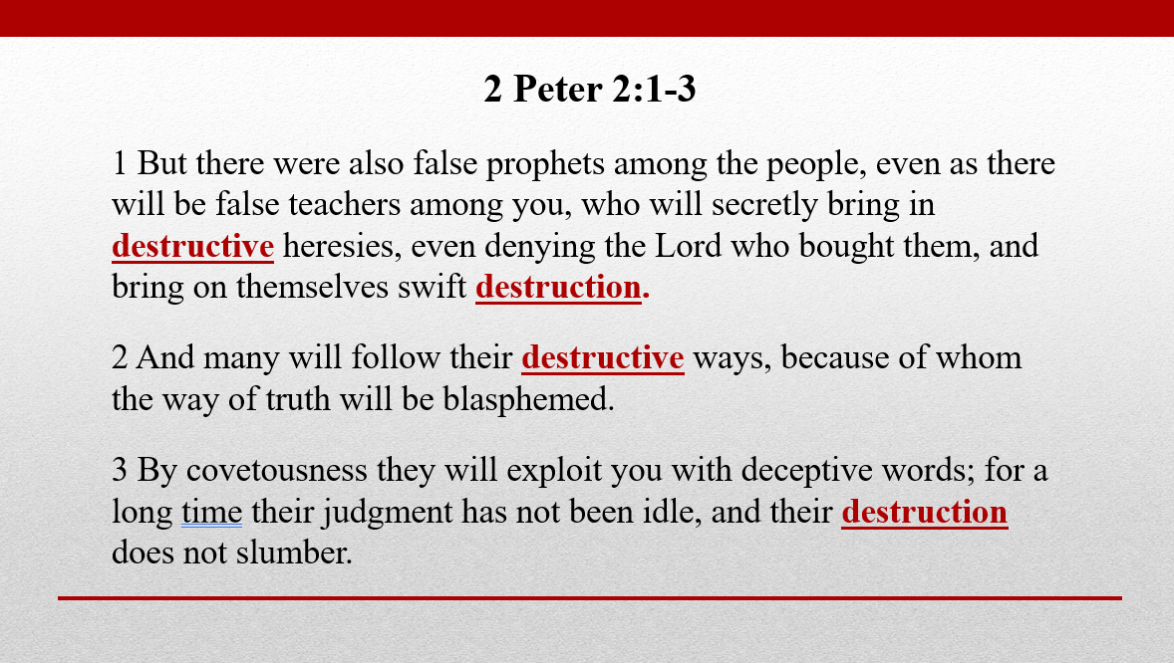
Of the Four Uses of “Destruction”
2 Point to Teacher
2 Point to the Hearer
Teacher Faces
Destruction
Second - V. 1b
Fourth - V. 3
Hearer Faces
Destruction
First - V. 1a
Third - V. 2

Slide 11

Destructive False Teachers
2 Peter 2:1-3

Slide 12
Destructive
False Teachers
Their Destructive Heresies (Vv. 1, 2)

Slide 13

Their Destructive Heresies (Vv. 1, 2)
Define “Heresies”
  Choosing – a choice – that which is chosen
Vines:
“‘a choosing, choice’ (from haireomai, "to choose"); then, ‘that which is chosen,’ and hence, ‘an opinion,’ especially a self-willed opinion, which is substituted for submission to the power of truth, and leads to division and the formation of sects”
A. T. Robertson:
“is simply a choosing, a school, a sect like that of the Sadducees (Acts 5:17), of the Pharisees (Acts 15:5), and of Christians as Paul admitted (Acts 24:5).”

Slide 14
Their Destructive Heresies (Vv. 1, 2)
Define “Heresies”
  Choosing – a choice – that which is chosen
  Sect: Men who following their own teaching
    Sect of Sadducees (Acts 5:17)
    Sect of Pharisees (Acts 15:5)
    Sect of Nazarenes (Acts 24:5)
  Can refer to a sect or the doctrine they teach
  A Doctrine that creates divison

Slide 15
Their Destructive Heresies (Vv. 1, 2)
Define “Heresies”
“Deny the Lord that bought them” (v. 1)
  May refer to what the doctrine promoted
    Some questioned his deity (1 Jno. 4:1-6)
    Some questioned his humanity (1 Jno. 4:2-3)
  May refer to what the doctrine produced (effect)
  These had left the Lord:
    Had been bought (v. 1)
    Had escaped pollution (v. 20)

Slide 16
Their Destructive Heresies (Vv. 1, 2)
Define “Heresies”
“Deny the Lord that bought them” (v. 1)
Why their doctrine is destructive (v. 2)
  Many will follow
    Create a following
    Lead men astray
  Way of truth is blasphemed
    Think the false teachers represent Christianity

Slide 17
“Many unbelievers did not run to such excesses, and failing to distinguish between those professors and those who taught the truth, they regarded such conduct as the usual and ordinary fruits of Christianity, and held the institution of Christianity itself in contempt.”
- Guy N. Woods, 164

Slide 18
Their Destructive Heresies (Vv. 1, 2)
Define “Heresies”
“Deny the Lord that bought them” (v. 1)
Why their doctrine is destructive (v. 2)
  Many will follow
    Create a following
    Lead men astray
  Way of truth is blasphemed
    Think the false teachers represent Christianity
    Speak evil of division

Slide 19
Destructive
False Teachers
Their Destructive Heresies (Vv. 1, 2)
Their Destructive Methods (Vv. 1, 3)

Slide 20
Their Destructive Methods (Vv. 1, 3)
They will work “secretly” (v. 1)
  Often work undercover, behind scenes to gain more ground
  Crepe in unnoticed (Jude 4)
  Will not invite open investigation of doctrine
  Literally means: slip in beside
    Artful, sly, skilful
    Slip error in along side of truth – easier to deceive

Slide 21
Their Destructive Methods (Vv. 1, 3)
They will work “secretly” (v. 1)
They will appeal to “covetousness” (v. 3)
  Preach a message that allows lascivious (ASV) living.
  Give the idea that Christians can live without moral restraint (at least remove some of the restraints)
  May offer things the flesh desires (wealth, health, pleasure, power, or influence)
  Motivated by their own gain
  They themselves are loose – given to lewdness (vv. 14,18)

Slide 22
Their Destructive Methods (Vv. 1, 3)
They will work “secretly” (v. 1)
They will appeal to “covetousness” (v. 3)
They will use “deceptive words” (v. 3)
  Speak great swelling words – yet empty (v. 18)
  Smooth talking – make message sound good.
  Hide (“feign” KJV) true motive
  “Exploit” – trading in people (using men for their own gain)

Slide 23
Destructive
False Teachers
Their Destructive Heresies (Vv. 1, 2)
Their Destructive Methods (Vv. 1, 3)
Their Destructive End (Vv. 1, 3)

Slide 24
Their Destructive End (Vv. 1, 3)
Bring on themselves “swift destruction” (v. 1)
  Not only destroy hearer – but themselves
  Word for “swift” used twice (here and 1:14 – “shortly”)
  When it comes it will be swift:
    Immediately: separated from the Lord
    At death: sudden misery in hades
    At judgment: eternal torment in gehenna

Slide 25
Their Destructive End (Vv. 1, 3)
Bring on themselves “swift destruction” (v. 1)
Judgment is not idle / destruction does not slumber (v. 3)
  God is not idle nor sleeping when it comes to their punishment
  The condemnation / judgment God pronounces is no idle threat or condemnation
  The destruction does not “nod off” in forgetfulness

Slide 26
Their Destructive End (Vv. 1, 3)
Bring on themselves “swift destruction” (v. 1)
Judgment is not idle / destruction does not slumber (v. 3)
Destroys the hearer (vv. 1a, 2)
  Error leads to sin
  Error leads to separation from God
  Error leads to lost souls!

Slide 27
Destructive
False Teachers
Their Destructive Heresies (Vv. 1, 2)
Their Destructive Methods (Vv. 1, 3)
Their Destructive End (Vv. 1, 3)

