Slide 1




Please
Silence
Your
Phone

Slide 2

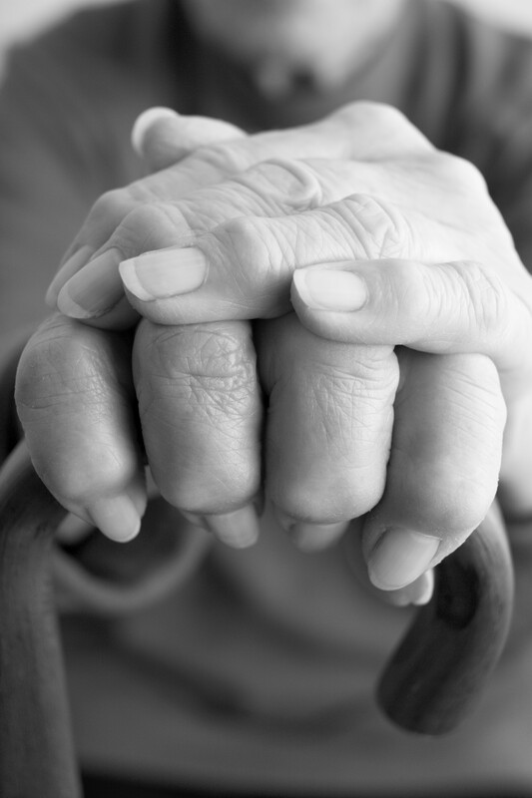
Remember those who are shut in
Wanda Kelly
Betty Prater
Annette Sissom
Some of these are continually shut in, others are temporary

Slide 3



Our Future Meetings
Oct. 3-5, 2025 - Matthew Webb
March 2026 – Rick Duggin
June 2026 - Wes Brown
Oct. 2026 - Jim Deason

Slide 4
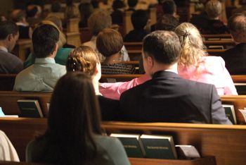
Quiet Please!
Let Us All Prepare
To Worship The
Almighty God

Slide 6
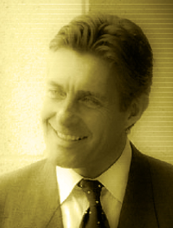
Philip
Philip
The apostle
One of the twelve
Not to be confused with Philip, the Evangelist (Acts 6, 8, 21)

Slide 7
Philip
the
Apostle

Slide 8
Our Introduction to Philip
Matt. 10:3
2 Now the names of the twelve apostles are these: first, Simon, who is called Peter, and Andrew his brother; James the son of Zebedee, and John his brother;
3 Philip and Bartholomew; Thomas and Matthew the tax collector; James the son of Alphaeus, and Lebbaeus, whose surname was Thaddaeus;
4 Simon the Canaanite, and Judas Iscariot, who also betrayed Him.

Slide 9
Our Introduction to Philip
Mark 3:18
14 Then He appointed twelve, that they might be with Him and that He might send them out to preach,
15 and to have power to heal sicknesses and to cast out demons:
16 Simon, to whom He gave the name Peter;
17 James the son of Zebedee and John the brother of James, to whom He gave the name Boanerges, that is, "Sons of Thunder";
18 Andrew, Philip, Bartholomew, Matthew, Thomas, James the son of Alphaeus, Thaddaeus, Simon the Cananite;
19 and Judas Iscariot, who also betrayed Him. And they went into a house.

Slide 10
Our Introduction to Philip
Luke 6:14
13 And when it was day, He called His disciples to Himself; and from them He chose twelve whom He also named apostles:
14 Simon, whom He also named Peter, and Andrew his brother; James and John; Philip and Bartholomew;
15 Matthew and Thomas; James the son of Alphaeus, and Simon called the Zealot;
16 Judas the son of James, and Judas Iscariot who also became a traitor.

Slide 11
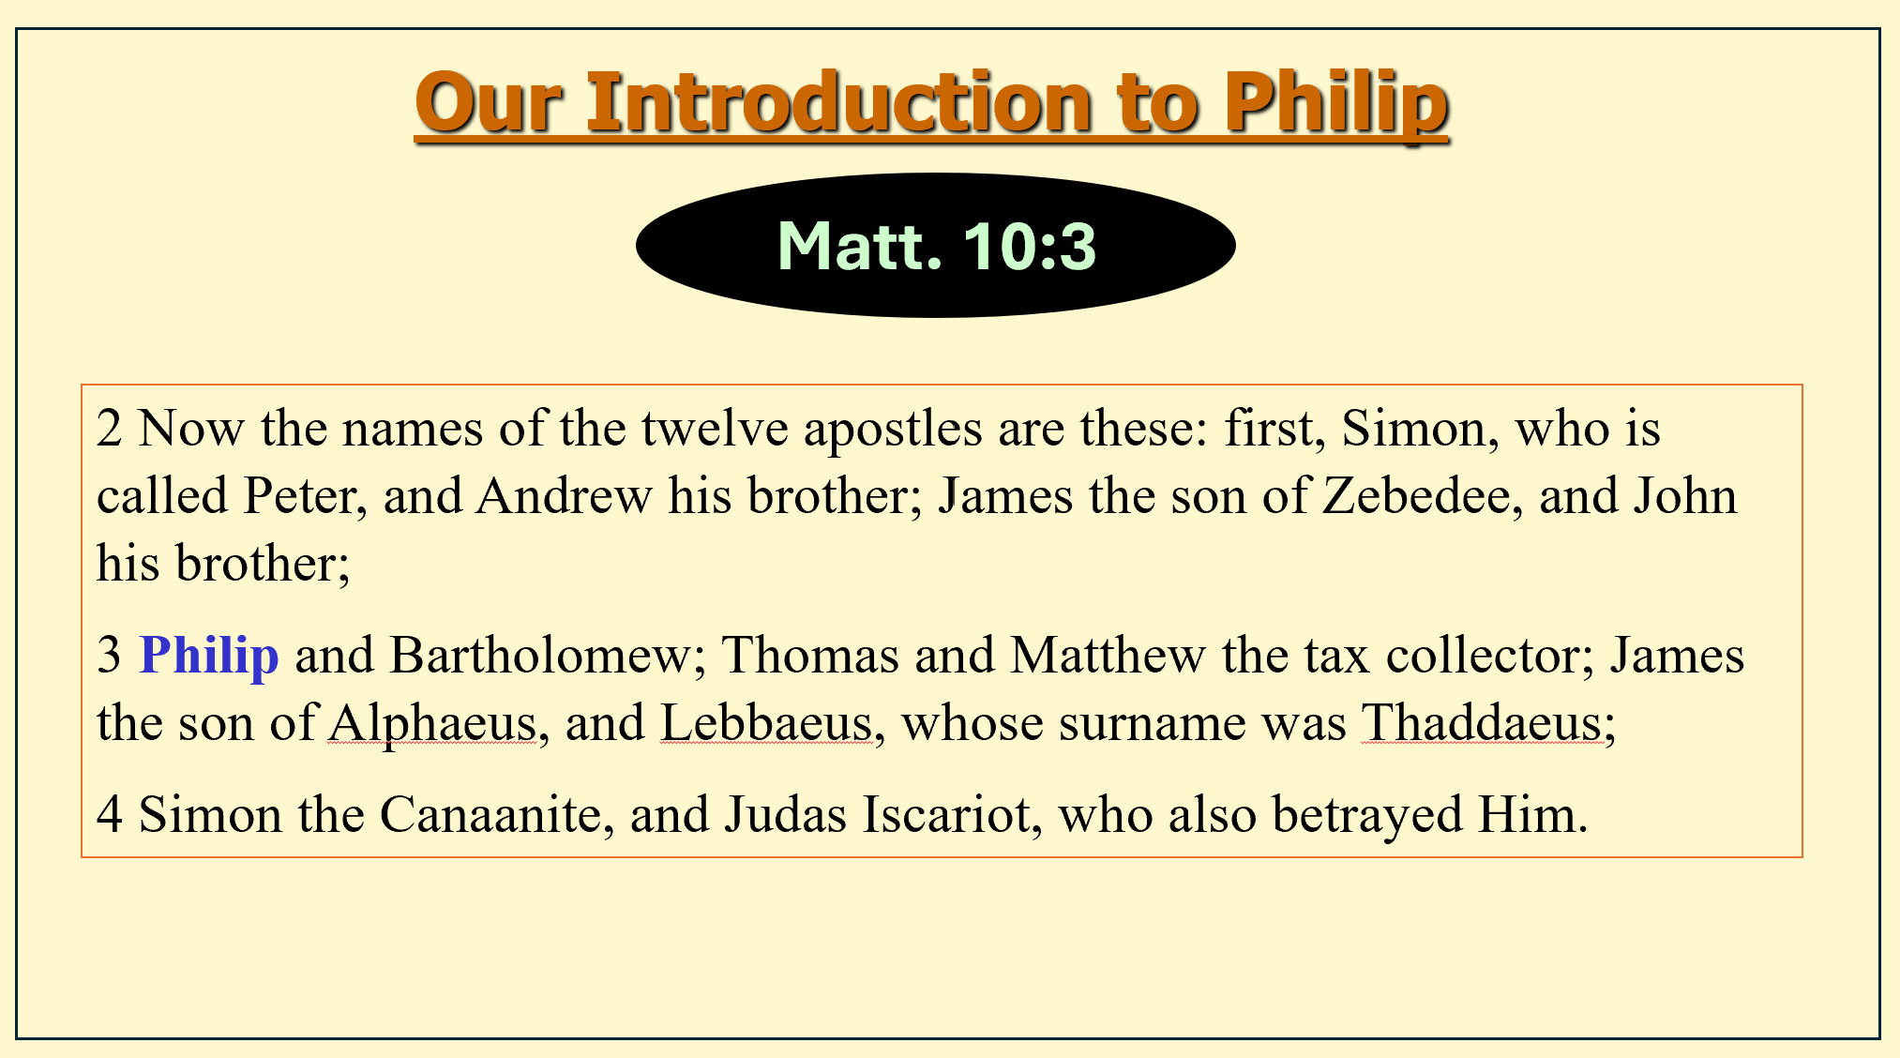
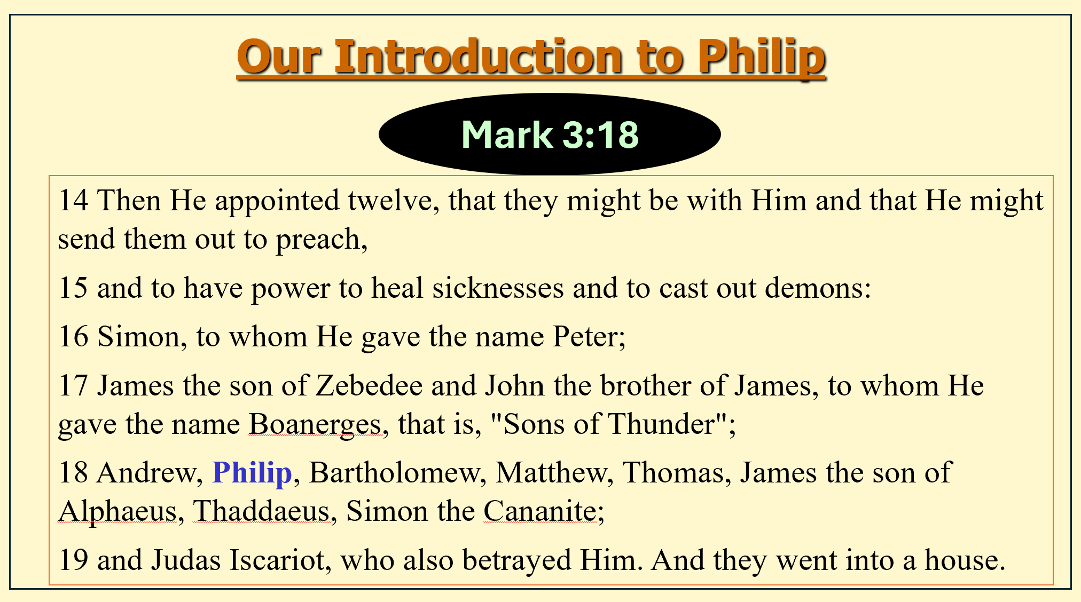
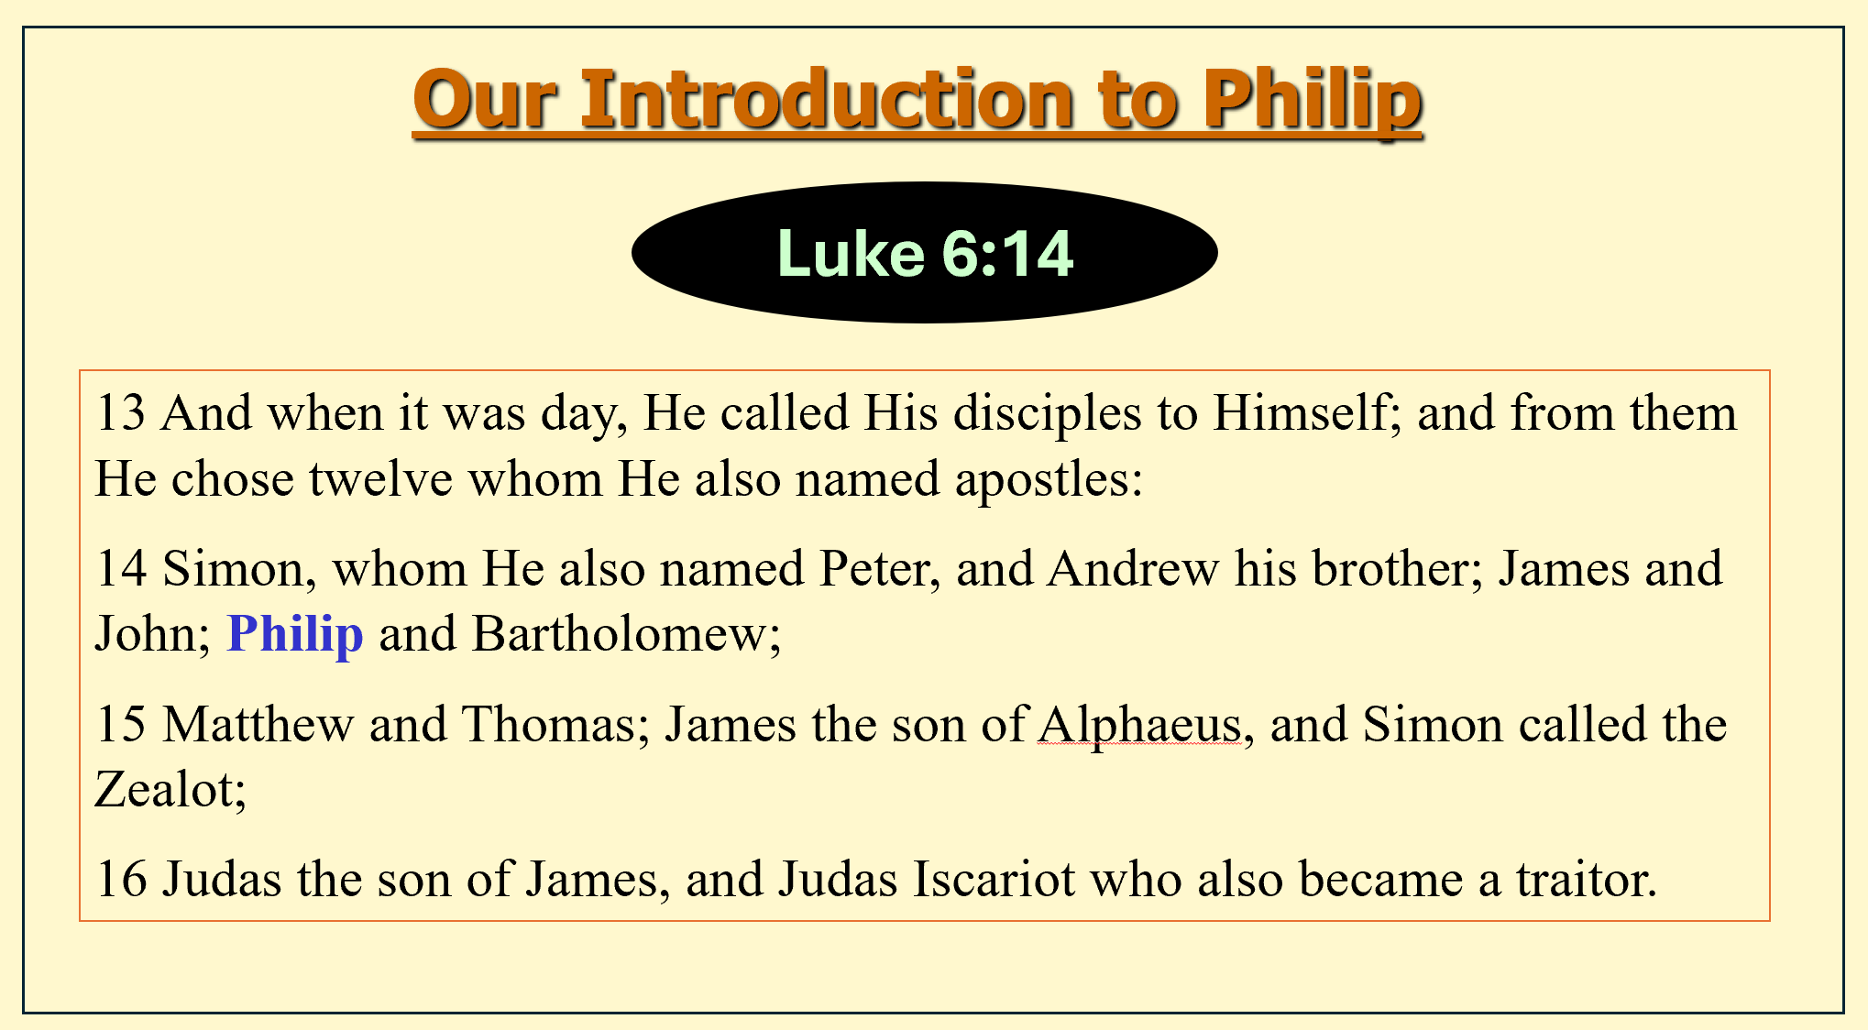
All that is said about Philip in the first 3 gospels
Listed fifth in the list (may suggest that he was a leader of the second group of four)
Philip, Bartholomew, Matthew, & Thomas

Slide 12
Most of What We Know Is Told in John
(in four scenes)
  He was sought & found by Jesus (1:43-48)
  Asked about feeding 5,000 (6:5-7)
  Greeks asked him to see Jesus (12:21-22)
  Last supper – asked to see the Father (14:8-9)
John is only gospel account to mention these four occasions
John is only gospel account to not give the list of the twelve

Slide 13
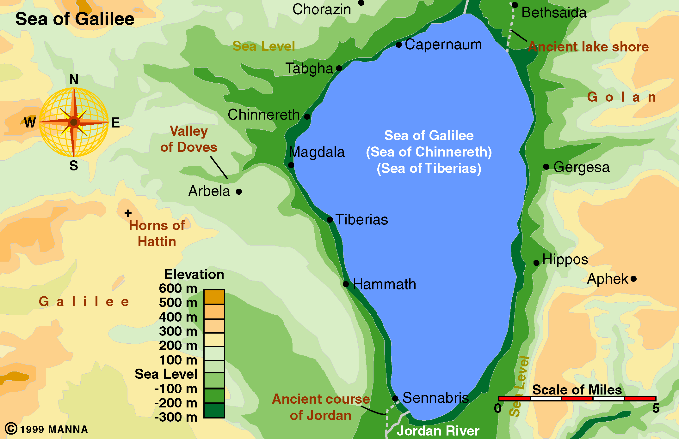
Home: Bethsaida (John 1:44)
Home of Andrew & Peter
  Tells us more about friendship and association than location
City that rejected Christ (Matt. 11:21)

Slide 14
Philip
Philip
Gentile / Greek name
Means “lover of horses”
Don’t know his Jewish name (though must have had one)

Slide 15
Philip
Philip
Look at the four occasions in John
  He was sought & found by Jesus (1:43-48)
  Asked about feeding 5,000 (6:5-7)
  Greeks asked him to see Jesus (12:21-22)
  Last supper – asked to see the Father (14:8-9)
Herbert Lockyer: “slow witted”
Another: “a man out of his element”

Slide 16
Philip
the
Apostle

Slide 17
Philip
His Call (1:43-48) – Seeker who was found

Slide 18
His Call (1:43-48) – Seeker who was found
Sought by the Lord (1:43-44)
  First one Jesus sought
  First one to whom Jesus actually said, “follow me”
  Was found:
    Shepherd found the sheep
    Physician found the patient
    Savoir found the sinner
  Being sought and found – must precede discipleship

Slide 19
His Call (1:43-48) – Seeker who was found
Sought by the Lord (1:43-44)
Tells it to another (1:45-48)
  “We have found him” – suggests that Philip sought for Jesus too!
  “Come and see”
    New convert becomes an evangelist
    Same words uttered to Andrew (1:39)
    Same words woman said to friends (4:29)
    Same words angels said to women at tomb (Mt. 28:6)
    Same invitation Christ & people issue to world

Slide 20
His Call (1:43-48) – Seeker who was found
Sought by the Lord (1:43-44)
Tells it to another (1:45-48)
Disciple is not just to know about Jesus – but must know Jesus!

Slide 21
Philip
His Call (1:43-48) – Seeker who was found
Feeding 5,000 (6:5-7) – Student who was dull

Slide 22
Feeding 5,000 (6:5-7) – Student who was dull
Good Student (1:45-48)
  Knew what the Law & Prophets foretold
  Concluded this Jesus is the one

Slide 23
Feeding 5,000 (6:5-7) – Student who was dull
Good Student (1:45-48)
Slow to Get the Point – Thus, His Faith was Tested (6:5-7)
  Too analytical for his own good
  Thinking with a materialistic trend
  “Naturally cautious and practically minded, Philip was hesitant about making a move unless he could see the way to go.” (Lockyer)
  His calculations were incorrect because he didn’t take God into account

Slide 24
Feeding 5,000 (6:5-7) – Student who was dull
Good Student (1:45-48)
Slow to Get the Point – Thus, His Faith was Tested (6:5-7)
He Was In Over His Head
  Seemed to have no idea how to solve the problem
  The situation (whole) is impossible to solve

Slide 25
Feeding 5,000 (6:5-7) – Student who was dull
Good Student (1:45-48)
Slow to Get the Point – Thus, His Faith was Tested (6:5-7)
He Was In Over His Head
Learn Must Take God / Spiritual Matters into Account
  Can do what seems impossible (Luke 18:27)
  God is on his throne – in control (Rev. 4) – rules in kingdoms of men
  Remember the power of prayer (Jas 5:16-18) – rules in nature
  Far more to consider than material, natural and physical concerns
  When we don’t – we will be in over our heads

Slide 26
Philip
His Call (1:43-48) – Seeker who was found
Feeding 5,000 (6:5-7) – Student who was dull
Visit of the Greeks (12:20-22) – Guide who could not lead

Slide 27
Visit of the Greeks (12:20-22)
– Guide who could not lead
Was Approachable
  For some reason the Greeks picked Philip to ask
  Perhaps – his Greek name
  “Their turning to Philip depended upon a law of kindly attraction” (Lange)
  To be of any influence – we must be approachable!

Slide 28
Visit of the Greeks (12:20-22)
– Guide who could not lead
Was Approachable
Yet Hesitant – Indecisive – Didn’t know what to do
  Comes to Andrew & together came to Jesus
  “Their uncertainty is to be seen in the fact that they brought the problem, not the Greeks, to Jesus!” (Guy N. Woods)

Slide 29
Visit of the Greeks (12:20-22)
– Guide who could not lead
Was Approachable
Yet Hesitant – Indecisive – Didn’t know what to do
What Happened?
  Don’t know for sure
  Since nothing else is said “it seems in order to assume that the request was granted.” (Woods)

Slide 30
Visit of the Greeks (12:20-22)
– Guide who could not lead
Was Approachable
Yet Hesitant – Indecisive – Didn’t know what to do
What Happened?
Prompted a Discussion (vv. 23-36)
  Now – the time for death has come (vv. 23-24)
  My disciples (vv. 25-26)
    Willing to sacrifice (even death) to gain eternal life (v. 25)
    Follow me (v. 26)
      Continuous – keep on following
      True discipleship – “consist not in conferences but in whole-hearted acceptance”

Slide 31
Visit of the Greeks (12:20-22)
– Guide who could not lead
Was Approachable
Yet Hesitant – Indecisive – Didn’t know what to do
What Happened?
Prompted a Discussion (vv. 23-36)
  Now – the time for death has come (vv. 23-24)
  My disciples (vv. 25-26)
  Evidence should prompt discipleship (vv. 27-30)
  Time to turn is now (vv. 31-36)

Slide 32
Philip
His Call (1:43-48) – Seeker who was found
Feeding 5,000 (6:5-7) – Student who was dull
Visit of the Greeks (12:20-22) – Guide who could not lead
In Upper Room (14:1-11) – Disciple who lacked insight

Slide 33
In Upper Room (14:1-11)
– Disciple who lacked insight
The Setting
  At last supper (Passover Feast)
  Upper room

Slide 34
In Upper Room (14:1-11)
– Disciple who lacked insight
The Setting
The Discussion (vv. 2-7)
  Going away (vv. 2-3)
  Where go & way you know (v. 4)
  Thomas said: Don’t know where. How know way? (v. 5)
  Jesus:
    I am way, truth & life (v. 6)
    If known me – known Father (v. 7)

Slide 35
In Upper Room (14:1-11)
– Disciple who lacked insight
The Setting
The Discussion (vv. 2-7)
The Request (v. 8)
  Perhaps asking for a vision
    As Moses had (Exo. 33:19)
    As Isaiah had (Isa. 6:1-4)
  Seeking the physical rather than spiritual
    Thomas sought a physical way of getting to God
    Philip sought a physical way of recognizing God
  Asking for what he already had – a way to see the Father
  Teaches us: satisfaction / happiness with God’s revelation

Slide 36
In Upper Room (14:1-11)
– Disciple who lacked insight
The Setting
The Discussion (vv. 2-7)
The Request (v. 8)
The Rebuke (vv. 9-11)
  Commendable that had the desire to see & know
  Sad that at end of sojourn with Christ he had not discovered / discerned what others had at the beginning!
  All too many come to end of life – not got a grasp of what should have learned

Slide 37
In Upper Room (14:1-11)
– Disciple who lacked insight
The Setting
The Discussion (vv. 2-7)
The Request (v. 8)
The Rebuke (vv. 9-11)
The Need

Slide 38
The Need
  Knowledge often falls short for want of comprehending what it all means
  Not a demonstration – but comprehension!
  Our problem – not that we need more evidence
    Need to comprehend what we’ve seen
    Need to apply what we have heard
    Need to do what we know
    Need to use what we have
  We should not always be babes – should press on to maturity in Christ
  To truly know God – the only way is through Christ & his revelation

Slide 39
Philip
His Call (1:43-48) – Seeker who was found
Feeding 5,000 (6:5-7) – Student who was dull
Visit of the Greeks (12:20-22) – Guide who could not lead
In Upper Room (14:1-11) – Disciple who lacked insight

Slide 40
Last Glimpse of
Philip
Philip
Upper Room
Acts 1:13
And when they had entered, they went up into the upper room where they were staying: Peter, James, John, and Andrew; Philip and Thomas; Bartholomew and Matthew; James the son of Alphaeus and Simon the Zealot; and Judas the son of James.
After been with the resurrected Lord
There when chose Matthias
Among the ones who received Holy Spirit (2:1)
Part of the small band that spreads the gospel (1:8)

