Slide 1
Does God Care
What I Wear?

Slide 2
The Need for Such a Study
The eldership here – requested a lesson almost every year
Continual teaching – same material serves as prevention
Recently been sermons preached – got some attention
  “I’ve restudied / modified my view” sermons
  Can’t define the line as clearly as we have preached in past
  Can’t say that exposing the thigh is immodest
Social media posts – ridiculed idea that you could be responsible for another person lusting (cf. Matt. 18:6)
Lot of attention being given to this in last few weeks

Slide 3
Possible to dress in a way that is wrong
Prov 7:10
“And there a woman met him,
With the attire of a harlot, and a crafty heart.”
“…dressed seductively” (LBP)

Slide 4

Does God Care
What I Wear?
What principles govern the clothes we wear?
Where is the line to be drawn – or can it?
Could you bear responsibility for sexual thoughts of others?

Slide 5
If Not, Anything Goes
Does God Care
What I Wear?

Slide 6
If Not, Anything Goes
Mean there is NO line to draw
  Thus, any clothing (extremely short) would be okay
  Thus, any clothing (extremely tight) would be okay
  Thus, any clothing (see through) would be okay
  Thus, any clothing (that you wouldn’t dare wear) would be okay
  Thus, no clothing at all would be okay!
If not, why not?

Slide 7
If Not, Anything Goes
Mean there is NO line to draw
Everyone of us will draw a line somewhere!
  If you don’t accept any clothing is okay – even no clothing – you will draw a line!
  When you draw the line – expected to defend it: “Why did you draw it there?”
  Is your line arbitrary?
  Do you have a Bible principle for drawing your line?

Slide 8
If Not, Anything Goes
Mean there is NO line to draw
Everyone of us will draw a line somewhere!
How are you drawing your line?
  Looking at Bible principles?
  Is it based on what seems good to you?
  Possible my line could be in wrong place (Isa. 5:20-21)

Slide 9
If Not, Anything Goes
Nakedness
Does God Care
What I Wear?

Slide 10
Nakedness
Nakedness is shameful
  Gen. 3:7
  Lev. 18:6-7
  Rev. 3:17; 16:15; 17:16

Slide 11
Nakedness
Nakedness is shameful
Partial nudity is nakedness

Slide 12


Nakedness
Complete Nudity
Partial Nudity
“Ill-clad” or “clad in undergarment only” (Thayer, p. 122)
“badly clad” or “not fully clothed” (Kittle, I:773-774)
“lightly clad” (Liddell & Scott, 170)
“Unclad, without clothing” (Thayer, p. 122)
Point: One can have some clothing on
and still be “naked”

Slide 13
Nakedness
Nakedness is shameful
Partial nudity is nakedness
Nakedness was covered in Genesis 3

Slide 14


Genesis 3
Apron
V. 7
“Naked”
(Nude)
V. 10
“Naked”
(Relatively)

Slide 15
Apron
Made for themselves
Girdle-like
Loin cloth type of garments
“Loin coverings” (NAS)
“Loin cloths” (NRS)
V. 10
“Naked”
(Relatively)
William Gesenius, Hebrew-Chaldee Lexicon of the Old Testament, 260
H.C. Leupold, Exposition of Genesis, I: 154-155
C.F. Keil and F. Delitzsch
The Pulpit Commentary, I: 59
Brown, Driver & Briggs Hebrew Lexicon

Slide 16
Genesis 3
Apron
Tunic
From The
Shoulder
To The
Knee
V. 7
“Naked”
(Nude)
V. 10
“Naked”
(Relatively)
V. 21
Clothed
Nakedness Covered

Slide 17
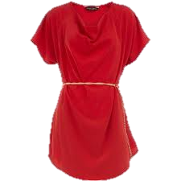
Original I.S.B.E. article on “Dress” says chiton (Greek word in LXX) “resembled the Roman tunic, corresponding most nearly to our long shirt, reaching below the knee always, and, in case it was designed for dress occasions, reaching almost to the ground” (I.S.B.E., II:877). Later in the article, it is noted that the chiton of the peasantry was shorter like modern kamis of Syrian fellah which is to the knee.

Slide 18
Hebrew: KUTTONET--"a tunic...; generally with sleeves, coming down to the knees, rarely to the ankles" (Gesenius, 420; cf. Harris, 1:459; Brown, Driver, Briggs, 509).

Slide 19
Wright says, “The tunic (inappropriately translated ‘coat’) was a shirt which was worn next to the skin. It was made of leather, hair-cloth, wool, linen, or in modern times, usually of cotton. The simplest form of it was without sleeves and reached to the knees or sometimes to the ankles. The well-to-do wore it with sleeves and extending to the ankles. Women as well as men wore it [see Cant. 5:3, A.R.V.], although there was no doubt a difference in style and pattern in what was worn by the two” (Fred H. Wight, Manners and Customs of Bible Lands, 91).

Slide 20
Genesis 3
Apron
Tunic
From The
Shoulder
To The
Knee
V. 7
“Naked”
(Nude)
V. 10
“Naked”
(Relatively)
V. 21
Clothed
Nakedness Covered

Slide 21
Conclusions
Man was naked and attempted to clothe himself
Man’s attempt did not cover enough
God made clothing that covered from shoulder to the knee
God put proper clothing on the man and the woman

Slide 22
Nakedness
Nakedness is shameful
Partial nudity is nakedness
Nakedness was covered in Genesis 3
The thigh is part of nakedness that is to be covered

Slide 23
Nakedness
Exposing the thigh = exposing one’s Nakedness
Gen. 3:7, 10-11
Exo. 28:42
Isa. 47:2-3
}
Nakedness

Slide 24
Exo. 28:42
“…from the waist to the thighs”
The “from…to…” construction includes all that is named
Gen. 11:31
Exo. 11:4-5
Exo. 12:29-30
Lev. 13:12-13
Num. 4:29-30
Num. 4:34-39
Num. 6:4
2 Sam. 14:25
Jer. 31:34

Slide 25
Exo. 28:42
Word for “thigh” = Hebrew Yarek
Argued that yarek is used “euphemistically” to refer to “private parts” / sexual organs
Most translations render it “thigh”
If it is used “euphemistically” would that not suggest that the “thigh” is considered a “private part” – thus should not be seen?
Could the term “thigh” be used as a euphemism for “private parts” when there is no problem exposing the “thigh”?

Slide 26
Isa. 47:2
Word for “thigh” = Hebrew Soq
Argued that soq is used refers to leg (ESV) from the knee to the foot
If so, that goes further than we have suggested – are saying that whole leg has to be covered?
No one denies that soq can be translated “leg” (Deut. 28:35; Psa. 147:10; Prov. 26:7; Song 5:15)
No one denies that soq can be translated “hip” (Judges 15:8)
More often translated “thigh” & used of the part of the leg reserved for the priest to eat (Exo. 29:22, 27; Lev. 7:32-34; 8:25-26; Num. 6:20)

Slide 27
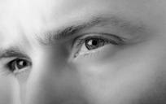
When One Sees Your Thighs
He Sees Your Nakedness
Bathing suit
Shorts
Short Dress
Rides up above knees
Splits that give a peek
Holes in jeans

Slide 28
“The apostle seems to refer here to different parts of the Grecian and Roman dress. The STOLEE seems to have been originally very simple. It was a long piece of cloth, doubled in the middle, and sewed up on both sides, having room only for the arms; at the top, a piece was cut out, or a slit made, through which the head passed. It hung down to the feet, both before and behind, and was girded with the ZONA round the body, just under the breasts. It was sometimes made with, sometimes without, sleeves; and, that it might sit the better, it was gathered on each shoulder with a band or buckle. Some of the Greek women wore them open on each side, from the bottom up above the knee, so as to discover a part of the thigh. These were termed PHAINOMEERIDES, showers (discoverers) of the thigh; but it was, in general, only young girls or immodest women who wore them thus.”
Adam Clark, Clark’s Commentaries, (Electronic Database, Copyright, 1996 by BibleSoft), s.v. “1Ti 2:9.”

Slide 29
If Not, Anything Goes
Nakedness
Modesty
Does God Care
What I Wear?

Slide 30
Modesty
1 Timothy 2:9-10
9 In like manner also, that women adorn themselves in modest apparel, with shamefacedness and sobriety; not with broided hair, or gold, or pearls, or costly array;
10 But (which becometh women professing godliness) with good works.
KJV
“modest apparel” implies
apparel can possibly be “immodest”

Slide 31
Modesty
Modest
W. E. Vine: “orderly, well-arranged, decent, ... The well-ordering is not of dress and demeanor only, but of the inner life, uttering indeed and expressing itself in the outward conversation.” (Vol. III, p. 79).

Slide 32
Modesty
Modest
Strongs: “orderly, i.e. decorous: - of good behavior” (#2887). From kosmos (#2889) which means orderly or well arranged. Word for world.
Thayer: “well-arranged, seemly, modest” (p. 356).
BDAG: “respectable, honorable” (p. 445).
Kubo: “modest, respectable” (p. 205).

Slide 33
Modesty
Modest
Idea of “order” suggests that God has always (cf. Gen. 2) insisted on “modesty” and forbidden “nakedness”

Slide 34
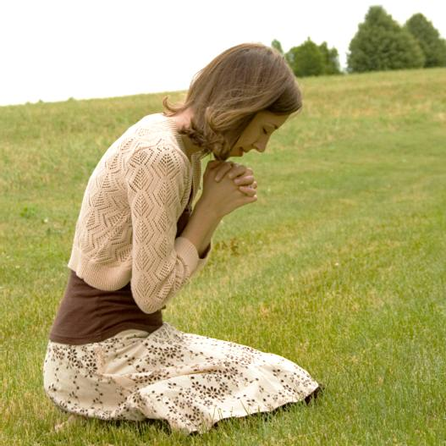
Modesty
Modest
Reserved
Humble
Respectable
Decent
Orderly

Slide 35
Modesty
Modest
Shame
1 Timothy 2:9-10
9 In like manner also, that women adorn themselves in modest apparel, with shamefacedness and sobriety; not with broided hair, or gold, or pearls, or costly array;
10 But (which becometh women professing godliness) with good works. KJV

Slide 36
Modesty
Modest
Shame
  KJV uses word “shamefacedness”; ASV - “shamefastness”; NKJV uses the word “ propriety”.
  NIV: “decency”; RSV “sensibly”
  From AIDOS which means:
    “A sense of shame, modesty, … ‘Shamefastness is that modesty which is ‘fast’ or rooted in the character...’” (Vines, Vol. IV, p. 17)
    Strong suggests that it may be from two words which would give the idea of “downcast eyes” thus meaning “bashfulness” (#127).

Slide 37
Modesty
Modest
Shame
Good Judgment
1 Timothy 2:9-10
9 In like manner also, that women adorn themselves in modest apparel, with shamefacedness and sobriety; not with broided hair, or gold, or pearls, or costly array;
10 But (which becometh women professing godliness) with good works. KJV

Slide 38
Modesty
Modest
Shame
Good Judgment
  KJV uses the word “sobriety”; NKJV - “moderation”.
  From SOPHROSUNE which means:
    “Soundness of mind... ‘sound judgment’ practically expresses the meaning; ‘it is that habitual inner self- government, with its constant rein on all the passions and desires which would hinder the temptation to these from arising....” (Vines, Vol. IV, pp. 44-45).
    “Soundness of mind, i.e.(lit,) sanity or (fig.) self- control” (Strongs 4997)
    Good judgment says: Don’t show what others shouldn’t see!

Slide 39
Modesty
Modest
Shame
Good Judgment
These words (taken together) make it clear that much of the clothing worn by society today is not pleasing to God

Slide 40


Applies to men as well as women (Gen. 3:21)
Applies when stand, sit, bend, & lean over
Thigh must be covered
Applies to more than length – tight, form fitting and see through
Conclusions
Conclusions

Slide 41

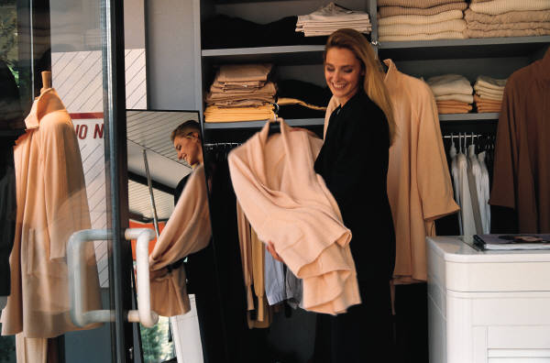

Application
Ways one could be immodest

Slide 42
Ways
That
One
Can
Be
Immodest
Too Short
Too Tight
Too Thin
Too Low
Too Loose

Slide 43
Application
Ways one could be immodest
Clothing that is not modest

Slide 44
Modest
Shame
Good Judgment
Godliness
Careful toward Others
Immodest
No Shame
Poor Judgment
Don’t Fear God
May Cause Lust
Swimsuits
Cheerleading Outfits
Short Dresses
Split Dresses
Tight / Formfitting
Sun Dresses
Low-Cut Blouses & Dresses
Shorts (reveal the thigh)
Jogging Shorts
Strapless Dresses
Swimming Trucks
See-Through Styles
Majorette Uniforms

Slide 45
Application
Ways one could be immodest
Clothing that is not modest
Where this applies

Slide 46
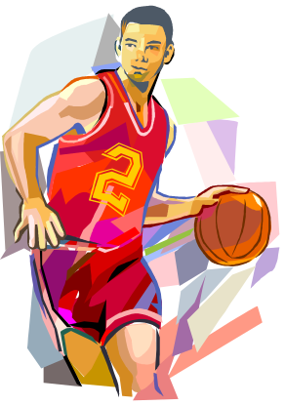
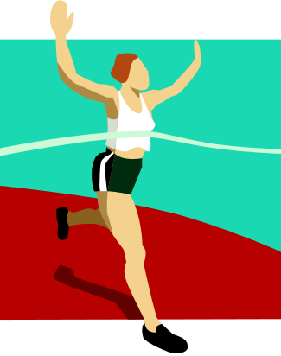
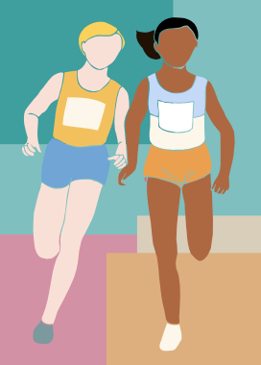
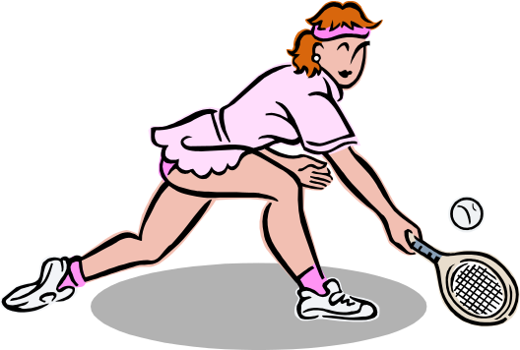

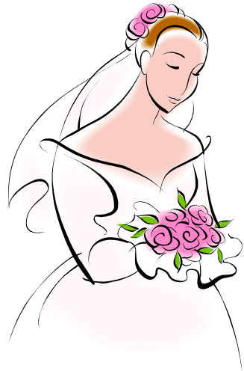
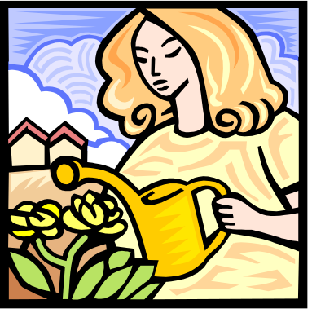
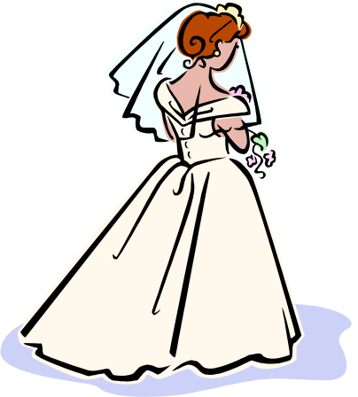

Sports
Modesty Applies:
Weddings
Yard Work

Slide 47
Application
Ways one could be immodest
Clothing that is not modest
Where this applies
Can’t dismiss the principles

Slide 48

“We’re Not ‘Immodest’!”
“Out-Right”
Immodesty
  Mini/short skirts
  Short shorts
  Swimsuits
  Men w/o shirts
  Strapless dresses
“Respectable”
Immodesty
  “Short” when sit
  Low cut front/back
  Snug / Form fitting
  Clothes “hug” body
  Low rise pants
  Top too short
Both Are Immodest!

Slide 49
If Not, Anything Goes
Nakedness
Modesty
Clothing in Worship
Does God Care
What I Wear?

Slide 50
Clothing in Worship
All Principles of Modesty Apply
  Possible to be immodest and yet fully clothed
  Possible to be immodest by: too short, tight, sheer or clingy
  Possible modest while stand and walk – but revealing while sit

Slide 51
Clothing in Worship
All Principles of Modesty Apply
Clothing Shows Respect for What We are Doing
  No “dress code” could or should be set
  Joseph dressed for the occasion (Gen. 41:4)
  David dressed for the occasion (2 Sam. 12:20)
  General principle of appropriate and inappropriate dress
  All worship should be decent and orderly (1 Cor. 14:40)
  Must be careful as we approach his subject

Slide 52
Clothing in Worship
All Principles of Modesty Apply
Clothing Shows Respect for What We are Doing
Casual Attitudes and Casual Dress
  Attitude and attire go hand in hand
  The more casual the attitude the more casual the attire
  There is a difference in dressing casual by choice and doing so by necessity (i.e. coming from work)
  Some studies show associate between how one dresses and attentiveness to what they are doing

Slide 53
If Not, Anything Goes
Nakedness
Modesty
Clothing in Worship
Does God Care
What I Wear?

