Slide 1
One of the most impressive subjects in all the Bible
Most people don’t understand what fear means
The Fear of God
Not all “Christians” fear God
People do not live right because they do not fear

Slide 2
Objective
Be more determined to walk in the fear of God.
Study more on the fear of God (notice the many references to fear)

Slide 3
The Fear of God
What It Means

Slide 4
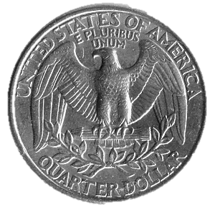
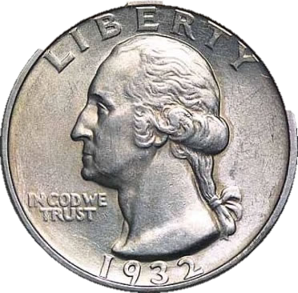
I. What It Means
Heads
Tails
Afraid of
Displeasing God
1 Sam. 11:7
Psa. 119:120
Isa. 66:2
Heb. 10:31; 12:29

Slide 5
1 Sam 11:7
So he took a yoke of oxen and cut them in pieces, and sent them throughout all the territory of Israel by the hands of messengers, saying, "Whoever does not go out with Saul and Samuel to battle, so it shall be done to his oxen." And the fear of the LORD fell on the people, and they came out with one consent.

Slide 6
I. What It Means
Heads
Tails
Afraid of
Displeasing God
1 Sam. 11:7
Psa. 119:120
Isa. 66:2
Heb. 10:31; 12:29
Respect & Awe
Luke 7:16
Jonah 1:9
Deut. 28:58

Slide 7
Luke 7:16
14 Then He came and touched the open coffin, and those who carried him stood still. And He said, "Young man, I say to you, arise." 15 So he who was dead sat up and began to speak. And He presented him to his mother. 16 Then fear came upon all, and they glorified God, saying, "A great prophet has risen up among us"; and, "God has visited His people."

Slide 8
I. What It Means
Heads
Tails
Afraid of
Displeasing God
1 Sam. 11:7
Psa. 119:120
Isa. 66:2
Heb. 10:31; 12:29
Respect & Awe
Luke 7:16
Jonah 1:9
Deut. 28:58

Slide 9
The Fear of God
What It Means
Purpose in Life

Slide 10
Ecc.12:13
What Is Man’s Purpose?
Pleasure
Wealth
Wisdom
Power
Fame
Let us hear the conclusion of the whole matter: Fear God, and keep his commandments: for this is the whole duty of man.
KJV

Slide 11
Conclusions:
If we fail in that - we have failed in life!
If our children don’t fear God, then we have failed.
If this is our purpose, then those who don’t fear God have no meaning in life.

Slide 12
The Fear of God
What It Means
Purpose in Life
Examples of Those Who Feared

Slide 13
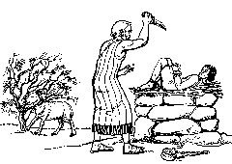
III. Examples of Those Who Feared
Joseph - Gen. 42:18
Jonah - Jonah 1:9
Nehemiah - Neh. 1:5, 11
Hananiah – Neh. 7:2
Abraham - Gen. 22:12
Obedience to the Utmost!
Without Question!
Without Doubt!

Slide 14
The Fear of God
What It Means
Purpose in Life
Examples of Those Who Feared
Fear in the Pentateuch

Slide 15
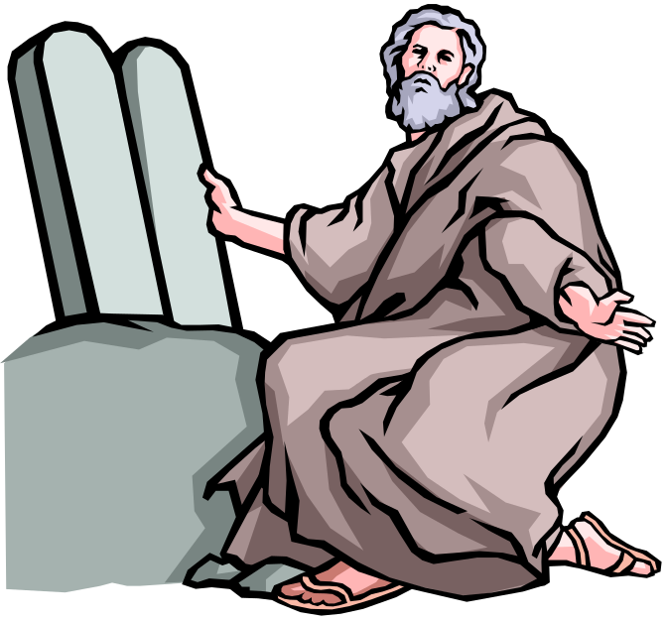
IV. Fear in the Pentateuch
Deuteronomy:
Second giving of law
Reiteration of the law
On the eve of crossing into the promised land

Slide 16
IV. Fear in the Pentateuch
Do what God Says
  Deut. 6:2
  Deut 8:6
  Deut. 13:4
  Deut. 17:19
Be Dedicated & Devoted
  Deut. 10:12, 20
  Deut. 17:19
  Deut. 31:12
  Deut. 28:58

Slide 17
IV. Fear in the Pentateuch
Hate & Cease Sin
  Exo. 20:20
Respect & Treat Others Right
  Gen. 20:11
  Lev. 19:14, 32
  Lev. 25:17, 36, 43

Slide 18
The Fear of God
What It Means
Purpose in Life
Examples of Those Who Feared
Fear in the Pentateuch
Fear in the Book of Nehemiah

Slide 19
Fear in the Book of Nehemiah
“…desire to fear you name…” (1:11)
Concerned about things of God (1:4)
View God as great & awesome (1:5)
See a need and act upon it (2:1-10)
Diligently work (3:20; cf. v. 5)
Work long and hard for the Lord’s cause (4:21)
Treat one another right (5:9)
Respect for the word (8)

Slide 20
Respect For Word
(Neh. 8)
Listened with intent of understanding (vv. 2,3,7,8)
Took time for the hearing of the word (v. 3; 9:3)
Stood at opening of book (v. 5)
Willing to do what found lacking in own lives (vv.13-18)
Viewed the speaker as a spokesman from God (9:26,29

Slide 21
The Fear of God
What It Means
Purpose in Life
Examples of Those Who Feared
Fear in the Pentateuch
Fear in the Book of Nehemiah

Slide 22
Objective
Be more determined to walk in the fear of God.
Study more on the fear of God (notice the many references to fear)

