Slide 1
A Study of the Book of Colossians

Slide 2
A Challenge:
Read the whole book once a week
  Just 4 chapters
  Just 95 verses
  Less than 2,000 words
  Average reader: 15 minutes

Slide 3
Schedule of Studies
June 8 Introduction
June 15 1:1-8 – Thanks For The Colossians
June 22 1:9-14 – Prayer For The Colossians
July 6 1:15-23a – Preeminence of Christ
July 13 1:23b-29 – Paul’s Ministry
July 20 2:1-3, 9-13 – All Needs Supplied in Christ (Complete In Him)
Aug. 3 2:4-7 – Remain Steadfast
Aug. 10 2:8, 14-23 – Don’t Be Lead Away
Aug. 17 3:1-4 – Set Affections On Things Above
Aug. 24 3:5-9 – Put Off The Old Man
Sept. 7 3:10-17 – Put On The New Man
Sept. 14 3:18-25 – Family Obligations & Servant Master Relationship
Sept. 21 4:1-18 – Further Duties Of A Hidden Life

Slide 4

“Christ in you, the hope of glory”
(Outline of Colossians)
Introduction: Thanks and Prayer for the Colossians (1:1-14)
The Preeminent Christ - Preached to the Word (1:15-29)
We Are Complete in Him - Thus Don’t Be Led Away (2:1-23)
A Life That is Hidden With Christ (3:1 - 4:6)
Greetings and Salutations (4:7-18)

Slide 5
Colossians 2:1-3, 9-13
All Needs Supplied in Christ
(Complete in Him)

Slide 6
Colossians 2:1-3
1 For I want you to know what a great conflict I have for you and those in Laodicea, and for as many as have not seen my face in the flesh,
2 that their hearts may be encouraged, being knit together in love, and attaining to all riches of the full assurance of understanding, to the knowledge of the mystery of God, both of the Father and of Christ,
3 in whom are hidden all the treasures of wisdom and knowledge.

Slide 7
Colossians 2:9-13
9 For in Him dwells all the fullness of the Godhead bodily;
10 and you are complete in Him, who is the head of all principality and power.
11 In Him you were also circumcised with the circumcision made without hands, by putting off the body of the sins of the flesh, by the circumcision of Christ,
12 buried with Him in baptism, in which you also were raised with Him through faith in the working of God, who raised Him from the dead.
13 And you, being dead in your trespasses and the uncircumcision of your flesh, He has made alive together with Him, having forgiven you all trespasses,

Slide 8
Introduction
Chapter 2 doesn’t begin a new thought – but continues the discussion of Paul’s ministry
Paul wrote one letter, not four chapters (Hendriksen)
Starts the chapter with his concern for the brethren in the Lycus Valley
The thrust of the chapter: urge them to remain steadfast in Christ – not allow the Colossian heresy to draw them away (cf. vv. 4-7)
The admonition is given in view of the fact that all our needs are supplied in Christ

Slide 9
Colossians 2:9-13
9 For in Him dwells all the fullness of the Godhead bodily;
10 and you are complete in Him, who is the head of all principality and power.
11 In Him you were also circumcised with the circumcision made without hands, by putting off the body of the sins of the flesh, by the circumcision of Christ,
12 buried with Him in baptism, in which you also were raised with Him through faith in the working of God, who raised Him from the dead.
13 And you, being dead in your trespasses and the uncircumcision of your flesh, He has made alive together with Him, having forgiven you all trespasses,

Slide 10
Complete in Him
Concern and Desire for the Brethren (vv. 1-2)
All Our Needs are Supplied in Christ (vv. 3, 9-13)
Remain Steadfast (vv. 4-7)
Don’t be Led Away by Error (vv. 8, 14-23)
Outline of Chapter 2

Slide 11
Colossians 2:1-3, 9-13
All Needs Supplied in Christ
(Complete in Him)
Concern and Desire for the Brethren (vv. 1-2)
Reasons for the Steadfastness in Christ (vv. 3, 9-13)

Slide 12
Colossians 2:1-3, 9-13
All Needs Supplied in Christ
(Complete in Him)
Concern and Desire for the Brethren (vv. 1-2)

Slide 13
Concern and Desire for the Brethren (vv. 1-2)
Concern (v. 1)
  Wanted them to know of the “conflict” he had for them and others
    NASV uses word “struggle”
    Translated from agon from which we get word agony
    Paul was agonizing over these brethren he loves!
  Some think this struggle is struggling in prayer (cf. 4:12)
    Argument is that since Paul was in prison – he couldn’t travel to Colosse – all he could do is pray
    Certainly, prayer is included – but involves much more
    The report from Epaphras caused some deep concern that the heresy posed a threat

Slide 14
Concern and Desire for the Brethren (vv. 1-2)
Concern (v. 1)
Desire (v. 2)
  What he desires: hearts may be encouraged (Strengthened)
    No mention of persecution or trial in context – only the error that could lead astray
    Thus, the need was to be strengthened and confirmed in the faith
    “These brethren need to be strengthened or fortified inwardly to the end that they might both advance in the faith and be equipped to successfully face the threat of false teaching.” (Walton Weaver, 404)

Slide 15
Concern and Desire for the Brethren (vv. 1-2)
Concern (v. 1)
Desire (v. 2)
  What he desires: hearts may be encouraged (Strengthened)
  How it would occur: being knit together in love
    This is the environment essential to be strengthened
    Same word used to describe the parts of the body being joined together in common function or goal (2:19; Eph. 4:16)
    Point: being united in love is the circumstance under which Christians will be strengthened so as to deal with any error

Slide 16
Concern and Desire for the Brethren (vv. 1-2)
Concern (v. 1)
Desire (v. 2)
  What he desires: hearts may be encouraged (Strengthened)
  How it would occur: being knit together in love
  The result of it: full assurance
    When they are strengthened as he desires – they will have full assurance or settle convictions
    “It was the desire of the apostle that they have entire conviction of the truth of the Christian doctrines.” (Barnes, 260)
    Strong conviction comes through understanding and knowledge of the mystery

Slide 17
Colossians 2:1-3, 9-13
All Needs Supplied in Christ
(Complete in Him)
Concern and Desire for the Brethren (vv. 1-2)
Reasons for the Steadfastness in Christ (vv. 3, 9-13)

Slide 18
Reasons for Steadfastness in Christ (vv. 3, 9-13)
Christ is the storehouse of all wisdom and knowledge (v. 3)
  All wisdom and knowledge is found in Christ
  They are hidden or stored away in Christ

Slide 19
The force of the passage then is this: all, not merely some of the treasures of wisdom and knowledge are contained in Christ; therefore, the search for them outside of Him is doomed to failure. But not only are they in Christ, but they are contained in a hidden way. Therefore, they do not lie on the surface, but must be sought for earnestly as men seek for hidden treasure.
Kenneth S. Wuest, Ephesians And Colossians in the Greek New Testament, 196-197

Slide 20
Reasons for Steadfastness in Christ (vv. 3, 9-13)
Christ is the storehouse of all wisdom and knowledge (v. 3)
He is God (v. 9)
  This verse gives the reason for the philosophy (v. 8) not being according to Christ
  Godhead: state of being God (Thayer, 288)
  Fullness: Totality of divine attributes (Affirmation of deity of Christ)
  Dwells: permanent residence in Christ (cf. Vincent, III, 487)
  Bodily: in his fleshly body – God in the flesh (1 Tim. 3:16)

Slide 21
He carried His human body with Him into heaven, and in His glorified body now and ever dwells the fullness of the Godhead.
Kenneth S. Wuest, 202

Slide 22
Reasons for Steadfastness in Christ (vv. 3, 9-13)
Christ is the storehouse of all wisdom and knowledge (v. 3)
He is God (v. 9)
We are complete in him (v. 10)
  All spiritual needs are provided in Christ
  “Made full” (Vincent)
  In Christ, we want for nothing spiritually
  Thus, we have no need to go elsewhere in search of something additional or supplemental (Weaver)

Slide 23
Reasons for Steadfastness in Christ (vv. 3, 9-13)
Christ is the storehouse of all wisdom and knowledge (v. 3)
He is God (v. 9)
We are complete in him (v. 10)
He is the head of all (v. 10)
  Christ is the head of all things – all creation (1:15-23)
  Christ is the head of the church (1:18)
  Some think (as in 1:16) that angelic powers are specifically mentioned

Slide 24
Reasons for Steadfastness in Christ (vv. 3, 9-13)
Christ is the storehouse of all wisdom and knowledge (v. 3)
He is God (v. 9)
We are complete in him (v. 10)
He is the head of all (v. 10)
He takes away sin (vv. 11-13)

Slide 25
Circumcision
Physical
External
Cutting off flesh
Patriarchal & Law
With Hands
Not ess. to salvation
Spiritual
Inward
Cutting off sins
Gospel
Without Hands
Ess. to salvation
Parallel
Contrast

Slide 26
Circumcision of Christ
Uncircumcised
“Dead in
sins”
(v. 13)
God
Operates
“wherein”
in
Baptism
(v. 12)
Circumcised
“Body of sins
put off…
forgiven”
(vv. 11, 13)

Slide 27
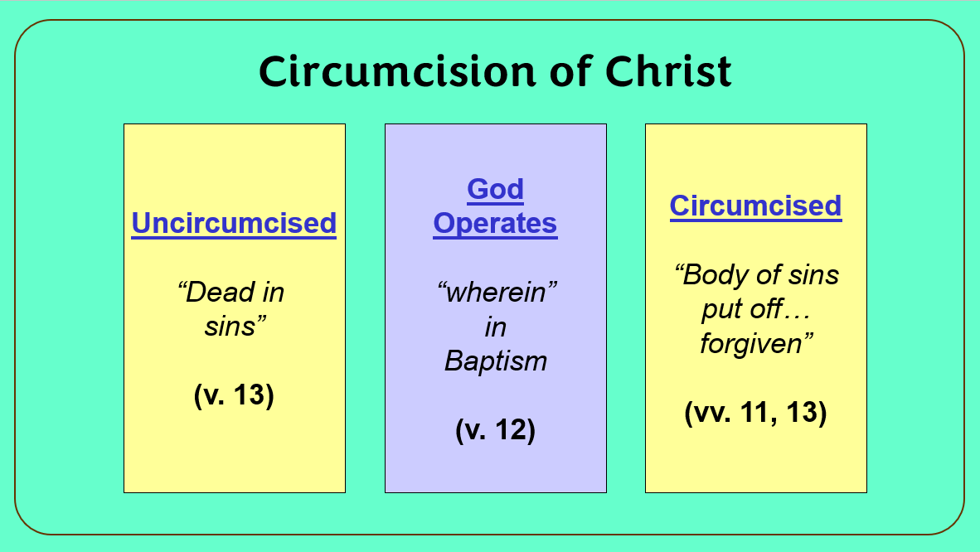
Learn:
If he takes away sin – all our needs are supplied
Baptism is a burial (v. 12)
Baptism is essential

Slide 28
Colossians 2:1-3, 9-13
All Needs Supplied in Christ
(Complete in Him)
Concern and Desire for the Brethren (vv. 1-2)
Reasons for the Steadfastness in Christ (vv. 3, 9-13)

Slide 29
Schedule of Studies
June 8 Introduction
June 15 1:1-8 – Thanks For The Colossians
June 22 1:9-14 – Prayer For The Colossians
July 6 1:15-23a – Preeminence of Christ
July 13 1:23b-29 – Paul’s Ministry
July 20 2:1-3, 9-13 – All Needs Supplied in Christ (Complete In Him)
Aug. 3 2:4-7 – Remain Steadfast
Aug. 10 2:8, 14-23 – Don’t Be Lead Away
Aug. 17 3:1-4 – Set Affections On Things Above
Aug. 24 3:5-9 – Put Off The Old Man
Sept. 7 3:10-17 – Put On The New Man
Sept. 14 3:18-25 – Family Obligations & Servant Master Relationship
Sept. 21 4:1-18 – Further Duties Of A Hidden Life

