Slide 1
A Study of the Book of Colossians

Slide 2
A Challenge:
Read the whole book once a week
  Just 4 chapters
  Just 95 verses
  Less than 2,000 words
  Average reader: 15 minutes

Slide 3
Schedule of Studies
June 8 Introduction
June 15 1:1-8 – Thanks For The Colossians
June 22 1:9-14 – Prayer For The Colossians
July 6 1:15-23a – Preeminence of Christ
July 13 1:23b-29 – Paul’s Ministry
July 20 2:1-3, 9-13 – All Needs Supplied in Christ (Complete In Him)
Aug. 3 2:4-7 – Remain Steadfast
Aug. 10 2:8, 14-23 – Don’t Be Lead Away
Aug. 17 3:1-4 – Set Affections On Things Above
Aug. 24 3:5-9 – Put Off The Old Man
Sept. 7 3:10-17 – Put On The New Man
Sept. 14 3:18-25 – Family Obligations & Servant Master Relationship
Sept. 21 4:1-18 – Further Duties Of A Hidden Life

Slide 4
Introduction to Colossians

Slide 5
Introduction to Colossians
It exalts the preeminent Christ like no other book
It turns and tells us how to live in service to him
  Our attitudes
  Our language
  Treatment of others
  Worship
  The home
  Conduct on the job

Slide 6
Introduction to Colossians
The city of Colosse
  Location

Slide 7
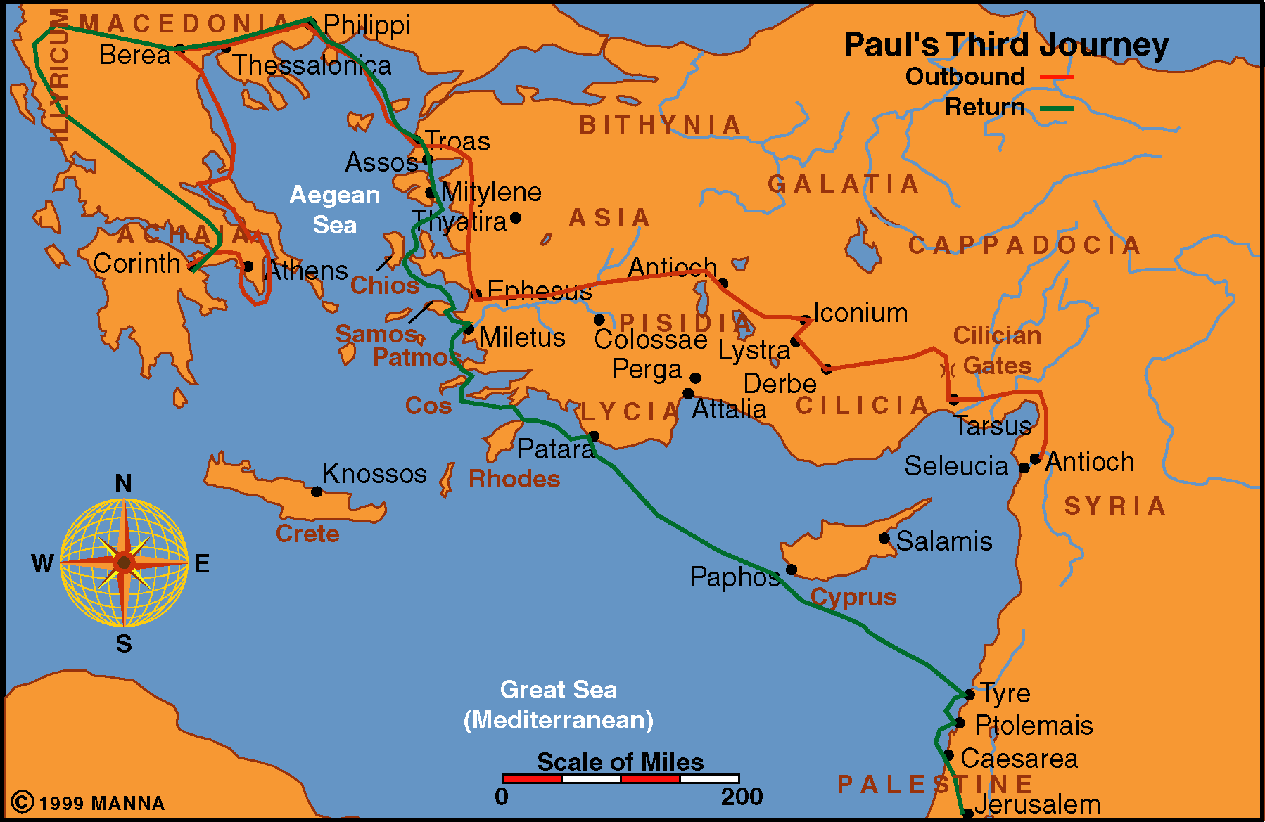

Slide 8
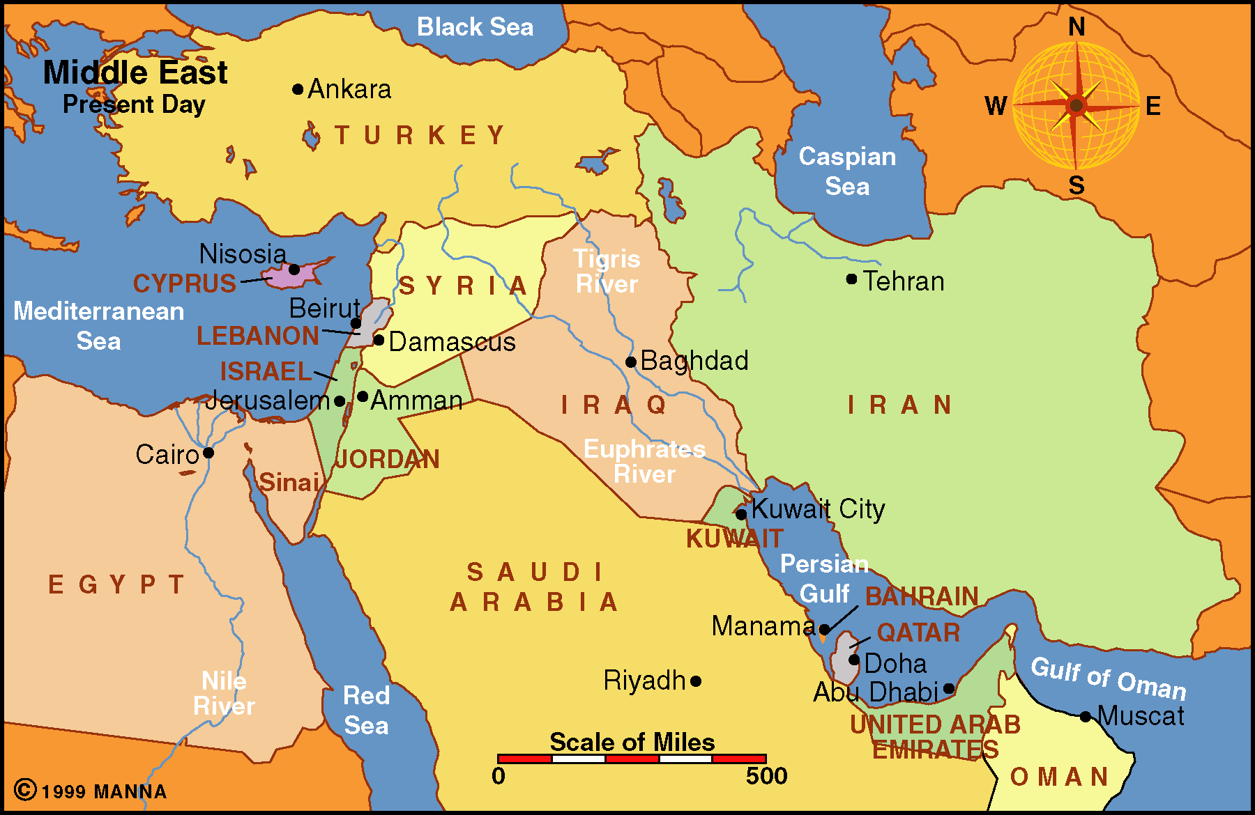
Colosse

Slide 9
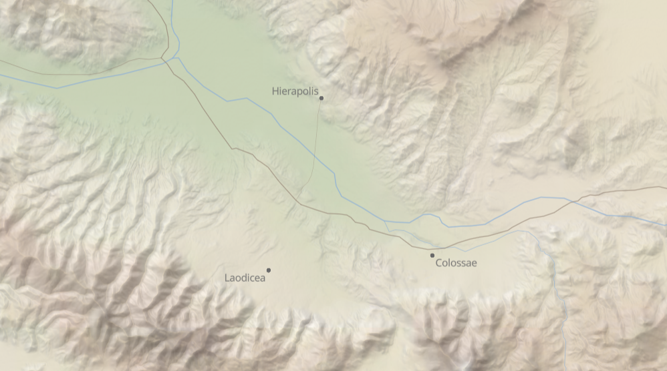
Hierapolis
Colosse
Laodicea

Slide 10
Introduction to Colossians
The city of Colosse
  Location
  Economy
    The cities prospered in the sell of wool due to rich pasture land in the Lycus valley
    Barclay: chalky waters (due to volcanic activity) were suitable for dying cloth
    Lenski speaks of a deep blue dye
    Colosse became famous for its trade in a certain dye that came to be called by the name of the city

Slide 11
Introduction to Colossians
The city of Colosse
  Location
  Economy
  Population
    Predominately Gentile (cf. Col. 1:21, 27)
    However, were Jews as well.
      There were Jews from Phrygia at Pentecost (Acts 2:10)
      Josephus tells of Antiochus, III transporting 2,000 Jews from Babylon and Mesopotamia into Lydia and Phyrgia in 2nd century BC
      Some estimate as many as 50,000 Jews were in the area by 62 AD (Barclay)

Slide 12
Introduction to Colossians
The city of Colosse
  Location
  Economy
  Population
  Demise of the city
    Many think that Laodicea and Hierapolis grew in prominence and Colosse faded.
    By the time of this letter it had dwindled in size and importance
    Shortly after this letter an earthquake destroyed Laodicea and perhaps did damage to Colosse
    By 12th Century the city had disappeared completely (Hendricksen)

Slide 13
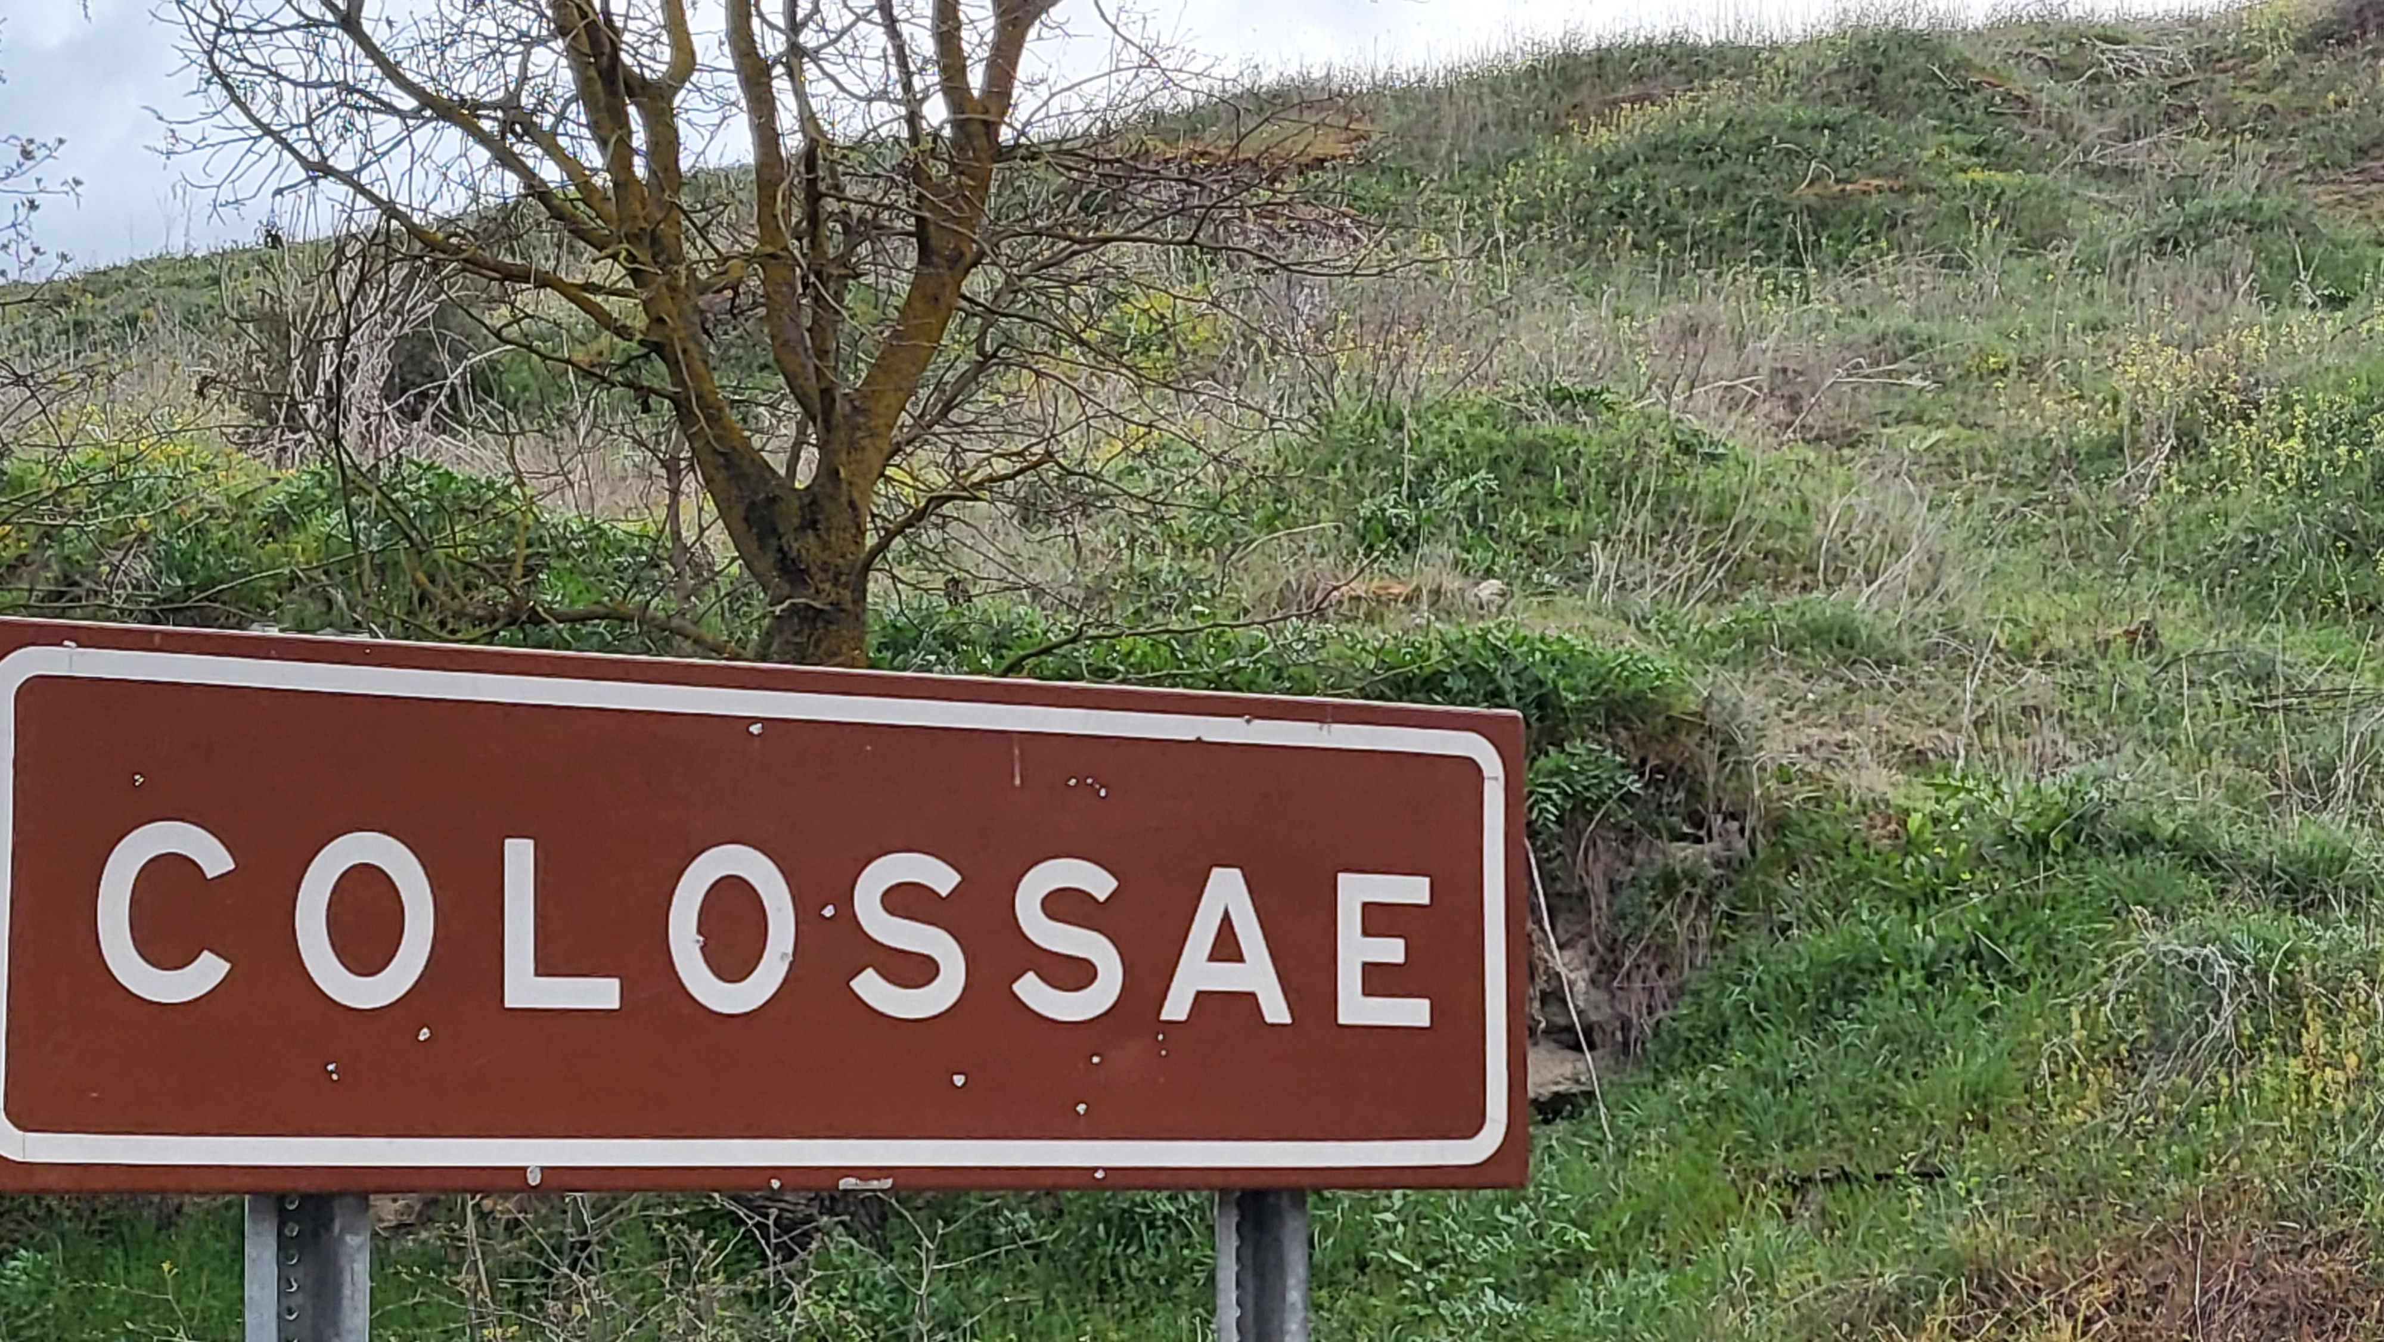
March 2025
Photo: Stephen Smith

Slide 14
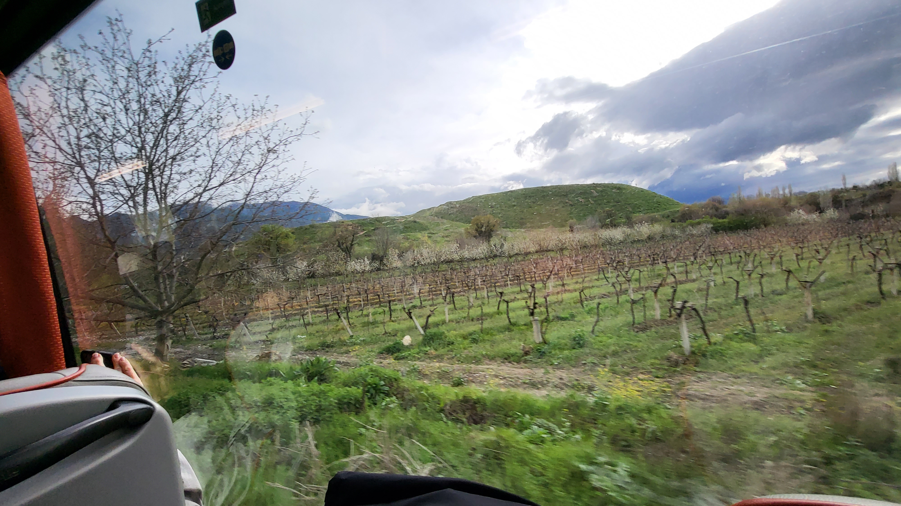
This Tell is all that can be seen today (March 2025)
Photo: Stephen Smith

Slide 15
Introduction to Colossians
The city of Colosse
Establishment of the church at Colosse
  Not a record in the book of Acts
  Was it Paul?
    Argument that it was not Paul
      Paul said he had not seen their face (2:1)
      We have no record of Paul going to Colosse or preaching there.

Slide 16
“It is not likely that Paul himself was the first to preach the gospel in the Lycus Valley. He states in Colossians 2:1 that he was not personally acquainted with the churches in that region. He may have passed through Colosse on his third missionary trip in A.D. 52, but most scholars think he took a route further to the north based on Acts 19:1. Here Luke says that Paul ‘having passed through the upper coasts came to Ephesus.’ The easiest and most natural way, however, for him to have traveled from Antioch to Syria to Ephesus would have been for him to go through Tarsus, Derbe, Lystra, Iconium, Antioch in Pisidia, Colosse, Laodicea, and on to Ephesus on the main east-west highway. Even though Colossians 2:1 would rule out Paul as the founder of the church in Colosse, it does not exclude the possibility of Paul having at least passed through Colosse on this trip”
(Walton Weaver, Truth Commentaries - Philippians, Colossians, 278).

Slide 17
Introduction to Colossians
The city of Colosse
Establishment of the church at Colosse
  Not a record in the book of Acts
  Was it Paul?
    Argument that it was not Paul
    Argument that it was Paul (MacKnight)
      It was his custom to go directly to great cities in heathen lands – he did go through Asia – including Phrygia (Acts 16:4, 6; 18:23)
      Col. 2:1 doesn’t refer to the Colossians but others
      The great concern that Paul and Colossians had for each other is the kind that exist between the teacher and the converted
      Signs off in his own handwriting which they would have known

Slide 18
Introduction to Colossians
The city of Colosse
Establishment of the church at Colosse
  Not a record in the book of Acts
  Was it Paul?
  Was it Epaphras?
    Evidence that it was Epaphras
      They learned the gospel from Epaphras (1:7)
      Possible that he was sent by Paul during his 3 years at Ephesus (gospel spread through Asia – Acts 19:10)

Slide 19
Introduction to Colossians
The city of Colosse
Establishment of the church at Colosse
  Not a record in the book of Acts
  Was it Paul?
  Was it Epaphras?
    Evidence that it was Epaphras
    Possible that he also established churches in Laodicea & Hierapolis
    What we know about Epaphras
      Greek who lived in Colosse (4:12)
      Faithful, hard worker, zealous (1:7; 4:12-13)
      Prisoner with Paul (Phile. 23)
      Not Epaphroditus

Slide 20
Introduction to Colossians
The city of Colosse
Establishment of the church at Colosse
Author and Messenger
  The author
    Paul (1:1, 23; 4:18)
    Questioned by some:
      Writer uses a new vocabulary – not used in other books
      Author deals with a second century dogma
  Messengers
    Tychicus and Onesimus (4:7-8)
    Also carried Philemon and Ephesians (Phile. 10-12; Eph. 6:21-22)

Slide 21
Introduction to Colossians
The city of Colosse
Establishment of the church at Colosse
Author and Messenger
Date and place
  Place
    From prison in Rome (4:3, 18)
    Other prison epistles: Ephesians, Philippians, and Philemon
  Date
    61-62 A.D
    In the middle to the last half of prison stay

Slide 22
Introduction to Colossians
The city of Colosse
Establishment of the church at Colosse
Author and Messenger
Date and place
The Error Refuted
  Hard to identify

Slide 23
Colossian Heresy
The principles that are refuted are nothing like the errors of Judaism as addressed in Romans or Galatians.
No one element
Apparently, Epaphras went to Rome to tell Paul of the developments of the church at Colosse (1:7-8).
  He reported of the growth and progress of the church
  He also informed him of the error that threatened their faith

Slide 24
Introduction to Colossians
The city of Colosse
Establishment of the church at Colosse
Author and Messenger
Date and place
The Error Refuted
  Hard to identify
  Elements of the doctrine

Slide 25
Colossian Heresy
Philosophy (2:8; 2:3)
Angel worship (2:18)
Attack the supremacy of Christ (1; 2:8-10)
Asceticism (2:16-21)
Antinomianism (3:5-8)
Intellectual superiority (1:28)
Practices of the Law (2:11-16)

Slide 26
Introduction to Colossians
The city of Colosse
Establishment of the church at Colosse
Author and Messenger
Date and place
The Error Refuted
  Hard to identify
  Elements of the doctrine
  What was the doctrine?

Slide 27
Colossian Heresy
Gnosticism
  All matter is evil
  Creation by a series of emanations
  Thus, Son of God – not in the flesh
  If flesh is evil, then either:
    Asceticism (rigid denial)
    Antinomianism (let anything go)

Slide 28
Colossian Heresy
Gnosticism
Jewish Element
  Reference to commandments (2:14, 22)
  Circumcision (2:11-12)
  Jewish rituals (2:16)
Perhaps a combination of the two

Slide 29
Colossian Heresy
But this cannot be made good as an adequate theory by the explanation of characteristic individual traits, since, on the contrary, that theosophico-Judaistic false teaching presents sufficient evidences of its having its historical root in Essenism, and its further development and diversified elaboration in the later Gnosticism.
(H.A W. Meyer, Critical and Exegetical Hand-Book to the Epistles to the Philippians and Colossians and to Philemon, 198)

Slide 30
Colossian Heresy
Although religion as such could be described as philosophy in the hellenistic age, it is probable that here we have a reference to that attempted fusion of philosophy and religion known as Gnosticism, which at this stage was not fully developed as in the second century.
(Everett F. Harrison, Introduction to the New Testament, 324)

Slide 31
Colossian Heresy
The time was ripe, surely, for the birth of Gnosticism such as we find it, in its infant form, in this Epistle.
(G. G. Findlay, Pulpit Commentary Colossians, vii)
The Colossians heresy evidences a courious mixture of both Jewish and Hellenistic religious and philosophical ideas.
(Michael R. Weed, The Letters of Paul to the Ephesians, the Colossians, and Philemon, 32)

Slide 32
Colossian Heresy
This meant that in his [J.B. Lightfoot - DVR] view the Colossian error was an amalgam of Judaism (the Essene type) and paganism (incipient Gnosticism). The result was a “philosophy” in which great emphasis was placed upon mysticism and asceticism.
(Walton Weaver, Truth Commentaries - Philippians, Colossians, 284)

Slide 33

Introduction to Colossians
The city of Colosse
Establishment of the church at Colosse
Author and Messenger
Date and place
The Error Refuted
Theme and Purpose
  Theme
“Christ in you, the hope of glory”
(1:27)

Slide 34
Introduction to Colossians
The city of Colosse
Establishment of the church at Colosse
Author and Messenger
Date and place
The Error Refuted
Theme and Purpose
  Theme
  Purpose

Slide 35
Purpose of Book
Warn of the error (Colossian heresy)
Exalt Christ as preeminent in all things
Encourage faithfulness
  Since we are complete in him (2)
  Life hid with Christ (3-4)

Slide 36
Introduction to Colossians
The city of Colosse
Establishment of the church at Colosse
Author and Messenger
Date and place
The Error Refuted
Theme and Purpose
Outline

Slide 37
Outline Suggestions
The Doctrinal Section (1:13 - 2:3)
The Polemical Section (2:4 - 3:4)
The Practical Section (3:4 - 4:6)
The Personal Section (4:7-17)
(Henry C. Thiessen, Introduction to the New Testament, 234).

Slide 38
Outline Suggestions
This Only and All-Sufficient Savior Is the Object of the Believer’s Faith (chapters 1-2)
This Only and All-Sufficient Savior Is the Source of the Believer’s Life and Thus the Real Answer to the Perils by Which They Are Confronted (chapters 3-4)
(William Hendricksen, New Testament Commentary - Colossians, Philemon, 40)

Slide 39

“Christ in you, the hope of glory”
(Outline of Colossians)
Introduction: Thanks and Prayer for the Colossians (1:1-14)
The Preeminent Christ - Preached to the Word (1:15-29)
We Are Complete in Him - Thus Don’t Be Led Away (2:1-23)
A Life That is Hidden With Christ (3:1 - 4:6)
Greetings and Salutations (4:7-18)

Slide 40
Schedule of Studies
June 8 Introduction
June 15 1:1-8 – Thanks For The Colossians
June 22 1:9-14 – Prayer For The Colossians
July 6 1:15-23a – Preeminence of Christ
July 13 1:23b-29 – Paul’s Ministry
July 20 2:1-3, 9-13 – All Needs Supplied in Christ (Complete In Him)
Aug. 3 2:4-7 – Remain Steadfast
Aug. 10 2:8, 14-23 – Don’t Be Lead Away
Aug. 17 3:1-4 – Set Affections On Things Above
Aug. 24 3:5-9 – Put Off The Old Man
Sept. 7 3:10-17 – Put On The New Man
Sept. 14 3:18-25 – Family Obligations & Servant Master Relationship
Sept. 21 4:1-18 – Further Duties Of A Hidden Life

